Slide 1
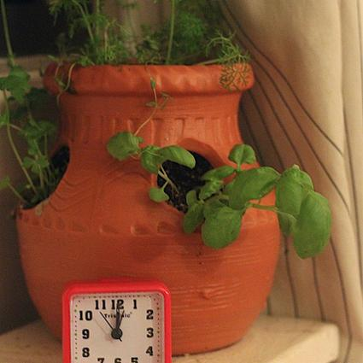
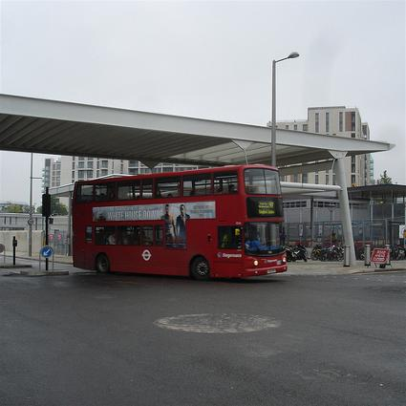
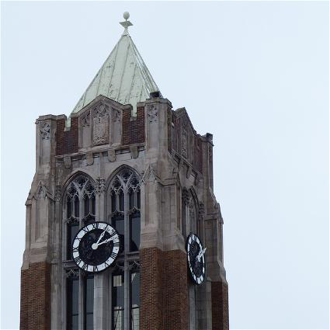
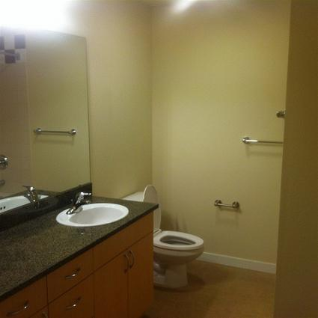
The task is to visually imagine the image 2 presentations ago inside of the white square.
To make the task easier, we present a text description of the image you should be visualizing before every white square.
Whenever “blank” is presented, visually imagine nothing inside the white square.
Trial 1
blank
2 sec
0.5 sec
1.5 sec
4 sec
1 sec
Imagine nothing!
Trial 2
potted
plant
Imagine the same potted plant from trial 1 as if it was visually depicted inside the white square! Try to mentally visualize as much rich details as you can about the image!
red
london
bus
Trial 3
Try your best to fixate your eyes to the very center of screen, using your peripheral vision to take in the images. The center of the screen is often depicted with a red circle, but even when the circle is not displayed you should still try to not move your eyes away from the center.
Trial 4
clock
tower
Sometimes a trial will consist of no image presented at all! In such cases, on the subsequent trial you will imagine nothing in the white square.
Trial 5
blank
If you ever completely forget what image you are supposed to visualize, simply make up an image that fits the text description.
If an image is reflective of your own memory, try to both visualize the image as well as think about your past memory and any feelings associated with that memory.
Also remember to be as still as possible inside of the machine while you are being scanned. Even a millimeter of movement will blur the brain scans. Keep your whole body still, not just your head -- moving your legs can still lead to movement of your head.

