Slide 1

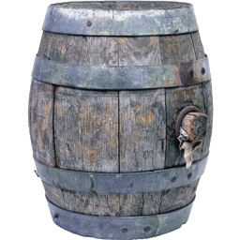
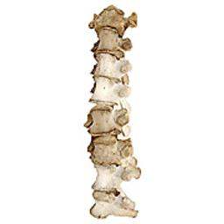
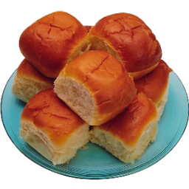
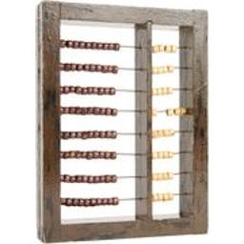
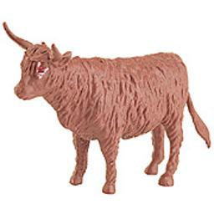

Testing Source Memory (Plan for Preregistration – mTurk)
Nrp
DAY1
Entire triplets encoding
: Memorize visual details of objects
X 5 REPETITIONS (TRAINING)
STUDY
Rp-
Rp+
Rp-
60 Entire triplets = 30 triplets Day1 only, 30 triplets Day1 & 2
Half of Day1 triplets encoding
: Memorize visual details of objects
STUDY
30 triplets Day1 & 2 :15 Rp, 15 Nrp
3mins T among Ls search task
Recognition practice
: Use the half of images (15 Rp) presented on the 2nd position from Day2 list. (2 blocks)
“Have you seen this pic today? Yes(1) or No(2)”
DAY2
PRACTICE
3mins T among Ls search task
Source memory test
: Use All images (180 objects) from entire triplets
“Have you seen this pic today? Yes / No (Sure/Unsure)”
TEST

