Slide 1


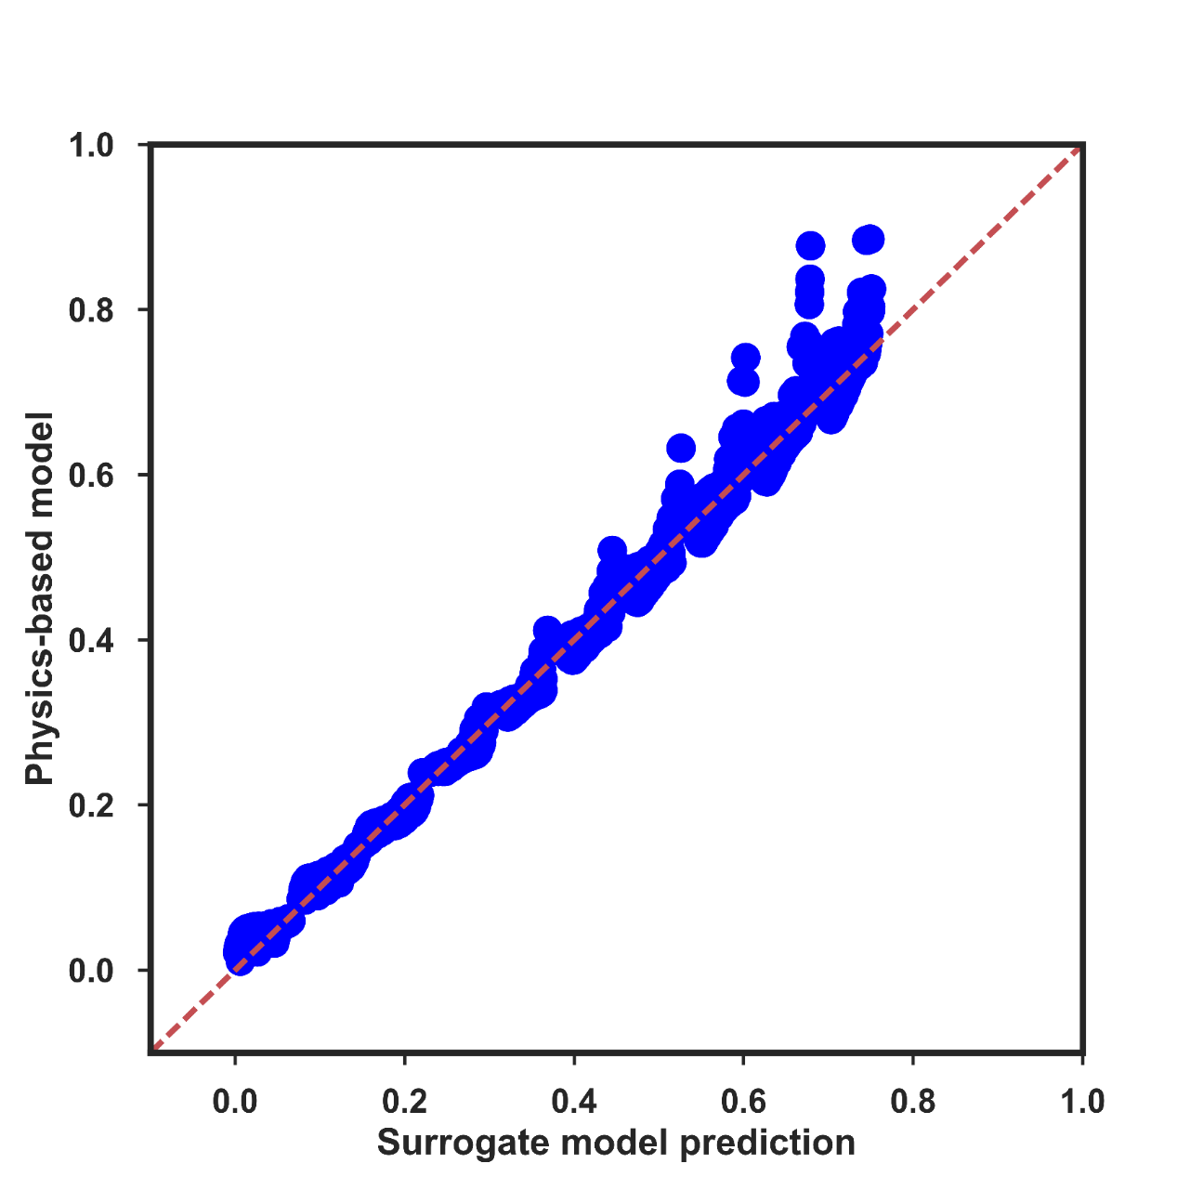
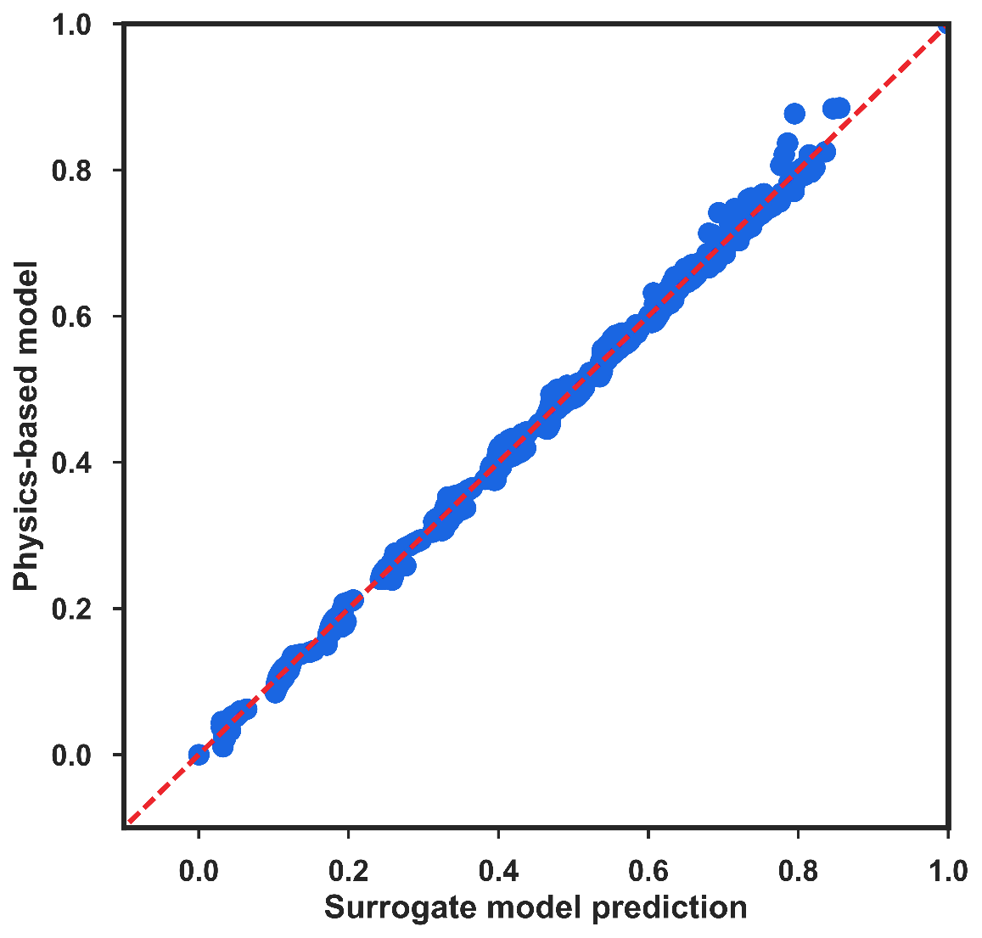
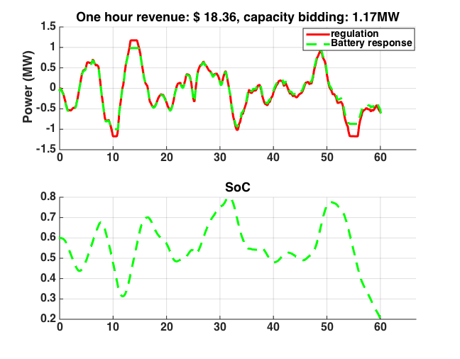
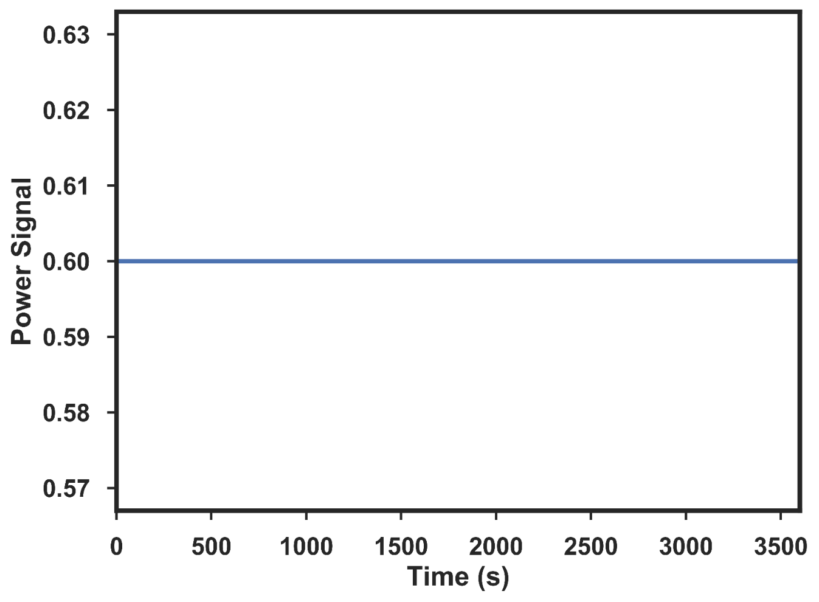
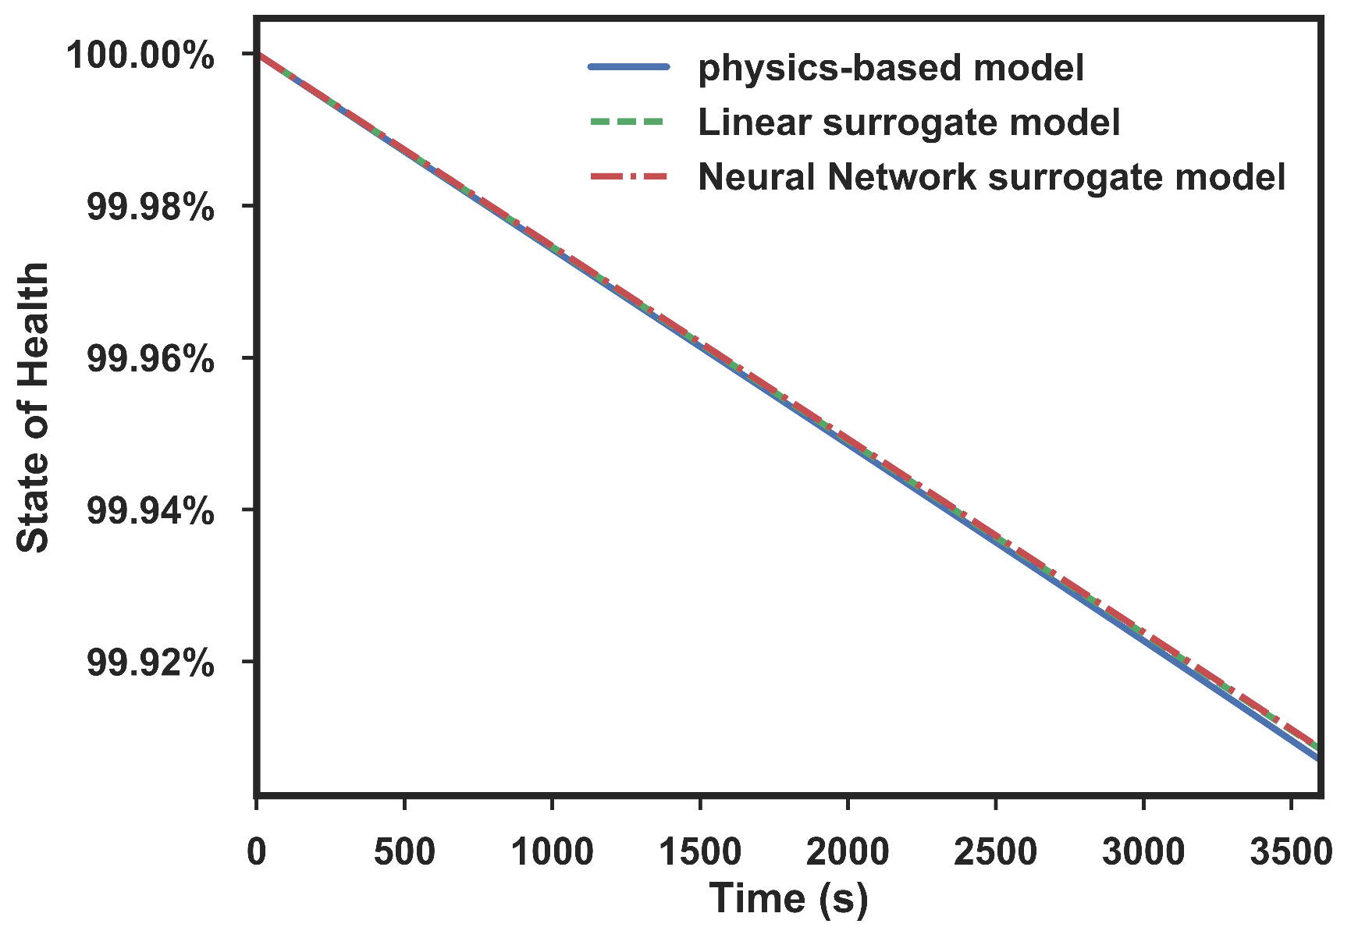
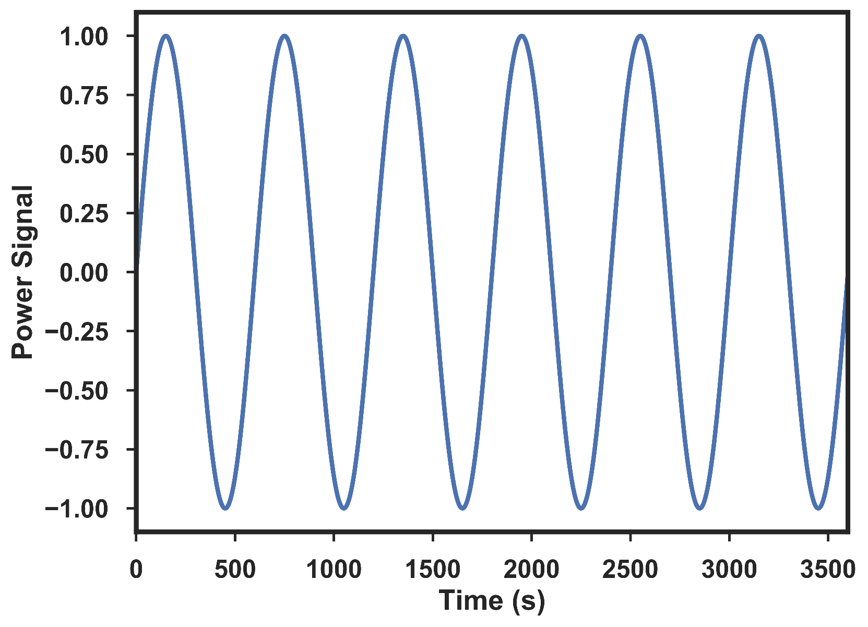
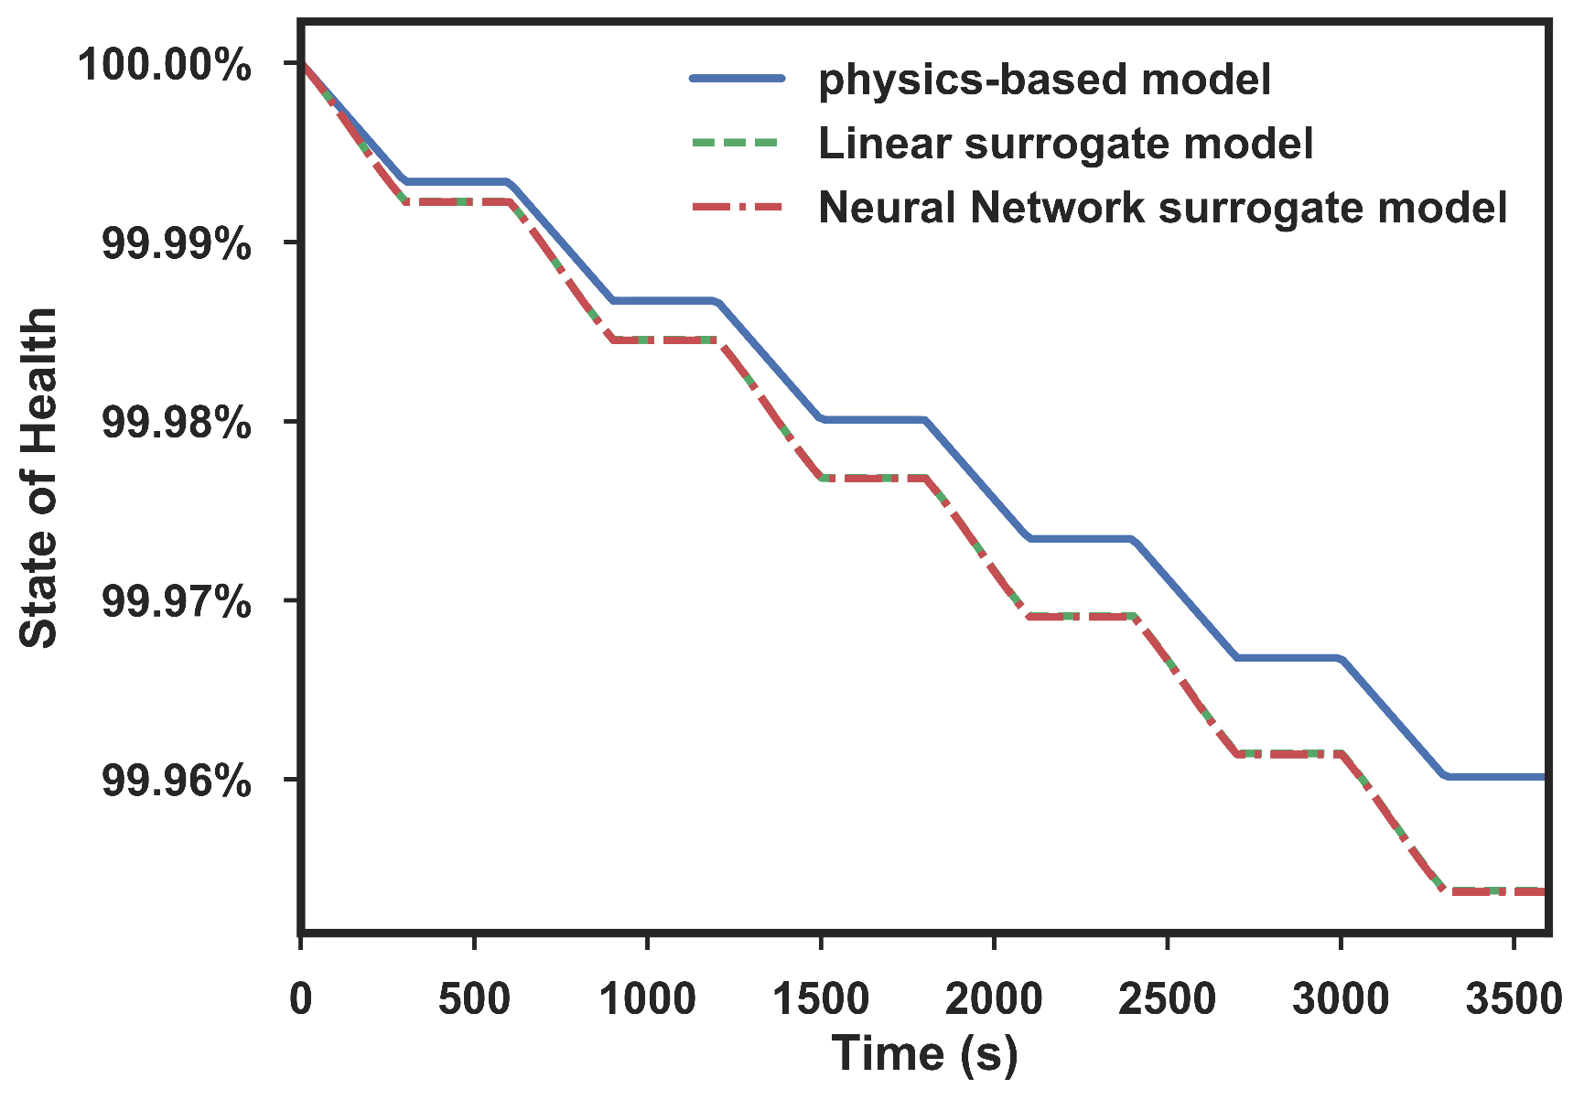
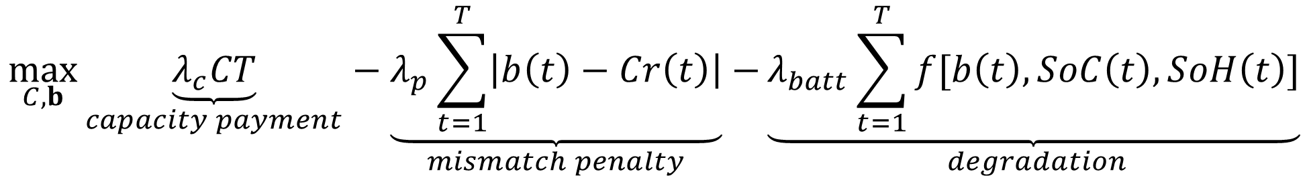
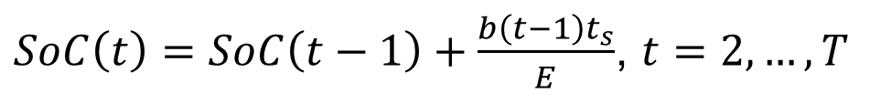


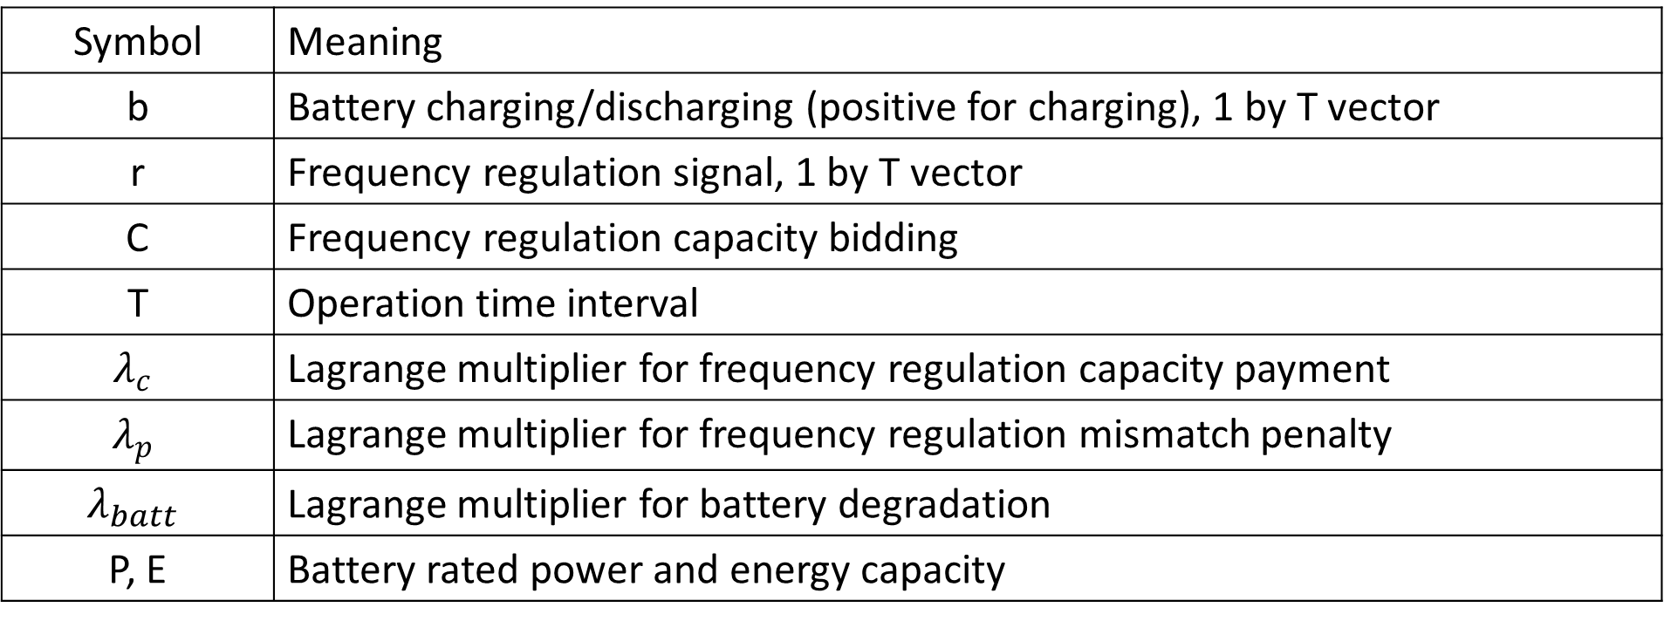
A Battery-grid Integration by Machine Learning Approach
Yuanyuan Shi ª, Yanbo Qi ^{b}, Jerry Chen ^{b}, Baosen Zhang ª, and Venkat R. Subramanian ^{a, b}
Electricity Engineering, University of Washington ª, Chemical Engineering, University of Washington ^{b}
Background
P2D Surrogate Model
Optimization Results
Ideally , the grid frequency is the same everywhere on an interconnected grid, for example, 60 Hz in the USA. If power generation and demand mismatch happens to the grid, the grid frequency move away from the nominal value. To avoid this situation, Automatic Regulation Mechanism has been developed. The grid operator holds power capacity by energy producers, which can be activated any time to bring the balance to the grid. The primary reserve that stops the frequency drift in case of a grid failure event and the secondary reserve that brings the frequency back to its nominal value. Batteries are usually used as secondary reserves for frequency control.
“Pay for performance” scheme aims to quantify and better compensate the regulation service supplied to the grid by a given asset. Batteries (fast assets) are the good option for its fast response time under 2 second comparing to thermal power plants (slow assets). The ISOs (Independent System Operators) such as PJM or NYISO will publish the dynamic regulation (RegD) signal to ask contracted energy producers to follow. Participants will be paid by their frequency regulation capacity and their accuracy in signal following.
However, current battery owners didn’t consider the battery degradation which happens a lot under high charging rate. The battery degradation (capacity fade) is due to solid-electrolyte interphase (SEI) growth and it can be the cost of the batteries. So, even if they receive the reward by following the RegD signal posted from ISOs, they might lose money by replacing new batteries. Therefore, establishing a new signal following strategy by considering the cost of the battery degradation is presented in this work.
We use the P2D model to generate the data matrix (12,200 conditions). We consider State of Charge (SoC), State of Health (SoH), Initial SEI thickness (δ), and Power (P) as inputs and SoC, SoH, δ as outputs. The resolution of the dataset is 2 second which is the same as the RegD signal in order to minimize the prediction error. Artificial Neural-Network (ANN) and Linear Model are applied to this data set. We randomly split the data in to training data (80%) and test data (20%). The test set in Linear Model shows absolute percentage error, 0.0715%, and variance score, 0.989, while ANN has absolute percentage error, 0.0682%, and variance score, 0.992.
The objective function is to maximize the reward by considering the mismatch penalty and battery degradation (negative terms). Function f represents the linear surrogate model. The optimal decisions are made every 2 second.
$$\max_{C, b}{\underset{capacity payment}{\underbrace{λ_{c}CT}}−\underset{mismatch penalty}{\underbrace{λ_{p}\sum_{t=1}^{T}{\left|b\left(t\right)−Cr\left(t\right)\right|}}}}−{\underset{ degradation}{\underbrace{λ_{batt}\sum_{t=1}^{T}{f[b\left(t\right),SoC\left(t\right),SoH\left(t\right)]}}}}$$
$$s.t. f\left[b\left(t\right),SoC\left(t\right),SoH\left(t\right)\right]=β_{0}+β_{1}b\left(t\right)+β_{2}SoC\left(t\right)+β_{3}SoH(t)$$
$$C≥0$$
$$0≤b\left(t\right)≤P, t=1, 2,…,T$$
$$SoC≤SoC\left(t\right)≤SoC_{max}$$
Linear Model
ANN Model
$SoC\left(t\right)=SoC\left(t−1\right)+\frac{b\left(t−1\right)t_{s}}{E}$, $t=2,…,T$
$SoH\left(t\right)=SoH\left(t−1\right)+f[b\left(t−1\right),SoC\left(t−1\right),SoH\left(t−1\right)]$, $t=2,…,T$
Symbol | Meaning
b | Battery charging/discharging (positive for charging), 1 by T vector
r | Frequency regulation signal, 1 by T vector
C | Frequency regulation capacity bidding
T | Operation time interval
$$λ_{c}$$ | Lagrange multiplier for frequency regulation capacity payment
$$λ_{p}$$ | Lagrange multiplier for frequency regulation mismatch penalty
$$λ_{batt}$$ | Lagrange multiplier for battery degradation
P, E | Battery rated power and energy capacity
The verification is also conducted to demonstrate the prediction accuracy of the surrogate model. We tested 2 scenarios: (1) +0.6 constant power charge for 60 minutes (2) ±1 sine wave power charge/discharge for 60 minutes (assume 65.949 W/m² as 1C rate). We decide to use Linear model for optimization because of its has similar performance in our verification and its convenience.
Motivation
(1) +0.6 constant power charge
Physics-based model (P2D) describes battery behavior accurately including the degradation, but it takes minutes to solve. We cannot directly incorporate P2D model with RegD signal (with 2 second resolution) to make the optimal decisions between the reward policy and the cost of the battery. We use machine learning techniques to build up a surrogate model for P2D model to accomplish real-time integration of a lithium-ion battery grid storage system.
Conclusions
Gird Failure Event
(2) ±1 sine wave power charge/discharge
Surrogate model gives satisfactory results in mid-to-low power situation (<0.6). The error in SoC/SoH will accumulated when experienced high power history.
Optimal decision strongly depends on the battery capitol cost and reward policy. If the battery cost is low and penalty is comparatively high, the battery will prone to follow the RegD signal.
Primary Reserve
Secondary Reserve
Grid Frequency (Hz)
Nominal value (60Hz in the USA)
Reference:
[1] Frequency regulation: the need for fast responding assets and the “mileage” case in the USA.
Stop the
frequency drift
Get the frequency back to the normal
eg. Generators
eg. Batteries
Time (min)

