Slide 1

EInNEL TECHNOLOGIES machine learning internship
NAME : SUDARSHAN PAUL
COLLEGE : KARUNYA INSTITUTE OF TECHNOLOGY AND SCIENCES, COIMBATORE.
MACHINE LEARNING INTERNSHIP FINAL PROJECT REVIEW
TOPIC : DEVELOP A MACHINE LEARNING MODEL TO ANALYSE THE DEGRADATION OF LITHIUM-ION BATTERIES DURING THEIR CHARGING CYCLES.
TIME FRAME : 4 WEEK ( 11/07/2020 TO 11/08/2020)

Slide 2
Problem statement:
The aim of this project is to analyze the degradation of Lithium-ion Batteries during their charging cycles. We will be trying to build a model to accurately predict the change in SEI (Solid Electrolyte Interphase) Layer in the batteries and to study their impact in various important parameters of the battery such as SOH (State of Health), SOC (State of Charge).
Notes:
Delete this slide when you finish preparing the other slides.

Slide 3


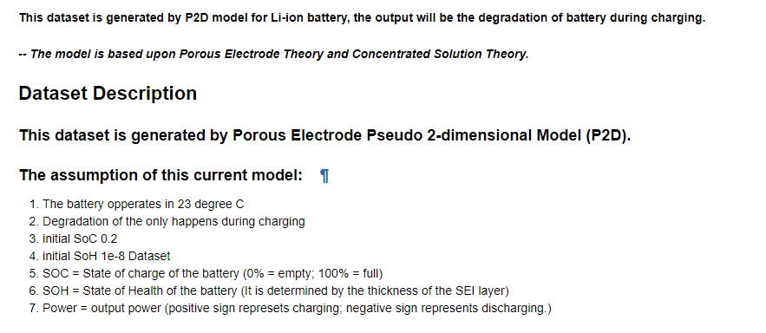
Dataset Description

Slide 4
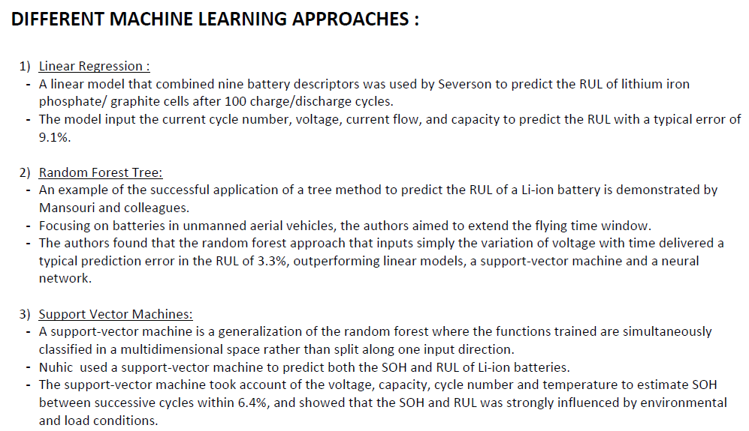
Important terms

Slide 5

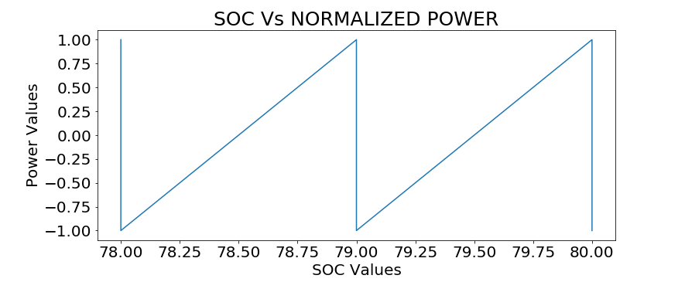
Soc vs normalised power

Slide 6
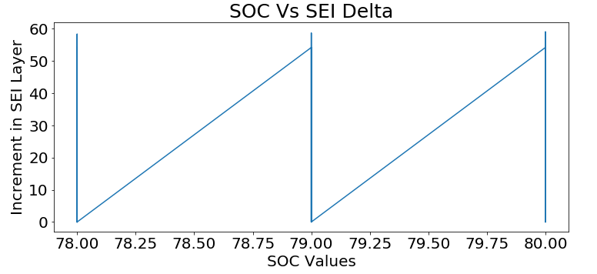
Soc vs sei delta

Slide 7
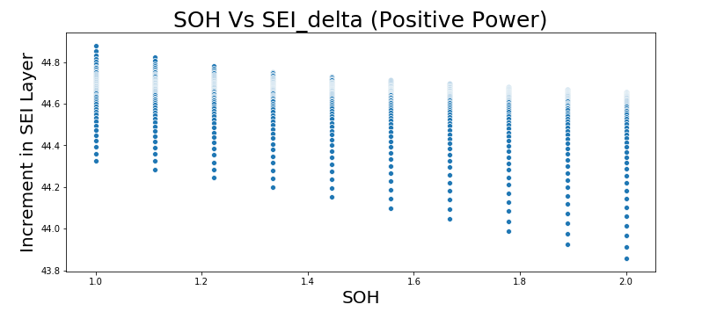

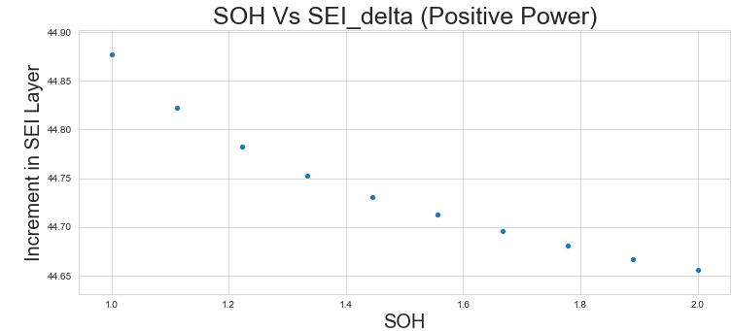
Soc vs sei delta

Slide 8
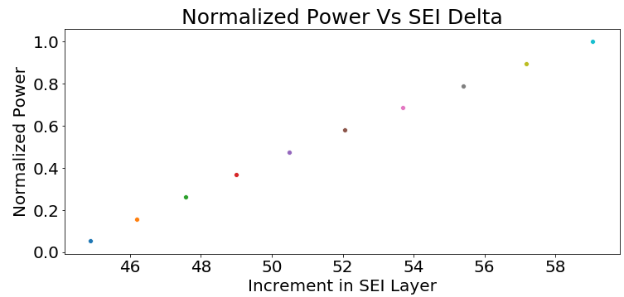
Normalised power vs sei_delta

Slide 9
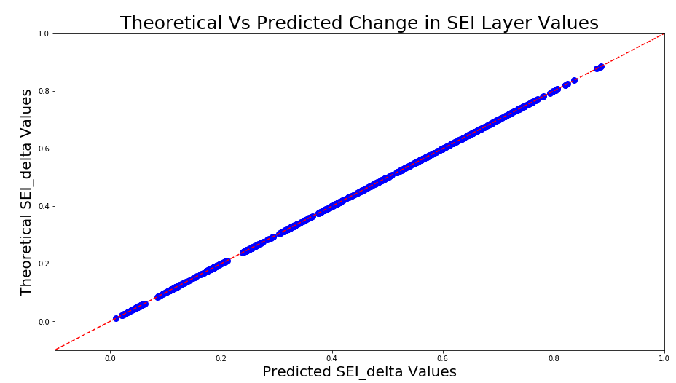
Predicted curve using linear regression model

Slide 10
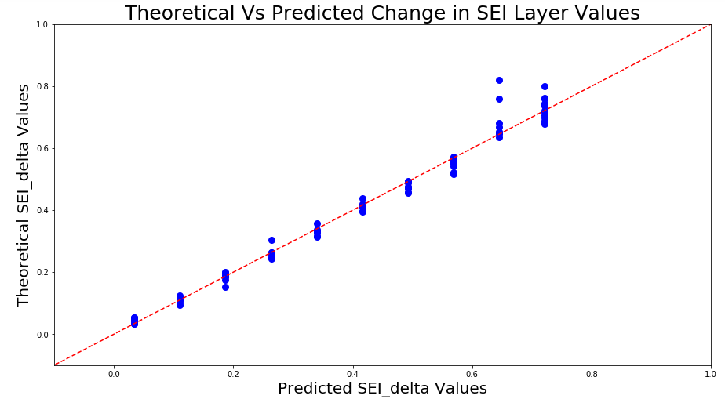
Sei_layer prediction (using two variables)

Slide 11
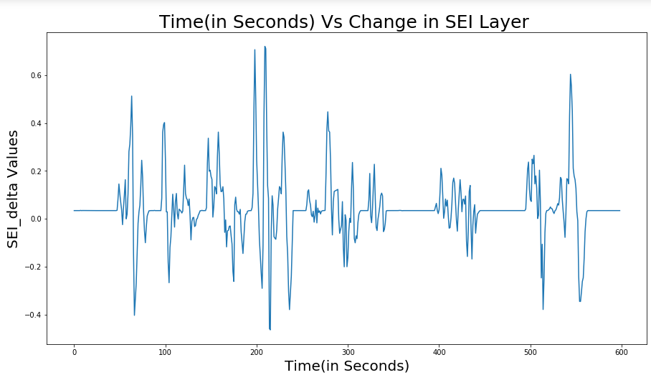
Change in Sei_layer with time in ny-taxi-batteries

Slide 12
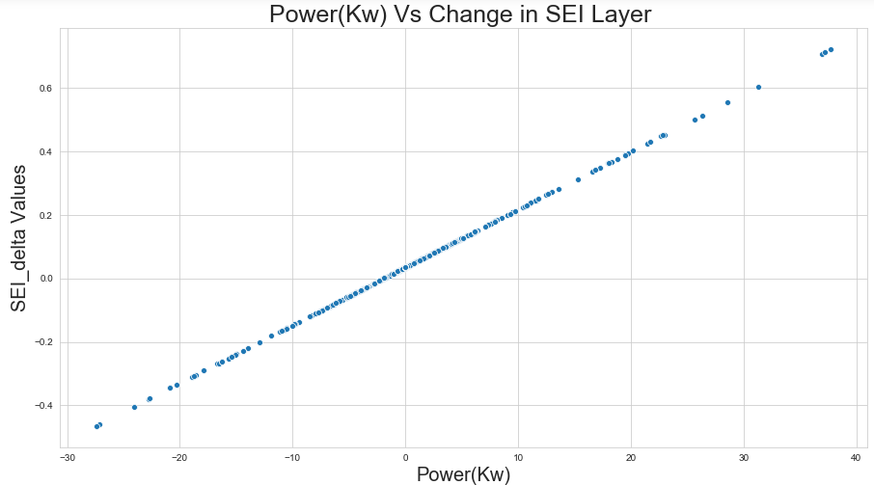
Battery power rating vs change in SEI_Layer

Slide 13
Final project overview
http://127.0.0.1:8050/
The project was implemented with the sole purpose to determine the degradation in lithium ion-batteries occurring during the charging cycle using various parameter values such as SOC (State of Charge), SOH (State of Health) and Power Ratings.
As a practical use-case of the above model I tried to implement it for the New-York Taxi Battery Power Ratings dataset wherein we had Power Ratings of a Li-Ion battery of a Taxi calculated over interval of 600 seconds.
Using the power ratings our main objective was to predict the accumulation of Solid Electrolyte Interphase Layer (SEI_Layer) in the battery which ultimately impacts the battery health.
I have tried to bring out the model in the form of a simple SEI Layer Analysis ToolKit (using web based micro-framework called Flask), which takes in the power ratings values of Lithium-Ion Battery and predicts the occurrence of Solid Electrolyte Interphase Layer at each instance of time for which the battery power ratings were measured.
Let’s have a look at the ToolKit (Currently deployed on Local Server).
http://127.0.0.1:8050/

Slide 14
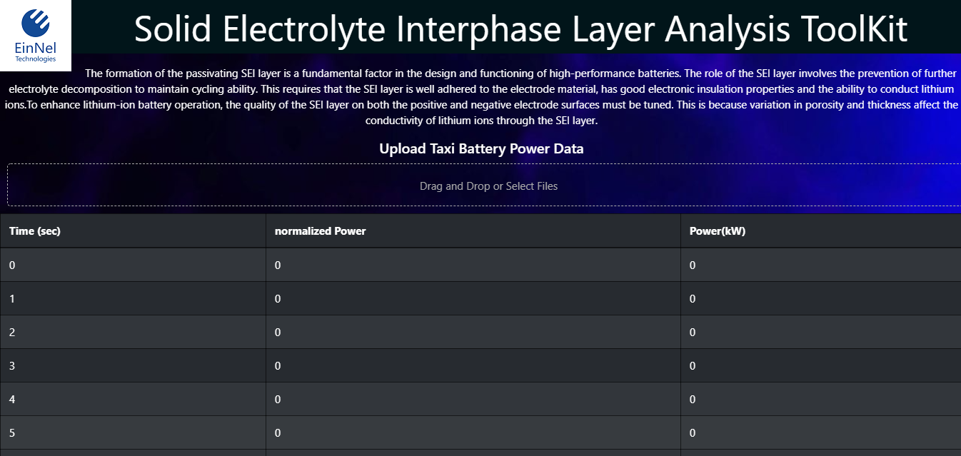

Slide 15
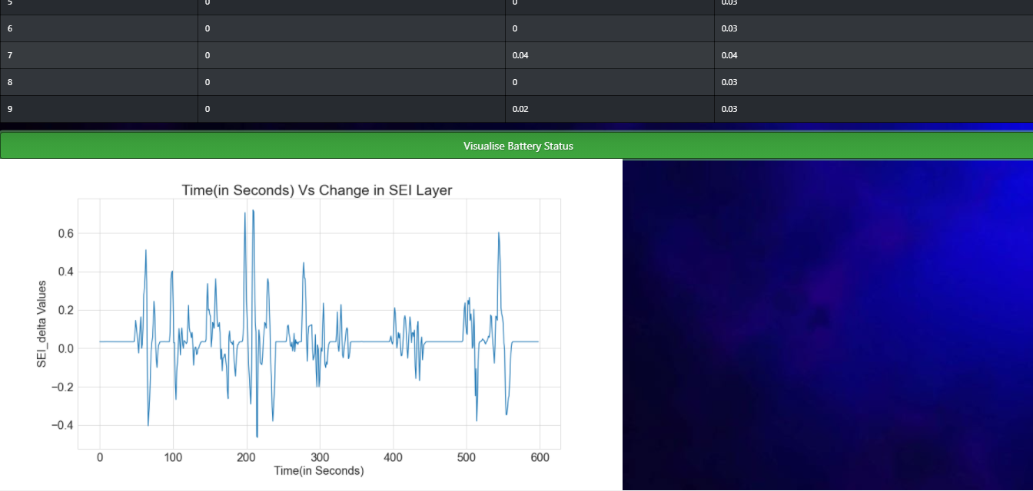

Slide 16
THANK YOU!!

