Slide 1
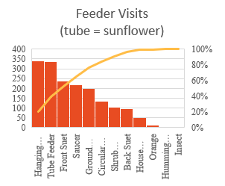
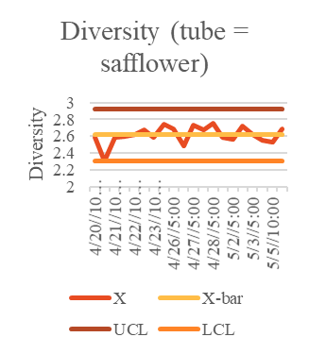
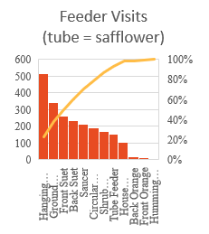
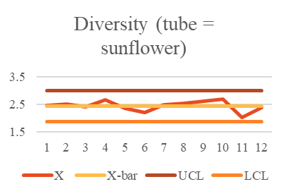
Bird Feeder Improvement
Process owner: Paul Tuck
Team
Launch
Define
Measure
Analyze
Improve
Control
4/19 4/19 4/20-5/5 5/6 5/12 5/12-ongoing
Key Dates --->
DEFINE
MEASURE
ANALYZE
IMPROVE
Mean = 2.61
Problem: To improve the diversity of birds visiting my birdfeeders by attracting more species.
Inputs: Amount (in ml) and type of seed placed in feeders; which feeder the seed is placed in; time; temperature; time of day.
Outputs: Number of species visiting; number of each species visiting; diversity of visitor; number of visits to each feeder.
Defect: less than 13 species visit during count.
SQL before switch: 3.1
SQL after switch: 0
Tube feeder visits increased after switching to sunflower. 19% of visits.
Recorded species that visited feeders and number of each species.
Calculated diversity with:
-sum(Pi*ln(Pi)) for day.
Where Pi = count of species i/count all birds
Recorded amount and type of feed added each day.
Tube feeders account for only 7% of all feeder visits.
CONTROL
Mean = 2.44
Price to fill feeders: Tube = safflower
Mean | sd | n | sd^2/n
5.05062 | 3.382945071 | 11 | 1.040392
Price safflower | $2.28/l
Price sunflower | $1.57/l
Diversity due to other factors (plant cover)?
Safflower more expensive than sunflower.

Slide 2
Data Measurement Plan
Performance Measure | Data Source and Location | How will data be collected? | Who will Collect Data | When will Data be Collected? | Target Sample Size | Data Type
Price of seed per bag | Receipts/Tractor Supply website | Look from website or receipt | Mother/father | 4/20 | 4 | Continuous
Amount of seed added in each feeder each day | Manual data collection | Measuring cup | Myself | 4/20-5/23 | 17 | Continuous
Types of seed used | Manual data collection | Record type. | Myself | 4/20 | 5 | Discrete
Price of other feed (suet, oranges, etc). | Reciepts/Tractor Supply website | Look from website or receipt | Myself | 4/20 | 3 | Continuous
temperature | Manual data collection | Phone app | Myself | 4/20-5/23 | 34 | Continuous
time of day observing | Manual data collection | Phone clock | Myself | 4/20-5/23 | 32 | Discrete
Species visiting | Manual data collection | Data form | Myself/Mom | 4/20-5/23 | 32 | Discrete
Feeders visited | Manual data collection | Data form | Myself | 4/20-5/23 | 32 | Discrete
Number of birds | Manual data collection | Data form | Myself/Mom | 4/20-5/23 | 32 | Discrete
Non-avian visitors | Manual data collection | Data form | Myself | 4/20-5/23 | 32 | Discrete
Hawk visits | Manual data collection | Data form | Myself | 4/20-5/23 | 32 | Discrete
Diversity | Manual data collection | Calculate | Myself | 4/20-5/23 | 32 | Continuous
A bird is counted when it is in the yard and actively visiting a feeder.
The maximum number of bird visiting at a time was used to determine the number of birds for the count period (if 2 House Finches visited the feeders, and then 3 visited; the count for House Finches would be 3).
  Unless the birds were easy to tell apart; e.g. male and female Northern Cardinals.
Output

Slide 3
Optimal Sample Size
Diversity
Z = 1.96 (95% CI)
Sd of diversity = 0.105
Fine with a diversity error of 0.05
Optimal sample size = 17
Actual sample size = 32
Money spent and temp.
Money (n) = 4,396
Impossible to get that much data in a short time, so I settled for 17.
Temperature (n) = 34.
Almost made it to 34, but for life reasons, I had to settle for 32.
The sample size for the rest of the data reflected the sample size for diversity.

Slide 4
Calculating Diversity
Diversity = -sum(pi*ln(pi)): where pi is proportion of ith species.
This is a common means of calculating species diversity (Spellerberg and Fedor 2003)
E.g.:
Species | Count | pi | pi*ln(pi)
Northern Cardinal | 3 | 0.333333 | -0.3662
Blue Jay | 1 | 0.111111 | -0.24414
Common Grackle | 5 | 0.555556 | -0.32655
Total | 9
Diversity | 0.936888

Slide 5
SQL
13 species occur regularly to feeder.
Defect = less than 13 species visit during a counting period.
Unit = The 2 1-hour count periods at 10-11 AM and 5-6 PM.
SQL (tube = safflower) = 3.1
SQL (tube = sunflower) = 0

Slide 6
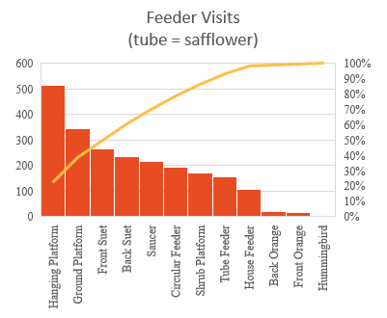
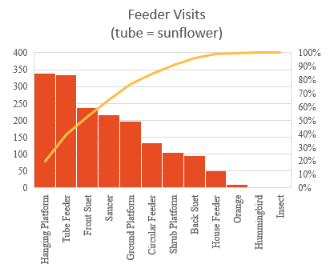
Sunflower vs. Safflower
Platform and saucer feeders contained sunflower.
Circular, tube, and house feeders contained safflower.
Do birds prefer sunflower over safflower?
Switched tube feeder to sunflower.
Greatly increased number of visits to the tube feeder.
Potential improvement: replace safflower with sunflower?

Slide 7
Sunflower vs. safflower: pricing
Safflower is more expensive than sunflower: $2.28 per l vs. $1.57 per l.
Will switching to sunflower in the tube feeder result in cheaper feedings per day?
H0: Mean price (tube has safflower) <= mean price (tube has sunflower).
H1: Mean price (tube has safflower) > mean price (tube has sunflower).
Tube = safflower |  |  |  |  | Tube = sunflower
Mean | sd | n | sd^2/n |  | Mean | sd | n | sd^2/n
5.05062 | 3.382945071 | 11 | 1.040392 |  | 8.473139 | 2.281265 | 6 | 0.867361
t | -2.47790569 |  |  |  | alpha | 0.05
P | 0.987201507
Fail to reject null (price of feeding increased).
Is this a result of more needing to replace the seed more frequently?

Slide 8
Sunflower vs. safflower: diversity
Did switching from sunflower to safflower increase diversity?
H0: diversity (tube has safflower) >= diversity (tube has sunflower)
H1: diversity (tube has safflower) < diversity (tube has sunflower)
Tube = safflower |  |  |  |  | Tube = sunflower
Mean | sd | n | sd^2/n |  | Mean | sd | n | sd^2/n
2.614707 | 0.1049749 | 20 | 0.000551 |  | 2.440152 | 0.188622 | 12 | 0.002965
Z | 2.9438585 |  | alpha = 0.05
P | 0.9983793
Fail to reject null (diversity decreased).
Might be due to influx of starlings (see caveats below)

Slide 9
Time of day.
Species/time of day | f(observed) | F(expected) | (f-F)^2/F
House Finch/morn | 4 | 4 | 0
House Finch/Aft | 4 | 4 | 0
Red-bellied/morn | 2 | 2 | 0
Red-bellied/aft | 2 | 2 | 0
Grackle/morn | 3 | 3.5 | 0.071428571
Grackle/aft | 4 | 3.5 | 0.071428571
Dove/morn | 3 | 3 | 0
Dove/aft | 3 | 3 | 0
Downy/morn | 2 | 2 | 0
Downy/aft | 2 | 2 | 0
Jay/morn | 1 | 1 | 0
Jay/aft | 1 | 1 | 0
Cardinal/morn | 3 | 3 | 0
Cardinal/aft | 3 | 3 | 0
Titmouse/morn | 2 | 1.5 | 0.166666667
Titmouse/aft | 1 | 1.5 | 0.166666667
Nuthatch/morn | 1 | 1 | 0
Nuthatch/aft | 1 | 1 | 0
Song Sparrow/morn | 1 | 1 | 0
Song Sparrow/aft | 1 | 1 | 0
Chickadee/morn | 1 | 1 | 0
Chickadee/aft | 1 | 1 | 0
White-throated/morn | 1 | 1 | 0
White-throated/aft | 1 | 1 | 0
Towhee/morn | 1 | 1 | 0
Towhee/aft | 1 | 1 | 0
Chipping Sparrow/morn | 1 | 1 | 0
Chipping Sparrow/aft | 1 | 1 | 0
Totals | 52 | 52 | 0.476190476
Are common birds and time of day related?
Used the mode of species visiting.
H0: Species and time of day are independent.
H1: Species and time of day are dependent.
Fail to reject null (lack of evidence that species and time of day are related).
df | 13
Chi-squared | 0.999999961

Slide 10
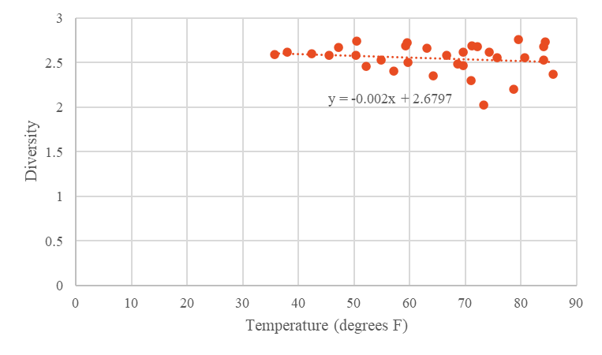
Temperature and Diversity
Regression Statistics
Multiple R | 0.176
R Square | 0.031
Adjusted R Square | -0.001
Standard Error | 0.164
Observations | 32
ANOVA
 | df | SS | MS | F | Significance F
Regression | 1 | 0.026 | 0.026 | 0.957 | 0.336
Residual | 30 | 0.804 | 0.027
Total | 31 | 0.829
 | Coefficients | Standard Error | t Stat | P-value | Lower 95% | Upper 95% | Lower 95.0% | Upper 95.0%
Intercept | 2.680 | 0.136 | 19.641 | 0.000 | 2.401 | 2.958 | 2.401 | 2.958
Temperature | -0.002 | 0.002 | -0.978 | 0.336 | -0.006 | 0.002 | -0.006 | 0.002
Temperature and diversity do not seem to be related at alpha = 0.05

Slide 11
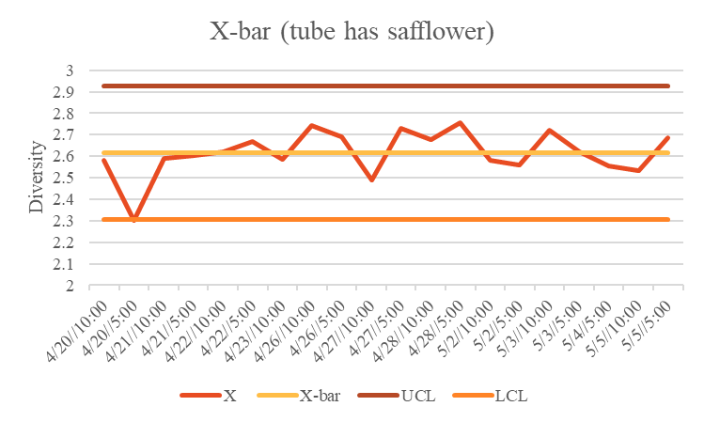
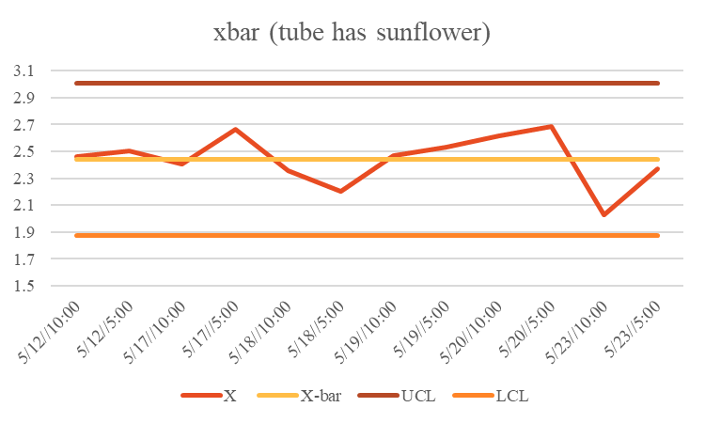
How stable was the diversity?
Temporarily out-of-control at first, but mostly stable.
Dip in diversity on the 23rd of May due to starlings.

Slide 12
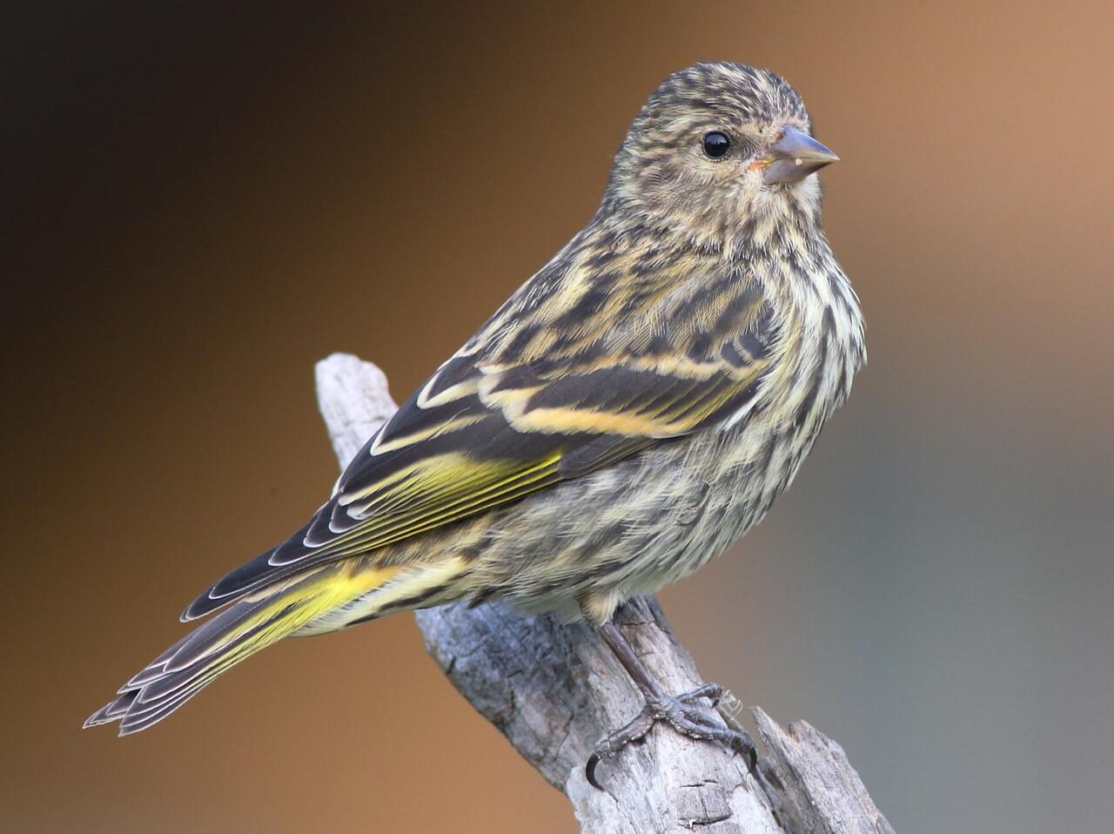
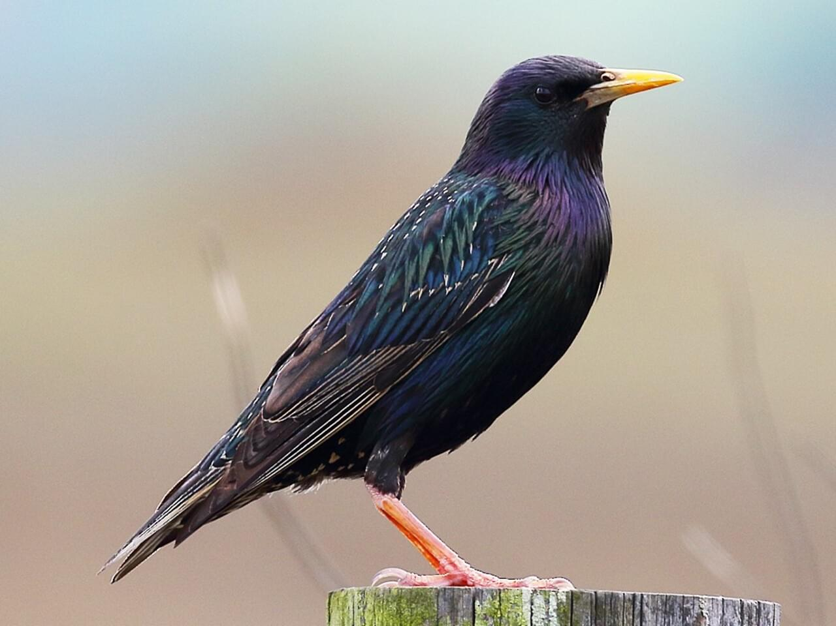
Caveats
Copyright Douglas Faulder 2017: Macaulay Library
Copyright Dan Vickers 2015: Macaulay Library
Large flock of Pine Siskins (Spinus pinus) during May, when they’re normally in Canada at that time.
Arrived and visited tube feeder after switching to sunflower.
They did not visit any feeders with safflower.
Large family of European Starling (Sturnus vulgaris) during last two days of count
Temporarily discouraged suet feeders (e.g. woodpeckers), and temporarily drove down diversity.

Slide 13
Conclusions
I have not identified factor(s) that drive(s) diversity.
Though birds visited tube feeder more often when it had sunflower, switching did not increase diversity.
Future experiments should take place throughout year to get seasonal differences.
Perhaps I should switch to entirely to sunflower, and look at the results.
I should also look for other factors affecting diversity (e.g. amount and types of plants in the yard).
References
Spellerberg, I. F., and Fedor, P. J., 2003. A tribute to Claude Shannon (1916–2001)
and a plea for more rigorous use of species richness, species diversity and
the ‘Shannon – Wiener’ Index. Global Ecology and Biogeography, 12, 177-179

