Slide 1
AWS::Compute Resources
Webinar

Slide 2
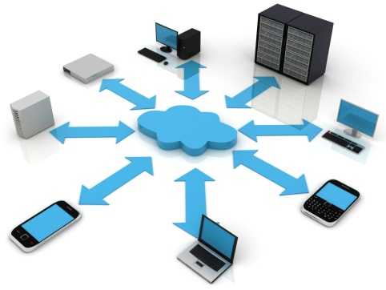




Cloud Computing Essentials
On-demand self-service
Broad network access
Resource pooling
Rapid elasticity
Measured service

Slide 3

Elasticity

Slide 4
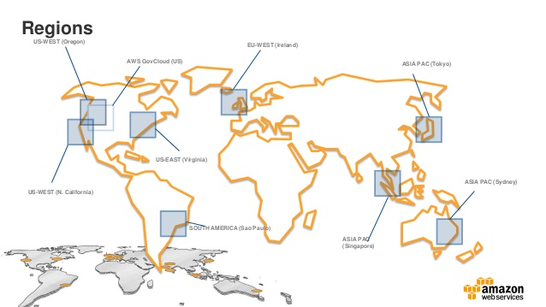
Global Infrastructure

Slide 5
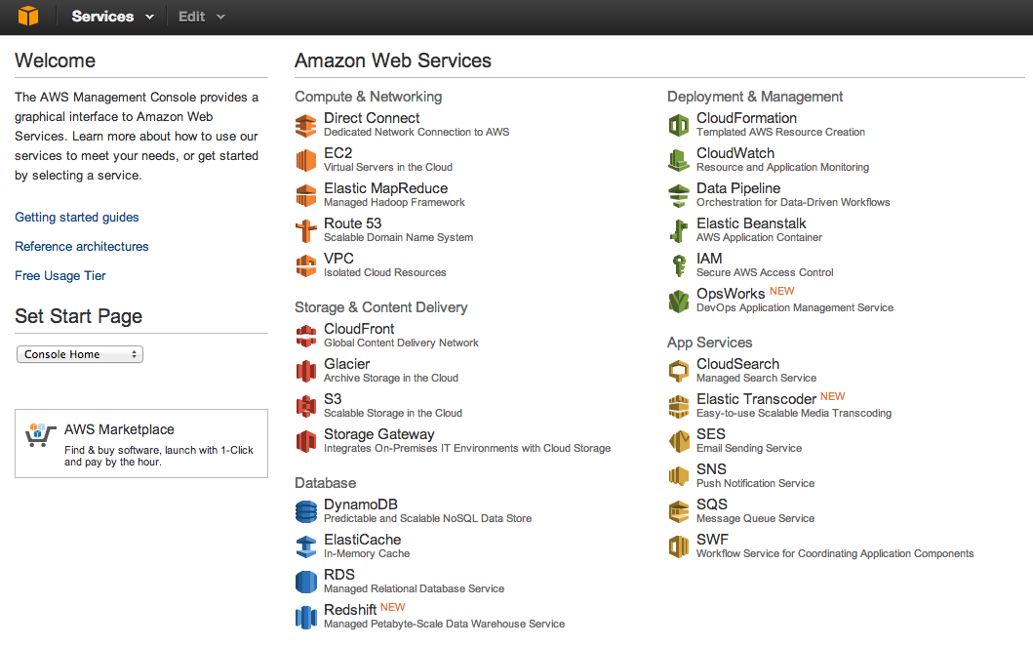
Service List

Slide 6
Plan for today
Create few instances
Play with volumes, images
Adjust security
Automate instance bootstrap
Set balancing

Slide 7
Links
http://docs.aws.amazon.com/AWSEC2/latest/UserGuide/ec2-instance-metadata.html
https://git.epam.com/andrii_melekhovskiy/devops_ed_aws/tree/master

