Slide 1
AWS::Data Storages
Webinar

Slide 2
S3

Slide 3
S3 Description and Design
Secure
Reliable
Scalable
Fast Enough
Inexpensive
Simple
policies and encryption
99.999999999% durability and 99.99% availability
from 1 byte to 5 Tb, any number of files
depends on instance type, unexpectedly
first 1 TB / month $0.0300 per GB (standard)
I’ll show ;)

Slide 4
S3 is really reliable
Copy
Copy
Copy
S3 Bucket
Data

Slide 5
Use Cases
Content storage and distribution
Storage for any data (object oriented)
Artifact storage
Backup, archiving and Disaster Recovery
Static website hosting

Slide 6
Glacier

Slide 7
Glacier overview
Low Cost – $0.01/GB
Secure
Durable - 99.999999999% durability
S3 integration out of the box

Slide 8
S3 data can be archived automatically to Glacier
Glacier
S3 Bucket
Data
Older then 2 weeks

Slide 9
Cloud Front

Slide 10
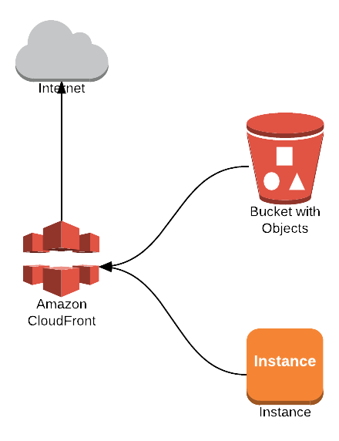
Cloud Front Integration
S3 integration
Get files from custom distribution

Slide 11
Links
http://docs.aws.amazon.com/AWSEC2/latest/UserGuide/ec2-instance-metadata.html
https://git.epam.com/andrii_melekhovskiy/devops_ed_aws/tree/master

