Slide 1
AWS::Databases
Webinar

Slide 2

RDS
Relational DB as a service

Slide 3
High Lights
Db as a service
Backups and recovery out-of-the-box
No ssh and root access
Replication

Slide 4
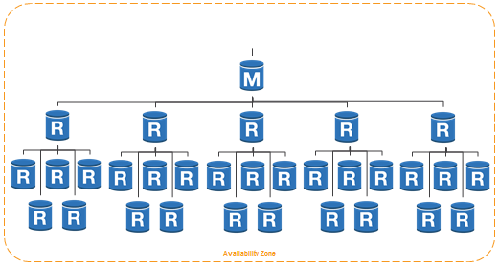
Replication
Master-slave replication

Slide 5
Available engines
MySQL
PostgreSQL
Oracle
Microsoft SQL Server

Slide 6

Dynamo DB
Key-value storage

Slide 7
High Lights
Scalable
Provisioned Throughput
Automated Storage Scaling
Fast, Predictable Performance
No Administration
Built-in Fault Tolerance
No fixed schema
Indexing - primary, secondary key
Strong Consistency
Integrated Monitoring
Integrated with:
Amazon Redshift
Amazon Elastic MapReduce

Slide 8
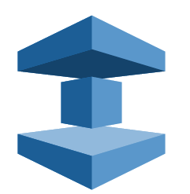
ElastiCache
Cache cluster as service

Slide 9


Available Engines

Slide 10
Links
http://docs.aws.amazon.com/AWSEC2/latest/UserGuide/ec2-instance-metadata.html
https://git.epam.com/andrii_melekhovskiy/devops_ed_aws/tree/master

