Slide 1
AWS::VPC
Webinar

Slide 2



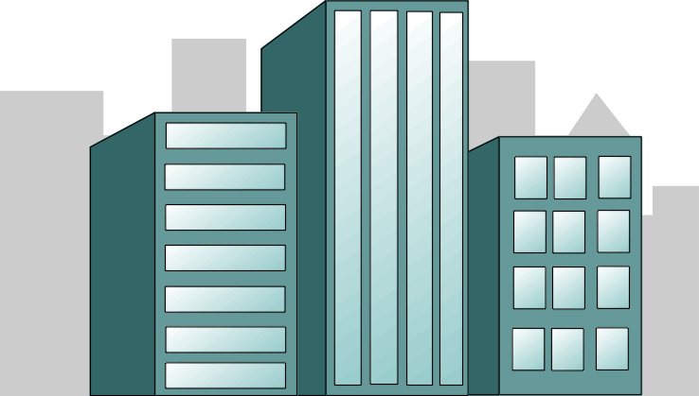
Private vs. Public
Private Cloud
Public Cloud

Slide 3
Not so Private
Pros:
Isolation is only logical
Cons:
The same AWS resources available -> scale
Complete control of network and security

Slide 4
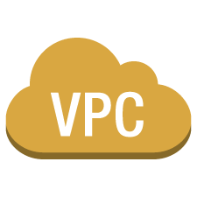



Use Cases
Simple apps
Multi-tier web applications with lots of components
Environment isolation
Extend your Data Center
Disaster Recovery
corporate data center

Slide 5
Connectivity Options
Public subnets
Private subnets
VPN to your Data Center
Pear-to-Pear connect to another VPC(s)
Combine all methods

Slide 6




Public/Private Subnets
instance
Private subnet
Internet gateway
Internet
Elastic IP
instance
instance
Elastic Load
Balancing
Public subnet

Slide 7
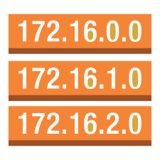

Routing
instance
NAT
Private subnet
route table
Internet gateway
Internet
router
Elastic IP
instance
instance
Elastic Load
Balancing
Public subnet

Slide 8
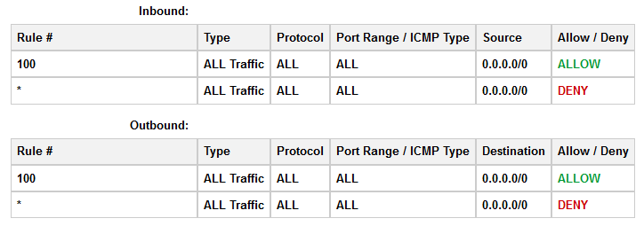
Security
Public/Private subnets
Network ACL
Security groups

Slide 9
Links
https://git.epam.com/andrii_melekhovskiy/devops_ed_aws/tree/master

