Slide 1

ICEG
Open Standards
URI strategy
October, 11th 2019
1

Slide 2
ICEG - URI strategy Shared workspace
https://github.com/belgif/thematic/tree/master/URI

Slide 3
Agenda
Welcome
Process & methodology
Formal process
How to collaborate?
URI strategy
Motivation & context: Identifier management
URI strategy elements
Open discussion

Slide 4
Welcome
Tour de table
Estimated time 20 minutes

Slide 5
Process & methodology

Slide 6
Agenda P&M
Objective:
Creation of a data standard for Belgium by interfederal cooperation
A common URI strategy as guinee pig
Process & methodology
The flow
How to come to adoption in the interfederal landscape
Timeplan
How to provide feedback, aquire background information, share with colleagues
Questions on the process & methodology

Slide 7
Governance
INTERFEDERAL GOVERNANCE
GOVERNANCE
ICEG
REVIEW GROUP
COLLABORATION
THEMATIC WORKING GROUPS
STAKEHOLDERS
LOGICAL DATA MODEL
SHACL RULES
SPECIFICATION
DOCUMENTATION
GUIDANCE
DOCUMENTATION
VOCABULARY (RDF)
JSON-LD CONTEXT

Slide 8

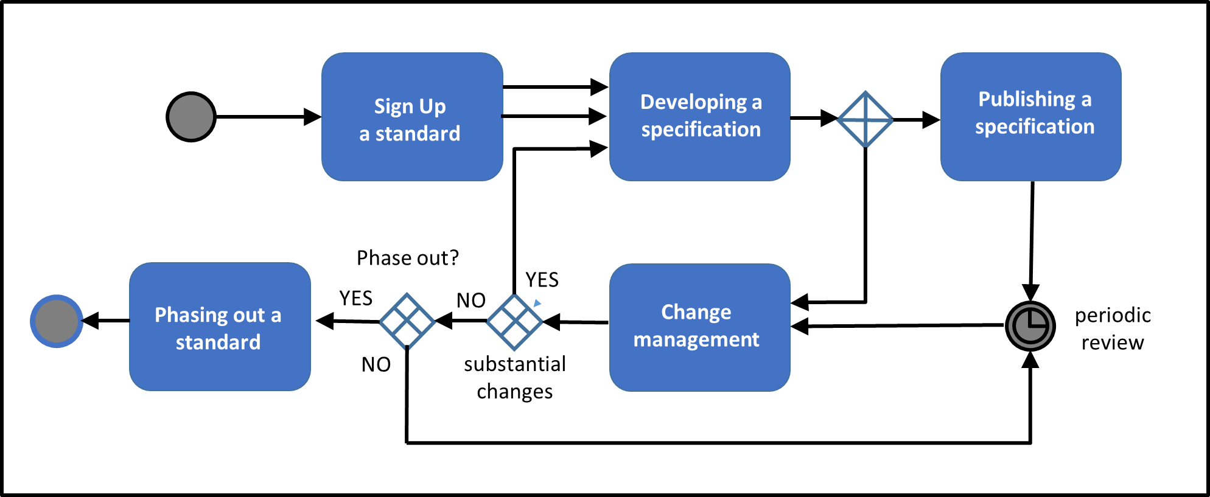
Governance: Process and method
W3C, IEEE, IETF, IAB en ISA, Open Stand, OSLO

Slide 9
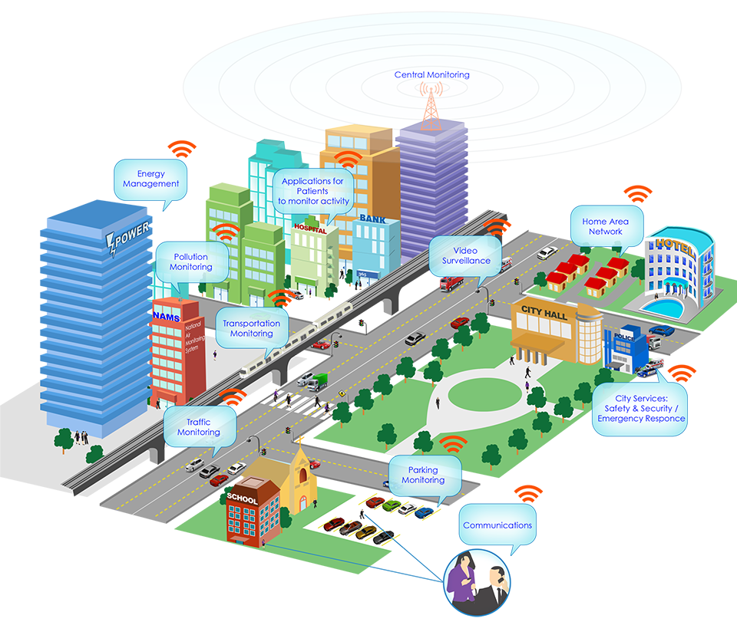
Roadmap 2019: URIs The Web as a Blueprint
Persistent Identifiers: URIs
Dereferenceable HTTP URIs
Standardised Information (RDF)
Links to other information
9

Slide 10
Milestones & planning
Date | Location | Start - End | Lead | Contact | Register
October 11 | Espace 27 septembre - Salle Alphonse Demoulin, Local 0 E 039 Address: Boulevard Léopold II 48, 1080 Molenbeek-Saint-Jean Directions: http://bit.ly/directions-espace | 14h - 16h | CFWB | Thierry Brouwer - Thierry.BROUWER@cfwb.be | see contact.
November 8 | WTCIII – Room 2A 04 Address: Simon Bolivarlaan 30, 1000 Brussels | 14h – 16h | BOSA | Marc Bruyland - marc.bruyland@bosa.fgov.be
November 22 | Ellipsgebouw - Room 0.A11 Address: Koning Albert II-laan 35, 1030 Brussel Directions: http://bit.ly/directions-ellips | 14h - 16h | Informatie Vlaanderen | Raf Buyle - raf.buyle@kb.vlaanderen.be | http://bit.ly/registration-link-wg

Slide 11
Collaboration
Collaboration: https://github.com/belgif/thematic/tree/master/URI

Slide 12
URI strategy

Slide 13
Context and Motivation
URI strategy is tightly connected with identifier management

Slide 14


Illustrative example
VO:Gebouw:2132
Identificator 2132
https://data.vlaanderen.be/id/gebouw/2132
By saving a reference
By taking over all the data
{
“buildingName”: “VAC GENT”,
“buildingYear”: “2010”,
“E-level” : “50”,
“address”: “Maria Hendrikaplein 90”
…
}
time

Slide 15
URI strategy elements
Persistent : continues to exist forever → an important commitment
Identifier : refers to an entity in reality
Dereferenceable: core information can be found by a machine and humans in terms of a publicly accessible vocabulary
Notes:
Hebben we voldoende verduidelijkt waarom? Nog niet gesproken over principes linked data en semantisch web.
Waarom dereferentieerbare id's
Omdat in een context naar een identificator wordt verwezen en dat het dan niet duidelijk is aan welke bron die verbonden is.
Opties: http & doi

Slide 16
Terminology
URI = “a string of characters that unambiguously identifies a particular resource”
URL = “the address of a resource on the Internet. A URL indicates the location of a resource as well as the protocol used to access it.”
Specific type of a URI
PURI = Persistent URI

Slide 17
Dereference
A protocol to retrieve (core) data about an identifier
Should support ability to retrieve data for different audiences:
Human & machines
Protocol HTTP GET fullfills the needs using content negation.

Slide 18
Dereferencing (human readable data)
HTTP GET http://data.vlaanderen.be/id/straat/12345
proxy
Accept: text/html
Respons: 303 See also
http://data.vlaanderen.be/doc/straat/12345
HTTP GET http://data.vlaanderen.be/doc/straat/12345
Accept: text/html
Renderer
(html creation)
Triplestore
(sparql endpoint)
Get content
Respons: RDF
Respons: HTML document
18

Slide 19
Dereferencing (machine readable data)
HTTP GET http://data.vlaanderen.be/id/straat/12345
proxy
Accept: application/rdf+xml
Respons: 303 See also
http://data.vlaanderen.be/doc/straat/12345
HTTP GET http://data.vlaanderen.be/doc/straat/12345
Accept: application/rdf+xml
Renderer
(serializer)
Triplestore
(sparql endpoint)
Get content
Respons: RDF
Respons: RDF document
19

Slide 20
Returned content of the subject page
Direct information
Add references to it
123
Embedded objects
id5
abc
Transitive closure
me
id1
_anon
Tel+023445
id6
part-of
part-of
id3
id2
20

Slide 21
URI strategy elements
Agreements on the URI structure
facilitate a visual identification whether or not the URI/URL must be treated as an identifier and not as a Web service
Facilitate the creation of common services to implement the dereference process
Provide guidelines to increase the stability of the identifiers, making them more persistent
Agreements on the dereference protocol
Facilitate the creation of tools on top of the identifiers
Harmonize the implementations of dereference

Slide 22
URI structure
http(s)://{domain}/{type}/{concept}(/{reference})*
{domain}, {type} and {concept} are obligatory
{reference} is optional
The combination {domain}/{type}/{concept}(/{reference})* must be unique on the Web and unchangeable.
Once the {reference} has been assigned, then the reference as the semantics (the real world item to which it refers to) cannot change.

Slide 23
{protocol}
http(s)://
Advice: use by preference https
Other protocols not supported as they do not support dereferencing

Slide 24
{domain}
The name of the domain and eventually all subdomains should be independent of organisation, product, marketing and time.

Slide 25
{type}
Provides distinction between
The actual object/concept
Its digital or Web representation
A term which is part of a vocabulary or ontology.

Slide 26
{type}
The default classification for these 3 categories are id, doc and ns.
Additional types can be added, but should not be used to replace these 3.

Slide 27
{concept}
The {concept} represents the category of the resource. It can be part of a managed classification or list, but that is not obligatory.

Slide 28
{reference}
The (/{reference})* refers to a specific resource. The {reference} element can occur multiple times to form a hierarchical structure.
Each {reference} can be constructed in 2 different ways:
{reference-base}
{reference-base}/{reference-version}

Slide 29
REST API URLs vs URIs
Both use the HTTP protocol for 2 closely related, yet different purposes:
To share data about an identifier (URI & dereference)
To offer data services over a domain (REST)

Slide 30
REST API URLs vs URIs
REST API URLs
All suburls have a service attached
URLs can change to offer a slightly other view/service content without changing the actual content (thus no persistence)
/api/v1 -> /api/v2
PURIs
Optimised of identification & stability
The full string is meaningful, a substring has no meaning.

Slide 31
REST API URLs vs URIs
Impact on used words
REST APIs use plurals:
https://bestadd.data.belgium.be/api/v1/buildings/flanders/32131231
URIs use singular
https://bestadd.data.belgium.be/id/building/flanders/32131231

Slide 32
Fragments as part of an identifier
A fragment is a local identifier in the document found at the URL.
In many usages fragments are considered as optional.
E.g. for proxy servers, a fragment is not meaningful: all decisions are made on the URL without the fragment.
Use has been more and more abandoned with the rise of REST APIs. Because it does not scale well: if the data is growing then a single page with a growing number of entities has to be created.
However commonly used in “ontologies”:
The document forms a natural grouping. That practice is best maintained.

Slide 33
Dereference agreements
A URI with {type} id must forward to a corresponding digital representation of type doc
For each URI having {type} id, there must exist a corresponding simular URI having {type} doc. The URI with {type} doc may refer to other URLs holding the actual document. The final URL does not need to follow the URI conformance.
The forwarding between {type} id and {type} doc URIs is done using a HTTP 303 redirect

Slide 34
Dereferencing 303 (human readable data)
HTTP GET http://data.vlaanderen.be/id/straat/12345
proxy
Accept: text/html
Respons: 303 See also
http://data.vlaanderen.be/doc/straat/12345
HTTP GET http://data.vlaanderen.be/doc/straat/12345
Accept: text/html
Renderer
(html creation)
Triplestore
(sparql endpoint)
Get content
Respons: RDF
Respons: HTML document
34

Slide 35
Dereferencing 303 (machine readable data)
HTTP GET http://data.vlaanderen.be/id/straat/12345
proxy
Accept: application/rdf+xml
Respons: 303 See also
http://data.vlaanderen.be/doc/straat/12345
HTTP GET http://data.vlaanderen.be/doc/straat/12345
Accept: application/rdf+xml
Renderer
(serializer)
Triplestore
(sparql endpoint)
Get content
Respons: RDF
Respons: RDF document
35

Slide 36
Alternative dereference
An alternative to {type} id, is the usage of URIs with {type} doc having the fragment #id. This approach avoids the 303 HTTP redirect.
Advice to use this approach only when the 303 cannot be followed.

Slide 37
Dereferencing: fragment (human readable data)
proxy
Requirement that html page contains the #id fragment
HTTP GET http://data.vlaanderen.be/doc/straat/12345#id
Renderer
(html creation)
Accept: text/html
Triplestore
(sparql endpoint)
Get content
Respons: RDF
Respons: HTML document
37

Slide 38
Dereferencing: fragment (machine readable data)
Requirement that proxy passes #id to the renderer
proxy
HTTP GET http://data.vlaanderen.be/doc/straat/12345#id
Renderer
(RDF creation)
Accept: application/rdf+xml
Triplestore
(sparql endpoint)
Get content
Respons: RDF
Respons: RDF document
38

Slide 39
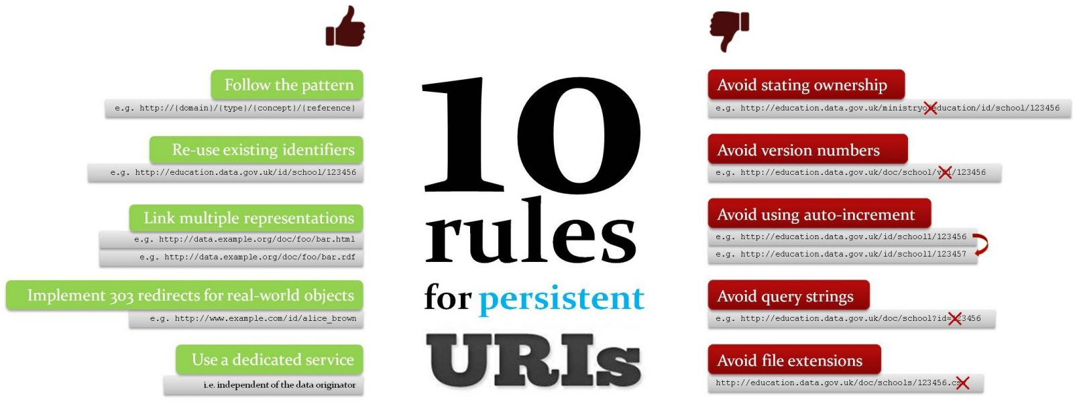
Guidelines for stability
SEMIC 10 rules for persistent identifiers
https://joinup.ec.europa.eu/sites/default/files/inline-images/URI_Visualisation_v0_03.jpg

Slide 40
