Slide 1
Machine Learning
Classification

Slide 2
Classification Outline
NO | Topics
1 | Classification Model
2 | K- Nearest Neighbors
3 | Naïve Bays

Slide 3
Classification
Unlike regression where you predict a continuous number, you use classification to predict a category.
Classification models include linear models like Logistic Regression, SVM, and nonlinear ones like K-NN, Kernel SVM and Random Forests.

Slide 4
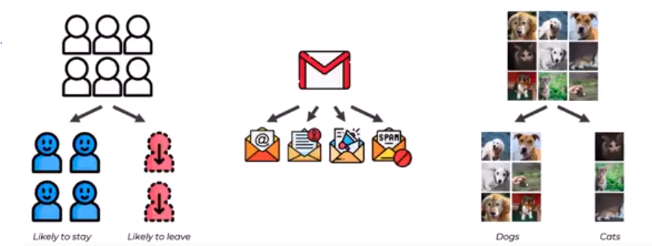
Classification Applications

Slide 5
K-Nearest Neighbors (KNN)
It is a non-parametric, supervised learning classifier
It is typically used as a classification algorithm, working off the assumption that similar points can be found near one another.

Slide 6
How does it work?
step 1: choose the number of K neighbors.
Step 2: Take the K neighbors of the new data point.
Step 3: Among these K neighbors you need to count the number of data points in each category.
Step 4: Assign the new data point to the category where you counted the most neighbors.

Slide 7
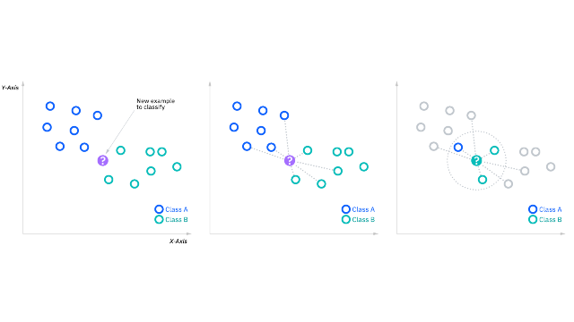
How does it work?

Slide 8
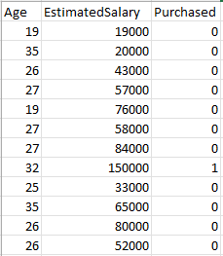
Getting Data ready for Classification
Dataset composed of 1000 row.
Age and Salary are the independent variables.
Purchased is the dependent variable

Slide 9
Classification Model Steps
Splitting dataset into the Training set and Test set
Training the KNN model on the Training set
Predicting the Test set results
Making the Confusion Matrix
Visualizing the Confusion Matrix

Slide 10
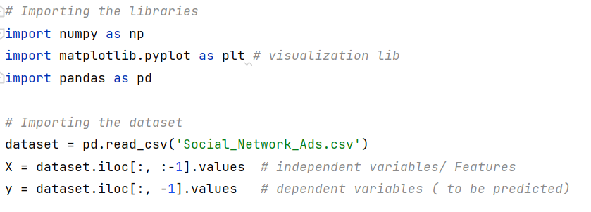
Getting Data ready for Classification

Slide 11
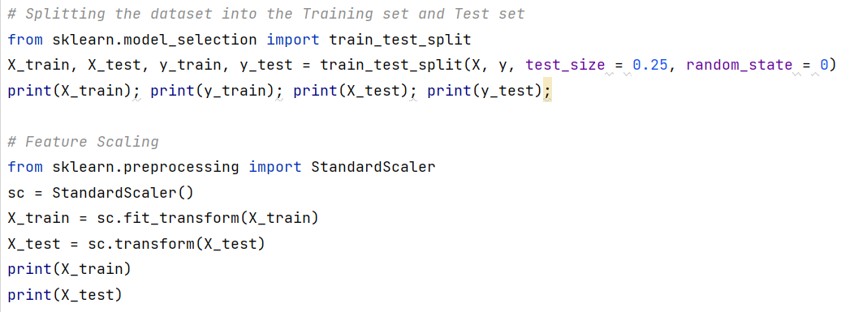
Getting Data ready for Classification

Slide 12
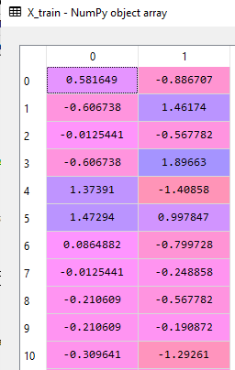
Training set after scaling

Slide 13
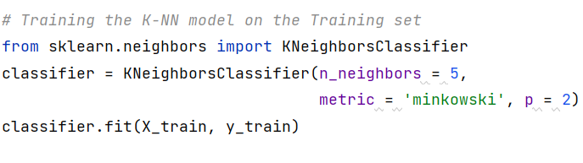
Training the K-NN model on the Training set

Slide 14
Training the K-NN model on the Training set
sklearn.neighbors.KNeighborsClassifier(n_neighbors = 5, metric = 'minkowski', p = 2) | class sklearn.linear_model.LinearRegression(*, fit_intercept=True, copy_X=True, n_jobs=None, positive=False)
neighbors | is a module implements the k-nearest neighbors algorithm
KNeighborsClassifier | Classifier implementing the k-nearest neighbors vote. n_neighbors : int, default=5 Metric , default=’minkowski’ P , default=2, Power parameter for the Minkowski metric.
fit(X, y) | A method to fit the k-nearest neighbors classifier from the training dataset.
predict(X) | A Method to predict the class labels for the provided data.
Notes:
https://scikit-learn.org/stable/modules/generated/sklearn.neighbors.KNeighborsClassifier.html

Slide 15
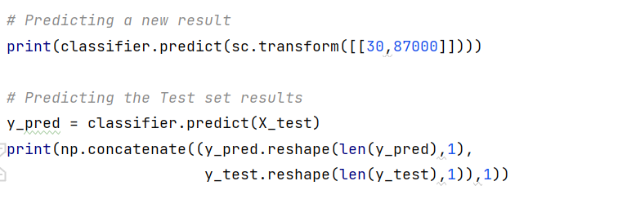
Predicting the Test Set Results

Slide 16
What is a Confusion Matrix?
A confusion matrix is a summary of prediction results on a classification problem.
The number of correct and incorrect predictions are summarized with count values and broken down by each class.
The confusion matrix shows the ways in which your classification model is confused when it makes predictions.

Slide 17
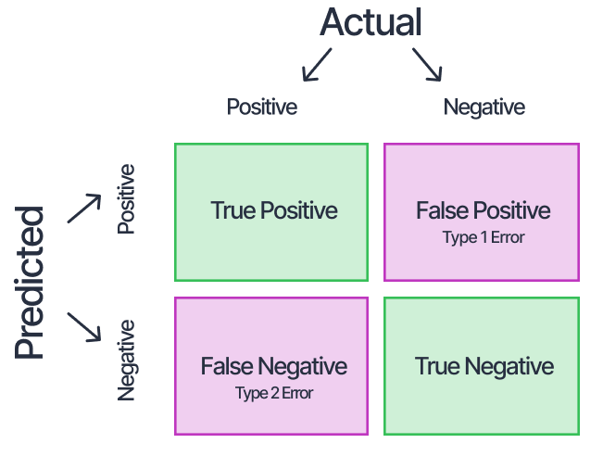
What is a Confusion Matrix?

Slide 18
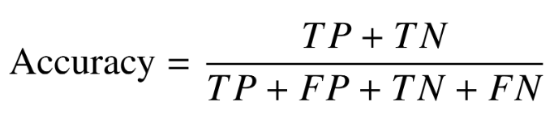
Making the Confusion Matrix
Name | Description
sklearn.metrics | Is a module includes score functions, performance metrics and pairwise metrics and distance computations.
confusion_matrix | Is a function which Computes confusion matrix to evaluate the accuracy of a classification.
accuracy_score | A function to computes the accuracy

Slide 19
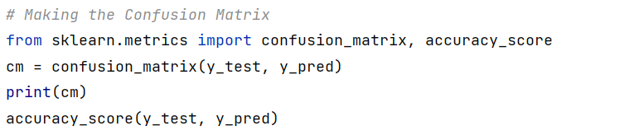

Making the Confusion Matrix

Slide 20
Visualising the Confusion Matrix
Name | Description
Seaborn | Is a Python data visualization library based on matplotlib. It provides a high-level interface for drawing attractive and informative statistical graphics.
heatmap | This is an Axes-level function and will draw the heatmap into the currently-active Axes if none is provided to the ax argument.
Notes:
A heat map is a two-dimensional representation of data in which various values are represented by colors. A simple heat map provides an immediate visual summary of information across two axes, allowing users to quickly grasp the most important or relevant data points. More elaborate heat maps allow the viewer to understand complex data sets.

Slide 21
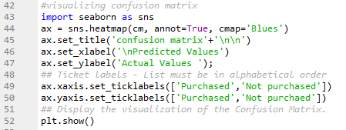
Notes:
The scatter() function plots one dot for each observation. It needs two arrays of the same length, one for the values of the x-axis, and one for values on the y-axis
By default, the plot() function draws a line from point to point.

Slide 22
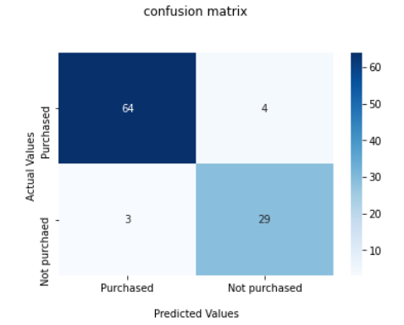
Visualising the Confusion Matrix
Notes:
The scatter() function plots one dot for each observation. It needs two arrays of the same length, one for the values of the x-axis, and one for values on the y-axis
By default, the plot() function draws a line from point to point.

Slide 23
Naïve bayes
Naive Bayes classifier assumes that the presence of a particular feature in a class is unrelated to the presence of any other feature.
The naive Bayes classifier assumes that all features in the input data are independent of each other, which is often not true in real-world scenarios.
However, despite this simplifying assumption, the naive Bayes classifier is widely used because of its efficiency and good performance in many real-world applications.

Slide 24
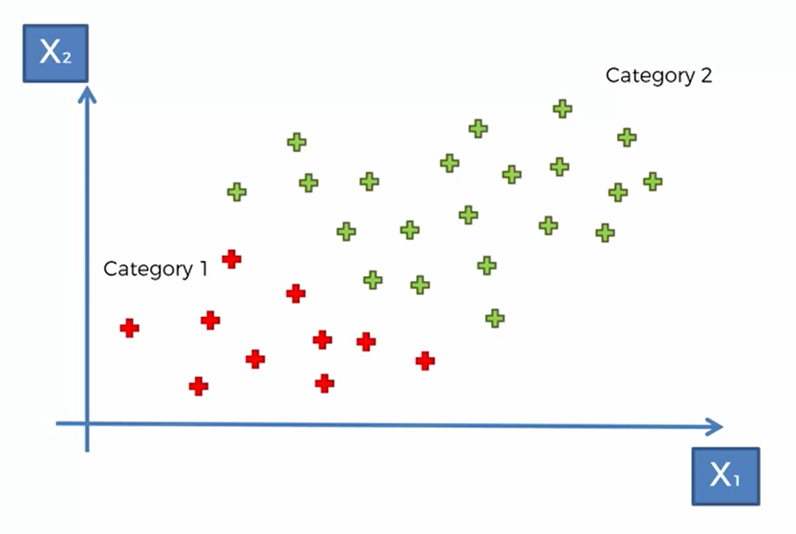
Naïve Bias

Slide 25
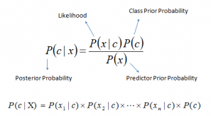
How Does Naive Bayes Algorithm Work?
Step 1: Convert the data set into a frequency table
Step 2: Create Likelihood table by finding the probabilities
Step 3: Use Naive Bayesian equation to calculate the posterior probability

Slide 26
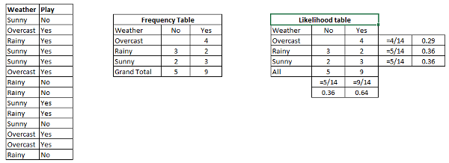
Example

Slide 27
Example 1
Problem: Players will play if the weather is sunny. Is this statement correct?
We can solve it using the above-discussed method of posterior probability.
P(Yes | Sunny) = P( Sunny | Yes) * P(Yes) / P (Sunny)
Here we have P (Sunny |Yes) = 3/9 = 0.33, P(Sunny) = 5/14 = 0.36, P( Yes)= 9/14 = 0.64
Now, P (Yes | Sunny) = 0.33 * 0.64 / 0.36 = 0.60, which has higher probability.

Slide 28
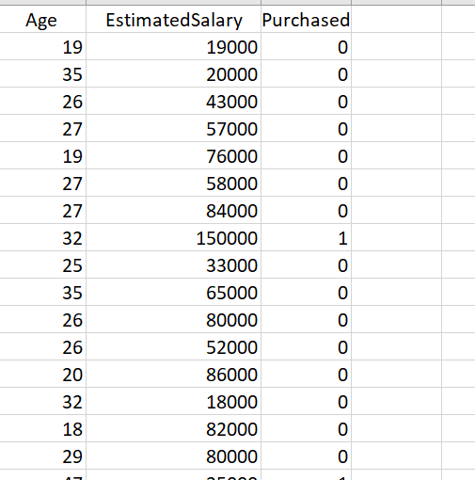
Getting Data ready for Classification
Dataset composed of 1000 row.
Age and Salary are the independent variables.
Purchased is the dependent variable

Slide 29
Getting Data ready for Classification

Slide 30
Getting Data ready for Classification

Slide 31
Training set after scaling

Slide 32
Training the Naïve bayes model on the Training set
class sklearn.naive_bayes.GaussianNB() | class sklearn.linear_model.LinearRegression(*, fit_intercept=True, copy_X=True, n_jobs=None, positive=False)
naive_bayes | is a module implements Naive Bayes algorithms.
GaussianNB() | Classifier implementing the gaussian naïve bayes.
fit(X, y) | A method to fit the Naïve bayes classifier from the training dataset.
predict(X) | A Method to predict the class labels for the provided data.
Notes:
https://scikit-learn.org/stable/modules/generated/sklearn.neighbors.KNeighborsClassifier.html

Slide 33
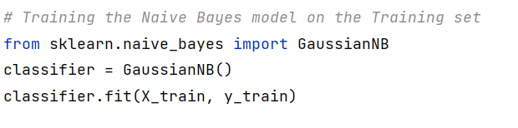
Training the Naïve bayes model on the Training set

Slide 34
Predicting the Test Set Results

Slide 35

Making the Confusion Matrix

Slide 36
Visualising the Confusion Matrix

Slide 37
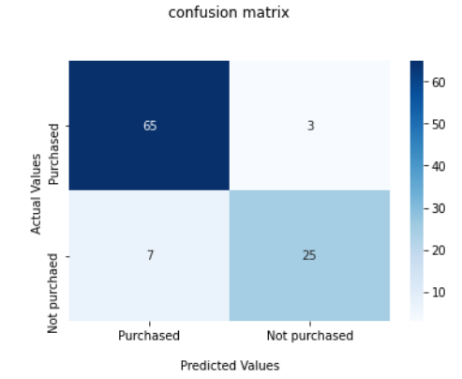
Visualising the Confusion Matrix

Slide 38
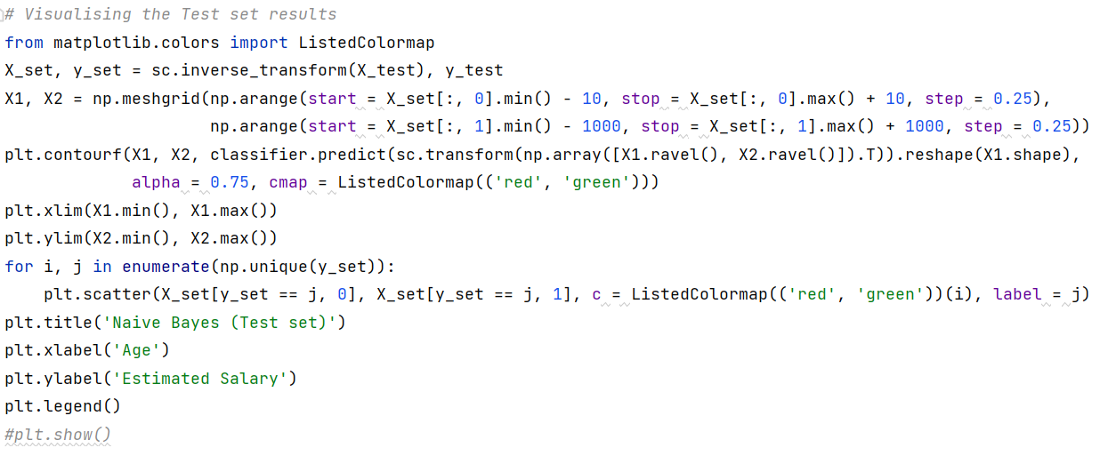
Visualization

Slide 39
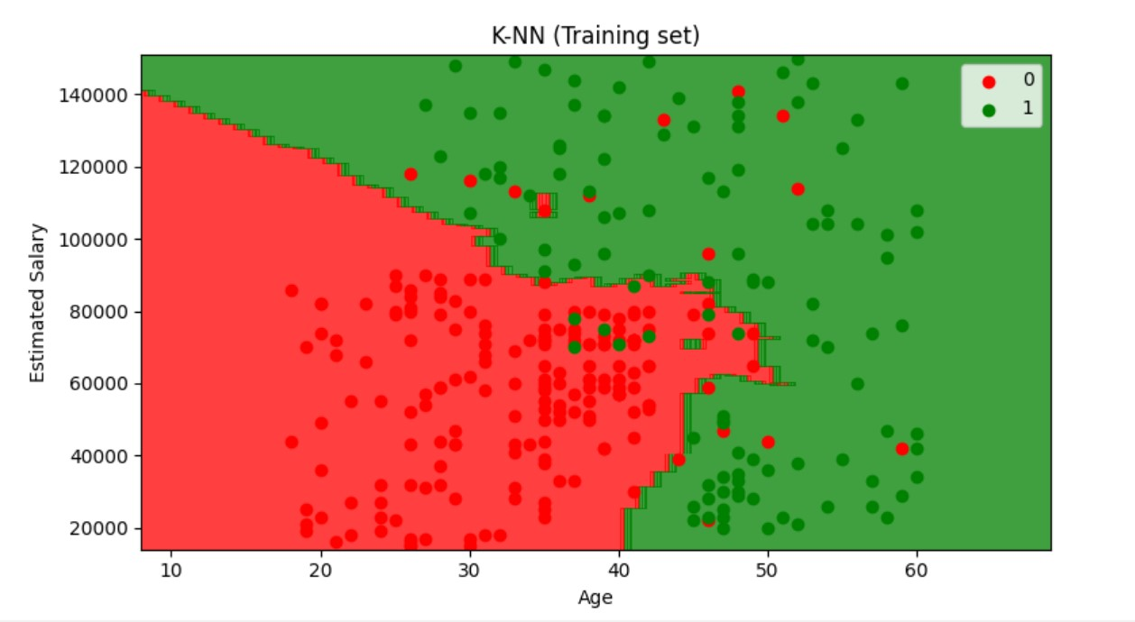

Slide 40
Thank you!

