Slide 1
Machine Learning
Regression

Slide 3
Regression Outline
NO | Topics
1 | Regression Model
2 | Simple Linear Regression
3 | Multiple Regression

Slide 4
Regression Model
A regression is a statistical technique that relates a dependent variable to one or more independent (explanatory) variables.
A regression model is able to show whether changes observed in the dependent variable are associated with changes in one or more of the explanatory variables.

Slide 5
Regression Model
Regression models are used for predicting a real value, like salary for example.
If your independent variable is time, then you are forecasting future values, otherwise your model is predicting present but unknown values.
Regression models:
Simple Linear Regression | Support Vector for Regression
Multiple Linear Regression | Decision Tree Regression
Polynomial Regression | Random Forest Regression

Slide 6
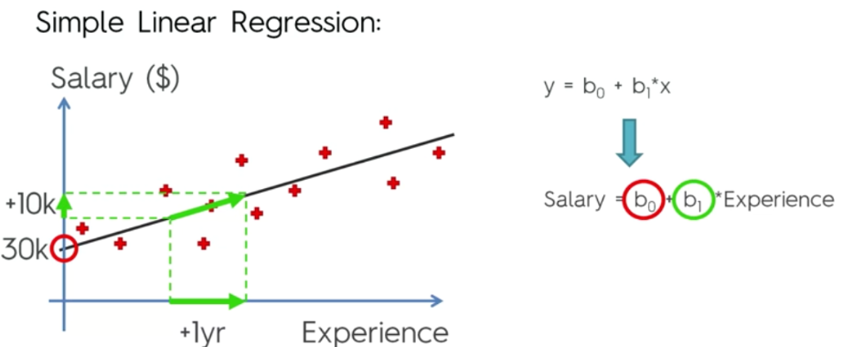
Simple Linear Regression
Based on the graph, it is clear that this is a positive slope.
If the co-efficient b1 is big, the slope is going to steeper, which means that if there is a small increase in the age, then there will be a big increase in the salary.
If the value of b1 is small, the slope is going to be more gentle and with change is experience, the salary is going to increase gently.
Notes:
https://www.javahabit.com/2019/01/22/part-2-ml-simplelinear-regression/

Slide 7
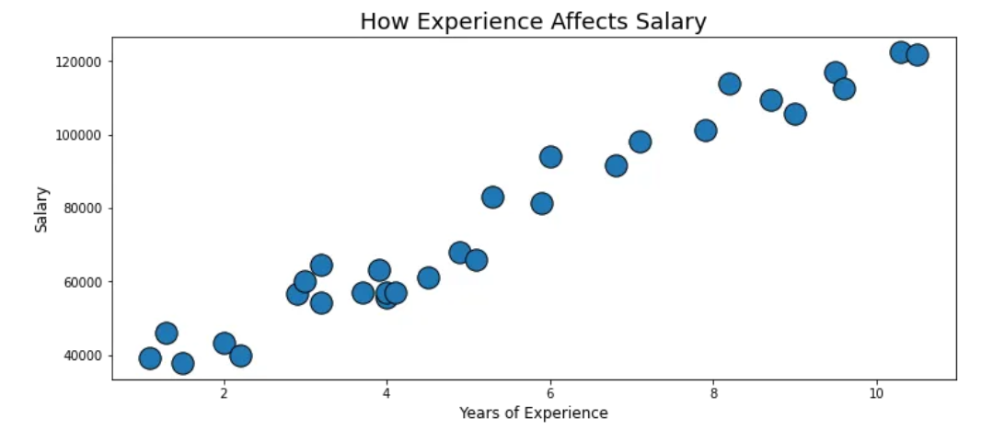
Simple Linear Regression
Simple linear regression aims to find a linear relationship to describe the correlation between an independent and possibly dependent variable.
The regression line can be used to
predict or estimate missing values,
this is known as interpolation.

Slide 8
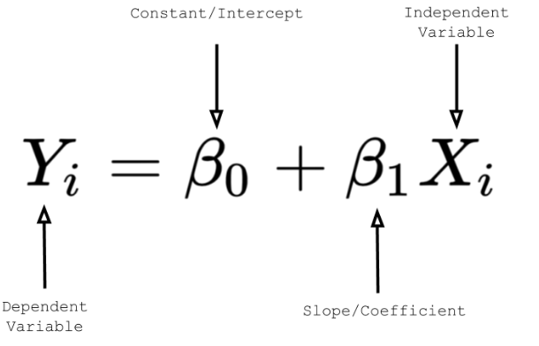
Simple Linear Regression Equation
The simple linear regression equation we will use is written below.
The constant is the y-intercept (𝜷0), or where the regression line will start on the y-axis.
The beta coefficient (𝜷1) is the slope and
describes the relationship between the
independent variable and the dependent
variable.

Slide 9
Simple Linear Regression Equation
The coefficient can be positive or negative and is the degree of change in the dependent variable for every 1-unit of change in the independent variable.
Example, let's say we have a regression equation of y = 2 + 0.5x.
For every 1-unit increase in the independent variable (x),
there will be a 0.50 increase in the dependent variable (y).

Slide 10
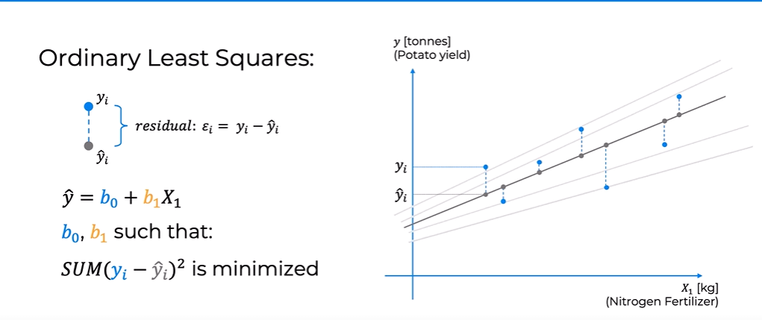
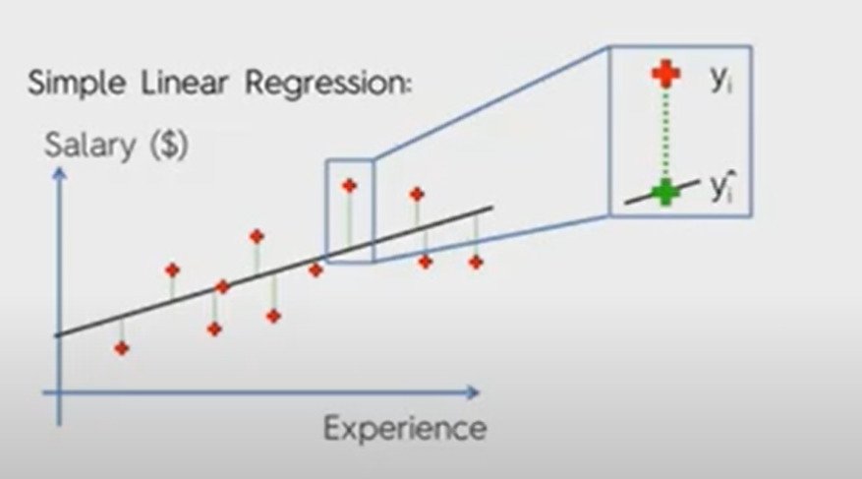
Simple Linear Regression

Slide 11
Regression Model Steps
Splitting dataset into the Training set and Test set
Training the Simple Linear Regression model on the Training set
Predicting the Test set results
Visualizing the Training set results
Visualizing the Test set results

Slide 12
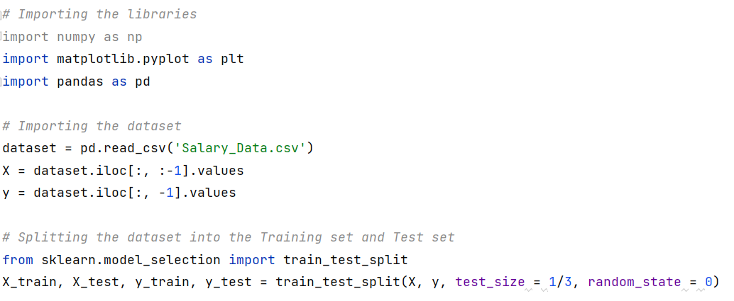
Getting Data ready for Regression

Slide 13
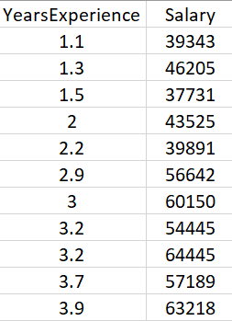
Getting Data ready for Regression
YearsExperience | Salary
1.1 | 39343
1.3 | 46205
1.5 | 37731
2 | 43525
2.2 | 39891
2.9 | 56642
3 | 60150
3.2 | 54445
3.2 | 64445
3.7 | 57189
3.9 | 63218
4 | 55794
4 | 56957
4.1 | 57081
4.5 | 61111
4.9 | 67938
5.1 | 66029
5.3 | 83088
5.9 | 81363
6 | 93940
6.8 | 91738
7.1 | 98273
7.9 | 101302
8.2 | 113812
8.7 | 109431
9 | 105582
9.5 | 116969
9.6 | 112635
10.3 | 122391
10.5 | 121872
Training Set
Testing Set

Slide 14
Training the Simple Linear Regression Model on the Training Set
class sklearn.linear_model.LinearRegression(*, fit_intercept=True, copy_X=True, n_jobs=None, positive=False) | class sklearn.linear_model.LinearRegression(*, fit_intercept=True, copy_X=True, n_jobs=None, positive=False)
linear_model | is a module implements a variety of linear models. The term linear model implies that the model is specified as a linear combination of features.
LinearRegression | LinearRegression class from sklearn. This model will take data and minimize a Loss Function (in this case, one called Sum of Squares) step by step until it finds the best possible line to fit the data.
fit(X, y[, weight]) | A method to fit linear model.
predict(X) | A Method to predict using the linear model.
Notes:
https://scikit-learn.org/stable/modules/generated/sklearn.linear_model.LinearRegression.html

Slide 15
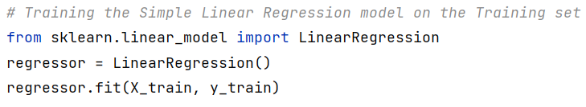
Training the Simple Linear Regression Model on the Training Set
q

Slide 16

Predicting the Test Set Results

Slide 17
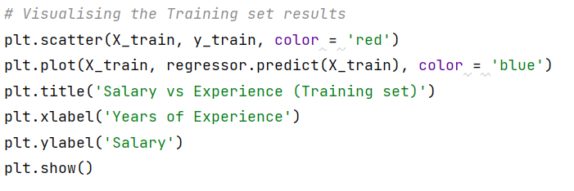
Visualising the Training Set Results
Notes:
The scatter() function plots one dot for each observation. It needs two arrays of the same length, one for the values of the x-axis, and one for values on the y-axis
By default, the plot() function draws a line from point to point.

Slide 18
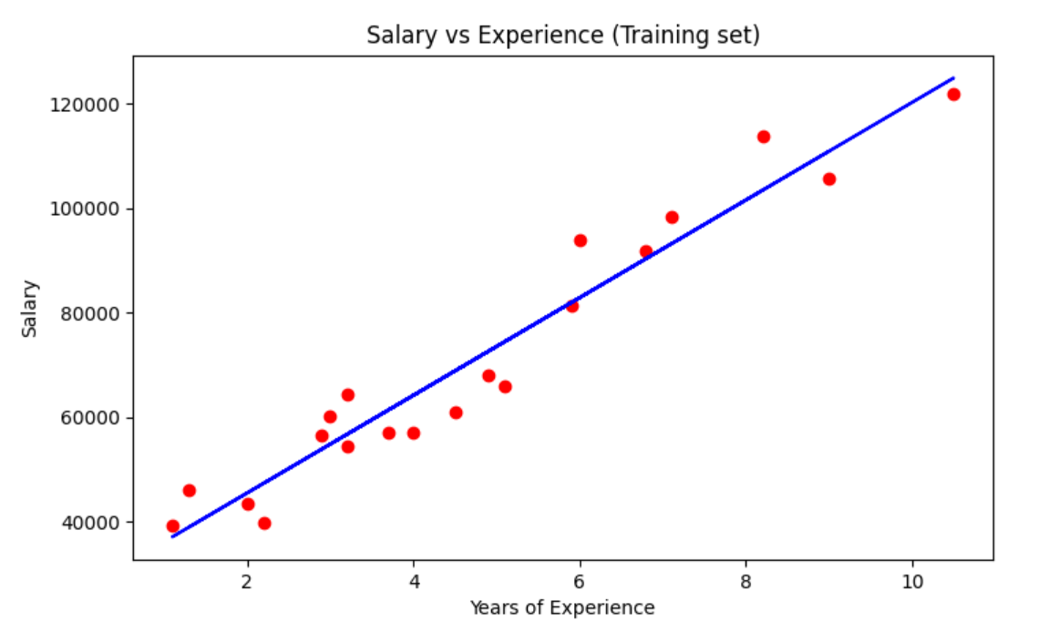
Visualising the Training Set Results

Slide 19
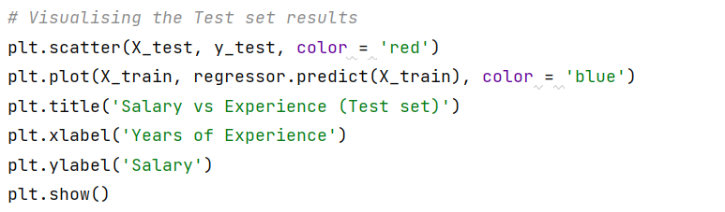
Visualising the Test Set Results

Slide 20
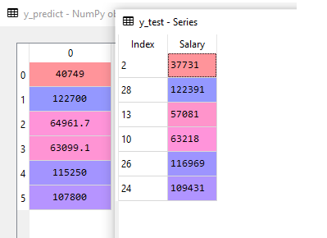
Actual VS. prediction

Slide 21
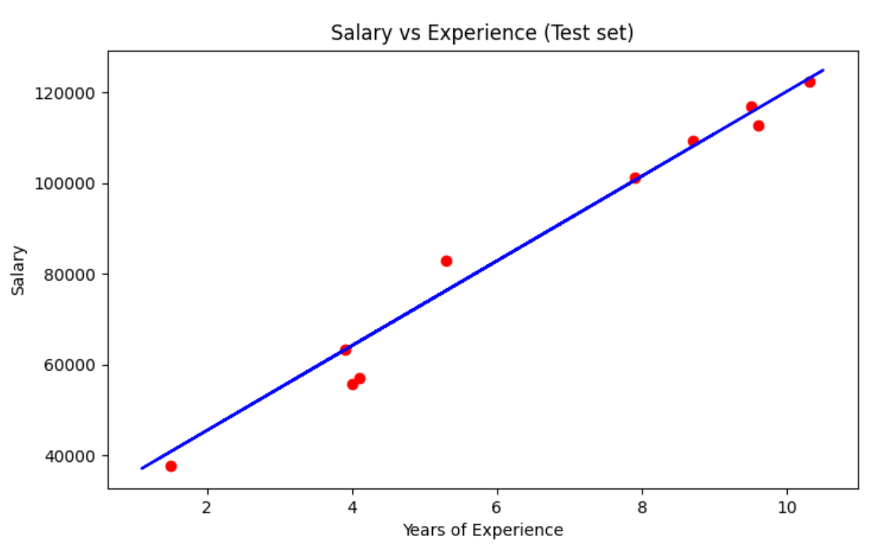
Visualising the Test Set Results

Slide 22
Multiple Linear Regression
Multiple Linear Regression (MLR) makes it possible to relate one variable with several variables through a linear function in its parameters.
When we are discussing multiple linear regression, then the equation of simple linear regression y=A+Bx is converted to something like:
y = A+B1x1+B2x2+B3x3+B4x4
The key parameters B1, B2, B3, and B4 are the slopes or coefficients concerning this independent feature.

Slide 23
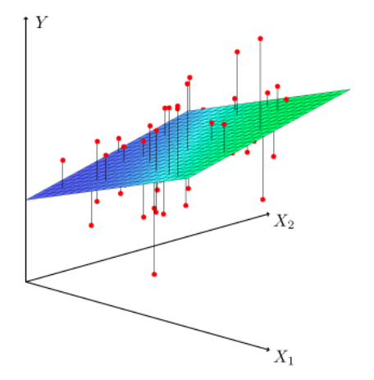
Multiple Linear Regression(with 2 independent features)

Slide 24
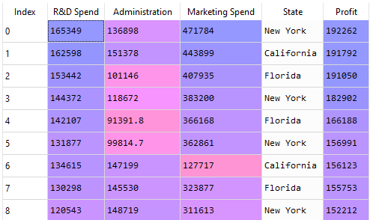
Getting Data ready for Regression
Notes:
R&D is research and development

Slide 25
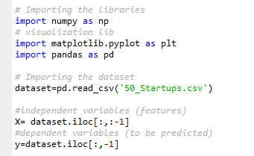
Getting Data ready for Regression

Slide 26
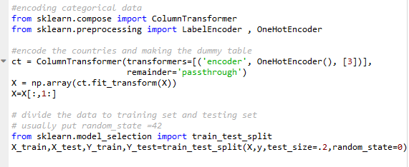
Getting Data ready for Regression
Notes:
No need to apply feature scaling because of the slope multiplied by the feature.

Slide 28

Training the Multiple Linear Regression Model on the Training Set then predict results

Slide 29
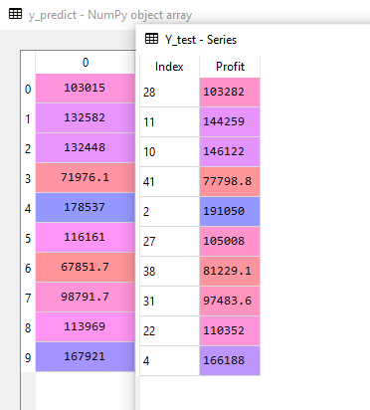
Actual VS. prediction

