Slide 1

Portfolio Analysis
Paula Boks, 2024-11-06

Slide 2

Portfolio: basic information
Five Assets
Different Investment Types
Over Three Years

Slide 3
Objectives of analysis
Overall performance and price developments
Growth rate, cumulative & annualized returns, annualized volatilities
Correlation between asset performances
Weighting of assets individually and by investment type

Slide 4
Short Summary of Findings
Assets 2 and 3 promise big profits but show high volatility
Asset 5 is a real „alternative“: good profits, less volatility
Performances are not clearly dependent on type of investment
Assets 1 and 4 are low-performer but stable

Slide 5
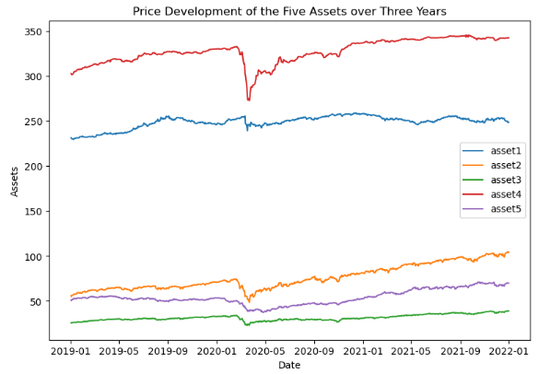
Very different selling prices at the start of the portfolio
Positive overall performance of all assets
All assets are affected by Covid in March 2020
Asset 2 and Asset 4 show the best performance over time

Slide 6
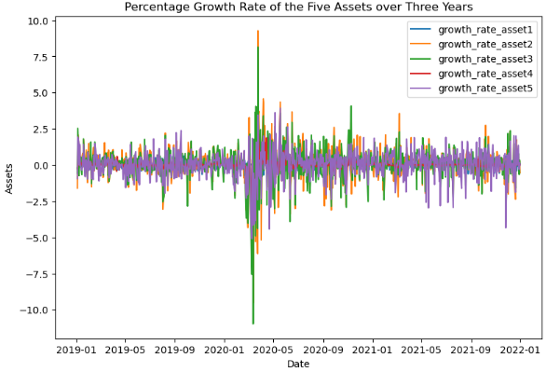
Covid shows:
Before March 2020:
~ +- 2.5
March 2020: high negative rates and shortly after high positive rates
Afterwards: higher fluctuation than before

Slide 7
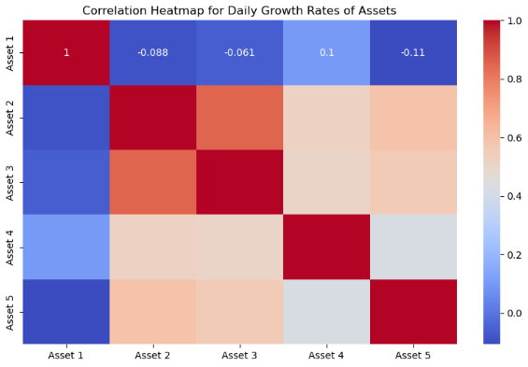
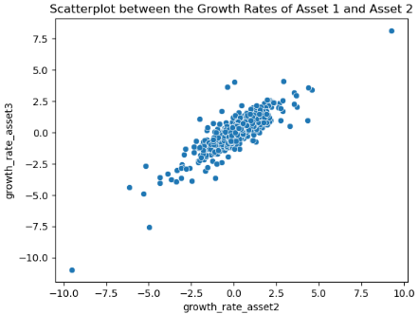
Asset 2 and 3: highly correlated (linear & monotonic)
Asset 1: very low correlation with all of the others
Rest: medium high correlation with each other
In almost all cases is the linear relationship (a little) stronger than the monotonic

Slide 8
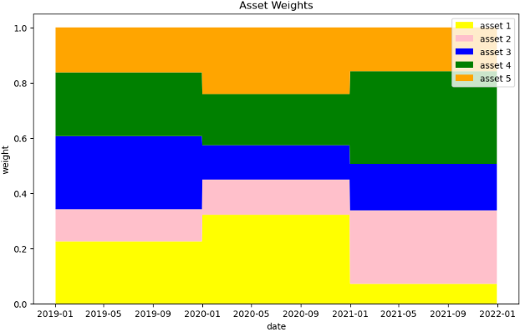
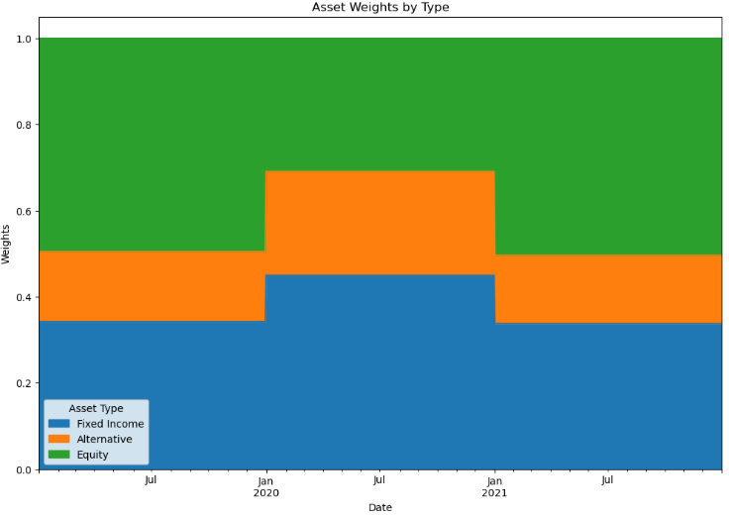
HIGHLIGHTS 2:
Decrease in Equity in 01/20 and increase in 01/21
Fixe Income and Alternative were sold/ bought mirroring Equity
HIGHLIGHTS 1:
Two big shifts in the weights, each at the beginning of 2020 and 2021
Overall Asset 2 and Asset 4 were increased in relative volume while all the others were decreased over the three years

Slide 9
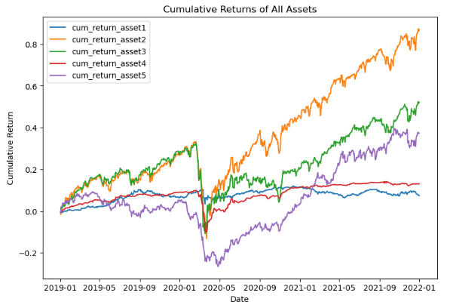
All assets show losses around Marsch 2020
Asset 2, 3 and 5 recover quickly and then increase strongly
Asset 1 and 4 go back to before
Asset 1 shows almost the same cumulative return over the whole period

Slide 10
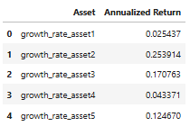
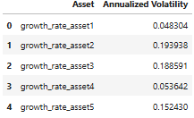
RISK AND HIGH PROFIT COME TOGETHER !!!
Annualized Returns: (all over again!)
Asset 2 and 3 are best
Asset 1 and 4 lowest performer
Asset 5 likes the middle ground
Annualized Volatility: (all over again!)
Asset 2 and 3 show the highest
Asset 1 and 4 the lowest
Asset 5 likes the middle ground

Slide 11
Main Conclusions
Strong nerves and risk affinity: Asset 2 and 3
Asset 5 seems like a real alternative
Correlation between Asset 2 and 3 (better diversify?)
Stable but very low profit (inflation compensated?)
No investment type is clearly better then others
Portfolio Changes at the beginning of each year to focus on performers

Slide 12

Thank you and good luck!
github.com/Paula0923

