Slide 1
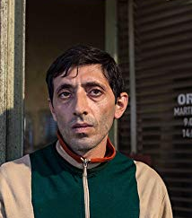
Marcello Fonte Actor Biography Fonte lived his childhood and adolescence in the suburbs of Reggio Calabria, where at the age of 10 he learned to play the snare drum in the town's band. He then moved to Rome in 1999, where he worked as guardian at the Teatro Valle and became passionate about acting and got small parts in television and film productions. In 2018, Fonte received critical acclaim for his performance in Matteo Garrone's Dogman and is awarded with the Best Actor Award at the 2018 Cannes Film Festival

Slide 2
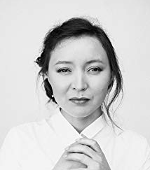
Samal Yeslyamova Actress Samal Yeslyamova is an actress, known for Ayka (2018), Tulpan (2008) and Festival international de Cannes (1970).

Slide 3
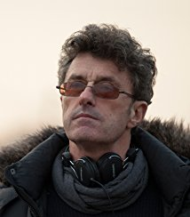
Pawel Pawlikowski Director Born 15 September 1957) is a Polish filmmaker, who has lived and worked most of his life in the UK. He garnered much acclaim for a string of award-winning documentaries in the 1990s and for his feature films Last Resort and My Summer of Love, both of which won a BAFTA and many other European awards. His film Ida won the 2015 Academy Award for Best Foreign Language Film. At the 2018 Cannes Film Festival, Pawlikowski won the Best Director prize for his latest film Cold War.

Slide 4
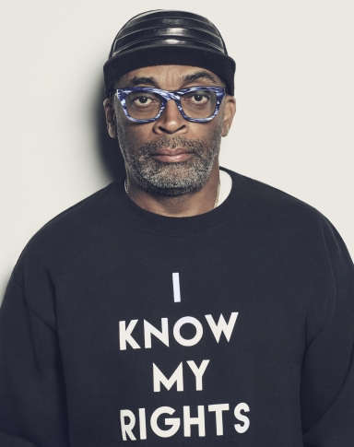
Spike Lee Biography Actor, Producer, Director, Film Actor (1957–) Producer, director, writer and actor Spike Lee creates provocative films that explore race relations, political issues and urban crime and violence. His films include 'She's Gotta Have It' and 'Do the Right Thing.' Who Is Spike Lee? Spike Lee was born Shelton Jackson Lee on March 20, 1957, in Atlanta, Georgia. He was making amateur films by age 20, and won a Student Academy Award for his graduate thesis film. Lee drew attention with his first feature, She's Gotta Have It — one of the most profitable films made in 1986 — and continues to create films that explore provocative topics like race, politics and violence. He is also known for his documentaries and commercials.

Slide 5
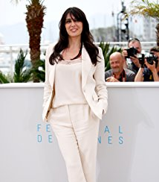
Nadine Labaki Nadine Labaki was born on February 18, 1974 in Beirut, Lebanon. She is an actress and writer, known for Et maintenant on va où? (2011), Sukkar banat (2007) and Capharnaüm(2018). She has been married to Khaled Mouzanar since October 2007.

Slide 6
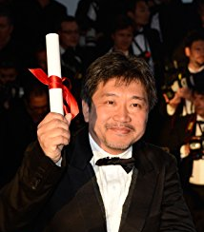
Palme d'Or Hirokazu Koreeda Born in Tokyo in 1962. Originally intended to be a novelist, but after graduating from Waseda University in 1987 went on to become an assistant director at T.V. Man Union. Snuck off set to film Mou hitotsu no kyouiku - Ina shogakkou haru gumi no kiroku (1991). His first feature, Maboroshi no hikari (1995), based on a Teru Miyamoto novel and drawn from his own experiences while filming Kare no inai hachigatsu ga (1994), won jury prizes at Venice and Chicago. The main themes of his oeuvre include memory, loss, death and the intersection of documentary and fictive narratives.

Slide 7
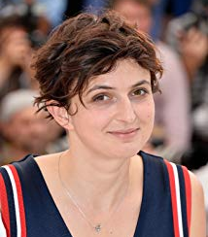
Alice Rohrwacher Alice Rohrwacher was born in 1982 in Fiesole, Tuscany, Italy. She is a writer and director, known for Le meraviglie (2014), Corpo celeste (2011) and Lazzaro felice (2018).

