Slide 1
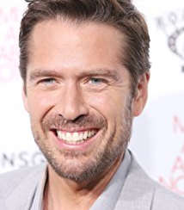
Alexis Denisof Alexis Denisof was born on February 25, 1966 in Salisbury, Maryland, USA. He is an actor, known for The Avengers(2012), Guardians of the Galaxy (2014) and Justice League: Doom (2012). He has been married to Alyson Hannigan since October 11, 2003. They have two children.

Slide 2
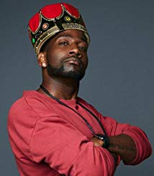
DeStorm Power DeStorm Power is an actor and writer, known for Caught the Series (2017), Punk'd (2003) and Sharknado 4: The 4th Awakens (2016).

Slide 3
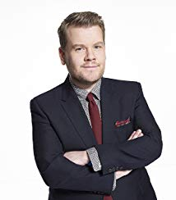
James Corden Describing himself as the "chunky unit", James Kimberley Corden was born in Hillingdon, London and raised in Buckinghamshire, the son of Margaret (Collins), a social worker, and Malcolm Corden, a musician. He studied drama at the Jackie Palmer Stage School before going on to Holmer Green Senior School, near High Wycombe. However, he admits that he had very little academic ambition and turned to acting, making his screen debut in the monochrome Shane Meadows film TwentyFourSeven (1997). After taking small roles in television drama series, he landed his first notable role as the teenage member of a slimming club in the British TV comedy-drama Fat Friends (2000). Shortly afterwards, he appeared on the London stage in Alan Bennett's play "The History Boys", taking part in its subsequent international tour, as well as the cinema adaptation. Whilst working on Fat Friends (2000), he met the Welsh actress Ruth Jones and, between them, they fashioned the sitcom (in which both also appear) Gavin & Stacey (2007), the big hit of the 2007 season, winning British Film Academy awards for them both as Best Comedy Show and for James as Best Comedy Actor. He also persuaded three of the erstwhile "History Boys" to make cameo appearances as Gavin's stag party friends. In 2011 he found fame as a stage actor in the acclaimed farce 'One Man, Two Guv'nors' transferring with it from London to Broadway, thus beginning Transatlantic success topped in 2015 when he became the host of CBS 'The Late, Late Show'.

Slide 4
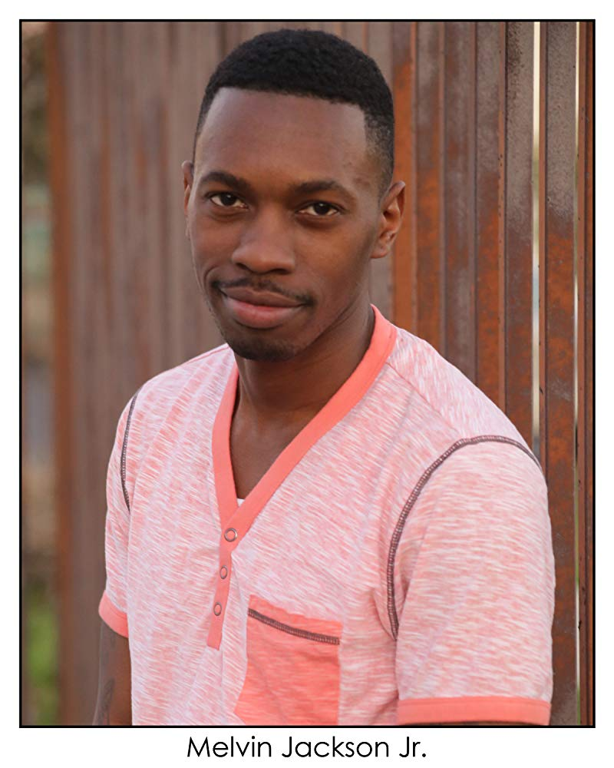
Melvin Jackson Jr Melvin Jackson Jr, is an Emmy nominated Actor, as well as a Comedian, Writer, Producer, Director and CEO of Urban Vision Entertainment. He started out in the entertainment business when he was 18 years old managing music Artist. He will soon direct his first feature film Sex, Lies and The things women go thru. Melvin is best known for his roles on the hit HBO Series 3rd season of The Wire as Bernard the cell phone guy and as the Bully on Award winning CW's "Everybody Hates Chris". Melvin who is originally is from Washington, DC also live in Islamabad, Pakistan for 4 ½ years and in Ankara Turkey for 4 years. Where he won two gold medals in track n field long distance running and a bronze medal in wrestling.

Slide 5
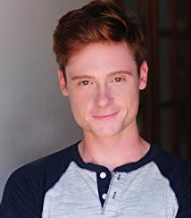
Miles Tagtmeyer Miles Tagtmeyer is an actor and producer, known for Broken (2018), Disney Descendants: School of Secrets (2015) and The Candle & the Curse (2018).

Slide 6
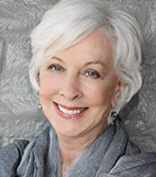
Christina Pickles Hailing from an English theatrical family, Christina Pickles is a beloved stage-trained actress who has enjoyed a rich and varied career that has allowed her to show her incredible range and great depth of character in her performances. She sets the bar for all at an entirely new height with this year's "Outstanding Actress, Short Form, Comedy or Drama, Short Form" for her critically lauded performance in "Break a Hip" earning a remarkable seventh Emmy nomination for a superior performance. Earlier, Christina earned an Emmy nod for her hilarious role on "Friends" as 'Ross' and 'Monica Geller's' mom adding to five nominations for her historic role on precedent-setting "St. Elsewhere." Probably best known for her portrayal of "Nurse Helen Rosenthal" on the NBC hit hospital drama "St. Elsewhere" and "Judy Geller," the dysfunctional mother of Monica (Courtney Cox) and Ross (David Schwimmer), on the NBC smash comedy hit "Friends," Christina was Emmy-nominated five times for "St. Elsewhere" and once for her indelible role on "Friends."

Slide 7
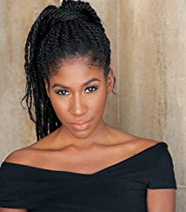
Diarra Kilpatrick Diarra Kilpatrick is an actress and writer, known for American Koko (2017), The Salton Sea (2016) and American Koko(2014).

Slide 8
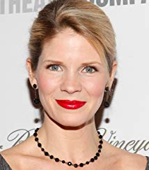
Kelli O'Hara Kelli O'Hara was born on April 16, 1976 in Elk City, Oklahoma, USA. She is an actress, known for Sex and the City 2 (2010), Live from Lincoln Center (1976) and Numb3rs(2005). She has been married to Greg Naughton since July 28, 2007. They have two children

Slide 9
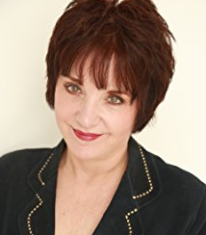
Lee Garlington The American actress was born in Teaneck, New Jersey, and grew up in Delaware, Illinois, West Virginia, and Washington D.C. Garlington was recently nominated for a 2018 Primetime Emmy Award / Outstanding Actress in a Short Form Comedy or Drama Series for her role as 'Darlene' in Broken. Garlington was a series regular on several series Lenny, Townies, and Blame it on Ernie as well as eleven other pilots that did not go to series. She had recurring roles in several notable television series, including The West Wing, The Killing, Flashforward, Everwood, The Riches, The Bridge, Will & Grace, CSI: Crime Scene Investigation, Mistresses, and Roseanne. She also played Kirsten, Rose Nylund's (Betty White) daughter in the final season of The Golden Girls, Ronni, the mistress of Joey Tribbiani's father on Friends, and the waitress Claire at Pete's Luncheonette in the pilot episode, The Seinfeld Chronicles.

Slide 10
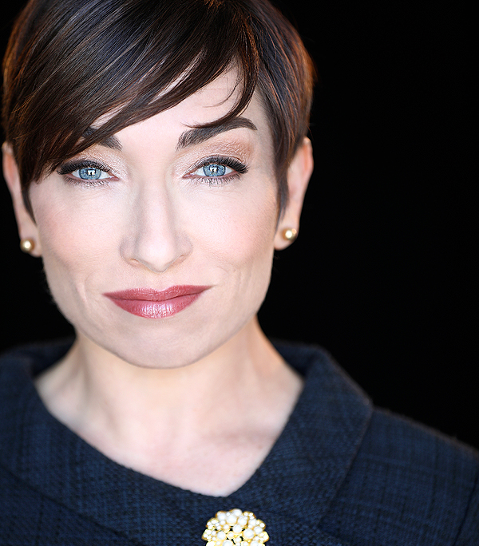
Naomi Grossman Naomi Grossman is best known for her portrayal of "Pepper" in "American Horror Story" Previously, she wrote, produced, and starred in her second hit solo show, "Carnival Knowledge: Love, Lust, and other Human Oddities," which enjoyed a twice-extended, sold-out run and rave reviews ("Recommended" by LA Weekly); the show was then reprised at the world-famous fringe theatre festival in Edinburgh, Scotland, where it received more critical praise (4 stars: The Scotsman, Broadway Baby, Fringe Review) and a transfer to London's West End (Leicester Square Theatre). It was later reprised Off Off Broadway in New York. Its predecessor, "Girl in Argentine Landscape," also received critical acclaim (LA Weekly, "Pick of the Week") and earned her an LA Weekly Theater Award nomination for best solo performance. Naomi also toured with "Girl..." to Chicago's Single File Festival, the Los Angeles Women's Theatre Festival, and the New York International Fringe Festival. A graduate in theatre from Northwestern University and a former member of the esteemed Groundlings Sunday Company, Naomi has starred in numerous self-penned/produced comedic shorts under her "Red Meat Entertainment" umbrella, as well as recently appeared in her first feature film, "Table for Three."

