Slide 1
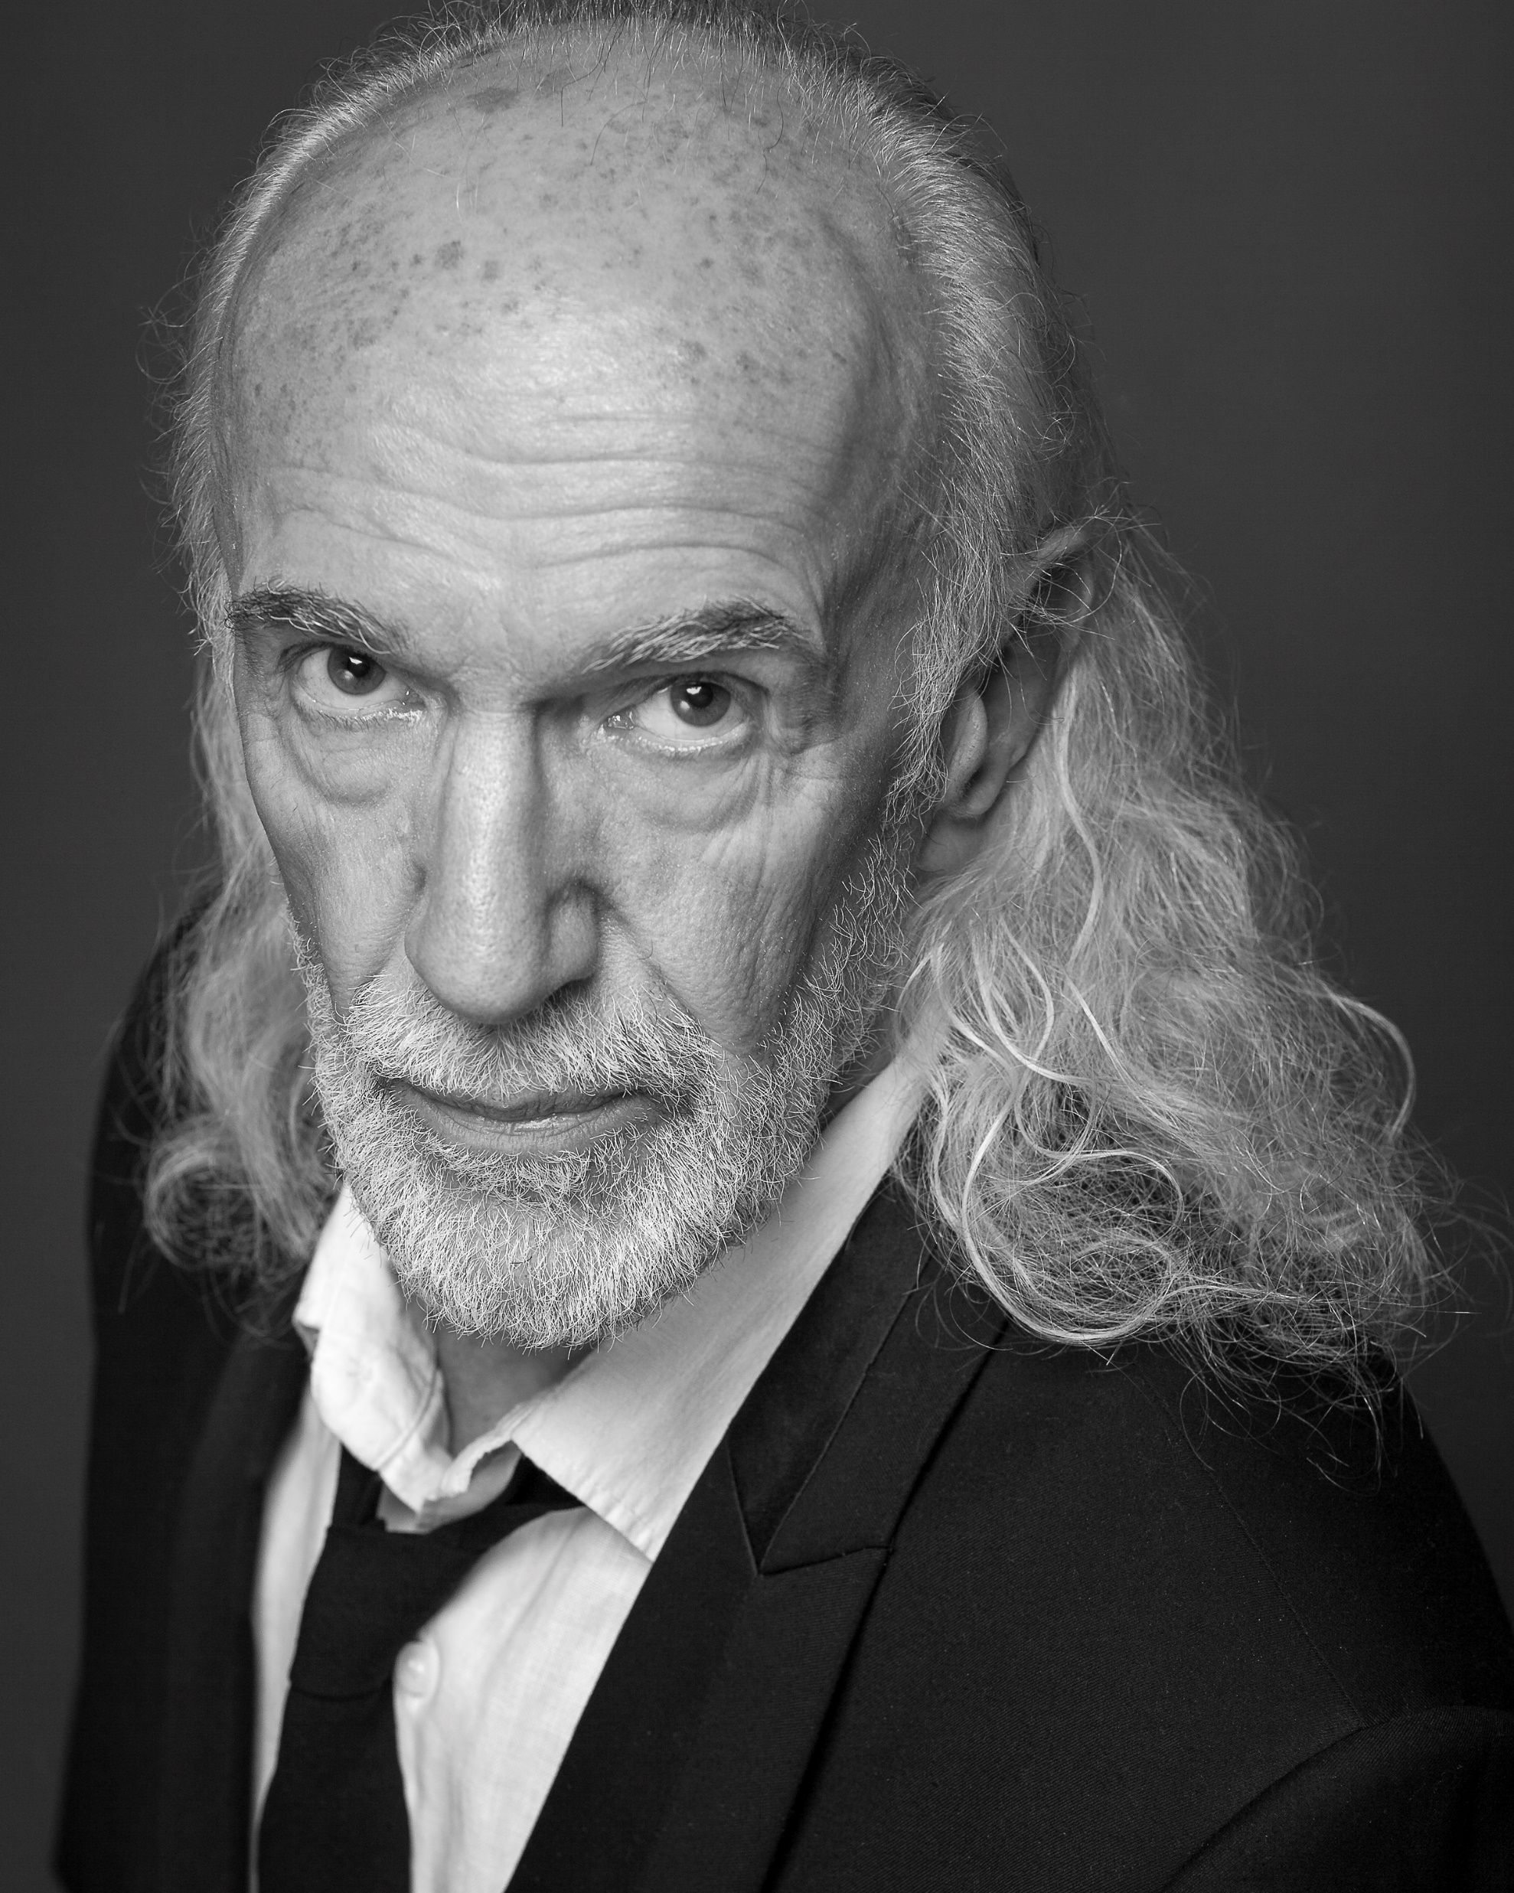
David Gant David Gant is known for his work on Braveheart (1995), Brazil (1985) and Lagaan: Once Upon a Time in India (2001).

Slide 2
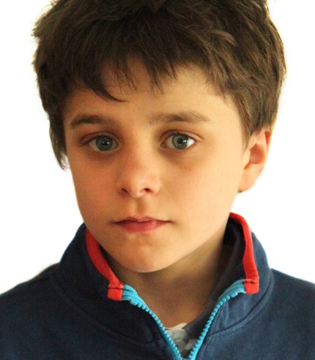
Ely Solan Ely Solan is an actor, known for Christmas Perfection (2018), The Man Who Invented Christmas (2017) and Detainment (2018).

Slide 3
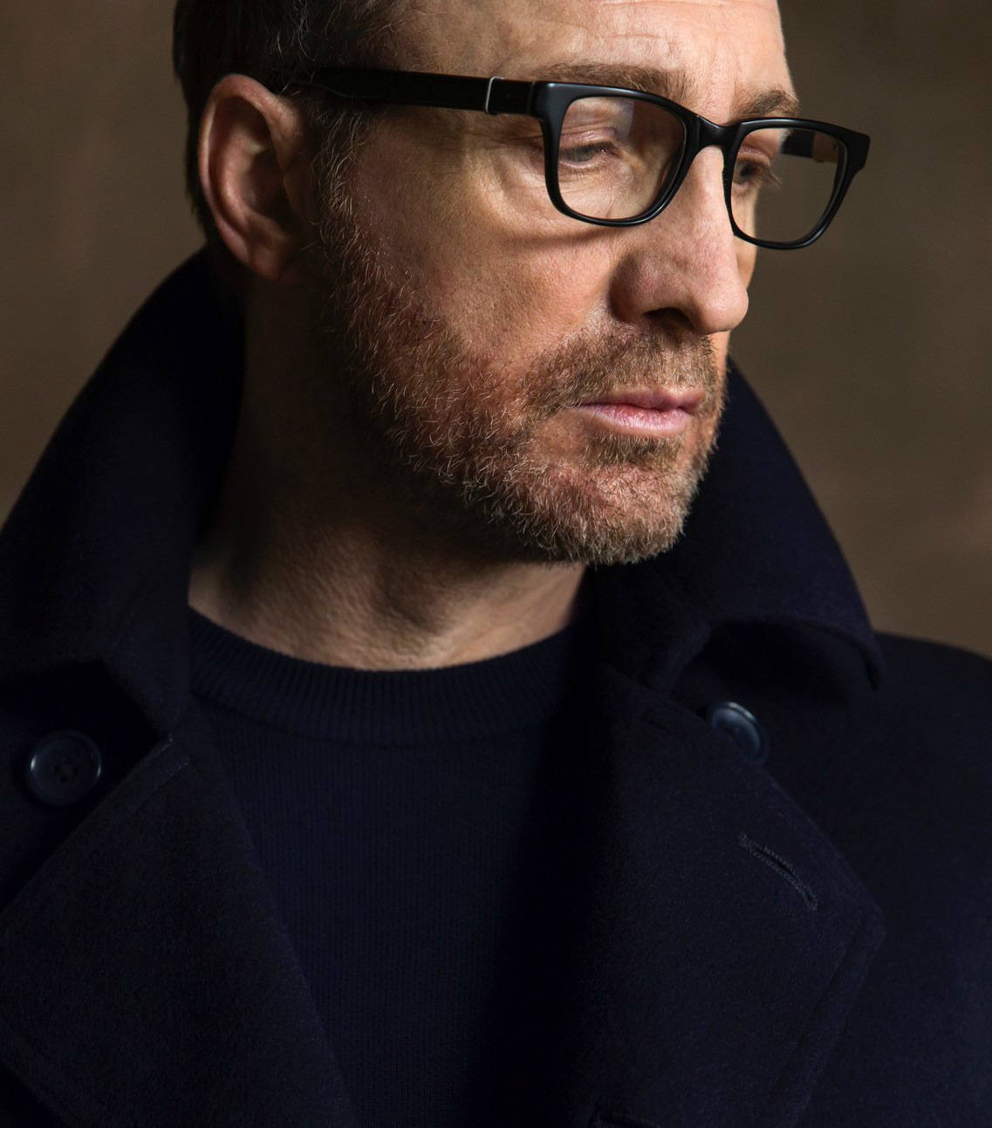
Michael McElhatton Michael McElhatton was born in 1963 in Terenure, Dublin, Ireland. He is an actor and writer, known for Game of Thrones (2011), Genius (2017) and The Fall (2013).

Slide 4
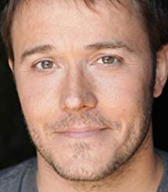
Mike McNamara Named by New City as one of the top 50 people in Chicago's booming film industry, Mike McNamara is an actor and producer in independent film. Mike is also the co-founder and executive director of the Midwest Independent Film Festival and serves on the screening committees for the Sundance and Austin Film Festivals. Acting credits include Matt Casey's questionable brother-in-law Jim Jordan in the NBC series Chicago Fire and festival winners Qwerty, The Lake Effect and The Alley Cat. Producer credits include Cannes Film Festival 2017 selection They.

Slide 5
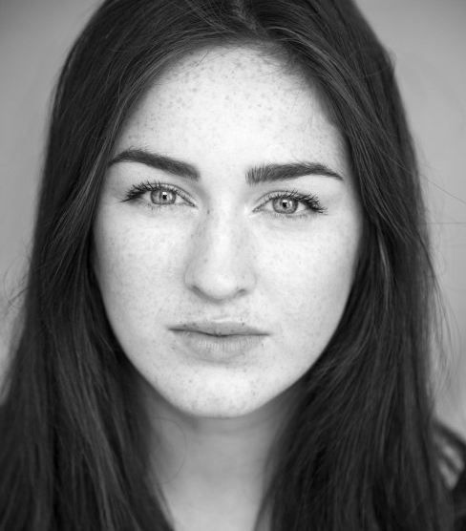
Danielle Galligan Danielle Galligan is an actress and writer, known for Strangers in the Park (2017), Beautiful Youth (2018) and Closing Time (2016).

Slide 6
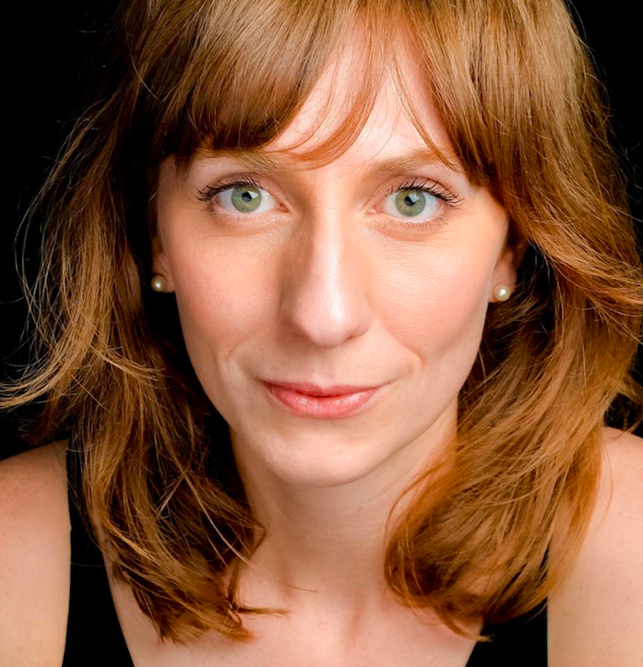
Gabby Best Gabby Best is an actress and writer, known for Switch (2012), The Marijana Method (2014) and I Want My Wife Back (2016).

Slide 7
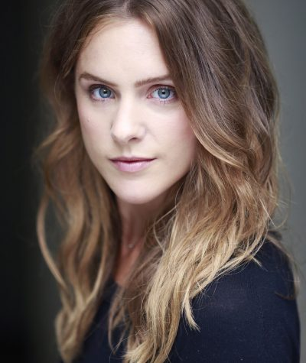
Kelly Gough Kelly Gough is an actress, known for Raw (2008), Kill Command (2016) and The Fall (2013).

Slide 8
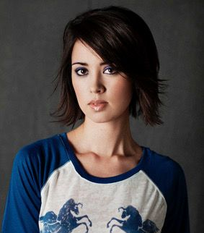
Laura O'Shea Laura O'Shea is an actress, known for Con (2017) and Narcan (2016).

