Slide 1
AuraDB Knowledge Graph Creation
Paula Auzāne, digital humanities, year 1

Slide 2
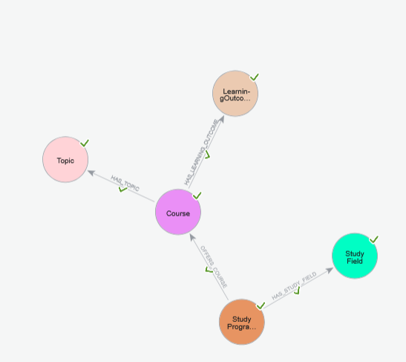
The initial schema created by AI
Legend:
The Study Programme
belongs to a Study Field
(HAS_STUDY_FIELD)
The Study Programme
offers courses
(OFFERS_COURSE)
The Course has Topics
and Learning Outcomes
(HAS_TOPIC and
HAS_LEARNING_OUTCOME)

Slide 3
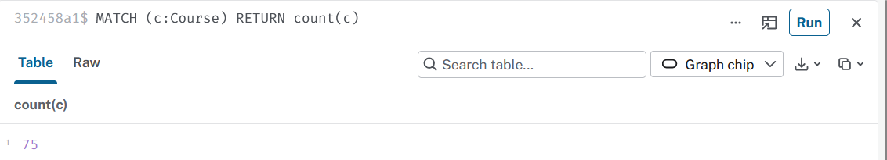
Querying the data
First, a simple query returning the count of courses*.
*Disclaimer: I used AI to help me with the syntax of this and other queries.

Slide 4
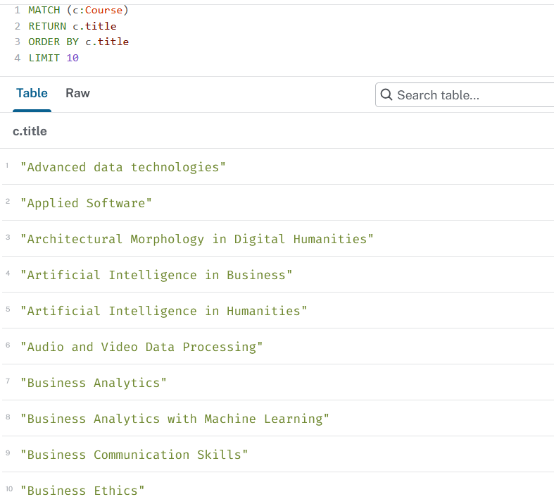
Querying the data
Then, a query that orders the courses alphabetically, limiting the count of courses to 10.

Slide 5
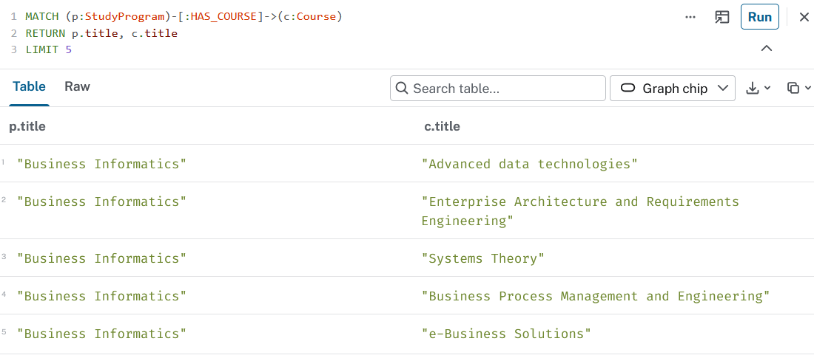
A query that returns the program title and the course title

Slide 6
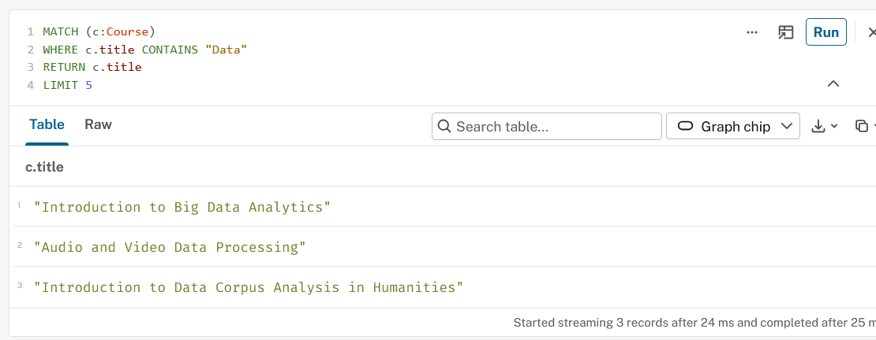
And finally, a query that returns the study courses containing the word “data”

