Slide 1
PREDICTIVE MAINTENANCE
USING TELEMETRY
Paula Beckett
UADEL-VIRT-DATA Project 4

Slide 2
TABLE OF CONTENTS
01
TELEMETRY
02
MAINTENANCE
03
DATASET
04
ML MODEL
What is telemetry and where is it used
Types of maintenance
Details of the dataset
Process to create a machine learning model
05
PROS & CONS
Benefits and drawbacks to using a Predictive Maintenance model

Slide 3
01
TELEMETRY
What is telemetry?
Where is telemetry used?

Slide 4

WHAT IS TELEMETRY?
  The collection of measurements or other data for automatic transmittion to a control device.
  Can be wireless or hard-wired, analog or digital, radio, ultrasonic or infrared systems.
  As early as the late 1700s the mercury pressure gauge was used to monitor steam engines from a (near) distance.
  Been used in weather balloons since the 1920s.
  Saw growth in the 1930s in rocket and aviation research.

Slide 5
EXAMPLE TELEMETRY APPLICATIONS
LAW ENFORCEMENT
HEALTHCARE
OIL & GAS INDUSTRY
AGRICULTURE
TRANSPORTATION
RESOURCE DISTRIBUTION
Tracking the movements of a person on house arrest
Monitoring and alerting of a patient’s condition
Transmission of well data as drilling occurs
Monitoring stations to transmit local micro-climate details
Data collection from onboard sensors and computers
Communication of tank flow and levels
Notes:
Law Enforcement:
Ankle bracelet can be tracked to ensure the person remains within their authorised limits, and sticks to a curfew.
Healthcare
Patients are fited with devices to measure, record and transmit data used by Doctors to monitor and diagnose.
Alerts can happen to inform nurses of any changes or dangerous avtivity.
Oil & Gas Industry:
As a well is drilled information from thousands of metres below ground can be sent uphole to surface sensors.
Agriculture:
Wireless weather stations transmit LOCAL MICRO CLIMATE details such as air temperature, wind speed & soil moisture to a base station.
Transportation:
Information sent and recorded about the vehicle including RPM, temperature, fuel consumption & battery voltage.
Resource Distribution:
One example is that of petrol tanks, telemetry of levels alerts to a remote tank requiring replenishment, or alerting when a well is full and needs to be emptied.
Many, many other uses of telemetry.

Slide 6
MAINTENANCE
02
Types of maintenance

Slide 7
TYPES OF MAINTENANCE
COMMONLY USED MAINTENANCE STRATEGIES
Scheduled | Preventive | Condition Based | Reactive
Based off the manufacturer's guidelines | Scheduled inspections | Sensor monitoring | Run to failure
Notes:
Scheduled:
Predetermined by the manufacturer when to do inspections and maintenance.
Can be planned for, inventory sourced, skilled labour onhand & minimal impact to machine/vehicle operator.
Preventive:
Scheduling inspections, based on time or usage, to capture problems before they occur.
Great for older equipment that may be outside the manufacturers scope.
As with the previous, it allows time for planning maintenance stopages and the sourcing of right parts.
Condition based:
Could be monitored from a sensor, alerting the maintenance crew to the issue.
Good for monitoring items that require the equipment to be running (safety).
Reactive:
Fixing something when it breaks/fails.
Okay for low cost inventory items that do not impact the safety of those operating the equipment, or cause high amounts of unplanned downtime.

Slide 8
PREDICTIVE MAINTENANCE
WHERE DOES IT FIT?
Rather than simply using reliable averages to prevent future issues both historical & real-time data is used to accurately predict the likelihood of a failure.
Highlighting small problems before they can develop into big problems.
Downtime can be planned and scheduled.
Less over-maintenance which not only means less wasted resources & personnel time, but also less safety risks.

Slide 9
DATASET
03
Details of the dataset

Slide 10
DATA PROCESS
Dataset from Kaggle
https://www.kaggle.com/datasets/arnabbiswas1/microsoft-azure-predictive-maintenance
SQL Database
5 CSV files imported to PgAdmin. Data merged to one table.
Data Exploration
Done in Google Colab, using Pandas, Seaborn, Numpy & Matplotlib.
Data Preprocessing
Pandas, Get dummies
Model Train & Test
Scikit-learn, Tensorflow & Keras Tuner

Slide 11
DATASET
5 CSV files containing details of 100 machines over a 1-year period with hourly readings.
8,761 readings per machine for a total of 876,100 records.
PdM_machines
machineID
Model
Age
PdM_maint
datetime
machineID
Comp
PdM_errors
datetime
machineID
errorID
PdM_failures
datetime
machineID
Failure
PdM_telemetry
Datetime
machineID
Volt
Rotate
Pressure
Vibration
Notes:
Assumptions made.
- all component failures were significant and of equal impact, so all recorded as 1
- maintenance is recorded at the terminal when machine locked down

Slide 12
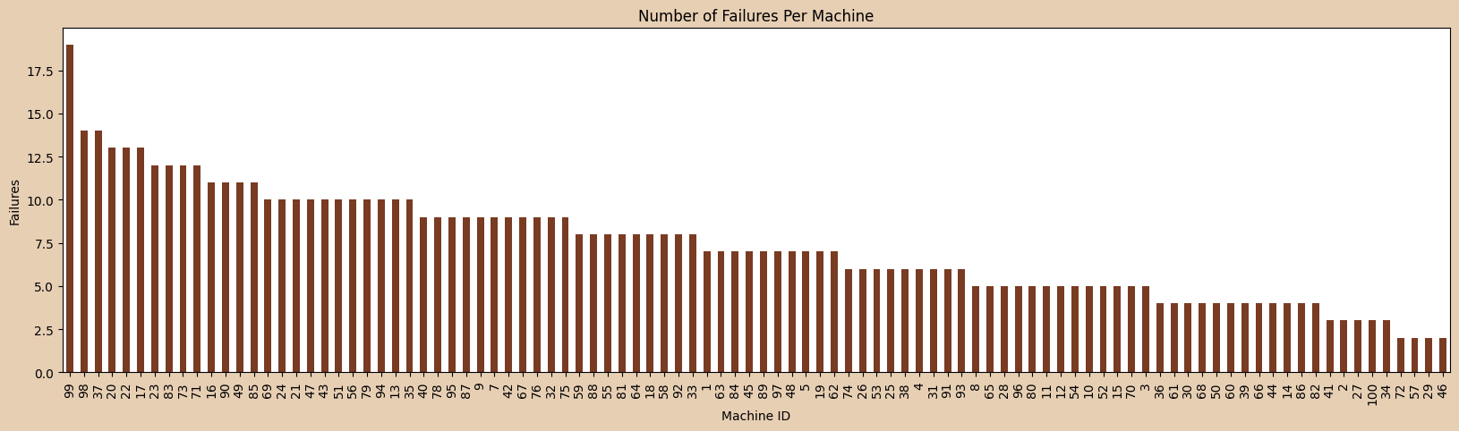
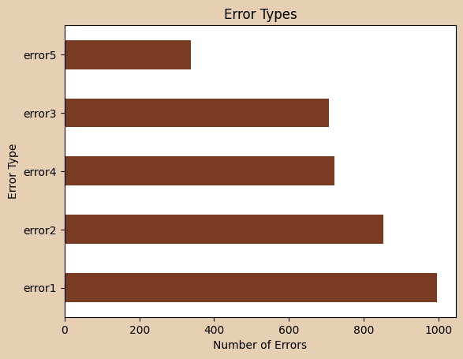
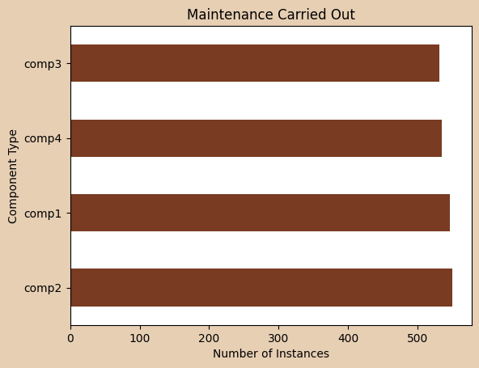
EXPLORATORY DATA ANALYSIS

Slide 13
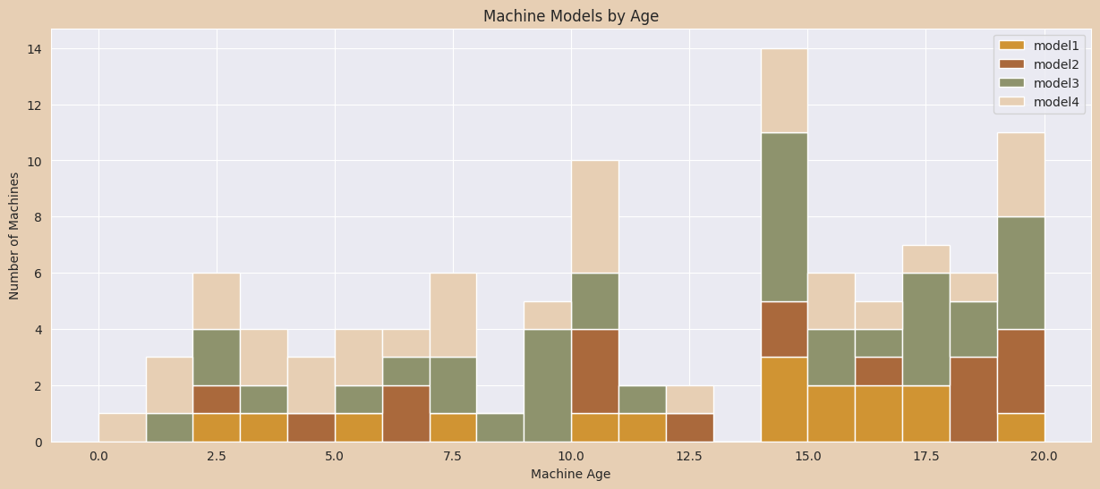
EXPLORATORY DATA ANALYSIS

Slide 14
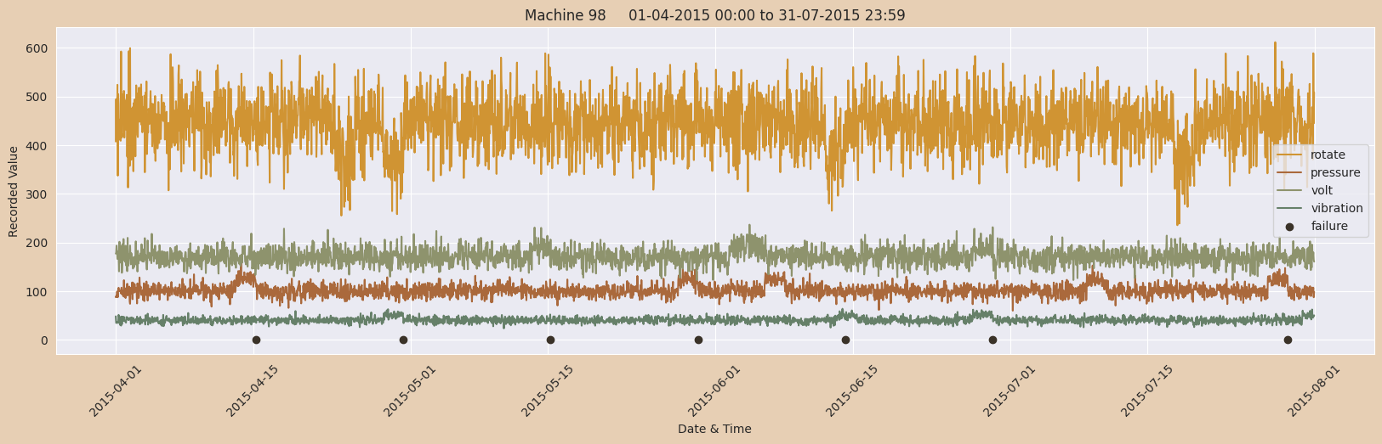
EXPLORATORY DATA ANALYSIS

Slide 15
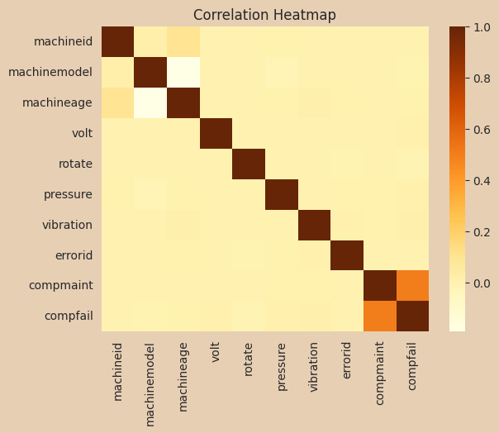
EXPLORATORY DATA ANALYSIS
Machine data of volt, rotate, pressure & vibration have no correlation with any other factor
Maintenance recorded during failures, hence the correlation
Small correlation seen with machine ID, model & age, but none of these correlate with machine failures
Notes:
Generic data set, we might expect to see more correlation between vib etc in real world data.
A real world data set may be helped with more factors collected, like temperature, gears etc.
Also a real world data set may see more factors of age and machine model impacting the failures.

Slide 16
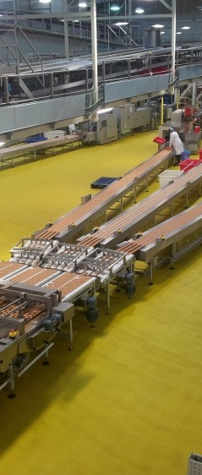
ML MODEL
04
Process to create a machine learning model

Slide 17

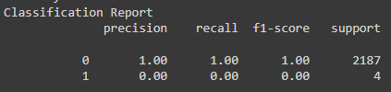

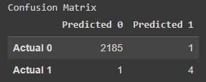
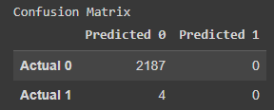
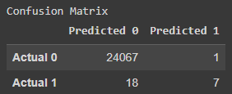
RANDOM FOREST CLASSIFIER
MACHINE 99
MACHINE 98
MACHINES 90-100
F1-score 80% to predict a failure.
F1-score 0% to predict a failure.
F1-score 42% to predict a failure.

Slide 18


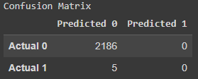
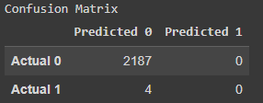
DEEP LEARNING – NEURAL NETWORK
PARAMETERS
MACHINE 99
MACHINE 98
Keras Sequential Model:
1st hidden layer, 35 nodes, relu activation
2nd hidden layer, 15 nodes, relu activation
Output layer sigmoid activation
Compiled with optimzer Adam
Model fit over 100 epochs
No predicted failures. All failures were false negatives (Pred 0)
No predicted failures. All failures were false negatives (Pred 0)

Slide 19

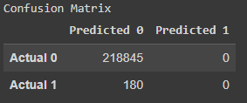
DEEP LEARNING – NEURAL NETWORK
PARAMETERS
ALL MACHINES
Added Date column to dataset.
Keras Sequential Model:
1st hidden layer, 35 nodes, relu activation
2nd hidden layer, 15 nodes, relu activation
Output layer sigmoid activation
Compiled with optimzer Adam
Model fit over 100 epochs
No predicted failures. All failures were false negatives (Pred 0)

Slide 20
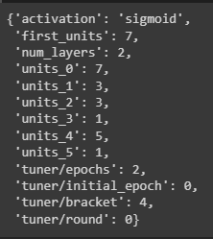
OPTIMISATION – KERAS TUNER
RESULT
Optimal Hyperparameters
Run Hyperband keras tuner on Machine 98 data.
Objective = Highest validated accuracy
Very high accuracy, but still no predictions of failure
Notes:
What is Keras hyperband?
The process of finding the optimal collection of hyperparameters for your machine learning or deep learning application is known as hyperparameter tuning. Hyperband is a framework for tuning hyperparameters which helps in speeding up the hyperparameter tuning process

Slide 21
OPTIMISATION – KERAS TUNER
RESULT
Optimal Hyperparameters
First run for maximum true positives had an overall accuracy of less than 10%
Run Hyperband keras tuner on Machine 98 data.
Objective = Highest validated True Positive
Notes:
What is Keras hyperband?
The process of finding the optimal collection of hyperparameters for your machine learning or deep learning application is known as hyperparameter tuning. Hyperband is a framework for tuning hyperparameters which helps in speeding up the hyperparameter tuning process

Slide 22
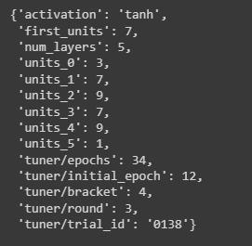
OPTIMISATION – KERAS TUNER
RESULT
Optimal Hyperparameters
Run Hyperband keras tuner on Machine 98 data.
Objective = Multi Objective, Highest validated True Positive & validated accuracy
High accuracy with 4 validated true positives which is 100% compared to previous testing splits
Notes:
What is Keras hyperband?
The process of finding the optimal collection of hyperparameters for your machine learning or deep learning application is known as hyperparameter tuning. Hyperband is a framework for tuning hyperparameters which helps in speeding up the hyperparameter tuning process

Slide 23
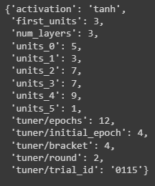
OPTIMISATION – KERAS TUNER
RESULT
Optimal Hyperparameters
Run Hyperband keras tuner on Machine 99 data.
Objective = Multi Objective, Highest validated True Positive & validated accuracy
High accuracy with 5 validated true positives which is 100% compared to previous testing splits
Notes:
What is Keras hyperband?
The process of finding the optimal collection of hyperparameters for your machine learning or deep learning application is known as hyperparameter tuning. Hyperband is a framework for tuning hyperparameters which helps in speeding up the hyperparameter tuning process

Slide 24
USAGE
05
Benefits and drawbacks to using a Predictive Maintenance model

Slide 25
BENEFITS OF USING PREDICTIVE MAINTENANCE
There are many possible benefits to be seen from using Predictive Maintenance, including:
Planning:
Scheduling downtime with minimal impact
Having inventory at hand
Having appropriately skilled technicians onhand
Budget forecasting
Safety:
Reduced risk of driver fatigue issues (Transport)
Reduced risk of injury to maintenance staff
Downtime:
Minimal impact on machine operators, eg can be allocated to other tasks or AL/RDO can be utilised
Customer satisfaction greater as orders are not unecessarily delayed
Notes:
Less unscheduled downtime would mean less requirement for extra production time (overtime)
Inventory on hand – some parts from overseas.
Example, impact of pandemic, parts only available overseas, and no viable means of transporting to Australia due to issues with shipping.
Part made available, it needed to be fitted by the manufacturer (again, from overseas), high cost of unplanned international travel expenses.

Slide 26
DRAWBACKS OF USING PREDICTIVE MAINTENANCE
There are also many possible drawbacks to be seen from using Predictive Maintenance, including:
Apathy:
Too many false readings could have people ignoring alerts & not trusting output
Other maintenance strategies becoming too relaxed if reliance on PdM is too high
Poor Data Integrity:
Time taken to build the historical data
Reliance on people to record maintenance correctly
Cost:
Initial outlay for sensors and installation
Labour for System implementation & training
Time taken to data cleanse
Prolonged time to see ROI

Slide 27
THANK YOU

Slide 28
THANKS!
Do you have any questions?
youremail@freepik.com
+91 620 421 838
yourwebsite.com
Please keep this slide for attribution

Slide 29


