Slide 1

Predicting companies' overall rating
Paula Bevilaqua

Slide 2


Who is looking for a new job?
Great resignation
Covid
Inflation
Priorities
Businesses struggling
Notes:
https://www.euronews.com/next/2022/05/25/no-end-in-sight-for-the-great-resignation-as-inflation-pushes-workers-to-seek-better-paid-

Slide 3

Exploration
Overall Rating
Work Life Balance
Culture Values
Diversity inclusion
Career Opportunities
Company benefits
Senior Management
Year (2018,2019,2020,2021)
Companies
Job Title
Current Status

Slide 4
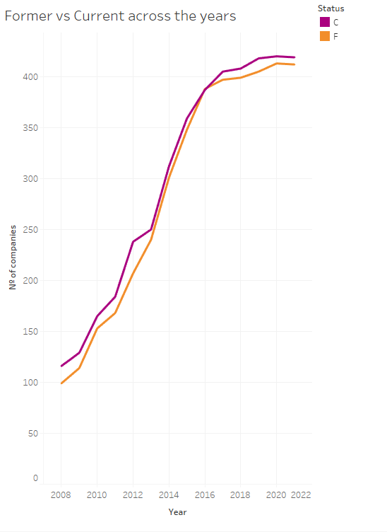
Increase of reviews across the years
3

Slide 5
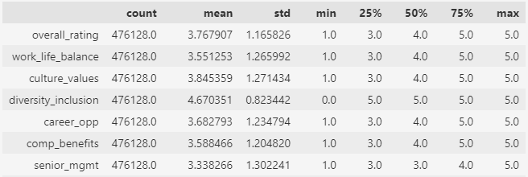
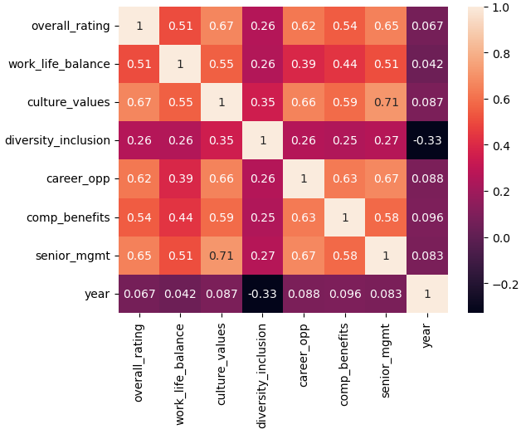
Data describe
Correlation Matrix

Slide 6
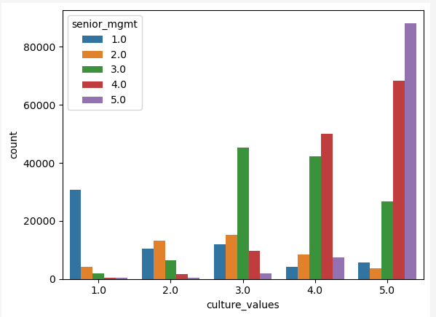
Exploring relationship on culture values and senior management

Slide 7
Tableau
LINK

Slide 8

Attracting the best candidates

Slide 9

Predictive models

Slide 10

Scores

Slide 11
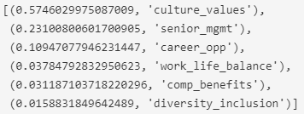
Random Forest_Importance

Slide 12
Application
With the importance of the attributes and prediction model
Internal evaluation of company satisfaction.
Review of hiring processes according to the perception of the candidates.
Evaluate the gap between them.

Slide 13

Next Steps
Using different filters such as job title, location (both were provided but with high cardinality), type of company and gender (not provided).
→ Attracting diverse talent
Sentiment analysis with the reviews ( to apply in different platforms such as LinkedIn and Indeed, and internal & external reviews).
→ Employer branding

Slide 14
Thank you !
Paula Bevilaqua

