Slide 1


Start-ups
Success
Paula Bevilaqua
Data Analytics Bootcamp Ironhack

Slide 2
Motivation
Several of the world’s most valuable companies had humble beginnings as start-ups and were founded by influential entrepreneurs such as Steve Jobs, Elon Musk, and Mark Zuckerberg.
A start-up is a young company that has developed a unique business idea, aims to make an instant impact, and take over the market. (Statista)
The objective is to predict if the start-up turns into a success or a failure.
The success here is defined as being in top 500 or acquired and still active (not closed). If is closed, it is going to be consider fail.

Slide 3


Scenarios
Thinking about investor perspective in either individuals that want to invest in start-up or a venture capital firm deciding in which start-up to financing.

Slide 4


Scenarios
You are a seller or a company that provides service or technology, looking for clients and needs to narrow down the search to be more assertive and avoid problems in the future.

Slide 5

Scenarios
You are one of the millions employees that were fired from the start-up risings looking for new jobs or a recently graduate that wants to work in a start-up but research about them before joining.

Slide 6
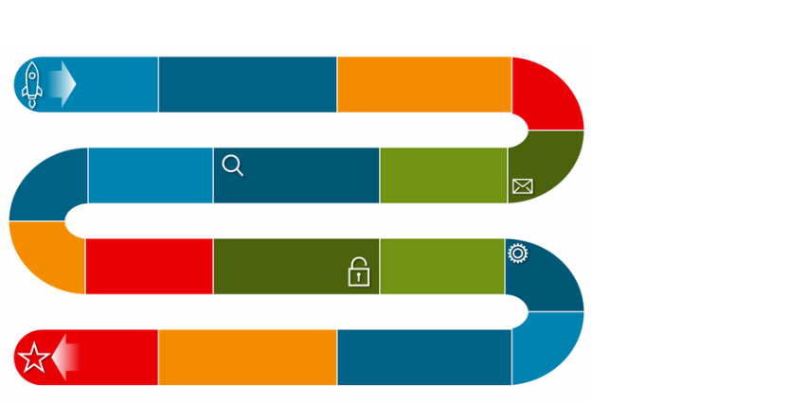
Project Process
Data Cleaning
Exploratory Data Analysis and Insights
Create a model to predict the success of a start-up
Conclusions

Slide 7

Start-up Dataset Exploratory Data Analysis
Click here for tableau visualization
Notes:
https://public.tableau.com/app/profile/paula7799/viz/startup_project_on/startup_final?publish=yes

Slide 8
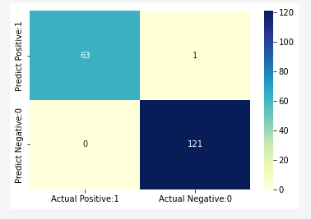
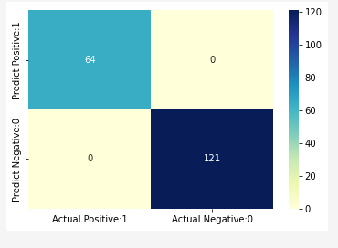
Predictions
Using Machine Learning to predict if the start-up will be success or not the best performance was with Decision Tree Regression model.
Confusion Matrix
Best performers predictive Models
Logistic Regression
Decision Tree Regression

Slide 9
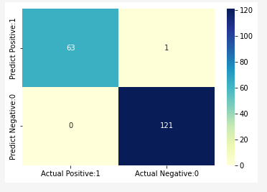
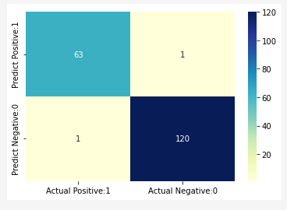
Confusion Matrix
Best performers predictive Models
Decision Tree Classification
Random Forest

Slide 10
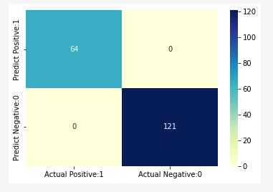
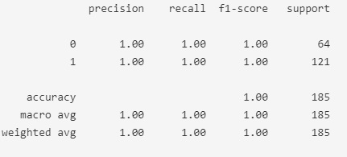
Decision Tree Regression – Best performer model
Confusion Matrix
Classification report

Slide 11
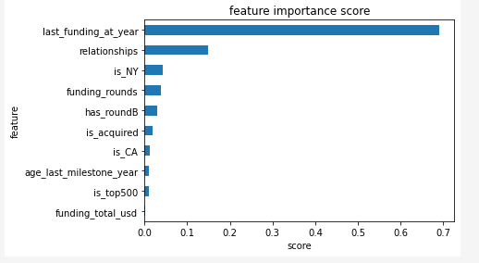
Decision Tree Regression – Best performer model
In the feature importance score last funding at year has the highest value followed by relationships, is NY and funding rounds.
Last funding year showing the year of the last funding the start-up received.
Relationships in this case can refer to accountants, investors, vendors, mentors etc (according to the explanation of the dataset).
Is NY showing that the location NY influences the success.
Funding rounds showing that how many funding rounds the start-up had also have a high impact.
From the best performance model is also possible to identify the feature importance score.

Slide 12
Conclusion & Next Steps
According to the feature importance score the model identified last funding at year has the highest value followed by relationships, is NY and funding rounds.
Money either showing that the start-up is keeping being invested and is up to date, or running more investment rounds to be able to invest more in the company and develop is a factor that influences the success.
When we identify what values could be relationship we identify different causes, the next step would be to separate those relationships into features for example accounts, mentors, vendors etc, to try understand if they have more impact separately.
NY showed a big influence (web and games video are the categories with more start-ups in this state), would be interesting for a next step to separate the locations before running the models and compare.

