Slide 1
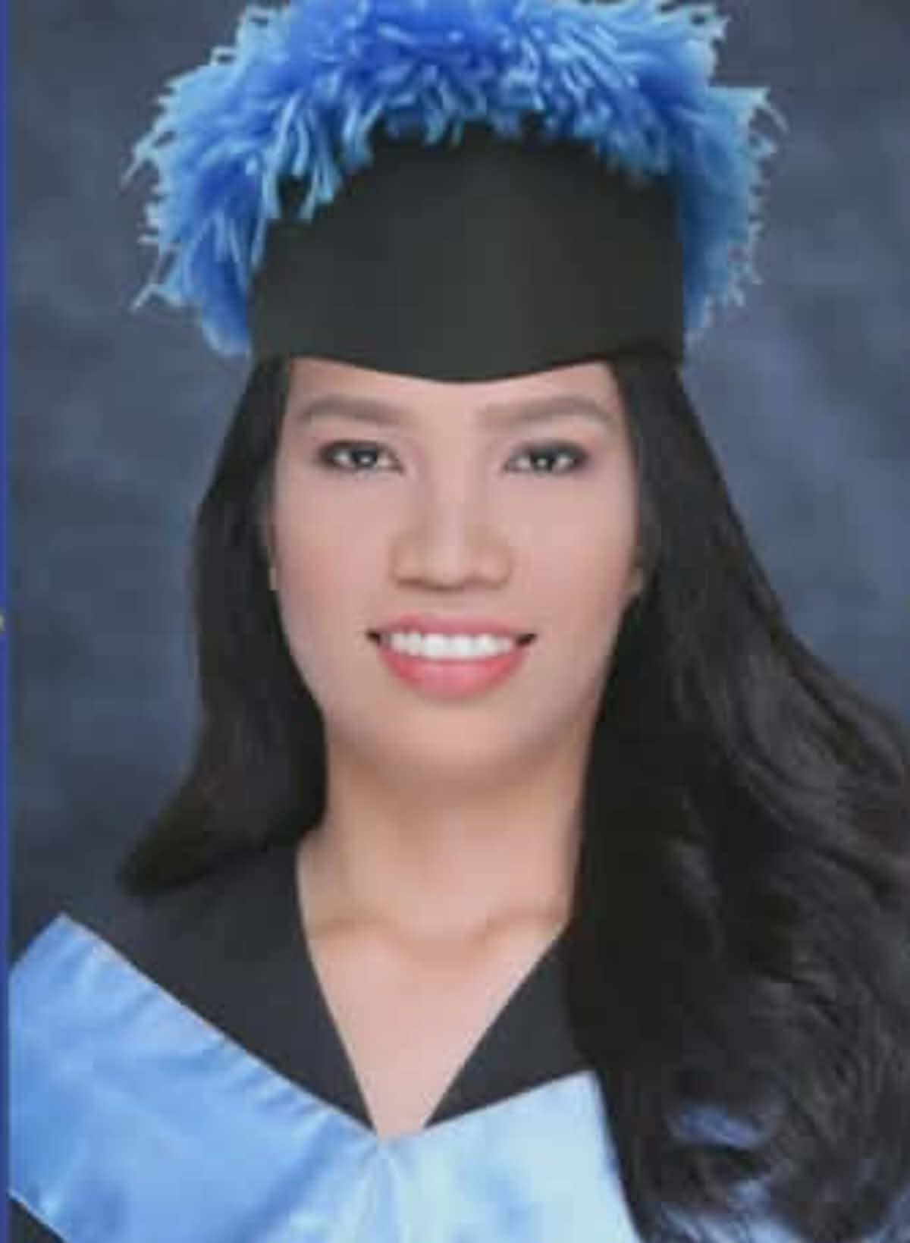
Hi, I'm Precy Alarba. Special Education Teacher and a Sign Language Interpreter I am willing to help you learn the Filipino Sign Language. Call-to-action buttons: View Courses Book a Session Now!

Slide 2
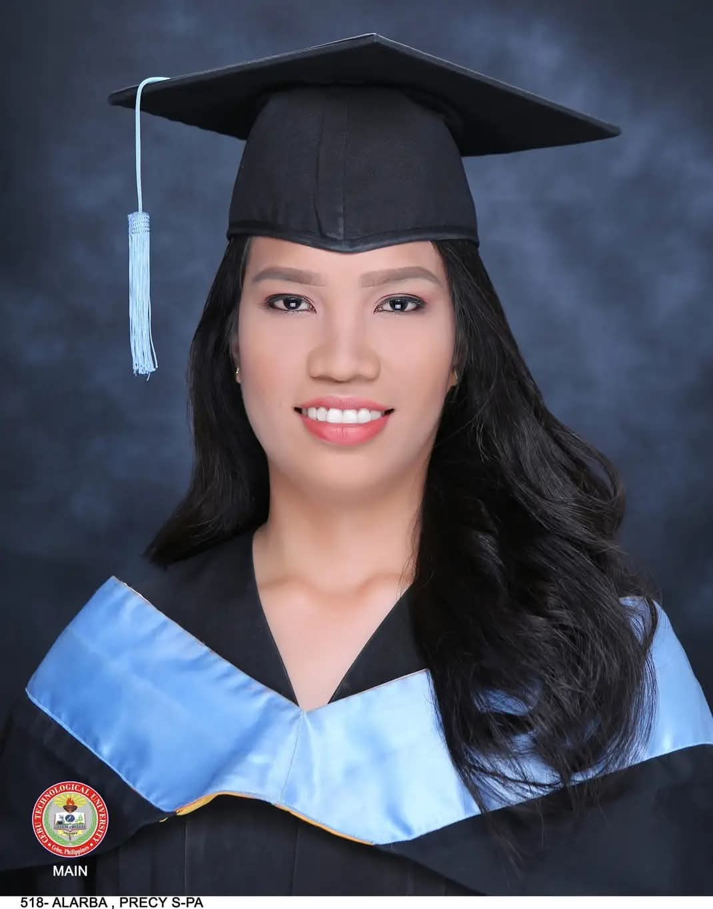
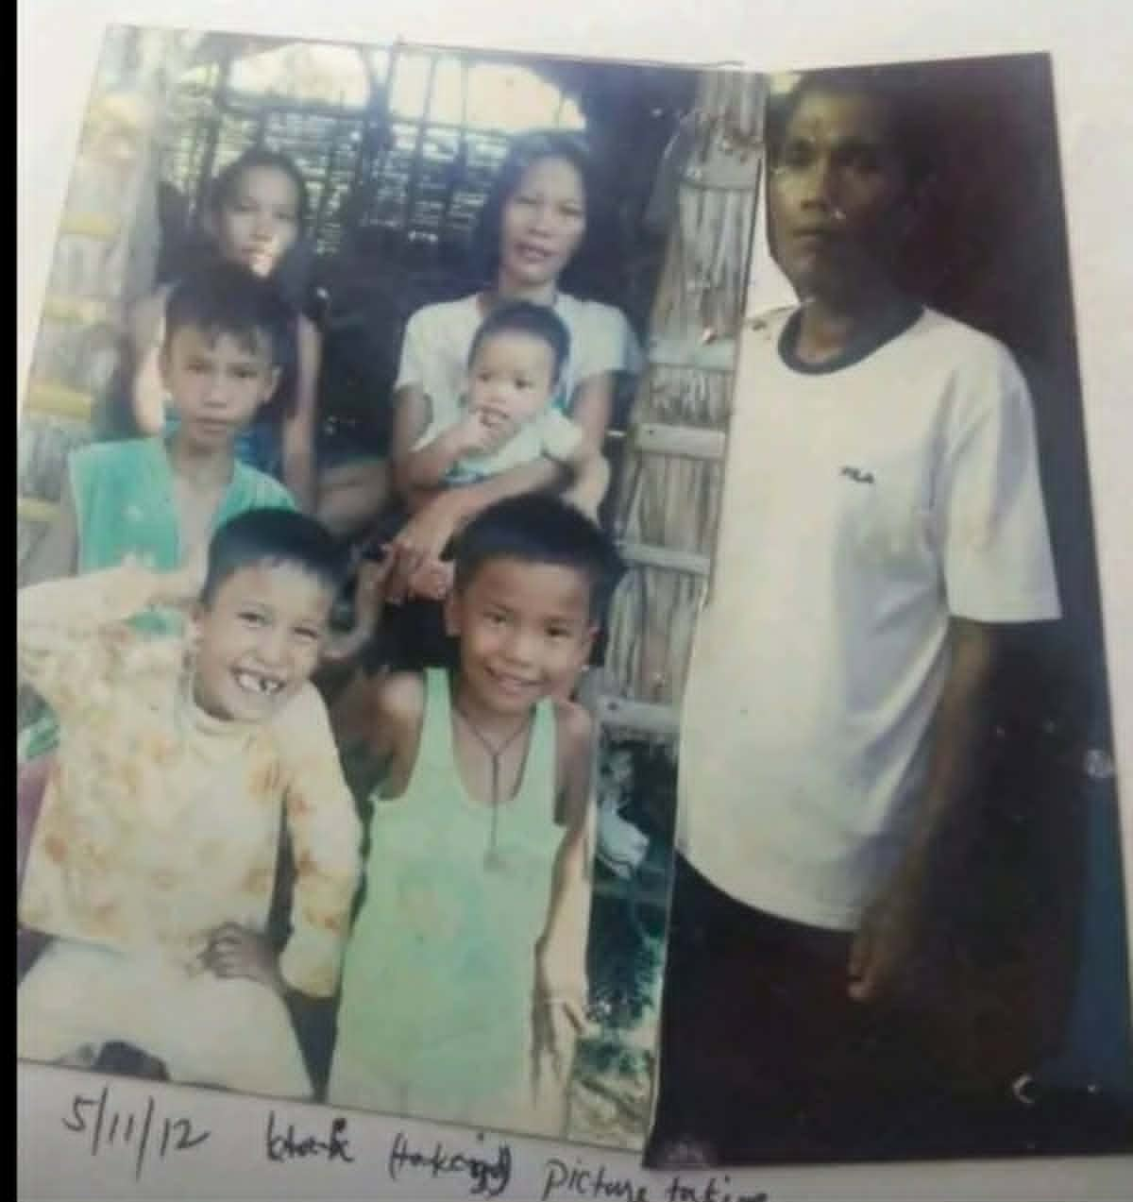
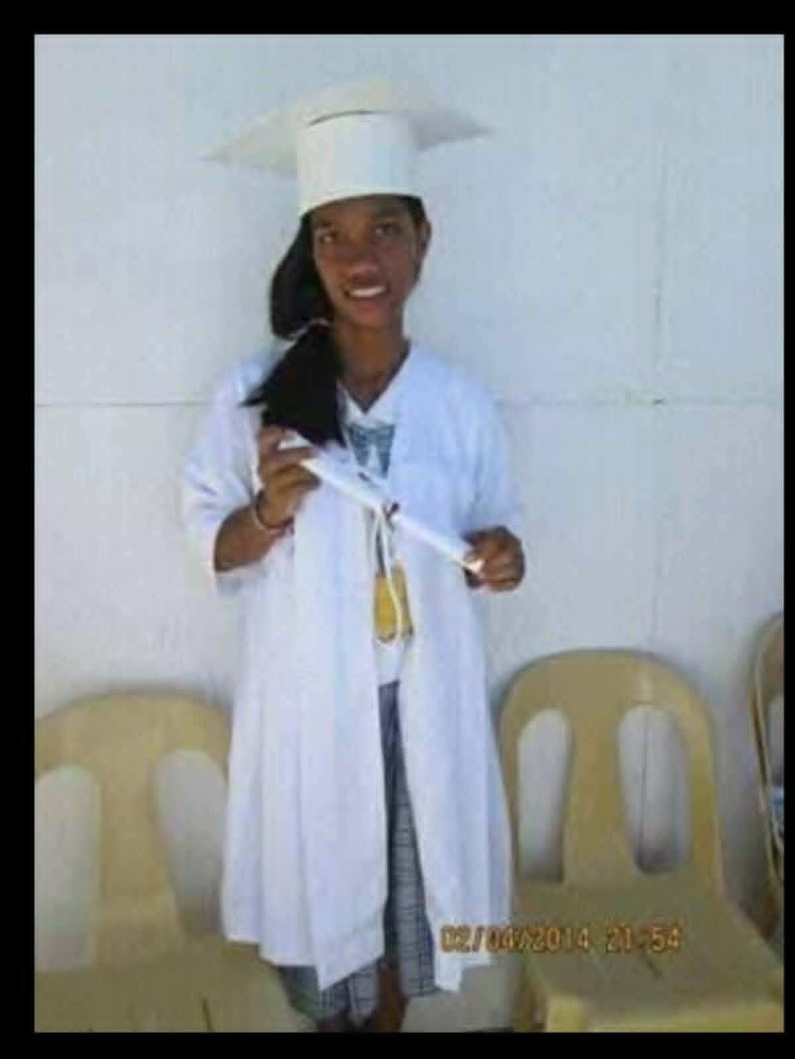
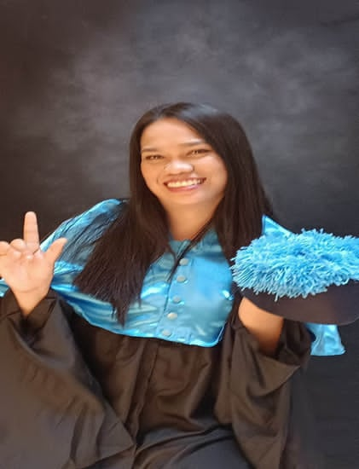
My Story and Educational Background
In 2019, I graduated with a Bachelor Elementary Education, major in Special Education
In 2022, I completed a Masters of Arts in Education major in Special Education and I am currently pursuing my doctoral degree.
When I first learned how to dream, I always wanted to become a teacher because I want to help children.

Slide 3
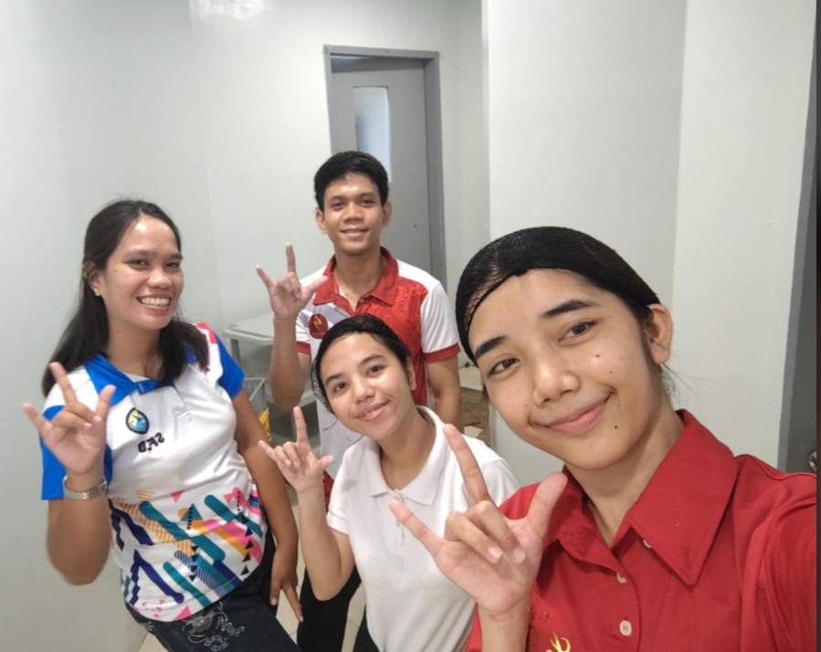
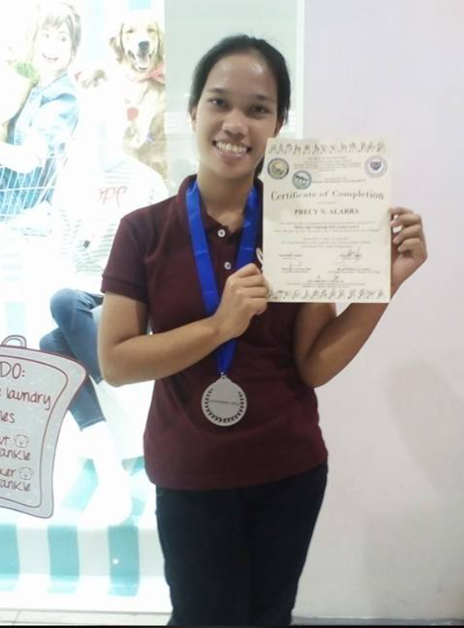
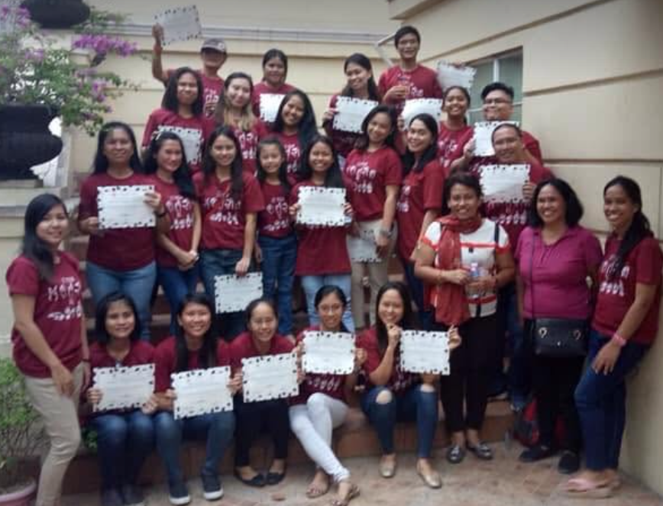
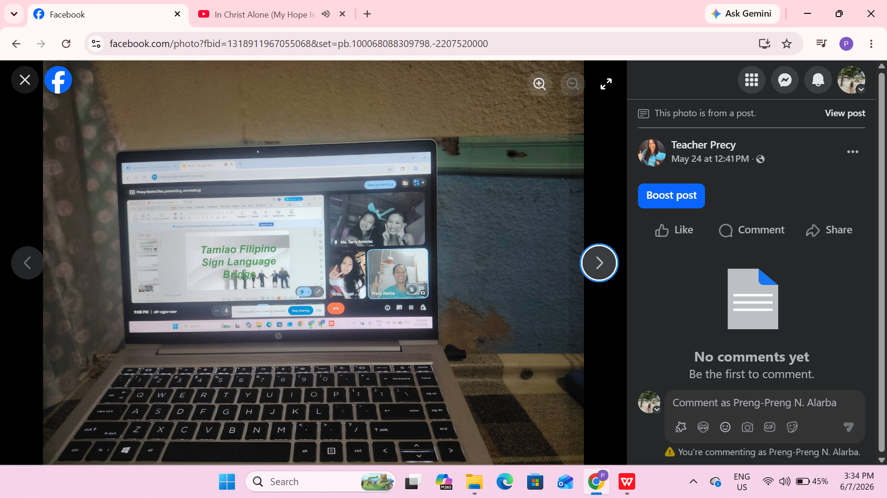
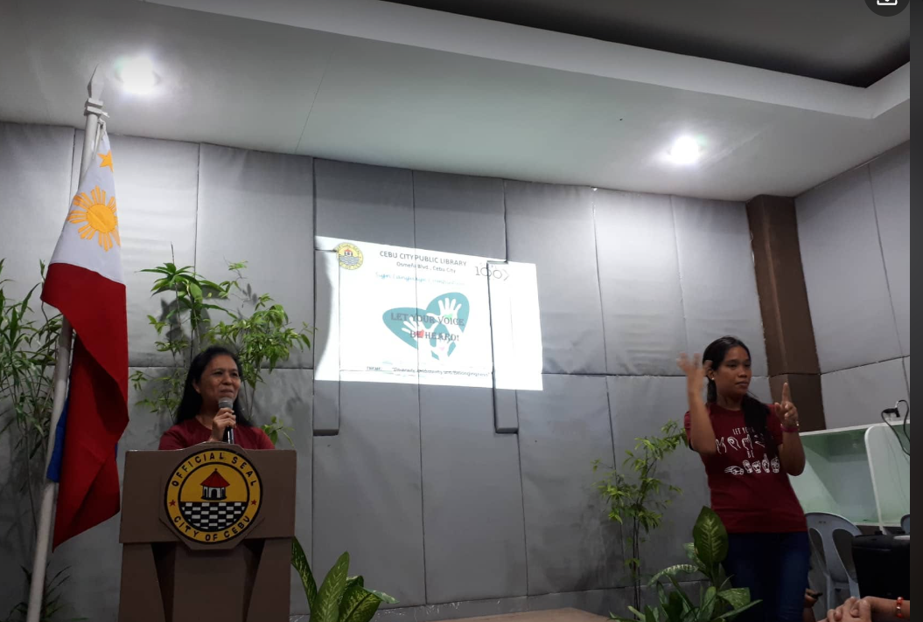
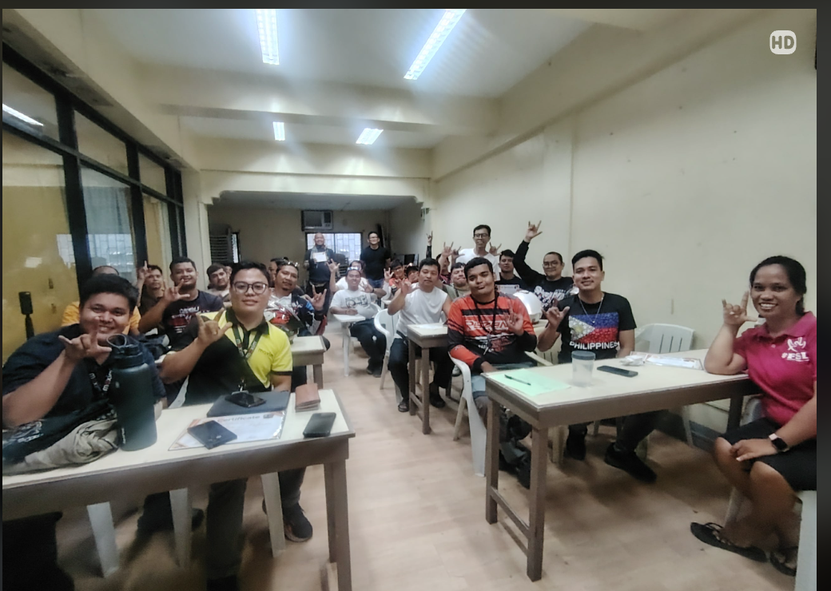
Professional Expertise
I am teaching and volunteering in any activities(seminars, court case, handling classes both face to face and online) that may include Deaf community.
I studied and learned Filipino Sign Language since 2017.

Slide 4
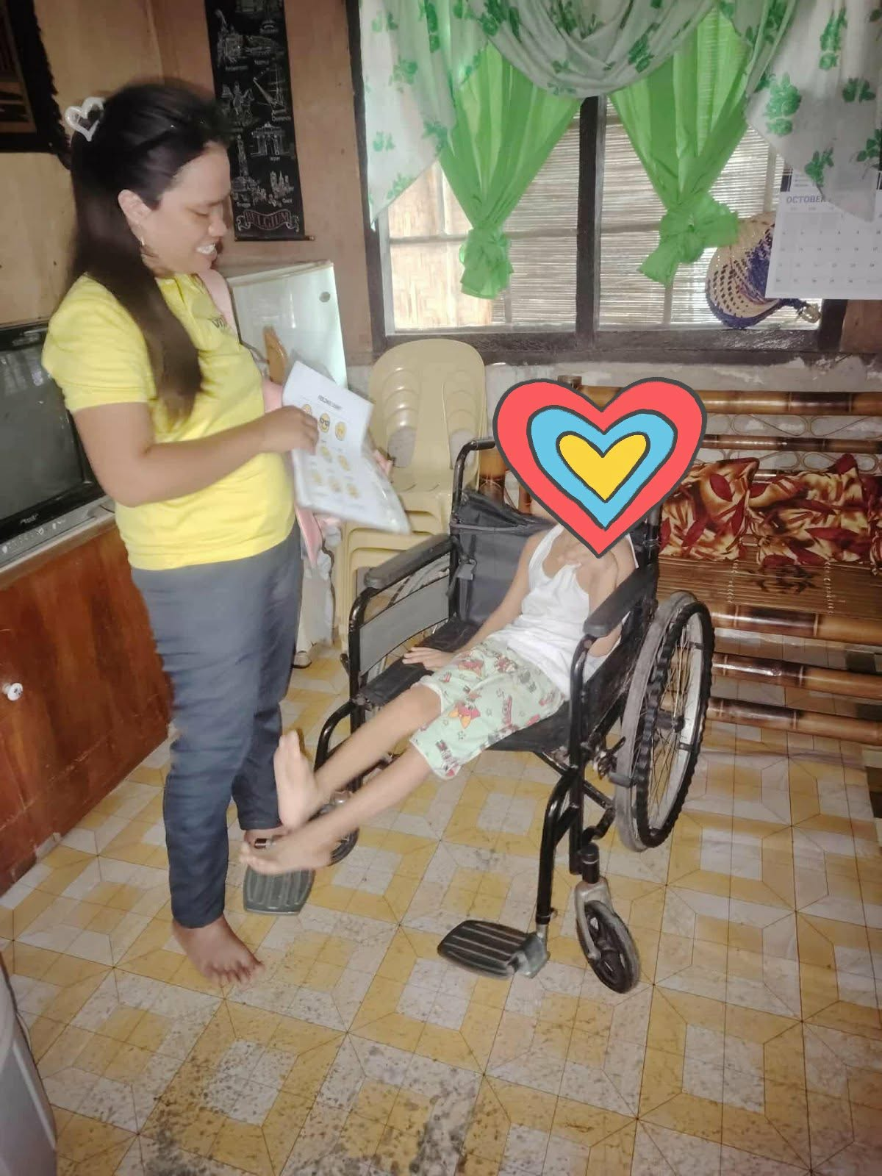
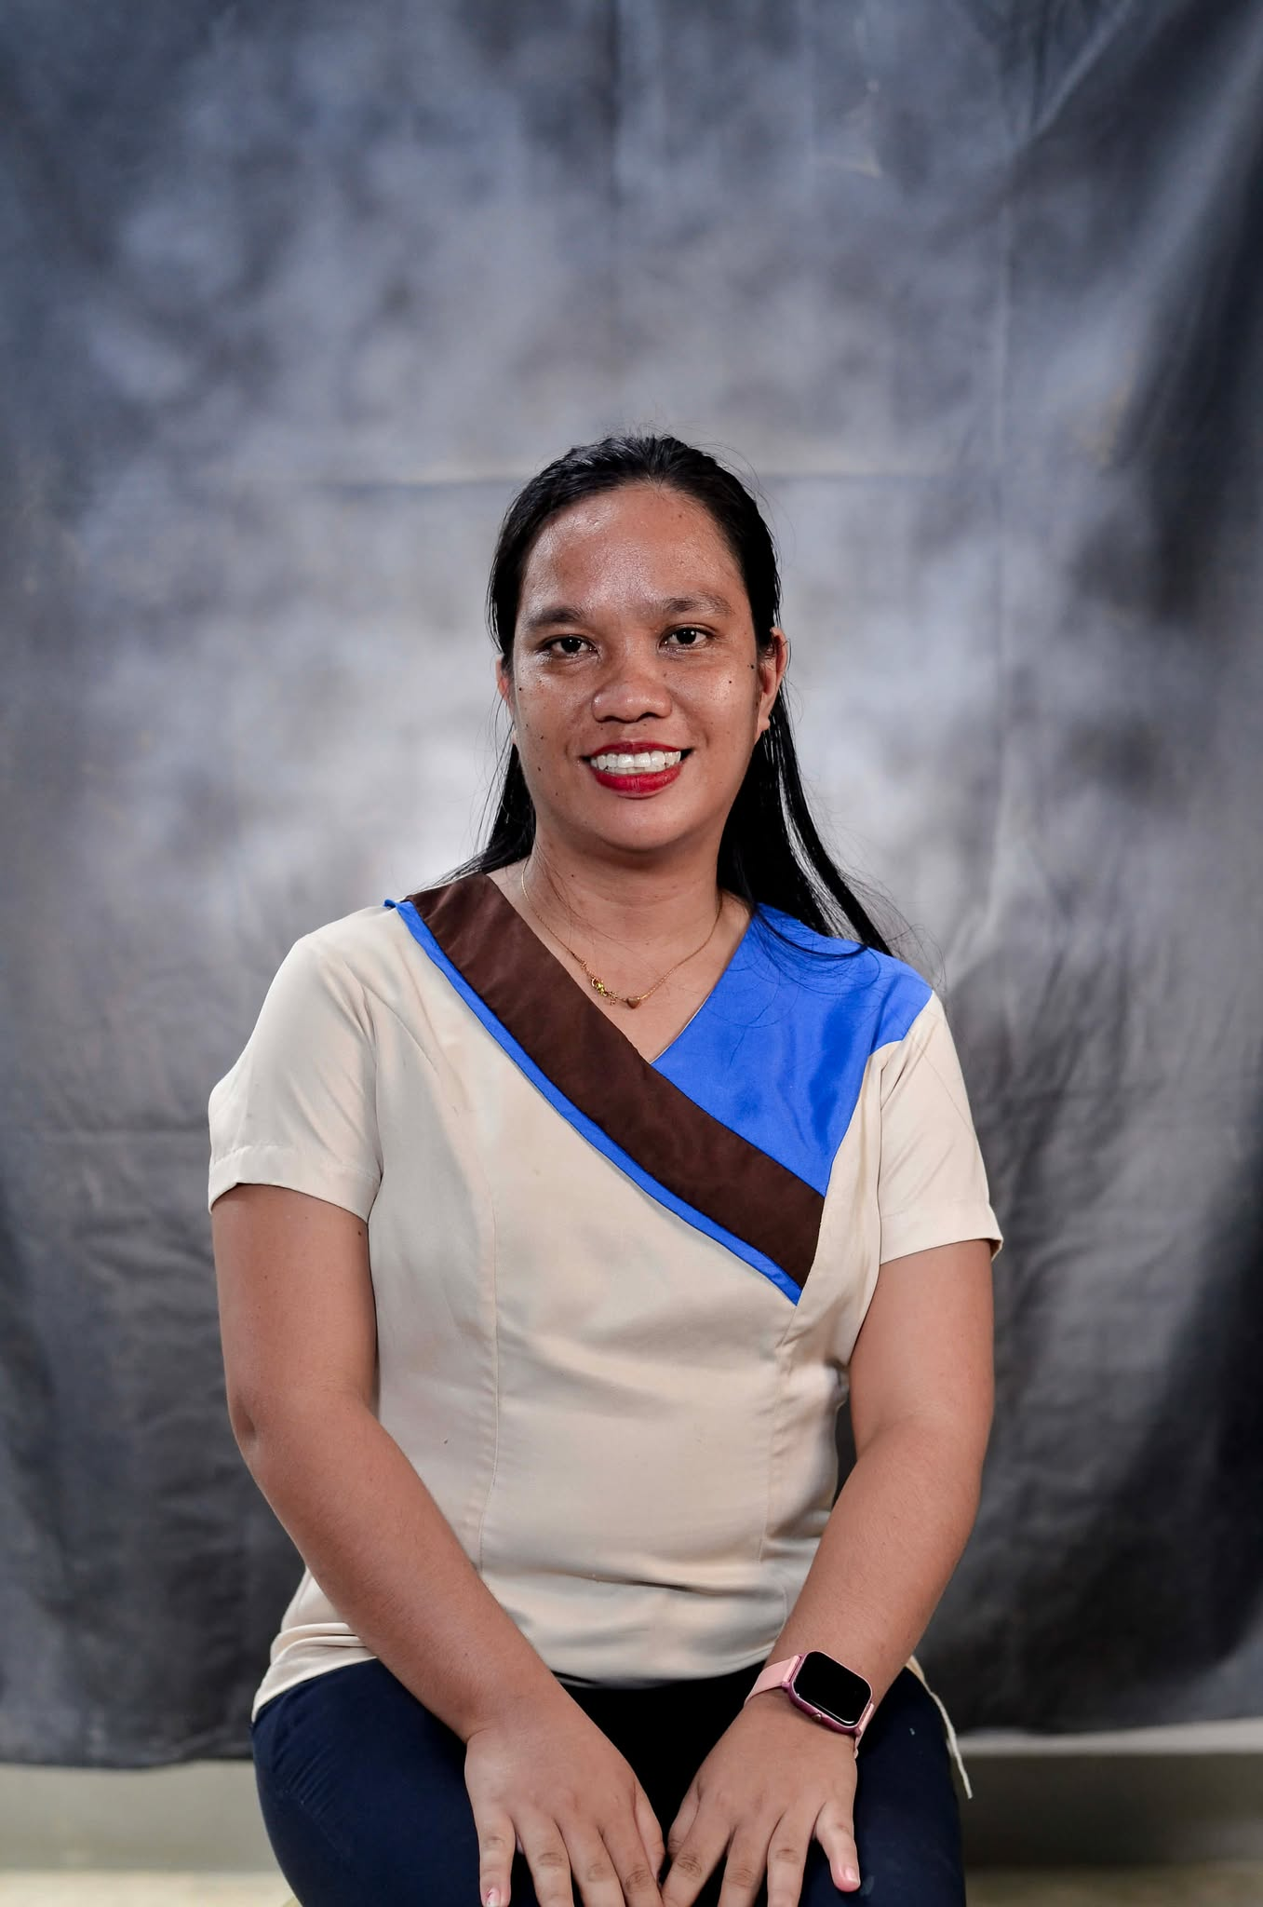
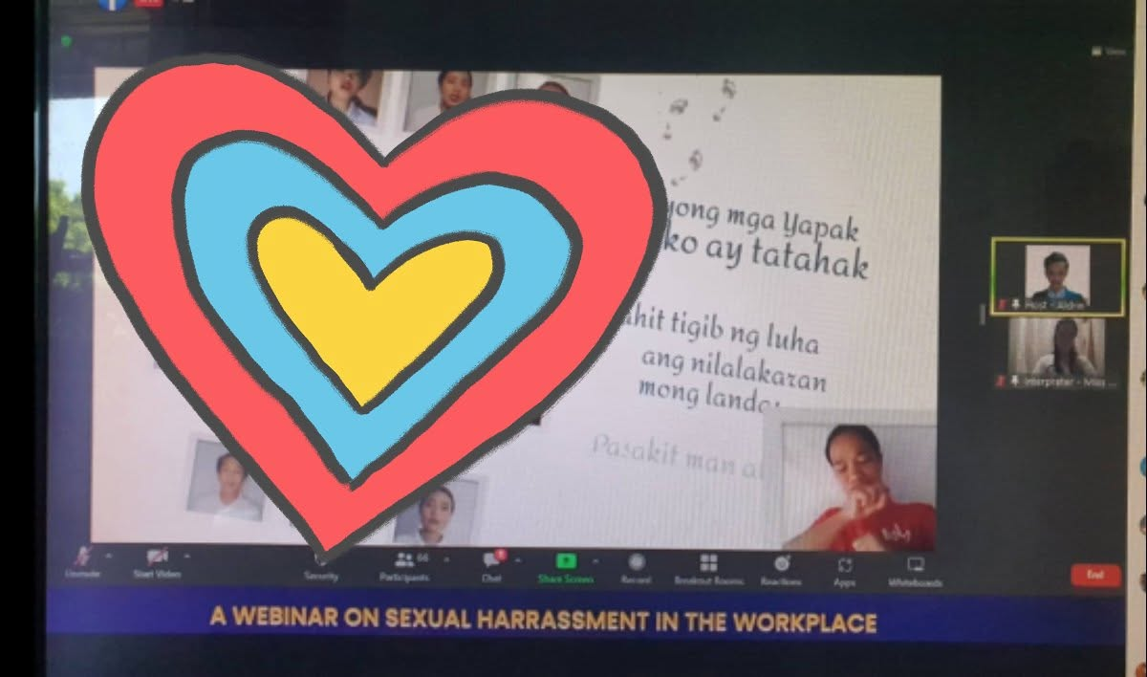
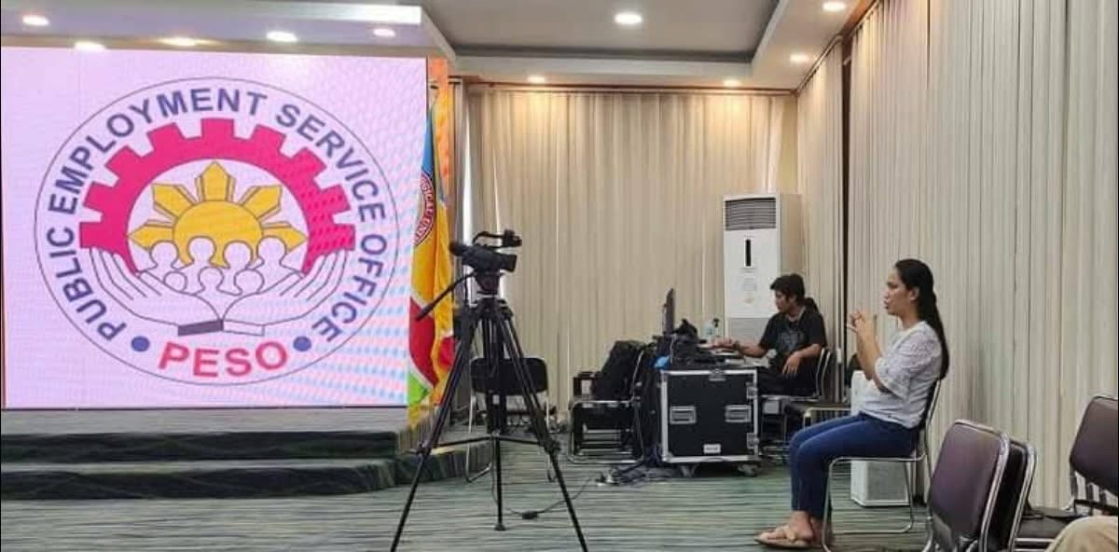
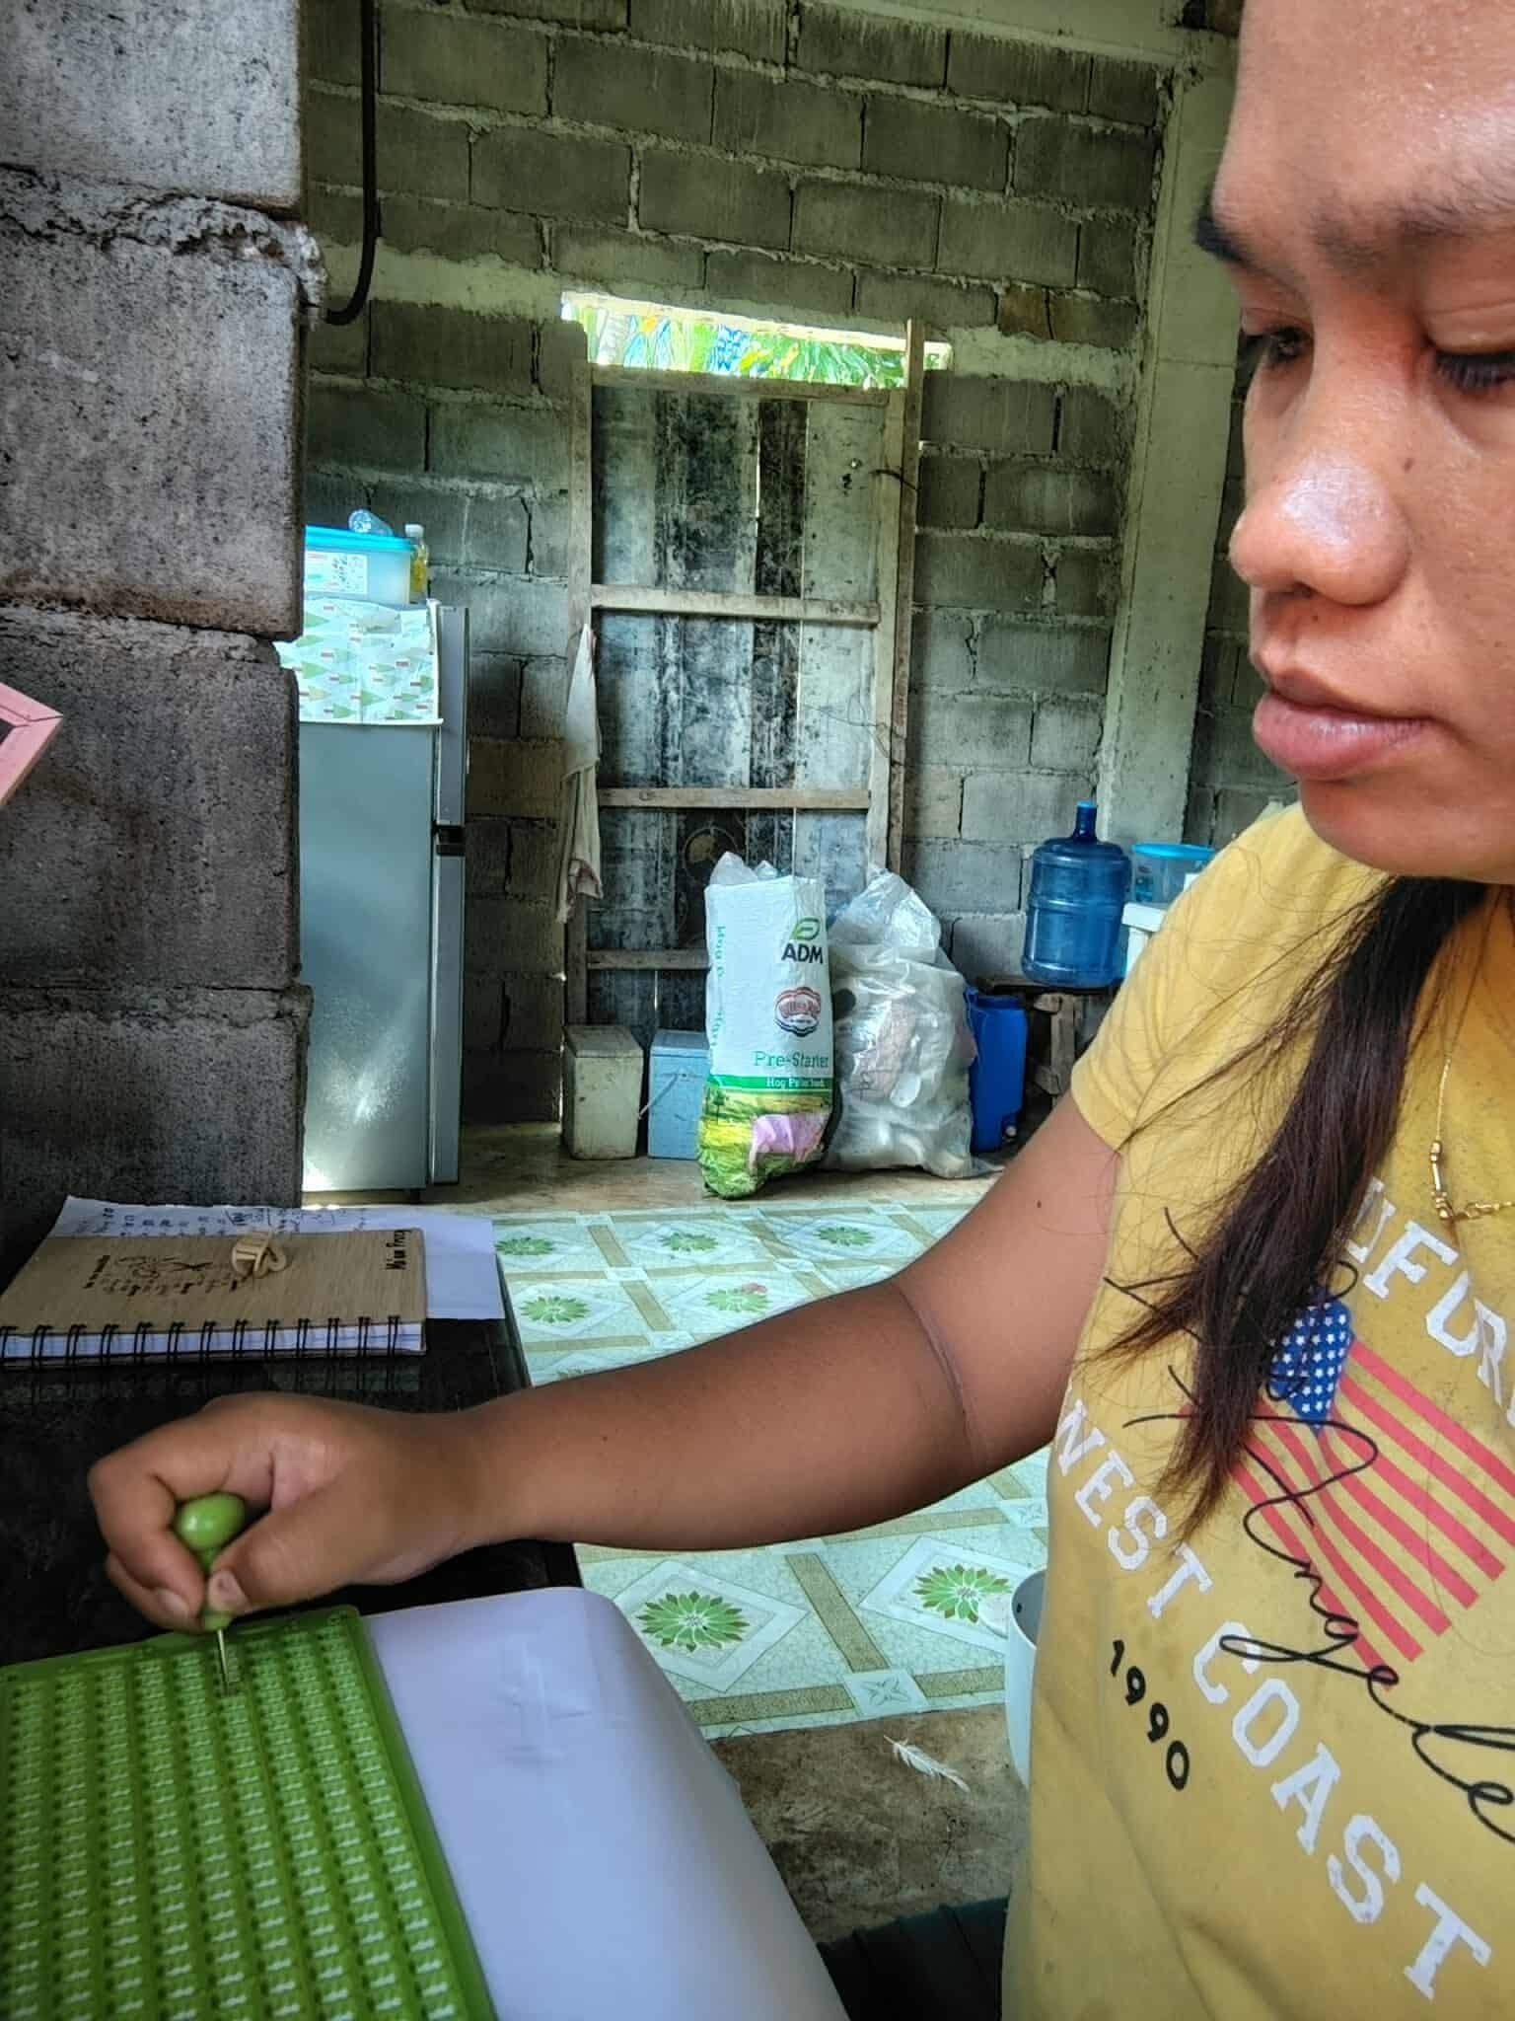
Skills and Expertise
I am a public school teacher, I can teach children with any special educatioanl needs.
I can also write and read using Braille.
I can interpret a song using sign language
I interpret in any kind of webinars or seminars.

Slide 5
Contact Info
Gmail: successfulprecy@gmail.com
FB Links: https://www.facebook.com/share/1HR8tnVdYS/

