Slide 1
Identifying Customer Churn

Slide 2
Objective
This project will create a binary classification model to determine which customers are likely to leave the telecom company.
Once customers are identified, the customer service team will contact them proactively to determine why they might leave. Resulting strategies to lower churn could include addressing individual customer concerns by customer service or general engineering improvements or sales policy changes.
To identify general improvements, we do not need to identify every churn instance, only enough to get sufficient customer feedback.

Slide 3
The Dataset
State
Account Length
Area Code
Phone Number
International Plan
Voicemail Plan
Number VM Messages
Total Day Minutes
Total Day Calls
Total Day Charge
Total Eve Minutes
Total Eve Calls
Total Eve Charge
Total Night Minutes
Total Night Calls
Total Night Charge
Total Intl Minutes
Total Intl Calls
Total Intl Charge
Customer Service Calls

Slide 4
Final Feature Set Importance
Total Day Minutes 0.18
Customer Service Calls 0.14
Total Eve Minutes 0.07
Total Intl Calls 0.07
Total Night Minutes 0.06
Total Intl Minutes 0.06
Account Length 0.05
Total Eve Calls 0.05
Total Day Calls 0.05
Total Night Calls 0.05
Number VM Messages 0.03
Area Code 0.05
Intl Plan 0.02
VM Plan 0.02

Slide 5
Evaluation Criteria
F1 Score – a measure of both:
precision (true positives/predicted positives)
recall (predicted true positives/actual true positives)
Accuracy –the total number of predictions the model gets correct
Confusion Matrix – shows True Negatives, False Positives
False Negatives, True Positives

Slide 6
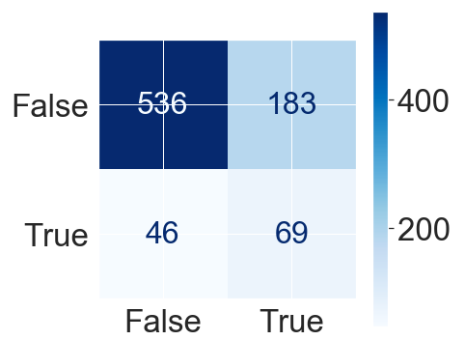
Logistic Regression
F1 Score 0.37 Accuracy 0.71
True Label
Predicted Label

Slide 7
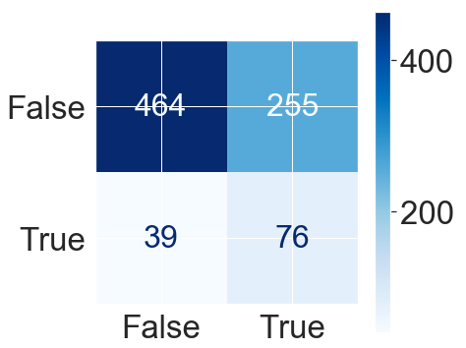
GaussianNB
F1 Score 0.35 Accuracy 0.66
True Label
Predicted Label

Slide 8
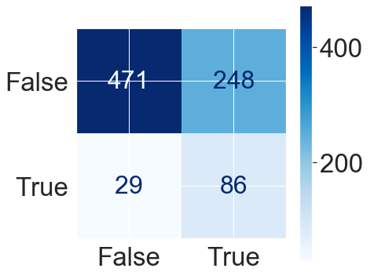
K Nearest Neighbors
F1 Score 0.40 Accuracy 0.70
True Label
Predicted Label

Slide 9
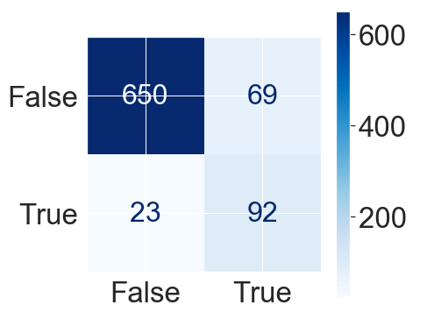
Gradient Boost
F1 Score 0.63 Accuracy 0.88
True Label
Predicted Label

Slide 10
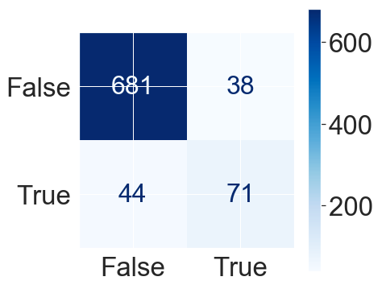
Random Forest
F1 Score 0.61 Accuracy 0.90
True Label
Predicted Label

Slide 11
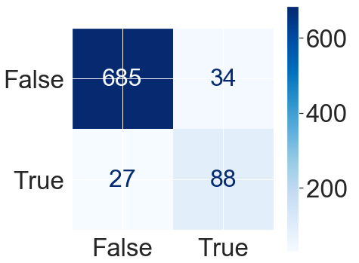
XGBoost
F1 Score 0.75 Accuracy 0.93
True Label
Predicted Label

Slide 12
Conclusion
The XGBoost model gives the best predictive model, with an F1 Score of 0.75 and an accuracy score of 0.93.
The model gives more false positives than negatives, which is preferred as it emphasizes capturing as much churn as possible.
The two most important features for predicting churn are the total number of day minutes used and the number of customer service calls.

