Slide 1
Modeling King County Home Prices

Slide 2
Objective To determine the best features to use to create a model that will predict the sale prices of King County homes

Slide 3
The Dataset A database of homes sold in King County in 2015 which includes:
Sale Price Sale Date Bedrooms Bathrooms Living Square Feet Lot Square Feet Total Floors Waterfront presence View presence Condition
Grade Square Feet Above Ground Square Feet Basement Year Built Year Renovated Zipcode Latitude Longitude Living Square Feet of Neighbors Lot Square Feet of Neighbors

Slide 4
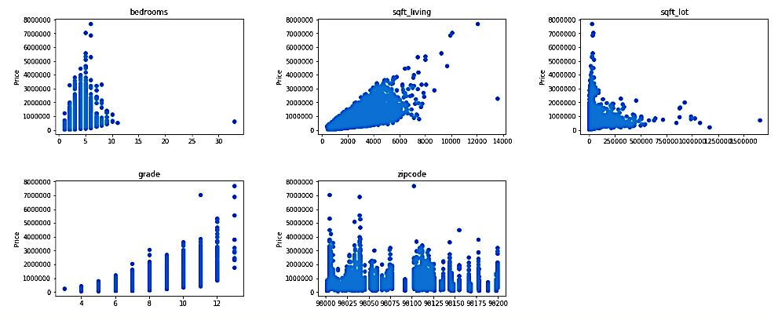
Plots of Considered Features

Slide 5
Selected Features
Living Square Feet
Lot Square Feet
Bedrooms
Grade
Zipcode

Slide 6
Data Processing
Removed outliers
Log transformed and normalized square feet features
One-hot encoded categorical features
Model Building
Used the Python statsmodel library to create an OLS model

Slide 7
Results
R2 Adj R2 p-values
Model with Living Square Feet
Model with all five features
0.374 0.374 0.000
0.767 0.767 <=0.723
High p-values were restricted to seven zipcodes.

Slide 8
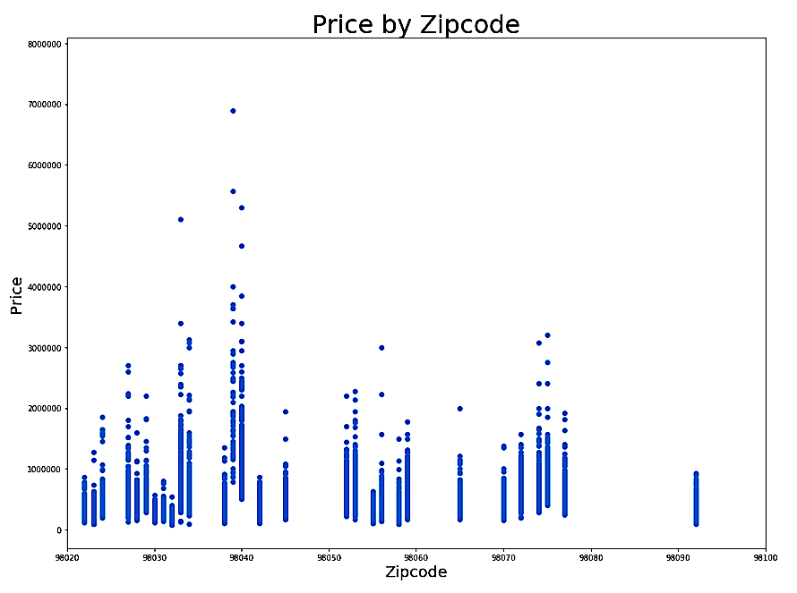
Affected Zipcodes
Enumclaw – 98022
Kent - 98030, 98032, 98042
Federal Way - 98023
Auburn – 98092
Why are these zipcode different?
For that we need to consider the geography of King County.

Slide 9
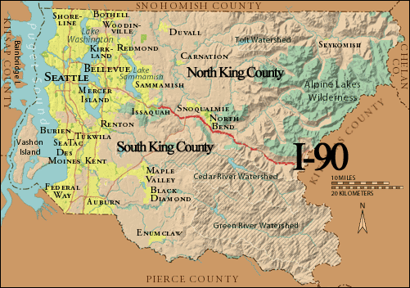
Map of King County
Enumclaw is the most isolated city in King County.
Kent, Auburn, and Federal Way are all along major commuting corridors and close to Tacoma.

Slide 10
Results
R2 Adj R2 p-values
Model with Living Square Feet
Model with all five features
Model with selected zipcodes removed
0.374 0.374 0.000
0.767 0.767 <=0.723
0.761 0.760 <=0.049

Slide 11
Conclusions
Living Square Feet, Lot Square Feet, Bedrooms, Grade, and Zipcode are important modeling features
This model is a starting point for setting a listing price, but that price should be adjusted based on a realtor’s understanding of other features.
Federal Way, Kent, and Auburn should be modeled separately.

