Slide 1

DriverPass
System Analysis
Jeremy R. Pauley | CS 255
Notes:
Slideshow Made by Jeremy Pauley – 10/17/2026

Slide 2

What the system requires
Give students one place to access training materials, practice exams, and driving lessons
Make scheduling easier for customers and staff while preventing conflicting appointments
System
Requirements
Keep customer progress, training packages,
and business records organized
What the system needs to deliver
Secure access based on each person's responsibilities
Reliable access from computers and mobile devices
Accurate, up to date information
with downloadable reports
2
Notes:
Liam and Ian, when we first discussed DriverPass, one thing stood out to me. You are not simply looking for a website where students can take practice tests.
You are building a business that brings classroom preparation, practice testing, and behind-the-wheel instruction together.
That means the system needs to do more than give customers a place to log in. It needs to make the day-to-day operation of DriverPass easier.
For example, when a customer schedules a driving lesson, the system needs to know whether that customer has available training hours, whether an instructor is available, and whether a vehicle is already assigned somewhere else.
At the same time, we want the system to be dependable. Your employees should only have access to the information they need, customer records should remain protected, and everyone should be working with the same up-to-date information.
These requirements give us a foundation for designing a system that supports both your customers and the people running your business.

Slide 3
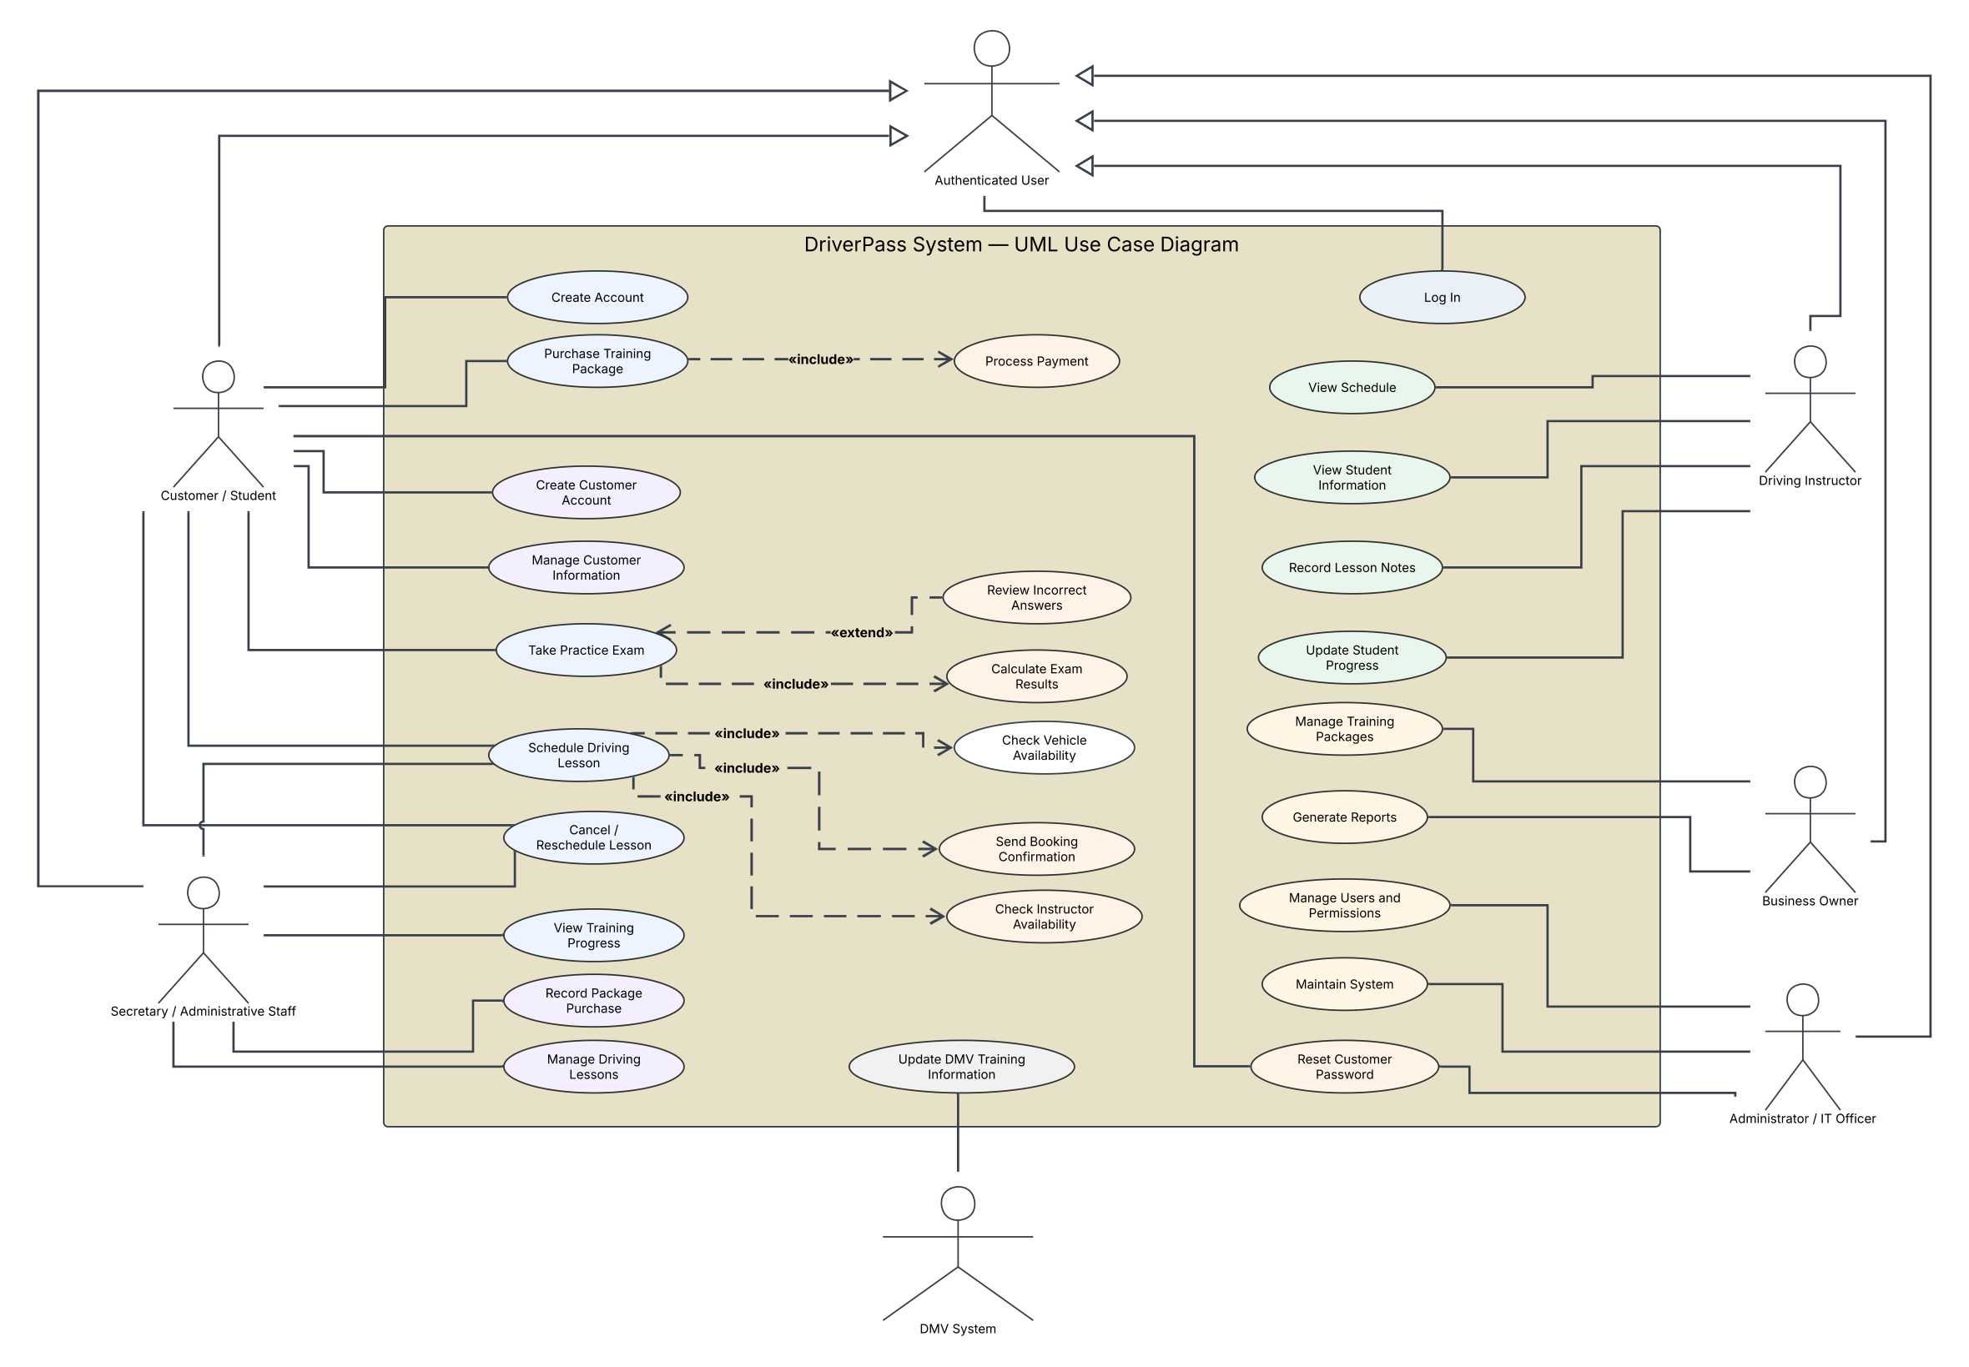
Use Case
Diagram
One connected system, with responsibilities tailored to each user
3
Notes:
Liam and Ian, this diagram gives us a high-level view of how everyone interacts with the DriverPass system. On the customer side, students can manage their accounts, access training materials, take practice exams, and schedule driving lessons.
Your secretary can help customers who prefer to call or visit the office, so they receive the same scheduling support without having to manage everything online themselves.
Instructors have access to their assigned lessons and can record the information needed to track a student's behind-the-wheel training.
Liam, your responsibilities are focused on overseeing the business, reviewing records, and understanding how DriverPass is operating. Ian, your responsibilities are different. You need the tools to manage accounts, control access, and maintain the system.
That separation is intentional. We want each person to have the tools needed to do their job without giving everyone unrestricted access to the entire system.
The DMV connection is also represented because keeping your training information current is an important part of the service you're providing.

Slide 4
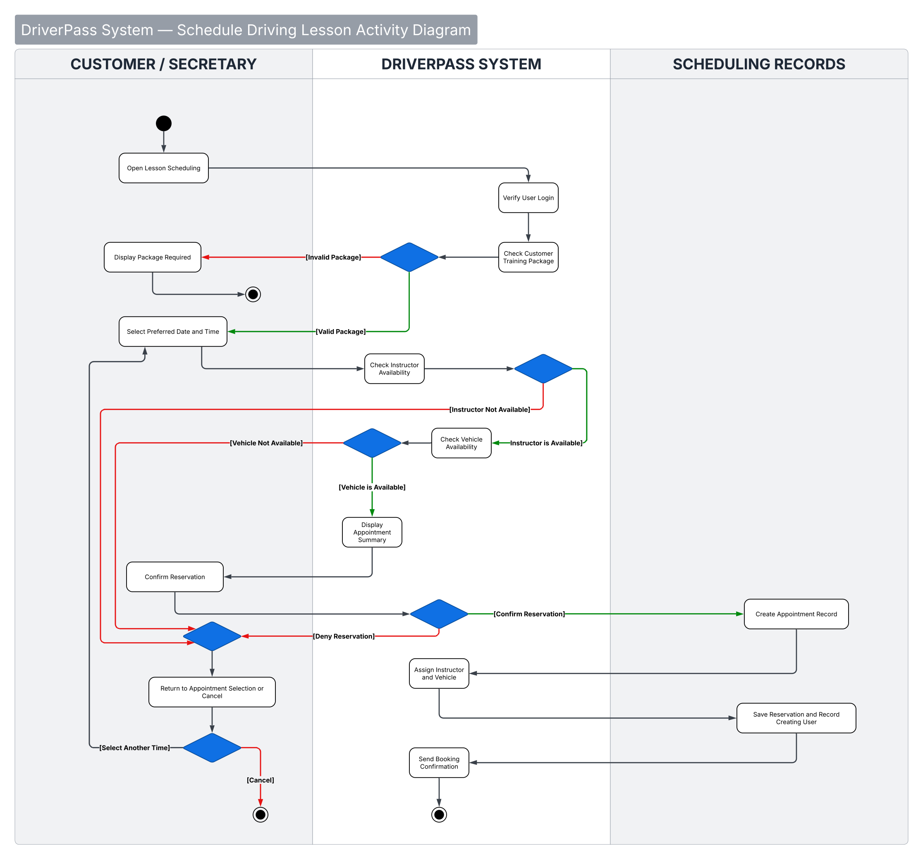
Activity
Diagram
From requesting a lesson to confirming an appointment, the system checks availability before committing to a reservation
4
Notes:
Now, let's look at how one of the most important parts of your business will work: scheduling a driving lesson.
Whether a student schedules online or your secretary schedules on their behalf, the process follows the same rules.
First, the system checks that the student is eligible to schedule the lesson and has the necessary training hours available. Next, it checks the requested time against your instructors and vehicles.
If everything is available, the appointment is saved and confirmed. If something conflicts, the customer or secretary can choose another available time instead of creating a scheduling problem that someone has to fix later.
This is important because you are coordinating students, instructors, vehicles, and two-hour training sessions. Even a small scheduling mistake can affect several people.
Our goal here is to catch those problems before the appointment is confirmed, rather than leaving your team to discover them afterward.

Slide 5
Protecting Your Customers and Your Business
Individual accounts with access based on job responsibilities
Secure customer sign in and account recovery
Security
Protection against repeated failed sign ins
Protected customer information and payment processing
A record of who creates, changes, or cancels appointments
Cloud-based backups and system monitoring
5
Notes:
Ian, one of the concerns you raised was making sure employees have the right level of access and that you can manage those accounts when someone forgets a password or leaves the company.
We've addressed that by designing the system around individual accounts and clearly defined responsibilities.
Liam, you also mentioned wanting to know who created, changed, or canceled an appointment. Rather than relying on someone remembering what happened, the system will maintain a record of those actions so your team can review them when questions come up.
We're also recommending that payment information be handled through a dedicated payment provider instead of storing customers' credit card details directly in DriverPass.
Finally, our proposed cloud environment will support backups, monitoring, and recovery.
The goal is not simply to keep unauthorized people out. It's to give your team confidence that customer information is protected, changes are accountable, and the business can operate reliably.

Slide 6
Planning for What Comes Next
An internet connection is required to update live system records
System
Limitations
DMV updates depend on the information and access methods the DMV provides
Cloud services and payment processing introduce ongoing operating costs
New training package customization is reserved for a future phase
Final implementation details depend on confirming DriverPass's existing technology and budget
6
Notes:
Before we move forward, I want to be clear about a few limitations and decisions we still need to make together.
First, the system is designed to work online. You will be able to download reports and review information offline, but changes to customer records and appointments need to happen while connected. This prevents different copies of information from getting out of sync.
Second, keeping training materials current with DMV requirements is part of our design. However, we still need to confirm how the DMV makes those updates available before we can finalize that connection.
There are also ongoing costs associated with cloud hosting and payment processing. We've recommended a Microsoft-based environment to keep the technology manageable, but we need to confirm your existing services and budget before treating that as a final purchasing decision.
Finally, the system will support your three current training packages. The ability to build completely new packages from custom training modules can be added later, but we're keeping that outside the initial release.
My recommendation is to get the core experience working well first: customer registration, training access, scheduling, progress tracking, and the tools your employees need. Once that foundation is dependable, DriverPass will be in a much stronger position to expand.

