Slide 1
A Adaptive and Simulated annealing based Failover Mechanism for Software-Defined Networks 軟體定義網路下適應及基於退火法 之控制器容錯機制
Notes:
學生：方科植 指導教授：王國禎
國立交通大學網路工程研究所
行動計算與寬頻網路實驗室
大家好今天我要介紹我的研究

Slide 2
Outline
Introduction
Related Work
Distributed SDN Architecture
Proposed ASAF Mechanism
Failure detection
Failure recovery
Experiments
Conclusion
References
Notes:
Related work
Failure detection mechanisms
Failure recovery mechanisms
這是整體的大鋼
Introduction 是介紹SDN的一些背景，還有我的架構的property，第二部分是和相關文獻做比較，
而第三部份是介紹所使用的分散式SDN架構，再來是failure detection和failure recovery的機制
最後是實驗結果和結論

Slide 3
Introduction
Software-defined network (SDN) is a new network architecture for managing network.
The control-plane is centralized to controller.
To avoid single point of failure problem(SPOF), many papers use multi-controller to guarantee reliability and scalability [1][2].
The goal of this paper :
achieve short failure detection time to reduce failover time in stable network condition.
have a reliable design to compute the recovery plan to balance between switch-controller delay and controllers load balancing.
Notes:
在failover議題中 為了避免SPOF問題
SDN 是一個新的網路架構來管理網路，最大的特點就是將control plane集中在controller身上，所以為了避免SPOF，許多文獻改用multi-controller來保證relia 和scala
我的目標就是，在網路穩定的情況下，降低failure detection time 來縮減整體的failover time
再來是選擇一個更加可靠的design來計算recovery plan

Slide 4
Introduction
We propose Adaptive and simulated annealing based failover (ASAF) mechanism that has several properties.
Quickly detect a controller failure in stable network conditions.
Quickly react to sudden changes in unstable network conditions to avoid generating false detection.
Consider reactive recovery type .
Avoid the out-of-date recovery plan of risk.
Save cpu resource.
Notes:
我提出的機制中有幾個property
第一點和第二點就是根據網路狀況，快速調整timeout來保持 low false detection和 較短的 failure detection time.
第三點就是選擇reactive recovery type來避免 過期的recovery plan 的風險，再來就是能節省cpu的資源。

Slide 5
Related Work – Classification
Existing failure detection mechanisms
Notes:
在既有的failure detection mechansim分成兩個部分，左半邊是現今文獻中timeout的演算法，而右半邊是選用一台或是多台controller決定某一台controller是否掛掉

Slide 6
Related Work – Comparison
Existing failure detection mechanisms for SDN
Failure detection mechanism | FDLM [9] | Akka [8] (Opendaylight) | FLCF [10] | ASAF (proposed)
Failure detector | Accrual | Accrual | Accrual | Adaptive
Timeout mechanism | AAFD [6] | Phi FD [5] | Phi FD [5] | 2W-FD [4]
Failure decision | More than one node make decision | One node makes decision | More than one node make decision | More than one node make decision
Notes:
從table可以看出
我所選用的failure detector是adaptive type.
那在failure decision方面
是利用多台controller一起決定某一台controller是否掛掉 進而增加可靠度
但相對地會增加failure detection time

Slide 7
Related Work – Classification
Existing failure recovery mechanisms
Notes:
在既有的failure recovery mechansim 中
左邊的
PPF : 提出多控制器底下選擇最近之controller的 failure-recovery 演算法
而右邊的
Survivor: 提出多控制器底下防止Overload 的 Failure Recovery 演算法
中間的部分則是同時考慮load balancing 和switch-controller 的delay.

Slide 8
Related Work – Comparison
Existing failure recovery mechanisms for SDN
Failure recovery mechanism | Survivor [2] | PPF [11] | FCF-M [7] | FLCF [10] | ASAF (proposed)
Proactive / Reactive recovery | Reactive | Proactive | Reactive | Proactive | Reactive
Considering controller load balancing or switch-controller delay | Only loading | Only delay | Both | Both | Both
Local / global optimization | Local | Global | Local | Global | Global
Notes:
在comparision table中，
我們是選用reactive recovery type來提供一個更可靠的design
在最佳化中是從整體來計算recovery plan
Choose the best controllers for switches
Choose the best switch-controller mapping

Slide 9
Multi-controller SDN architecture
Control plane
Switch network
Switch network
Switch network
Switch network
Notes:
那在SDN架構中 我是選用分散式的SDN架構來做實驗

Slide 10
Multi-controller SDN architecture
Send heartbeat / failure notification
Send heartbeat / failure notification
Send heartbeat / failure notification
Send heartbeat / failure notification
C1
C2
C3
C4
ASAF module
ASAF module
ASAF module
ASAF module
Check controller process aliveness
Check controller process aliveness
Check controller process aliveness
Check controller process aliveness
Controller
core
Controller
core
Controller
core
Controller
core
Notes:
在每一台controller中
ASAF module會同時確認controller的core是否還存活
並且適時地發送heartbeat message或是failure notification.

Slide 11
Failure Detection
A push-based mechanism
Monitored processes periodically send heartbeat message to detecting module.
Detecting module considers monitored process that is alive until exceeding the timeout that is calculated by 2W-FD[4].
Notes:
在ASAF的module中 我是選用以push-based的機制來傳遞heartbeat message
也就是被監測的process會定期地傳遞heartbeat到 detecting module的接收端
那detecting module是透過 2W-FD所制定的timeout來判定被監測的process是否存活
定期傳遞heartbeat message 到 偵測的module 的receive site
首先，每個controller定時會發出自己的heartbeat來告訴所有人他還活著。
其他人使用Phi Failure Detector去判斷該controller有沒有失效。
每個人會同步自己的判斷，以達到所有人都知道其他人怎麼認為該controller的健康狀態。
對於一個controller，會有另一個controller去蒐集大家意見，決定是否要判斷目標已死，這個controller的ip設為是目標controlle的下一個ip。

Slide 12
Failure Detection
A reliable detection of architecture [9]
Assume a controller crash
Step 1. Other lived controller detects this failure
Step 2. Each lived controller sends failure notification to others controllers.
Step 3. If any one lived controller receives more than half failure notification (including itself) , it will determine controller crash and trigger the recovery procedure.
Notes:
為了讓failure detection的架構 更加地可靠
我選用 reference 第九篇的架構來 做failure decision
下面是failure decision的機制
假設某一台controller掛掉的時候
首先存活著的controllers會先偵測到這個failure
並且傳遞failure的通知到其他還存活的controller上
如果有任一台的controller收到超過半數的failure的通知，它才會去trigger recovery的procedure.
對於一個controller，會有另一個controller去蒐集大家意見，決定是否要判斷目標已死，這個controller的ip設為是目標controlle的下一個ip。

Slide 13
Failure Detection
C₄
In case of C₄ failure
C₃
1. C3 sends failure notification of C₄
C₂
1. C1 sends failure notification of C₄
C₁
2. Exceed two failure notification of C4
3. Trigger recovery procedure
Notes:
這裡用一個例子來說明detection的步驟
假設C4掛掉
其他三台必定會偵測到這個錯誤，並且發送C4的failure notification到其他controller中
當任一台controller 假設是C2最先收到 超過兩個C4的failure notification 則C2會 trigger recovery的 procedure.

Slide 14
Failure Recovery
Proposed failure recovery mechanism
When detecting a failure, we need to compute the recovery plan to reassign switches that are managed by the failed controller.
Consider switch-controller delay (to reduce controller’s flow setup time).
Consider controller load balancing.
Using reactive recovery strategy to prevent out-of-date recovery plan of risk and save cpu resource.
Notes:
那在 failure recovery中
當有controller trigger recovery procedure，
我們就必須計算出一個recovery plan來做 reassign switches的動作。
在我的design中我是考慮兩個metric來計算recovery plan
並且選擇reactive recovery strategy來防範過期的recovery plan的風險並且節省cpu的資源
在我們的方法裡，每個控制器都有自己的recovery plan，顧名思義就是who tko底下的switch讓別人來接管。
所以每個控制器在算好這個recovery plan 知後，就會把recovery plan丟進分散式檔案系統中同步給所有人。
如此一來，一旦控制器失效了，所有人都知道要去接管該控制器的哪些switches

Slide 15
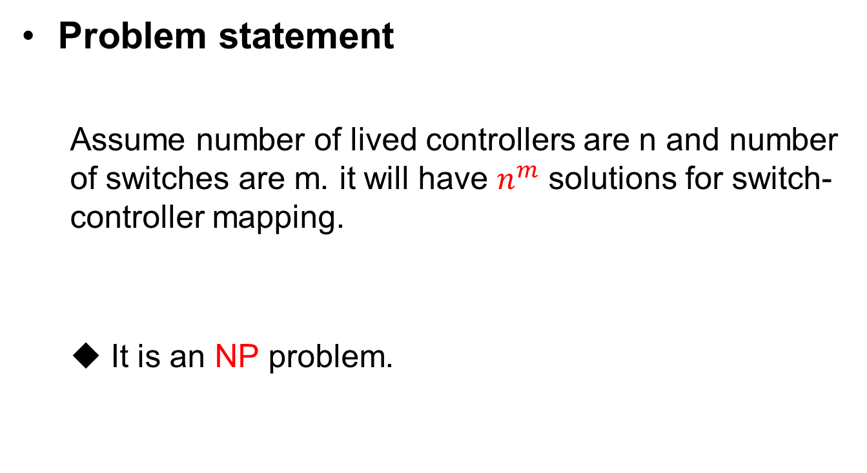
Failure Recovery
Problem statement
Assume number of lived controllers are n and number of switches are m. it will have $n^{m}$ solutions for switch-controller mapping.
It is an NP problem.
Notes:
當一台controller失效的時候，底下的switch必須被其他人接管。
從整體的system的角度去看的話，這樣的reassignment 的解可以有n的m次方種。
如果全部都評估過後再去選擇的話，那這樣的時間複雜度會是指數次方。

Slide 16
Failure Recovery
Simulated annealing (SA) algorithm properties [12]
A kind of single solution-based metaheuristic algorithm to find near optimal solution.
Single solution-based metaheuristic algorithm will take less time to compute the result than population-based algorithm (like genetic algorithm).
Using a probabilistic technique to try to find global optimal solution.
Notes:
所以我們利用heuristic的方法也就是simulated annealing algorithm，來快速地找到一組近似最佳解。
那SA有幾個property
第一是他single solution-based的heuristic algorithm 的其中一個
第二個是他計算一個近似最佳解的速度相較於 population-based 的heuristic algorithm 像是GA 還來地快
第三個是他是利用機率工程也就是波茲曼函數來試著找到全域最佳解
Metaheuristic
啟發式演算法
次經驗法則
(Boltzman's Function)
也就波茲曼函數
利用機率工程也就波茲曼函數 來接受較差解 試圖跳脫區域最佳解

Slide 17
Failure Recovery
Notes:
這個是SA的flow chart

Slide 18
Failure Recovery
Generate a neighbor solution:
Randomly select two elements and exchange them to generate a neighbor solution.
Notes:
SA的主要步驟是先 做selection的前處理
再產生鄰近解
我是利用2-exchange也就是隨機選擇兩個elements再去交換它們來產生鄰近解

Slide 19

Failure Recovery
Solution cost :
Evaluation function [10] :
Evaluation(S_{i}) = $\frac{Delayi−Delaylowest}{Delayhighest−Delaylowest}+\frac{Loadi−Loadlowest}{Loadhighest−Loadlowest}$
Notes:
產生完鄰近解後必須利用Evaulation function來判斷 鄰近解是否比現在的解還來得好
Evaluation function的部分我是參考 reference第十篇的公式
那這個公式評估的指標有兩個
第一是這組解能否讓系統中flow setup time是低的
第二是這組解是否能讓系統中controller的loading是平均的。

Slide 20
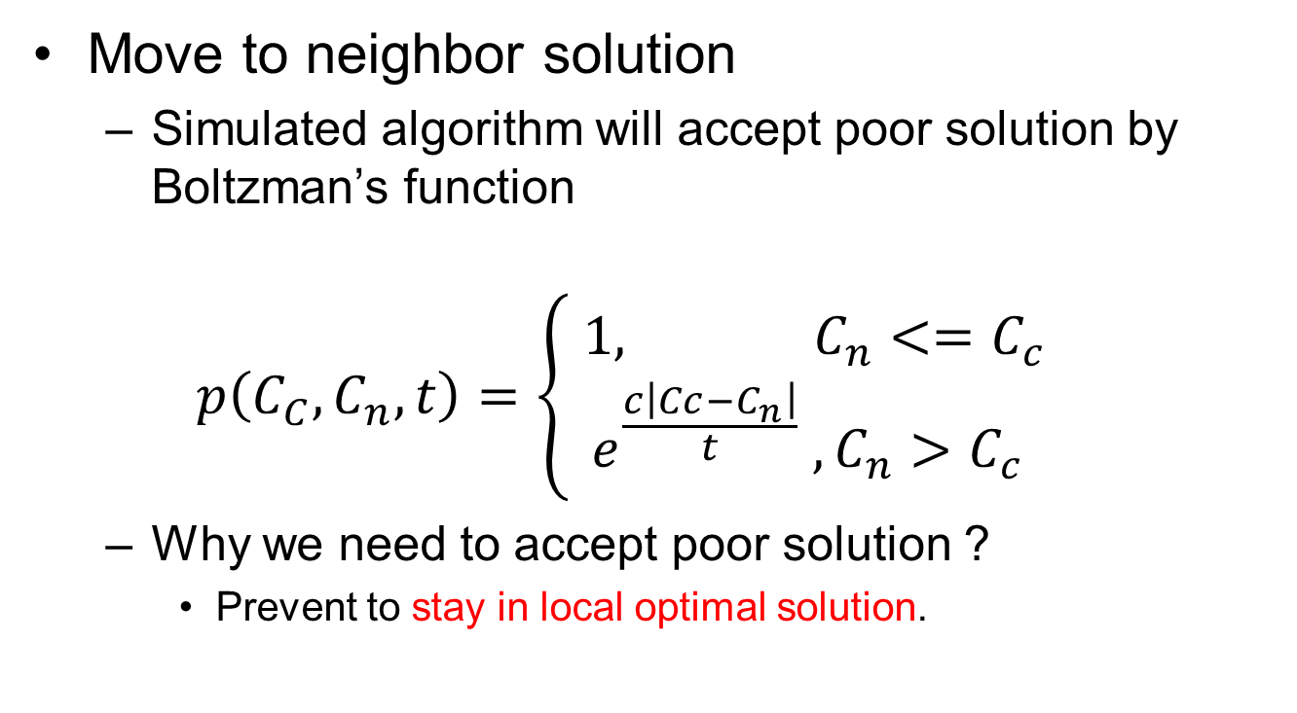
Failure Recovery
Move to neighbor solution
Simulated algorithm will accept poor solution by Boltzman’s function
$$p\left(C_{C},C_{n},t\right)=\left\{\begin{aligned} 1, C_{n}<{=C}_{c} \\ e^{\frac{c\left|Cc−C_{n}\right|}{t}} , C_{n}>C_{c}\end{aligned}\right.$$
Why we need to accept poor solution ?
Prevent to stay in local optimal solution.
Notes:
有了鄰近解和evaluation function之後
我們就可以判斷是否要將現在的解替換成鄰近解
那退火法替換的方式是透過波茲曼函數來做決策
透過波茲曼函數，退火法有機會會接受較差的解來試著跳脫區域最佳解。

Slide 21
Failure Recovery
Notes:
我設定退火法的終止條件是透過疊代的次數來判斷
當超過設定的疊代的次數時就會output結果 來做reassign switches的動作

Slide 22
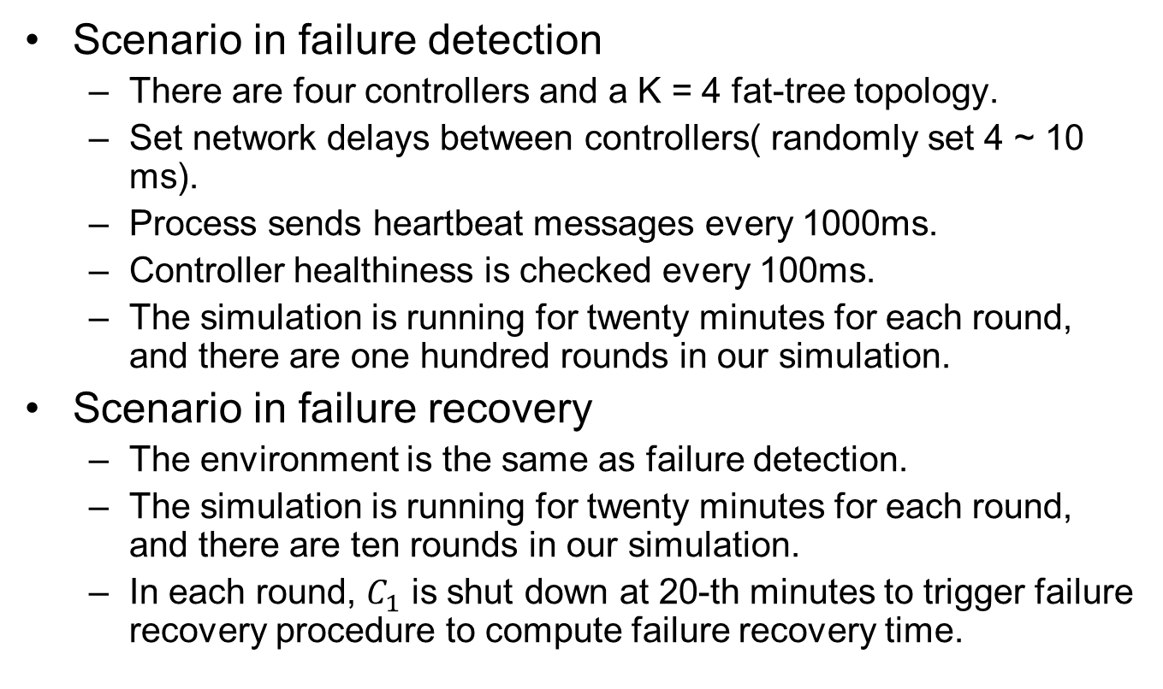
Experiments
Scenario in failure detection
There are four controllers and a K = 4 fat-tree topology.
Set network delays between controllers( randomly set 4 ~ 10 ms).
Process sends heartbeat messages every 1000ms.
Controller healthiness is checked every 100ms.
The simulation is running for twenty minutes for each round, and there are one hundred rounds in our simulation.
Scenario in failure recovery
The environment is the same as failure detection.
The simulation is running for twenty minutes for each round, and there are ten rounds in our simulation.
In each round, $C_{1}$ is shut down at 20-th minutes to trigger failure recovery procedure to compute failure recovery time.
Notes:
我去跑Phi跟EMA在沒有加長time-out的情況下師誤率及真測時間都差不多，我們做的就是把他拿來等待兩倍time-out的這段時間，來與其他controller溝通看看是否該controller真的無法連上

Slide 23
Experiments
Virtual machine
Virtual machine
Virtual machine
Virtual machine
Opendaylight controller 1
ODL controller 2
ODL controller 3
ODL controller 4
ASAF module
ASAF module
ASAF module
ASAF module
Virtual machine
K = 4 fat-tree network topology
(using Mininet)
Notes:
Case server斷電/斷網 process 死掉

Slide 24
Experiments
Simulation setup
Opendaylight
Controller1 VM
Controller2 VM
Controller3 VM
Controller4 VM
Mininet VM
OpenFlow switches
Hosts

Slide 25
Experiments
Environment setup
Parameter description | Notation | Value
Control plane | N/A | OpenDaylight controller [11]
Data plane | N/A | Mininet [12]
Number of controllers | n | 4
Number of switches for each controller | m_{i} | 5
Number of switches | m | 20

Slide 26
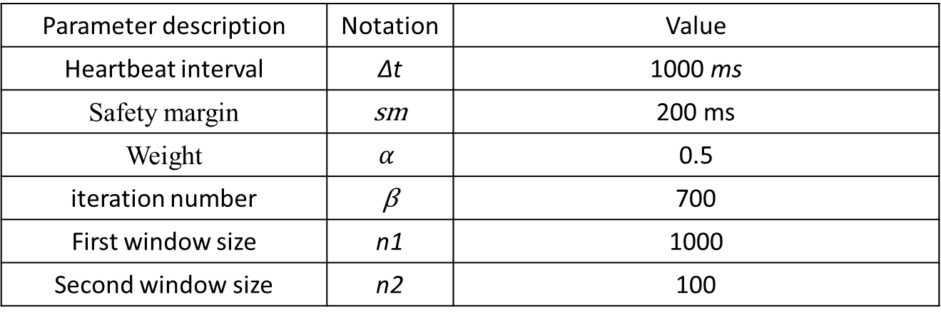
Experiments
Simulation parameters
Parameter description | Notation | Value
Heartbeat interval | ∆t | 1000 ms
Safety margin | sm | 200 ms
Weight | $$α$$ | 0.5
iteration number | β | 700
First window size | n1 | 1000
Second window size | n2 | 100

Slide 27
Experiments
Failure detection time comparison
No packet loss
packet loss 2%

Slide 28
Experiments
False detection rate comparison (packet loss rate is 2%)
Scheme | False detection rate | Failure detection time
ASAF (proposed) | 0.002% | 2187 ms
FLCF | 0% | 2462 ms
FDLM | 0.09% | 1308 ms
Notes:
我去跑Phi跟EMA在沒有加長time-out的情況下師誤率及真測時間都差不多，我們做的就是把他拿來等待兩倍time-out的這段時間，來與其他controller溝通看看是否該controller真的無法連上

Slide 29
Experiments
Failure recovery time comparison

Slide 30
Experiments
Average switch-controller delay comparison
Notes:
(在圖中表示清楚)

Slide 31
Experiments
Controller loading standard deviation comparison
Notes:
(在圖中表示清楚)

Slide 32
Conclusion
The proposed ASAF choose adaptive failure detector
Reduce 63% failure detection time to compare to FLCF in stable network condition.
Still have low false detection rate (0.002%) to compare to FDLM (0.09%) while packet loss rate is 2%.

Slide 33
Conclusion
The proposed ASAF choose reactive recovery type to compute recovery plan.
Avoid out-of-date recovery plan.
Save cpu resource.
However it will generate overhead to compare to proactive recovery type, we use simulated annealing to quickly compute recovery plan to reduce failover time.

Slide 34
References
[1] A. Tootoonchian and Y. Ganjali, “HyperFlow: a distributed control plane for OpenFlow,” in Proc. ACM Internet Network Management Conference on Research on Enterprise Networking, April 2010.
[2] L. Muller, R. Oliveira, M. Luizelli, and L. Gaspary, "Survivor: An enhanced controller placement strategy for improving SDN survivability" in IEEE Global Communications Conference (GLOBECOM), Dec. 2014, pp. 1909-1915.
[3] Wei Chen, S. Toueg and M. K. Aguilera, "On the quality of service of failure detectors," in IEEE Transactions on Computers, vol. 51, no. 1, pp. 13-32, Jan 2002.
[4] A. Tomsic, P. Sens, J. Garcia, L. Arantes and J. Sopena, "2W-FD: A Failure Detector Algorithm with QoS," 2015 IEEE International Parallel and Distributed Processing Symposium, Hyderabad, 2015, pp. 885-893.
[5] N. Hayashibara, X. Defago, R. Yared and T. Katayama, "The φ accrual failure detector," Proceedings of the 23rd IEEE International Symposium on Reliable Distributed Systems, 2004., 2004, pp. 66-78.
[6] B. Satzger, A. Pietzowski, W. Trumler, and T. Ungerer, "A new adaptive accrual failure detector for dependable distributed systems," in Proc. of the ACM Symposium on Applied Computing, Mar. 2007, pp. 551-555.
[7] Y. Chan, K. Wang, Y. Hsu, "Fast controller failover for multi-domain software-defined networks" in European Conference on Networks and Communications, Jun. 2015.

Slide 35
References
[8] Akka [online] Available: http://akka.io/.
[9] T. W. Yang and K. Wang, "Failure detection service with low mistake rates for SDN controllers," 2016 18th Asia-Pacific Network Operations and Management Symposium (APNOMS), Kanazawa, 2016, pp. 1-6.
[10] K. C. Fang, K. Wang and J. H. Wang, "A fast and load-aware controller failover mechanism for software-defined networks," 2016 10th International Symposium on Communication Systems, Networks and Digital Signal Processing (CSNDSP), Prague, 2016, pp. 1-6.
[11] M. Obadia, M. Bouet, J. Leguay, and K. Phemius, ”Failover mechanisms for distributed SDN controllers” in International Conference and Workshop on the Network of the Future (NOF), Dec. 2014, pp. 1-6.
[12] simulated annealing algorithm [online] Available: https://en.wikipedia.org/wiki/Simulated_annealing

