Slide 1
Threads
Introduction to Concurrency in Java

Slide 2
Processes and Threads
In concurrent programming, there are two basic units of execution: processes and threads.
In the Java programming language, concurrent programming is mostly concerned with threads. However, processes are also important.

Slide 3
Processes vs Threads
An application can be made up of one or more processes.
A process is a self-contained execution environment, with its own run-time resources such as memory space
Every process contains at least one thread ,which is essentially a lightweight process. It shares its parent processes memory and resources

Slide 4
Multithreaded execution
Multithreaded execution is an essential feature of the Java platform. Every application has at least one thread — or several, if you count "system" threads that do things like memory management and signal handling.
But from the application programmer's point of view, you start with just one thread, called the main thread. This thread has the ability to create additional threads, as we'll demonstrate in the next section.

Slide 5
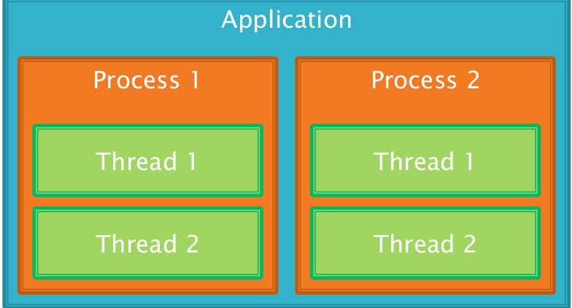
Anatomy of an Application
It's common for a process to have more than one thread, so that multiple tasks can be completed simultaneously

Slide 6
Shared resources
Different processes can only communicate with each other using Inter Process Communication (IPC) – a mechanism provided by the operating system
Different threads however, share the same memory space
Communication between threads is simple because they can all access the variables in your program
But we can also run into problems if we don't control how they access shared variables

Slide 7
Java class
Java provides two ways of creating new threads within our applications
Extend the Thread class and override its run method. This is the simplest approach.
Implement the Runnable interface and its run method, then create a new Thread object using our Runnable class. This means our class can be a subclass of something other than Thread

Slide 8
The Thread class
The Thread class defines several methods that help manage threads. Common used are show here below:
Methods | Return | Meaning
getName | String | Returns this thread's name.
gePriority | int | Returns this thread's priority.
isAlive | boolean | Tests if this thread is alive.
isInterrupted | boolean | Tests whether this thread has been interrupted.
join | void | Waits for this thread to die.
run | void | Entry point of the thread
sleep | void | Suspend a thread for a period of time
start | void | Start a thread by calling its method

Slide 9
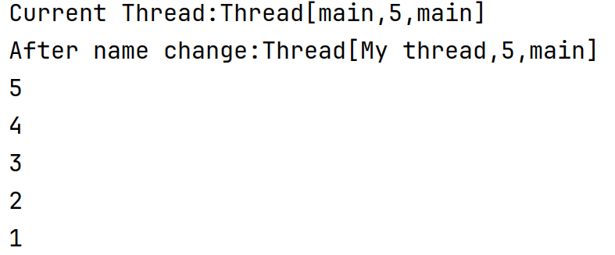
Main Thread
public class MainProgram {
public static void main(String[] args) {
Thread thread=Thread.currentThread();
System.out.println("Current Thread:"+thread);
//Change the name of the Thread
thread.setName("My thread");
System.out.println("After name change:"+thread);
try {
for(int n=5;n>0;n--){
System.out.println(n);
Thread.sleep(1000);
}
}catch(InterruptedException e){
System.out.println("Interrupted");
}
}
}
When Java Program starts up, one thread begins running immediately. This is usually called main thread of your program, because it is the one executed when your program begins.
It is a thread from which other child thread are spawned.
Often it must be the last thread to finish execution because it performs various shutdown actions

Slide 10
Implementing Runnable
class Person implements Runnable {
public void run() {
System.out.println("Hello from a thread!");
}
}
public class Main {
public static void main(String[] args) {
Thread thread = new Thread(new Person());
//(new Thread(new Person())).start();
thread.start();
}
}
Override run and pass to a new Thread...
The Runnable interface defines a single method, run, meant to contain the code executed in the thread.

Slide 11
Implementing Runnable(next…)
Inside the main method, start() is called, which starts the thread of execution beginning at the run() method. This cause the child thread’s loop to begin. Next the main thread enters its for loop. Both loops continue running sharing CPU until finished.
class Person implements Runnable {
public void run() {
System.out.println("Hello from a thread!");
try{
for(int i=5;i>0;i--){
System.out.println("Child Thread"+i);
Thread.sleep(1000);
}
} catch (InterruptedException e) {
System.out.println("Interrupted");
}
System.out.println( name+"exiting");
}
}
public class Main {
public static void main(String[] args) {
Thread thread = new Thread(new Person());
thread.start();
try {
for(int i=5;i>0;i--){
System.out.println("Main Thread:"+i);
Thread.sleep(1000);
}
}catch(InterruptedException e){
System.out.println("Interrupted");
}
System.out.println("Main thread exiting");
}}

Slide 12
Create Multiple Threads
class NewThread implements Runnable {
String name;
Thread t;
NewThread(String threadName){
name=threadName;
t=new Thread(this,name);
System.out.println("New Thread:"+t);
}
public void run() {
try{
for(int i=5;i>0;i--){
System.out.println("Child Thread"+i);
Thread.sleep(1000);
}
} catch (InterruptedException e) {
System.out.println("Interrupted");
}
System.out.println("Exiting child thread");
}
}
public class Main {
public static void main(String[] args) {
NewThread thread1 = new NewThread("One");
NewThread thread2 = new NewThread("Two");
NewThread thread3 = new NewThread("Third");
thread1.t.start();
thread2.t.start();
thread3.t.start();
try {
Thread.sleep(1000);
}catch(InterruptedException e){
System.out.println("Interrupted");
}
System.out.println("Main thread exiting");
}
}

Slide 13
Extending Thread
Override run and call start...
class Person extends Thread {
public void run() {
System.out.println("Hello from a thread!");
}
}
public class Main {
public static void main(String[] args) {
Person person = new Person();
person.start();
}
}

Slide 14
Which one to use?
Which of these idioms should you use? The first idiom, which employs a Runnable object, is more general, because the Runnable object can subclass a class other than Thread.
The second idiom is easier to use in simple applications, but is limited by the fact that your task class must be a descendant of Thread. This lesson focuses on the first approach, which separates the Runnable task from the Thread object that executes the task.

Slide 15
Interrupt
An interrupt is a message sent to a thread to tell it to do something else
Usually a programmer will have a thread respond to an interrupt by terminating
Every thread has
An interrupt method which will cause it to be interrupted
An interrupted method which checks to see if it has been interrupted

Slide 16
Interrupting
If a thread is processing a task which will take a long time, it should check interrupted from time to time to see if it should terminate
It is good practice therefore to break down large processing tasks into smaller units
for (int i < 0; i < data.length; i++) {
// Do some more processing
// of the task
if (interrupted())
break;
}

Slide 17
Sleeping
Every thread has a sleep method which will cause it to pause for the specified number of milliseconds
But the thread might be interrupted while it is paused – in which case it will throw an InterruptedException
We can call this method statically as well and it will pause the calling thread
try {
Thread.sleep(1000);
} catch (InterruptedException ex) {
}

Slide 18
Sleep(next)
public class SleepMessages {
public static void main(String args[])
throws InterruptedException {
String importantInfo[] = {
"Mares eat oats",
"Does eat oats",
"Little lambs eat ivy",
"A kid will eat ivy too"
};
for (int i = 0;
i < importantInfo.length;
i++) {
//Pause for 4 seconds
Thread.sleep(4000);
//Print a message
System.out.println(importantInfo[i]);
}
}
}
Thread.sleep causes the current thread to suspend execution for a specified period.
Two overloaded versions of sleep are provided: one that specifies the sleep time to the millisecond and one that specifies the sleep time to the nanosecond.
Notice that in the left example main declares that it throws InterruptedException. This is an exception that sleep throws when another thread interrupts the current thread while sleep is active.
The SleepMessages example uses sleep to print messages at four-second intervals:

Slide 19
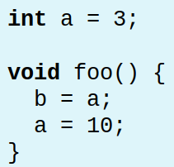
Thread interference
Supposing 2 threads access the following method called foo simultaneously...
What are the final values of a and b?

Slide 20
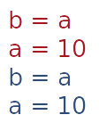
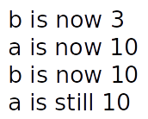
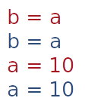
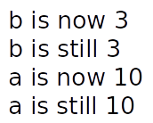
Thread interference
It depends on how the instructions are interleaved...

Slide 21
start()
When we call start on a new thread, we are defining a happens-before relationship
Everything prior to t.start() happens-before the instructions in Person.run()
class Person extends Thread {
public void run() {
Main.c = 5;
}
}
class Main {
public static int c = 0;
public static void main(String[] args) {
System.out.print(c);
Thread t = new Thread(new Person());
t.start();
}
}

Slide 22
start()
When we call start on a new thread, we are defining a happens-before relationship
Everything prior to t.start() happens-before the instructions in Person.run()
class Person extends Thread {
public void run() {
Main.c = 5;
}
}
class Main {
public static int c = 0;
public static void main(String[] args) throws InterruptedException
{
System.out.print(c);
Thread t = new Thread(new Person());
t.start();
System.out.print(c);
t.join();
System.out.print(c);
}
}
c could be 0 or 5
Main thread will pause here until worker completes
c is 5

Slide 23
Synchronized Methods
Defining a method as being synchronized means only one thread at a time can execute it – or any other synchronized methods
Now when one thread
enters foo, another thread
will wait until the first
thread leaves foo
The first thread's call to foo happens before the second thread's call
int a = 3;
synchronized void foo() {
b = a;
a = 10;
}

Slide 24
Synchronized vs unSynchronized
class Callme {
void call(String message){
System.out.print("["+message);
try{
Thread.sleep(1000);
}
catch(InterruptedException e){
System.out.println("Interrupted");
}
System.out.println("]");
}
}
public class MainProgram{
public static void main(String[] args) {
Callme target=new Callme();
Caller obj1=new Caller(target,"Hello");
Caller obj2=new Caller(target,"synchronised");
Caller obj3=new Caller(target,"World");
obj1.t.start();
obj2.t.start();
obj3.t.start();
try{
obj1.t.join();
obj2.t.join();
obj3.t.join();
} catch (InterruptedException e) {
System.out.println("Interrupted");
}
}
}
class Caller implements Runnable{
String msg;
Callme target;
Thread t;
public Caller(Callme targ,String s)
{
target=targ;
msg=s;
t=new Thread(this);
}
public void run(){
target.call(msg);
}
}

Slide 25
Synchronised
class Callme {
synchronized void call(String message){
System.out.print("["+message);
try{
Thread.sleep(1000);
}
catch(InterruptedException e){
System.out.println("Interrupted");
}
System.out.println("]");
}
}
public class TEST{
public static void main(String[] args) {
Callme target=new Callme();
Caller obj1=new Caller(target,"Hello");
Caller obj2=new Caller(target,"synchronised");
Caller obj3=new Caller(target,"World");
obj1.t.start();
obj2.t.start();
obj3.t.start();
try{
obj1.t.join();
obj1.t.join();
obj1.t.join();
} catch (InterruptedException e) {
System.out.println("Interrupted");
}
}
}
class Caller implements Runnable{
String msg;
Callme target;
Thread t;
public Caller(Callme targ,String s)
{
target=targ;
msg=s;
t=new Thread(this);
}
public void run(){
target.call(msg);
}
}

Slide 26
Synchronized Methods
class Counter {
private int val = 0;
public synchronized void inc() {
val++;
}
public synchronized void dec() {
val--;
}
public synchronized int getVal() {
return val;
}
}
It's not possible for any of the instructions from inc, dec or getVal to interleave

Slide 27
Synchronised methods
There is a happens-before relationship between all successive calls to any of the synchronized methods
Constructors cannot be synchronized, so we must be careful if we expose a reference to an object before its fully constructed...
class Counter {
public ArrayList<Counter> all = new ArrayList<Counter>();
public Counter() {
all.add(this);
}
}

Slide 28

Locks
When a thread calls a synchronized method, it obtains a lock for that object. When it leaves the synchronized method it releases that lock
Other threads cannot execute any of the synchronized methods until the lock is released. They wait in a queue until the lock is free
Static methods use a lock on the class object – a different lock

Slide 29
Synchronised statements
We can create synchronized statement blocks as well as methods
An object must be specified – its then used as the lock
If we use this, then the lock will be shared with any synchronized methods, e.g.
public void addName(String name) {
synchronized(this) {
lastName = name;
nameCount++;
}
nameList.add(name);
}
Synchronized code
Not synchronized

Slide 30
Deadlock
Deadlock occurs when two threads both block to wait for each other
For example, if there are two instances of SyncInt called s1 and s2, and one thread calls s1.add(s2) as another thread calls s2.add(s1)
class SyncInt {
private long val = 0;
public synchronized void add(SyncInt i) {
val += i.getValue();
}
public synchronized long getValue() {
return val;
}
}

Slide 31
Guarded blocks
Sometimes we need a thread to wait for a condition to become true
We could implement this with a simple while loop…
boolean ready = false;
while (!ready) { }
Assuming that ready can be modified by another thread
...but that's a waste of processing time

Slide 32
Guarded blocks
Much better to use to have the thread sleep so its not wasting CPU cycles and have another thread wake it up when its ready
We can do this with wait and notify which are both methods of Object and so are available to every object
try {
wait();
} catch (InterruptedException e) {
}
notifiy();

Slide 33
Wait
When a thread enters a synchronized method or block it acquires the lock – when it leaves it releases the lock
The wait method causes the thread to release the lock and go to sleep
This means another thread can now enter the synchronized method
wait must be called from synchronized code to ensure that the calling thread actually has the lock

Slide 34
notify and notifyAll
A thread that calls wait will sleep until another thread calls notify or notifyAll
We say that such a thread is blocking on that object
notify wakes up one thread – notifyAll wakes up all threads that are blocking on that object

Slide 35
Semaphores
The synchronized keyword restricts access to one thread
If we need to restrict access to a specific number of threads we can use a counting semaphore
For example – a database may only allow a certain number of connections – a semaphore could be used to ensure that only that number of threads can access it at one time

Slide 36
Semaphores
class Semaphore {
private int count;
public Semaphore(int n) {
this.count = n;
}
public synchronized void acquire() {
while (count == 0) {
try { wait(); }
catch (InterruptedException e) {
// Keep trying
}
}
count--;
}
public synchronized void release() {
count++;
notify(); // Wake a thread that's // blocking on this semaphore
}
}
A Semaphore can be easily implemented using wait and notify

Slide 37
Semaphores
public synchronized void acquire() {
while (count == 0) {
try { wait(); }
catch (InterruptedException e)
{
// Keep trying
}
}
count--;
}
wait should be called within a while loop. It shouldn't assume that because a thread has called notify that it should now continue
It should always check that is ok for it to proceed, and if not, call wait again, e.g.

Slide 38
Semaphores
Semaphore pass = new Semaphore(10);
public void connectToDB() {
try {
pass.acquire();
} catch (InterruptedException ex) {
}
// TODO Database code - Only 10 threads at a
// time can be here
pass.release();
}
The code that we want to limit thread access to should occur between calls to acquire and release, e.g.

Slide 39
Java classes
The java.util.concurrent package contains a Semaphore class as well as other high level synchronization objects
java.util.concurrent.atomic contains types such as AtomicInteger which emulate a primitive type whose operations are all atomic
java.util.concurrent.locks contains different types of locks which can be used for synchronization

Slide 40
Thread pools
Semaphores are ideal for limiting the number of threads that can access a resource simultaneously, however...
Sometimes we need to limit the number of threads created in the first place, e.g.
A web server which creates a new thread to handle each HTTP request. Too many requests at one time will crash the system if it can't create that many threads

Slide 41


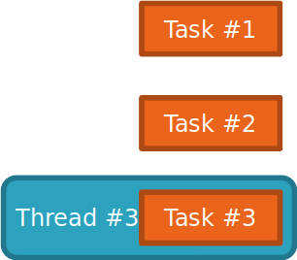

Thread pools
Until now, we've used one thread for each task we want to complete, i.e. each task becomes a thread

Slide 42


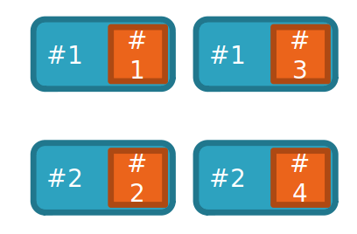


Thread pools
With a thread pool, we a create a set of threads, and have them work on a set of tasks until they are all complete

Slide 43
Thread Pools
A thread pool is created by using one of the factory methods of the Executors class
Typically we want a thread pool with a fixed number of threads, e.g.
Executor pool = Executors.newFixedThreadPool(10);
... will create a pool of 10 threads
Any Runnable object can now be run by passing it to the pool's execute method

Slide 44
Thread Pool Example
class Task implements Runnable {
public void run() {
System.out.println("Hello"); // Do something!
}
}
class Main {
public static int c = 0;
public static void main(String[] args) throws InterruptedException {
Executor pool = Executors.newFixedThreadPool(2);
for (int i = 0; i < 10; i++)
pool.execute(new Task());
}
}

