Slide 1


Analysis of Social buzz Content Categories
Notes:
A Hallmark of a foresightful business is an interest in the information their data conveys and how this information can be key in decision making. So, we appreciate the social buzz team for trusting us with the job of sifting through their data and extracting the insights, one of the many deliverables we pride ourselves in.
My name is Paulina John and, on behalf of the analytics team, I am happy to be presenting our findings from the analysis of social buzz content categories.
Here's the agenda for today...

Slide 2


Today's agenda
Project recap
Problem
The Analytics team
Process
Insights
Summary
Notes:
On the agenda for today, we have the project recap, the problem we are trying to solve, I’ll introduce the analytics team, run us through the process through which we did this analysis, share insights from the analysis and I’ll share our conclusions.

Slide 3

A
An audit of Social buzz big data practice.
Project Recap
Recommendations for a successful IPO
An analysis of Social buzz's content data showing the top 5 most popular categories.
Notes:
To recap, we are helping social buzz handle
an audit of their big data practice
Recommendations for a successful IPO and
An analysis of Socialbuzz's content categories showing the top 5 categories with the largest popularity
This is where we come in, as the analytics team

Slide 4


Problem
Over 500 million active users each month.
Over 100, 000 pieces of highly unstructured content everyday.
Socialbuzz needs more robust resources to draw insights from these data; one of such insights is; to find out their top 5 most popular content categories.
Notes:
With over 500 million active users each month over the past 5 years,
over 100, 000 pieces of highly unstructured content data everyday,
social buzz, asides needing help with handling this volume and variety of data and in scaling their processes, want to see their top 5 most popular content categories.

Slide 5



Andrew Fleming
Chief Technical Architect
The Analytics team
Marcus Rompton
Senior Principle
Paulina John
Data Analyst
Notes:
Andrew Fleming (Chief Technical Architect)- who is ensuring we deliver on high quality data insights and solid data strategy.
Marcus Rompton (Senior Principle)- Who is responsible for managing and overseeing the results of the analysis we present.
Myself, Paulina John- responsible for the hands-on analysis of data and translating the requirements of the data into insights
and;
Michelle Grove- who will work closely with the data team to produce predictions of future active user forecasts and developing aalgoritms for socialbuzz’s scale.

Slide 6
Understanding the business problem
Process
1
2
Data Cleaning
3
Data Modeling
4
Data Analysis
5
Sharing Insights
Notes:
Understanding the business problem: This involved understanding the deliverable socialbuzz expects and examining the data provided to ensure it has the needed information that will yield the expected insight.
I used SQL (MSSQL) for data cleaning.
Data cleaning- I cleaned each of the datasets by addressing dirty data issues like missing values, inconsistent formatting and multiple textual variants, and dropped columns irrelevant to the analysis.
Data modeling: this involved me understanding how each of the datasets provided connect with each other. I was able to carry out this task using the data model provided, by understanding how the datasets connect to each other, I was able to I merge the three cleaned datasets into a single one that focuses on the columns we need for the analysis (using Joins, a subquery, and a CTE and saved as a view).
Data Analysis- I moved the cleaned dataset into a spreadsheet document, from where I analyzed the data to get the top 5 most popular content categories by computing the total reaction score for each content categories (Using the UNiQUE() function to get a list of the categories without duplicates and Sumif to compute the total) and sorting (Using the SORT() function to get the top 5), which I saved in a new sheet.
Sharing insights- I will be using PowerBi for to create visualizations… creating a report of the top 5 categories amongst other insights from the cleaned and merged dataset.

Slide 7
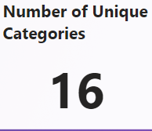
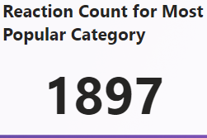
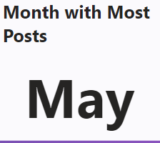

Insights
Notes:
There are sixteen different categories of content currently shared on Socialbuzz.
Content from the most popular category ‘Animal’, have received 1897 reactions. Asides being the most popular category, is also the category whose content have received the most reaction.
Users post content in may than in any other month.

Slide 8
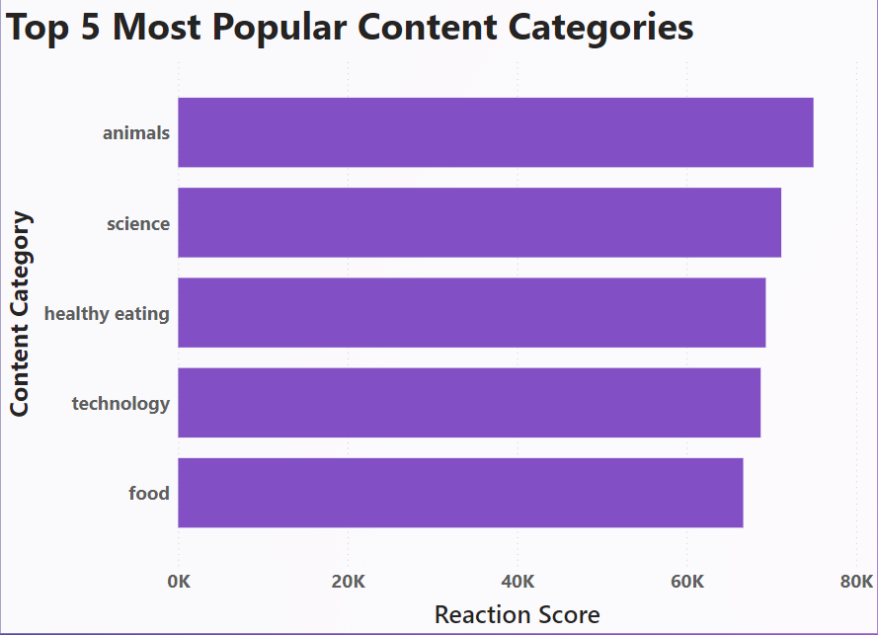
Notes:
‘Animals’ is the most popular category, followed by ‘Science’. The 5th most popular category is food.

Slide 9
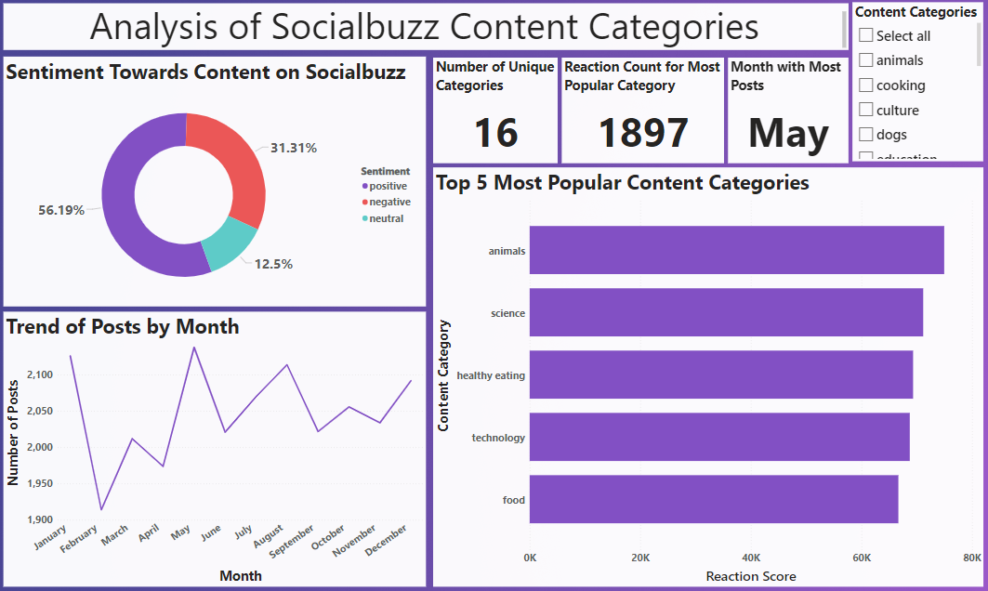
Notes:
And here is the full report of the analysis.
We also see from here here that:
%56.19% of the posts on socialbuzz receive positive reactions, 31.31% get neutral reactions and, 12.5% get negative reactions.
Number of posts is typically lowest in february, and then begins to rise gradually again until it hits its highest in may, and fluctuates through the remaining months all through to december when it begins to rise sharply again.

Slide 10

Analysis
The most popular content category is ‘Animals’, followed by ‘Science’.
Insight
Socialbuzz can leverage interest in food-related categories to:
Attract food and health-eating brands to advertise on the platform and/or;
Create in-house campaign and involve such brands, to boost user engagement, and possibly, even reduce chances of churn.
Summary
Next Steps
Progress to large-scale analysis and automation of the process so you can understand your business, draw insights and make decisions in real time. We can show you how to do this.
Notes:
to conclude, our analysis showed that
Analysis
Socialbuzz users are most interested in content about animals.
Insight
Two food-related categories; ‘healthy eating’ and ‘food’ making the top 5 may indicate keen interest in users’ eating lifestyle. This can be used to attract third party advertisement or campaign from food and healthy eating brands to the platform and/or Create an in-house campaign and involve food and healthy-eating related brands to engage users even more. This will help to keep users for longer and can even reduce chances of churn.
Also, the top interest in ‘animals’ category can also be used to attract pet company to advertise on the platform.
Next steps
Having caught a glimpse of what your data is saying through this initial analysis, we advise that you move towards large-scale Analysis and automation of the process, especially in anticipation of not yet generated data, so you can understand your business, draw insights and make decisions in real time, even when you now have newly generated data, without having to constantly repeat the analysis. We can show you how to do this.
The reception towards content on social buzz is mostly positive
Socialbuzz can use the monthly trend in posts to inform third party advert placement on its platform

Slide 11

Thank you!
ANY QUESTIONS?
Notes:
Thank you, and I am happy to take your questions

