Slide 1
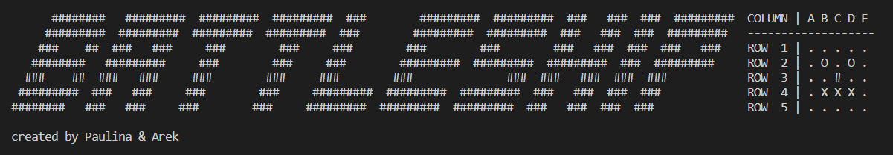
CodeCool
WAW.2022.04

Slide 2




VISUAL STUDIO CODE
GITHUB
PYTHON
TOOLS
DISCORD

Slide 3
Participants
Paulina Maciejewska POZNAN
Student at Technical University
young,
brillant mind, always focus ect
Arek Bojara
WARSAW
Graduated at Technical University and postgraduate in Finance
was young couple of decades ago
hard worker

Slide 4
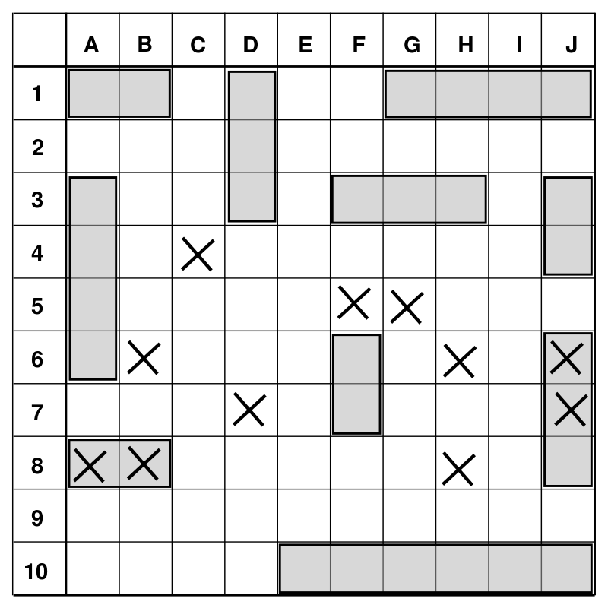
BATTLESHIP
Following WIKIPEDIA - https://en.wikipedia.org/wiki/Battleship_(game)
Battleship (also known as Battleships or Sea Battle[1]) is a strategy type guessing game for two players.
It is played on ruled grids (paper or board) on which each player's fleet of warships are marked.
The locations of the fleets are concealed from the other player.
Players alternate turns calling "shots" at the other player's ships, and the objective of the game is to destroy the
opposing player's fleet.
Battleship is known worldwide as a pencil and paper game which dates from
World War I.
It was published by various companies as a pad-and-pencil game in the 1930s
and was released as a plastic board game by Milton Bradley in 1967.

Slide 5
General INTRO
Player can choose size of board
Minimum 5x5
Maximum 26 x 26
Player can choose who will play
Human vs Human
Human vs Computer
Computer vs Human
Computer vs Computer
Player can choose level of difficulty
It idepends on the amount of ammunition but also – shoots error handlig
HARD uses AI and is very difficult to beat

Slide 6
General INTRO
LEVEL OF DIFFICULTY
If HUMAN
EASY → the amount of ammunition is 200% of number of the board spaces
MEDIUM → the amount of ammunition is 100% of number of the board space
HARD → the amount of ammunition is 75% of number of the board space
2. If COMPUTER (besides the amount of ammunition)
EASY → the computer shoots random places and can repeat itself
MEDIUM →the computer shoots random places but remember where it shot
HARD (AI) → initially shoots randomly, but has a list with hit part of ships and it try to sunk them

Slide 7



SomE extra
Terminal parameters
File handling with game statistic
Our first AI

Slide 8
Diagram simpliFY
START
BOARD WHO PLAY BOARD SIZE
PARAMETRYZACJA
BOARD CREATION
NO
COLUMN ROW
SHIP LENG
COMP_BOARD
YES
COMPUTER
HUMAN_BOARD
VALIDATION INPUT
NO COMP
VALIDATION PLACMENT
NO HUMAN
NO
SHOOTIN PHASE
HUMA INPUT
COLUMN ROW
END
COMPUTER
VALIDATION END
VALIDATION INPUT

Slide 9
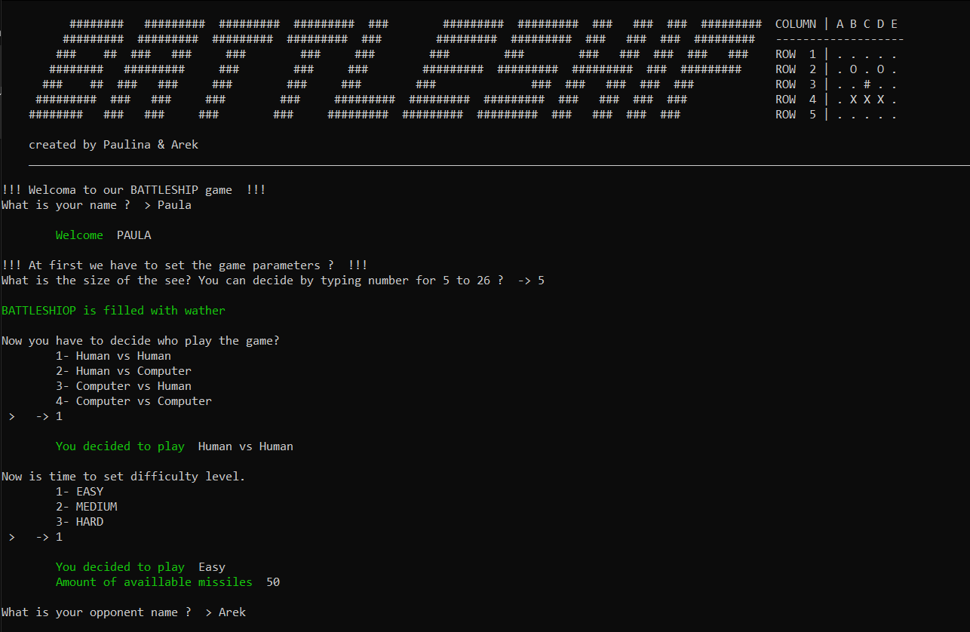
START - PARAMETERS

Slide 10
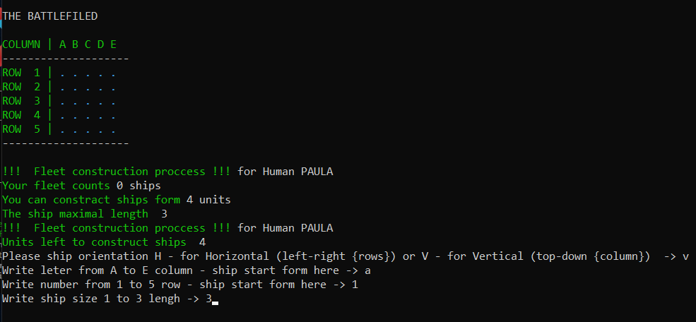
GAME PROCESS – HUMAN Placement phase

Slide 11
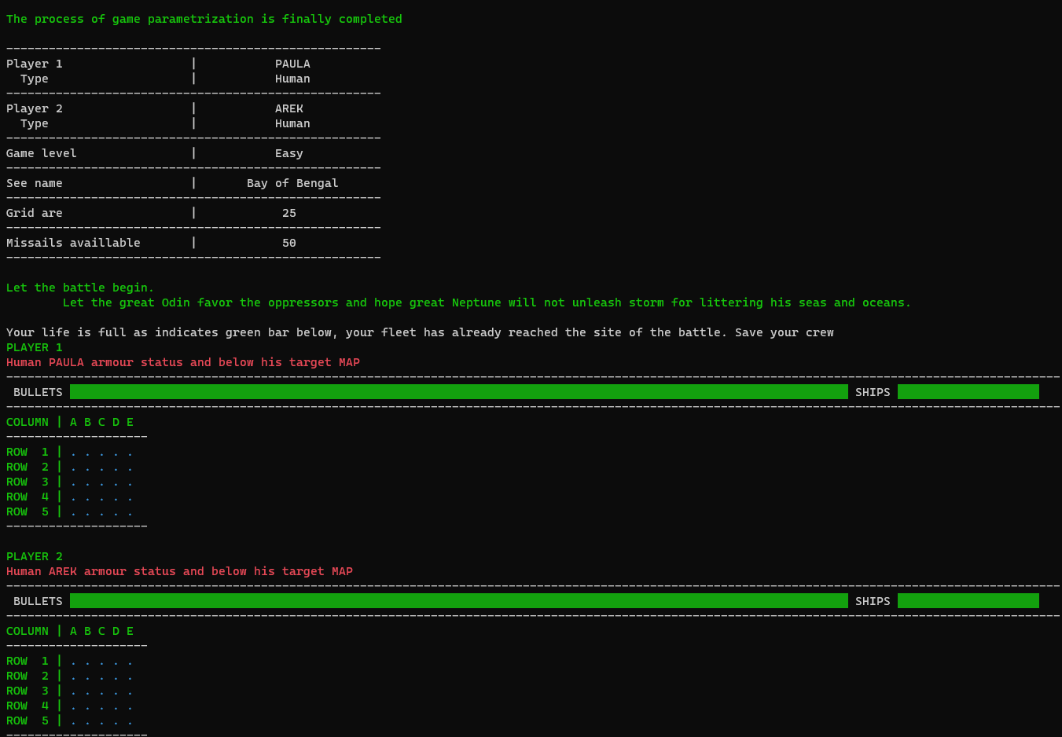
START – END OF PARAMETRISATION

Slide 12
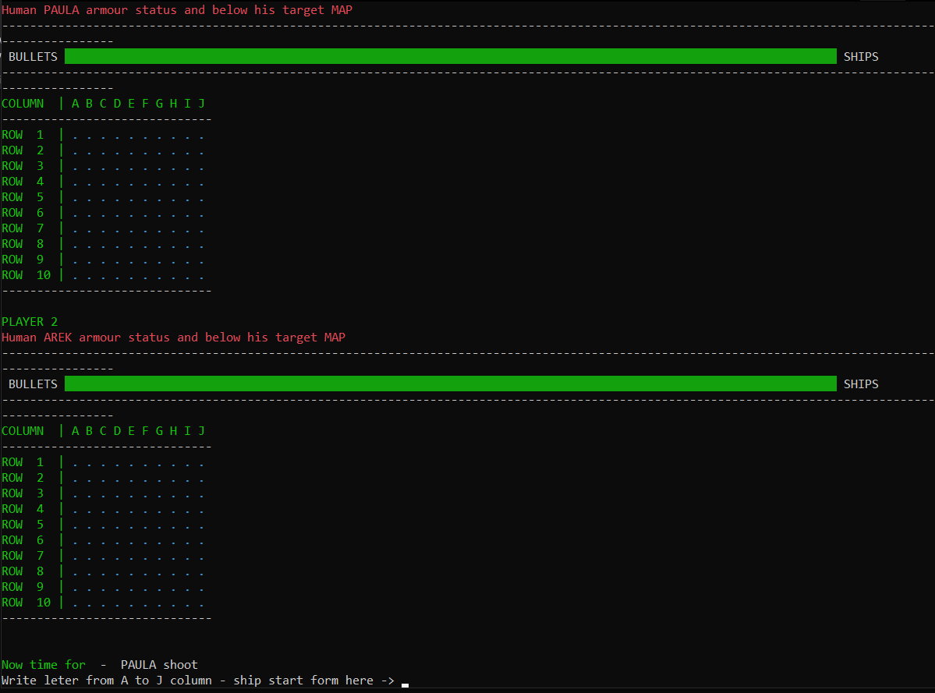
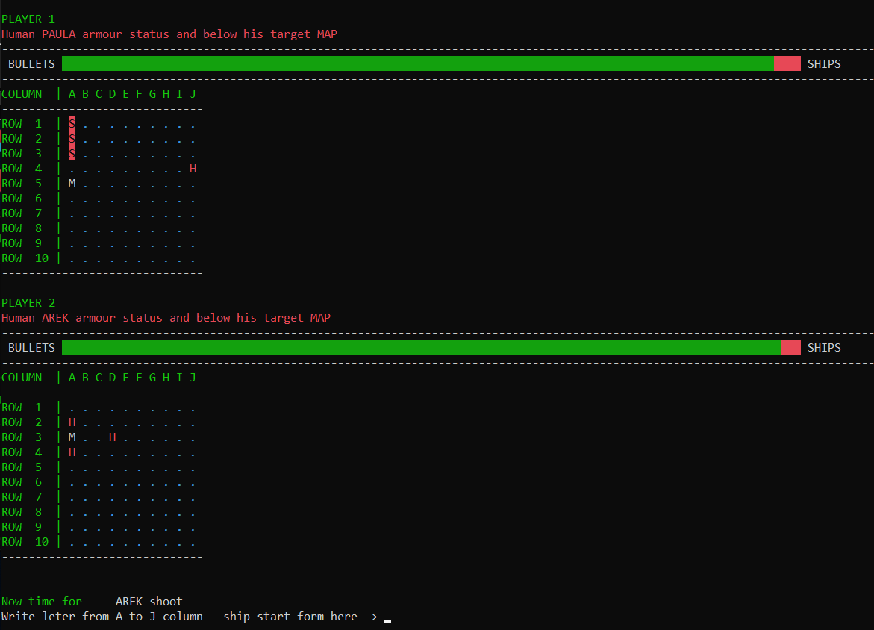
GAME PROCESS - Shooting phase

Slide 13

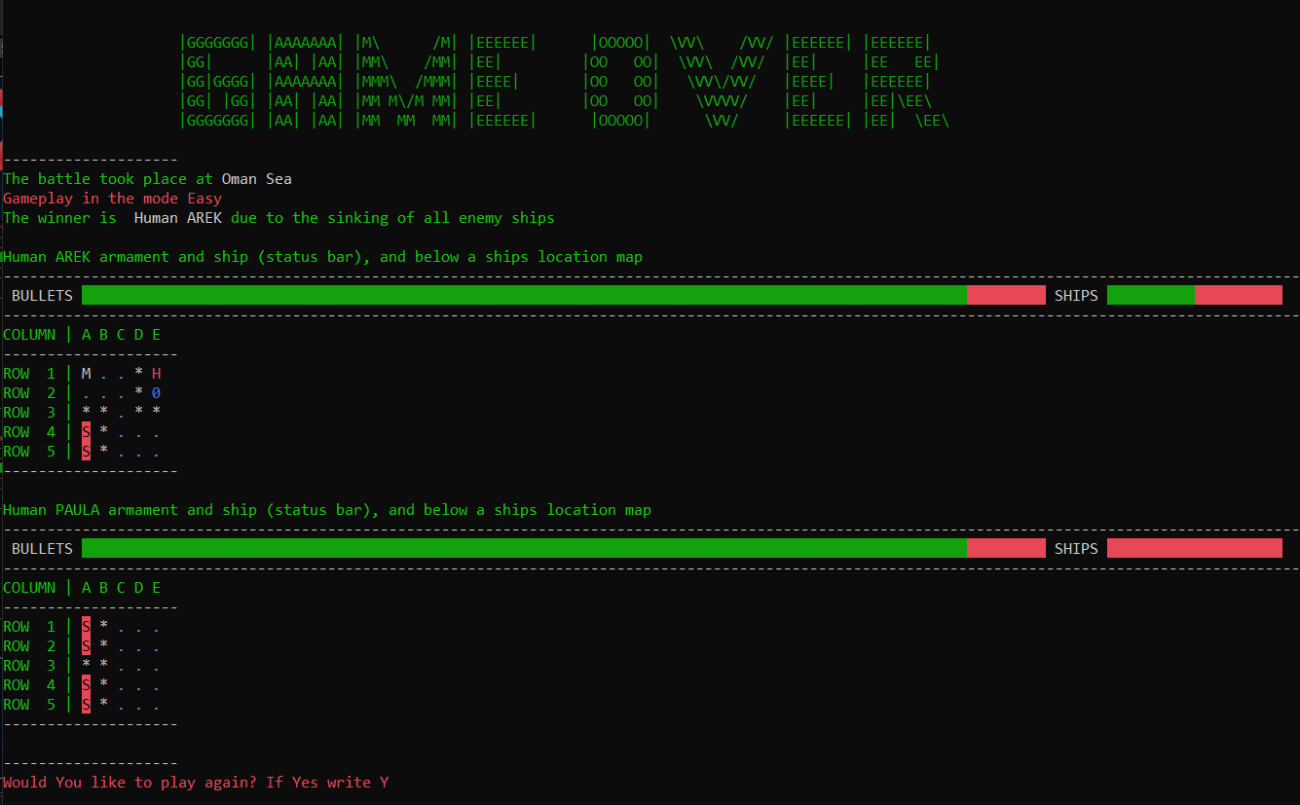
WINNING

Slide 14
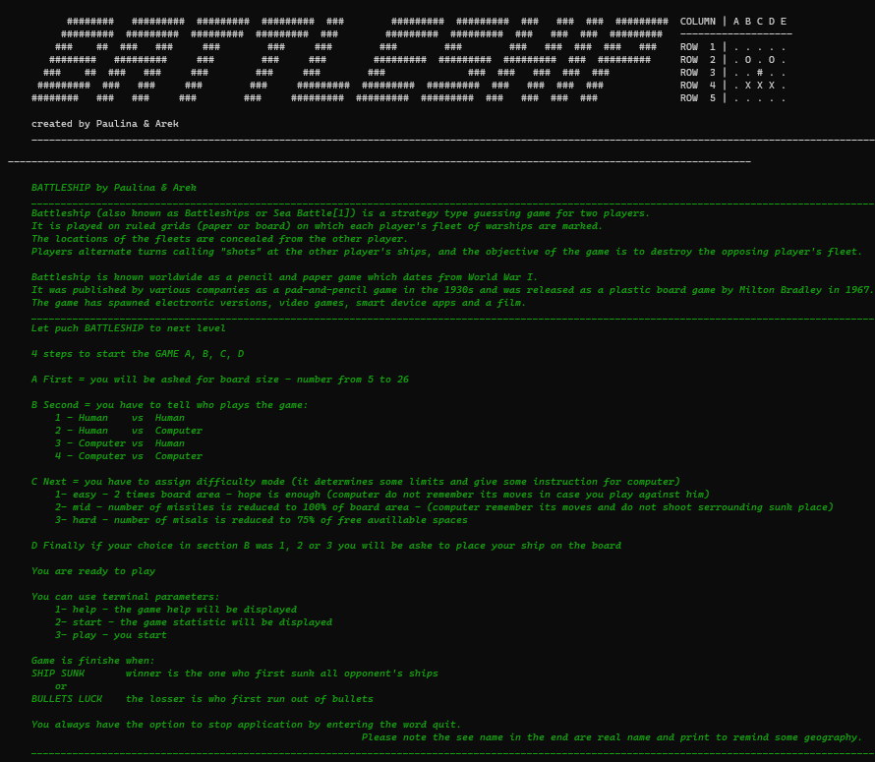
HELP

Slide 15
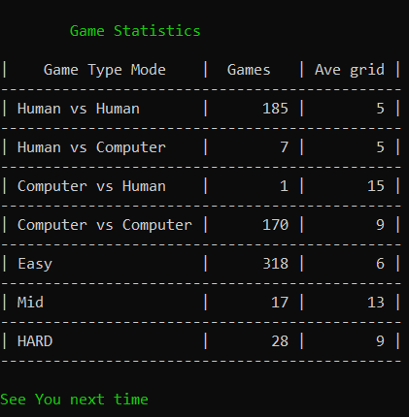
GAME stAtisticS

Slide 16
THANK YOU

