Slide 1

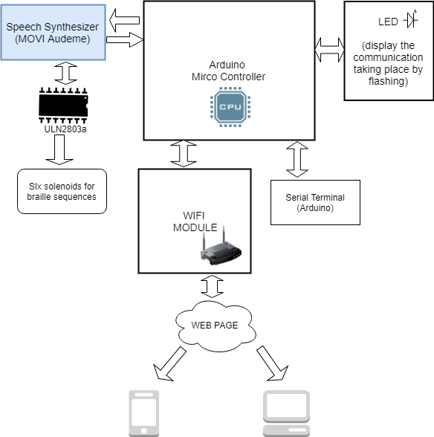

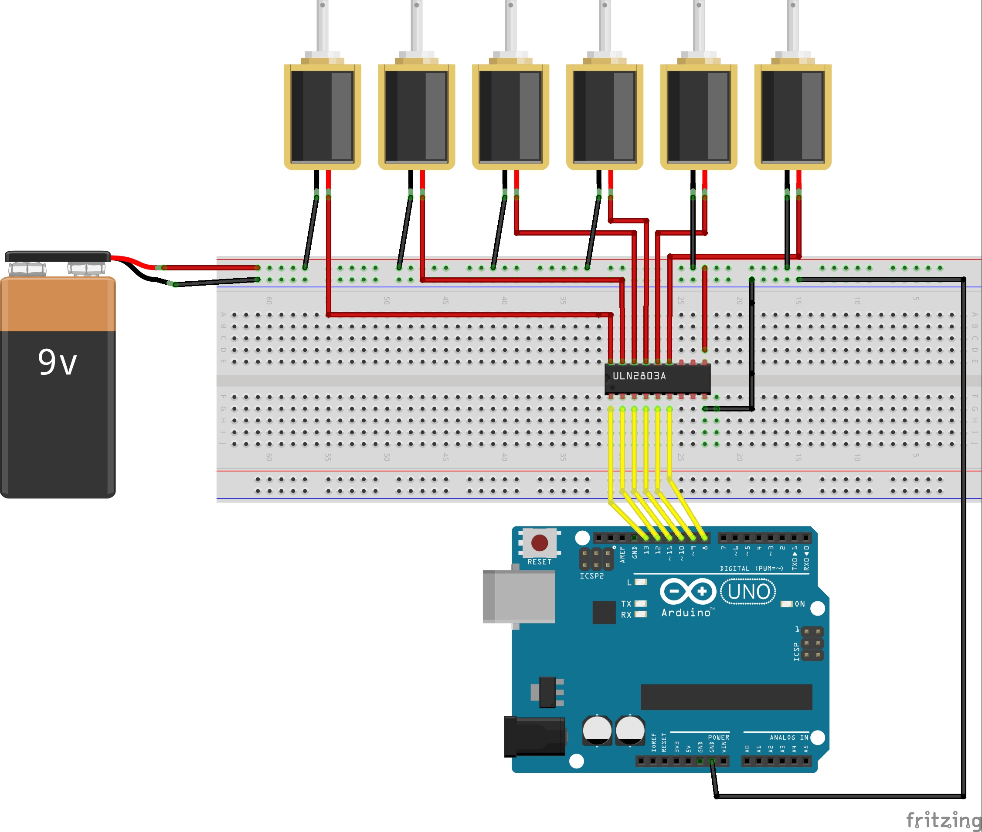
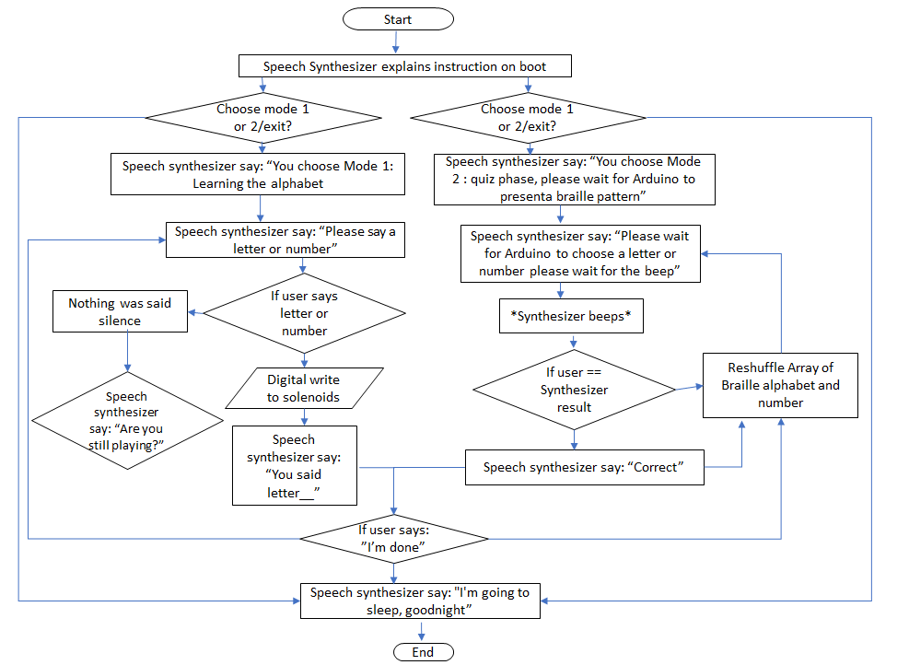

Electronic Braille Device
By Paulina Osikoya
Internet of Things (IOT)
BEng. Of Electronic and Software Engineering
Project Summary
Architectural Diagram
My Project is an electronic braille device which aids visually impaired individuals in learning Braille. My device is composed of an Arduino Microcontroller which is interfaced with a speech recognizer and synthesizer. The speech synthesizer allows the user to say a sentence which correlates to one of the letters in the alphabet and the synthesizer responds accordingly by activating a six sequence pattern represented by six D-frame push-pull solenoids, which represent the six braille cell, to produce an alphabet equivalent. My device is also integrated and networked with serial communications such as Serial terminal and Wi-Fi for added functionality and view my details of my project via a developed website using HTML and CSS
FACT
Around 36 million people of the earths population are somewhat visually impaired
Circuit Diagram
Features
Two modes to play in.
Plug and play.
Endless of hours of learning and fun.
Vocal Recognition and Quick response.
Can be connected over WIFI
Additional User Manual to understand working of the device
Why I choose my Project?
I choose my project simply because I wanted to give back to my community in a different way and the way I did this was by constructing a braille teacher for the blind community in my locality. Amidst the known technological developments implemented in my area I noticed that not many improvements were being amended to the blind community premised on the fact that braille was still being taught in rudimentary ways. So, I honed in on this area and decided to mesh electronics and technology into how braille was being taught to help the user enhance their learning and learn braille with ease
FLOWVCHART
Software and hardware
Data analysis
Digital Circuit Design
Circuit architecture analysis
Hardware build and test
C++/C programming
HTML and CSS
Networking: Wi-Fi,
Agile project management
User stories
Embedding architectures
Serial interfacing
Speech Synthesizer platform
Project planning
To yield the best experience with the device, it is recommended to use it with another individual

