Slide 1



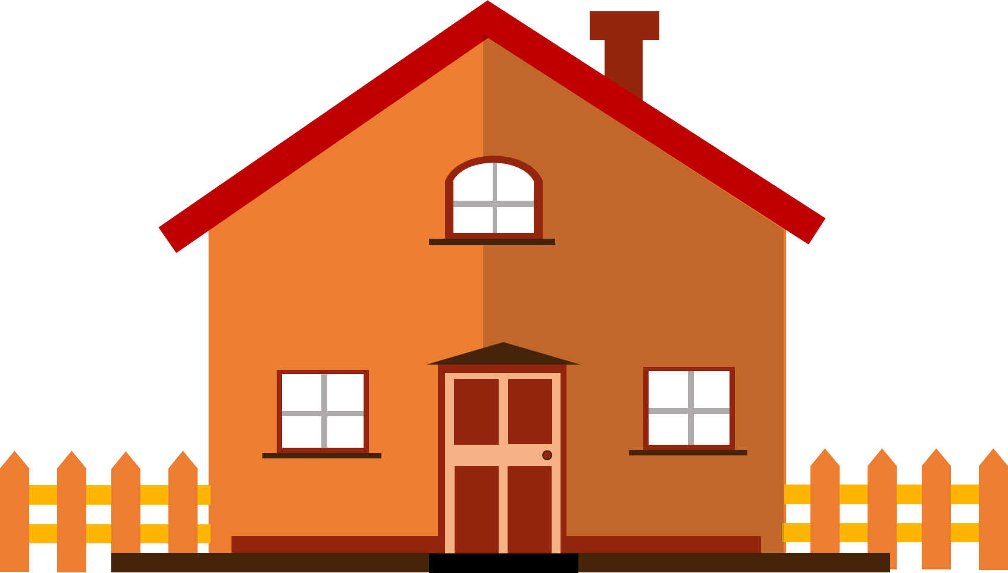








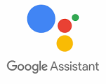

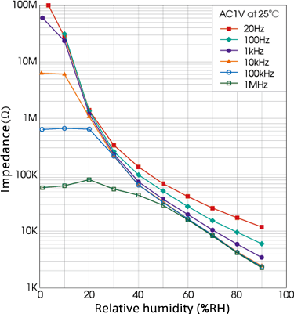
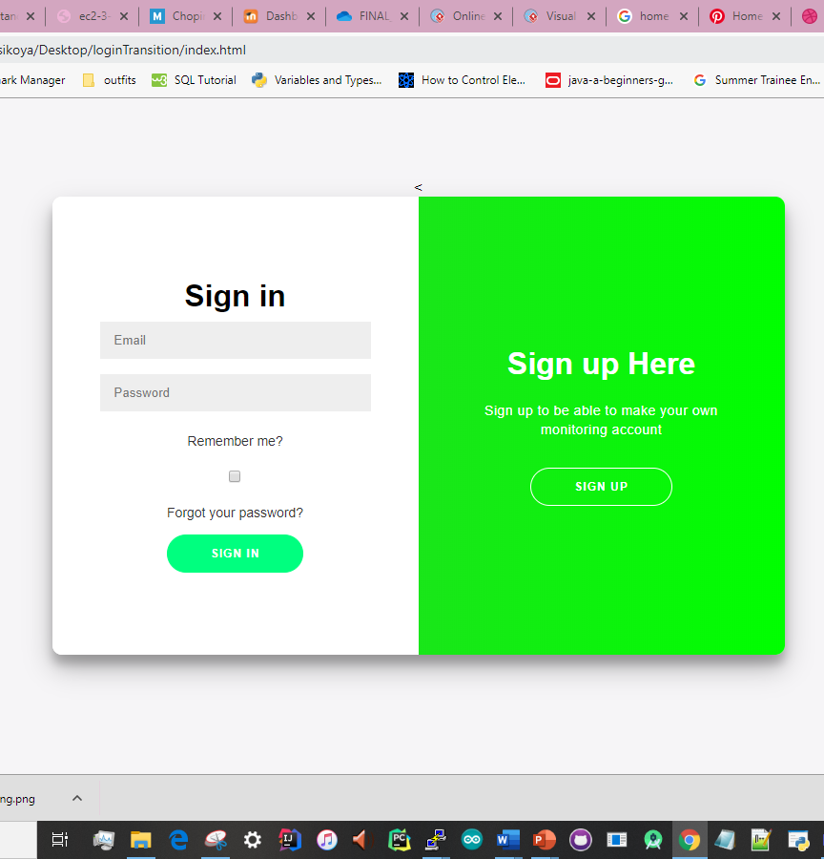
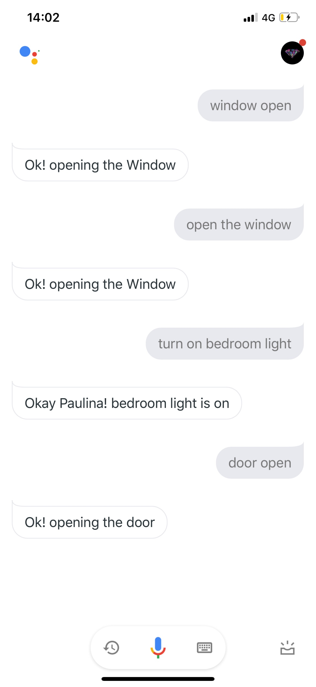
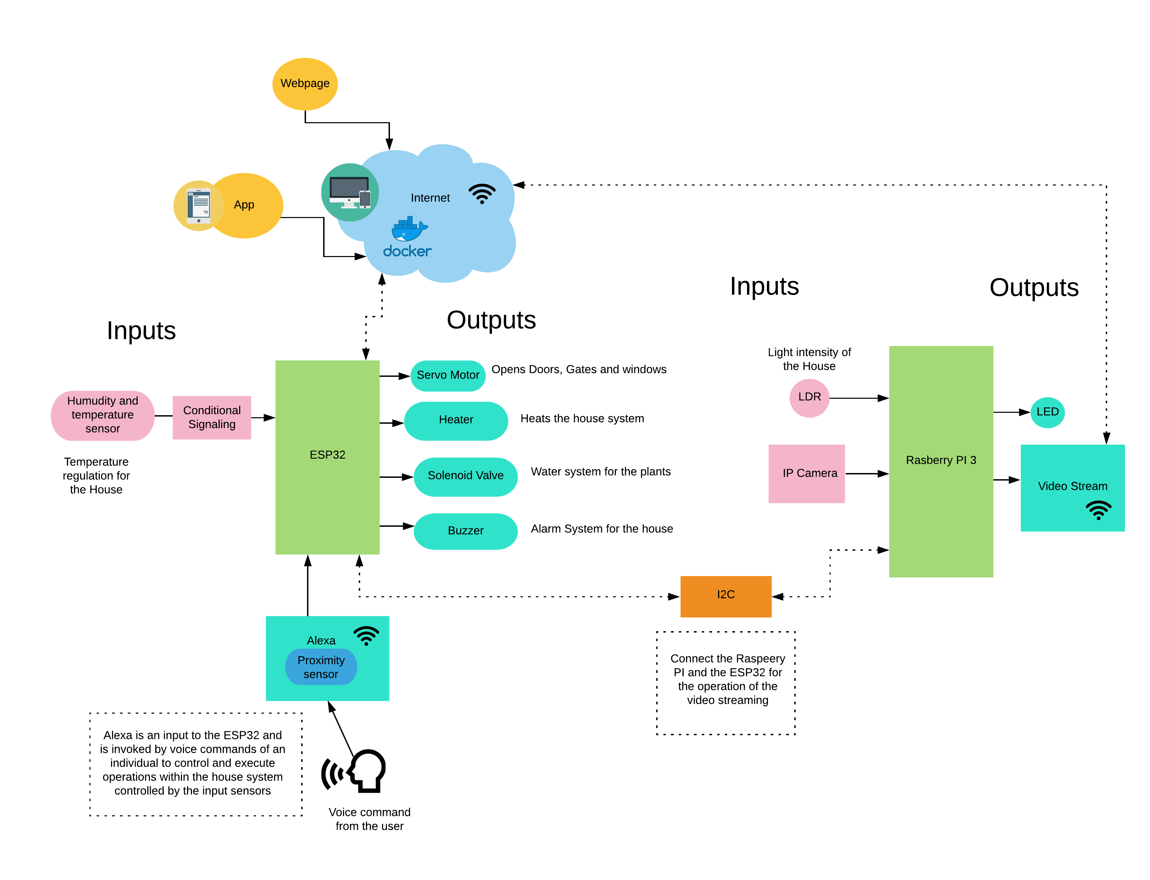
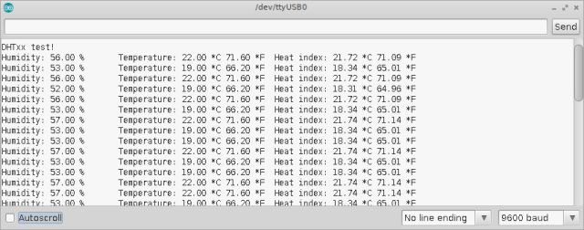
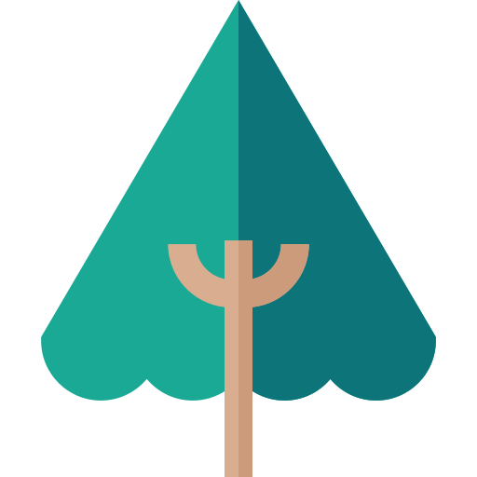

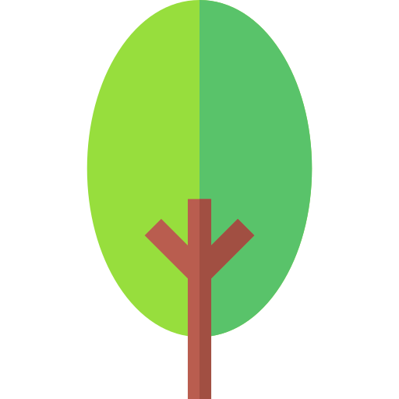
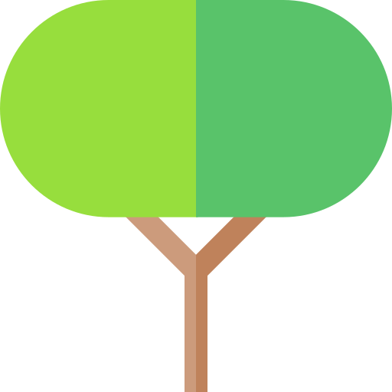

S U M M A R Y
My final year project is IOT home automation system. My system is developed on two development platforms; the Esp32 and the Raspberry pi which are connected to different sensors to monitor the house. The platforms communicate and send the data to a MQTT broker hosted on AWS. The Website is also connected to the broker and is responsible for displaying the data. The website is fully dynamic and equipped with user authentication and is built on the MEAN Stack framework. Also, I developed a mobile application that allows the user to control the house via commands voice using google assistant’s API. The final aspect of my project is experimental and features container technology using . The house Model was built by me using different architectural equipment and technologies
BEng Software and Electronic Engineering
Paulina Osikoya G00348898 Year 4
W H Y I C H O S E M Y P R O J E C T
I chose my project because over the past year since my internship at Intel, I became intrigued with internet of things products and Home automation. Premised on this fact, I wanted to develop a product that would aid the user to monitor their house remotely and reduce their daily tasks by automating them.
T E C H N O L O G Y U S E D
K E Y F I N D I N G S
The key finding that I believe served as an inspiration for my project was the fact that the average homeowner still spends an average of 7 hours doing chores and still manually writes To-do lists despite the prevailing technological revolution. After reading many sources, I observed that people save up to 5 hours a week when implementing home automation strategies. Armed with this knowledge, I went on to build a fully dynamic IOT home that is integrated with a website and mobile application that can control the house remotely. Using my system allows the user to monitor and control their house and fully maximise their time during the day.
Did you know that the average homeowner in Ireland spends over 7 hours weekly doing house chores like hovering, sweeping and turning on and off the lights!
F E A T U R E S
House Monitoring and secure security
House can be viewed from Website
Voice control for the house system via mobile application
Camera surveillance and video stream
G R A P H S
Architectural diagrams
R E S U L T S
While completing my project, I could clearly see the data coming from my sensors which are displayed above which I was able to visualize in the form of graphs. Also, I found that my system will make it easier for the user to track their house. The UI on both the app and website that I also competed, which are pictured above, made it easy for the user to navigate through the website and to access the various elements of their house

Slide 2
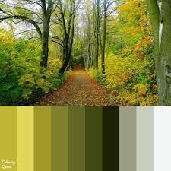



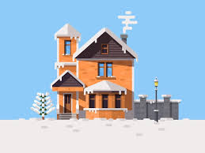



Slide 5
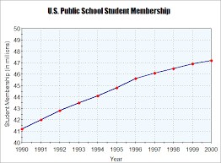
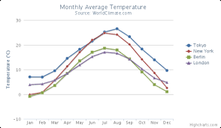
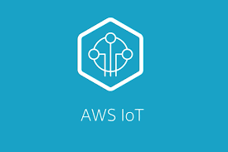

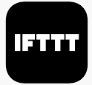

S U M M A R Y
My final year project is IOT home automation system. My system is developed on two development platforms; the Esp32 and the Raspberry pi which are connected to different sensors to monitor the house. The platforms communicate and send the data to a MQTT broker hosted on AWS. The Website is also connected to the broker and is responsible for displaying the data. The website is fully dynamic and equipped with user authentication and is built on the MEAN Stack framework. Also, I developed an mobile application that allows the user to control the house via commands voice using google assistant’s API. The final aspect of my project is experimental and features container technology using Docker.The house Model was built by me using different architectural equipment and technologies
BEng Software and Electronic Engineering
Paulina Osikoya G00348898 Year 4
W H Y I C H O S E M Y P R O J E C T
I chose my project because over the past year since my internship at Intel, I became intrigued with internet of things products and Home automation. Premised on this fact, I wanted to develop a product that would aid the user to monitor their house remotely and reduce their daily tasks by automating them.
T E C H N O L O G Y U S E D
K E Y F I N D I N G S
The key finding that I believe served as an inspiration for my project was the fact that the average homeowner still spends an average of 2 hours doing chores and still manually writes To-do lists despite the prevailing technological revolution. After reading many sources, I observed that people save up to 5 hours a week when implementing home automation strategies. Armed with this knowledge, I went on to build a fully dynamic IOT home that is integrated with a website and mobile application that can control the house remotely. Using my system allows the user to monitor and control their house and fully maximise their time during the day.
Did you know that the average homeowner in Ireland spends over 2 hours weekly doing house chores like hovering, sweeping and turning on and off the lights!
F E A T U R E S
House Monitoring and secure security
House can be viewed from Website
Voice control for the house system via mobile application
Camera surveillance and video stream
House control via voice commands
G R A P H S
Architectural diagrams
R E S U L T S
While completing my project, I could clearly see the data coming from my sensors which are displayed above which I was able to visualize in the form of graphs. Also, I found that my system will make it easier for the user to track and control their house remotely. The UI on both the app and website that I also competed made it easy for the user to navigate through the website and to access the various elements of their house.

