Slide 1
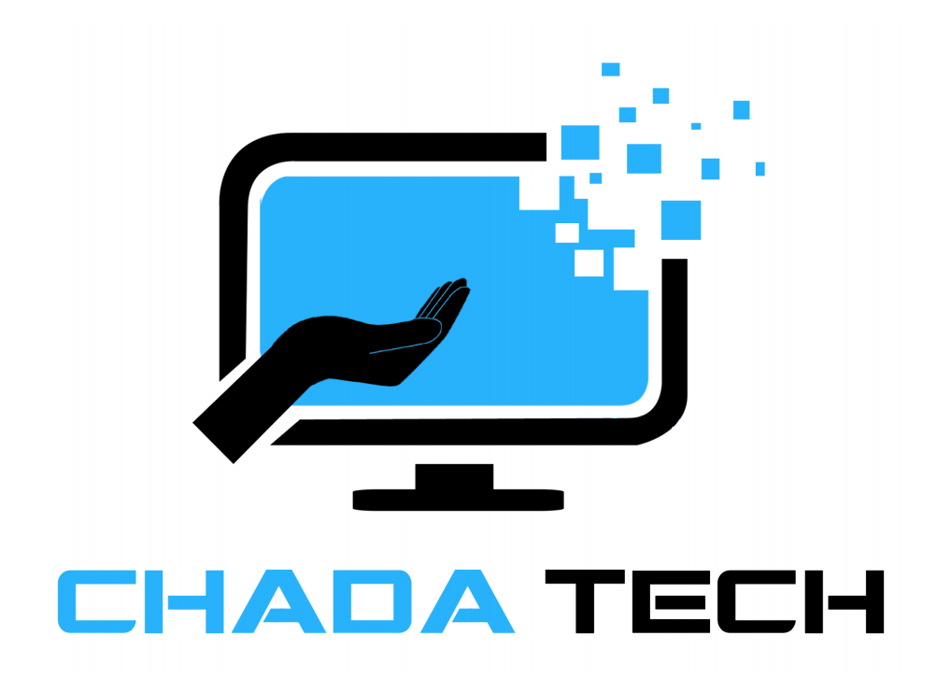
CS250 Agile Presentation
By Paulina Weaver

Slide 2
Scrum Master
The Scrum Master is responsible for ensuring that the Scrum framework is followed. They facilitate all Scrum events, including Sprint Planning, Daily Stand-ups, Sprint Reviews, and Sprint Retrospectives. Their primary focus is on removing obstacles that hinder the team's progress, thereby enabling the team to deliver high-quality products.
Importance:
Facilitates Agile Practices: By guiding the team through Scrum ceremonies, the Scrum Master ensures that Agile principles such as transparency, inspection, and adaptation are upheld.
Supports Team Collaboration: Acts as a buffer between the team and external distractions, allowing developers and testers to focus on their tasks without interruptions.
Promotes Continuous Improvement: Helps the team identify areas for improvement during retrospectives and encourages them to implement changes that enhance productivity and quality.
Why This Structure is Better:
Empowers Self-Organization: Unlike traditional project managers who direct tasks, Scrum Masters empower teams to self-organize and make decisions collaboratively.
Fosters Iterative Development: Facilitates iterative development cycles where teams can adapt quickly to changes in requirements or market conditions.
(Schwaber & Sutherland, 2020)

Slide 3
Product Owner
The Product Owner represents the voice of the customer and is responsible for maximizing the value of the product by managing the product backlog. They prioritize user stories based on business value and ensure that the team delivers the highest possible value in each sprint.
Importance:
Defines Product Vision: Communicates the product vision and goals to the development team, ensuring alignment with business objectives.
Prioritizes Backlog Items: Determines which features or enhancements should be implemented first, based on customer needs and market demands.
Makes Decisions: Acts as the primary decision-maker regarding product features, providing clarity and direction to the development team throughout the project.
Why Train as a Product Owner:
Direct Customer Interaction: Unlike traditional business analysts, Product Owners engage directly with stakeholders and customers to gather feedback and refine requirements.
Ensures Return On Investment : By prioritizing backlog items that deliver maximum business value, Product Owners optimize return on investment for the organization.
(Schwaber & Sutherland, 2020)

Slide 4
Developer
Developers are responsible for implementing the features and functionalities defined in user stories. They collaborate closely with testers and the Product Owner to ensure that each increment of work meets the acceptance criteria.
Importance:
Technical Expertise: Developers bring technical skills in programming languages, frameworks, and software design principles to build robust and scalable solutions.
Collaborative Development: Work closely with testers to identify and resolve defects early in the development process, ensuring high-quality deliverables.
Continuous Integration: Participate in continuous integration practices to merge code changes into a shared repository frequently, facilitating rapid feedback and integration testing.
Why this Team Structure is Better:
Cross-functional Collaboration: Agile teams consist of cross-functional members who collectively possess the skills needed to deliver a complete product increment.
Adaptive Skills: Developers are adaptable to changing requirements and can pivot quickly to address emerging challenges or opportunities.
(Schwaber & Sutherland, 2020)

Slide 5
Tester
Testers ensure the quality of the product by testing each increment of work against predefined acceptance criteria. They collaborate with developers and the Product Owner to validate user stories and identify defects.
Importance:
Quality Assurance: Testers verify that the product meets functional and non-functional requirements, ensuring it behaves as expected under various conditions.
Early Defect Detection: Identify and report defects early in the development process, reducing rework and improving overall product quality.
Test Automation: Implement automated testing frameworks and scripts to streamline testing efforts and increase test coverage.
Why Dedicated Testers:
Specialized Expertise: Testers bring specialized skills in testing methodologies, tools, and techniques that ensure thorough validation of software functionality.
Risk Mitigation: By conducting comprehensive testing, testers mitigate risks associated with product defects and ensure a positive user experience.
(Testdel, 2021)

Slide 6
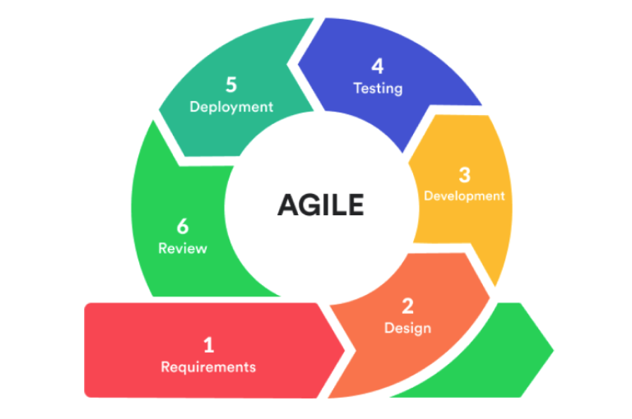
6 Phases of SDLC in Agile
Defining the Requirements
In Agile, defining requirements is a continuous process where the product team collaborates with stakeholders to
create and prioritize user stories based on business value and customer needs.
Importance:
Customer-Centric: Ensures that the development team focuses on delivering features that provide the most value to the end-users.
Flexibility: Allows for requirements to evolve as the project progresses, accommodating changes based on feedback and market conditions.
Design
The design phase in Agile is iterative, with initial high-level architecture defined at the beginning, followed by detailed design work within each sprint as user stories are selected for development.
Importance:
Adaptability: Enables the team to adjust the design as new insights are gained and requirements evolve.
Collaboration: Promotes continuous interaction between developers, designers, and stakeholders to ensure the design meets user needs and technical constraints.
Development
Coding in Agile is done in short, iterative cycles called sprints, where developers implement user stories prioritized for each sprint. Code is frequently integrated and reviewed.
Importance:
Quality Focus: Encourages practices like pair programming, code reviews, and continuous integration to maintain high code quality.
Incremental Progress: Delivers working software frequently, allowing for early validation and feedback.
(Raheja, 2023)

Slide 7
6 Phases of SDLC in Agile
Testing
Testing in Agile occurs throughout the development cycle. Each iteration includes testing to ensure that the software
meets the defined requirements and functions correctly.
Importance:
Continuous Quality Assurance: Ensures that defects are identified and addressed early, reducing the risk of major issues later.
User Feedback Integration: Allows for rapid response to user feedback and changing requirements.
Deployment
Agile emphasizes frequent releases of software increments. Each release is a potentially shippable product, providing value to the customer.
Importance:
Frequent Delivery: Ensures that the customer receives regular updates and new features, improving satisfaction and engagement.
Risk Mitigation: Smaller, incremental releases reduce the risk of major issues compared to large, infrequent releases.
Maintenance
Post-release, Agile teams continue to support and enhance the software based on user feedback and evolving requirements. Maintenance includes bug fixes, updates, and new feature development.
Importance:
Continuous Improvement: Ensures the product remains relevant and valuable to users over time.
Stakeholder Engagement: Keeps the lines of communication open between the development team and stakeholders, fostering a collaborative approach to long-term software success.
(Raheja, 2023)

Slide 8
If a Waterfall Approach was used
Under Waterfall, requirements are typically defined upfront and assumed to be static throughout the project lifecycle. This rigid approach could have led to challenges as the project progressed and requirements inevitably evolved. It might have caused delays and increased the likelihood of rework due to changes not being easily accommodated.
The Waterfall model follows a linear and sequential order of phases (requirements, design, implementation, testing, deployment, maintenance). This strict sequence means that each phase must be completed before moving on to the next. Issues or changes identified late in the process would have necessitated revisiting earlier stages, potentially causing delays and impacting project timelines.
Unlike Agile, which allows for flexibility and iterative development, Waterfall does not easily accommodate changes once a phase is completed. This lack of adaptability could have hindered the project’s ability to respond to changing market conditions, customer feedback, or emerging requirements.
Waterfall typically involves less frequent stakeholder involvement after the initial requirements phase. Limited ongoing communication with stakeholders could lead to misunderstandings or misalignments between the delivered product and stakeholder expectations. This might result in a final product that does not fully meet client needs or lacks critical features.
The sequential nature of Waterfall increases the risk of delays and budget overruns. Issues or changes identified late in the development process would require significant rework, impacting project costs and potentially leading to missed deadlines.
The rigid structure and limited feedback loops in Waterfall could have compromised client satisfaction. Without ongoing validation and feedback, there’s a higher risk that the delivered product might not meet current market needs or client expectations, leading to reduced satisfaction and potential business impacts.
(Hoory & Bottorff, 2024)

Slide 9
Factors to Consider: Agile vs. Waterfall
Agile
Waterfall
Requires a cultural shift and training for teams accustomed to traditional project management.
Involves continuous client feedback, suitable for projects requiring flexibility and iterative development.
Best for projects with evolving requirements, allowing adjustments throughout development.
Offers flexibility to adapt to changing priorities and market conditions.
Mitigates risks through iterative deliveries and continuous risk reassessment.
Promotes cross-functional collaboration throughout the project, enhancing innovation and problem-solving.
Ideal for organizations with structured processes and clear hierarchies.
Clients engage primarily during initial and final phases, with less involvement during development.
Effective when requirements are stable and well-defined upfront, minimizing changes.
Less adaptable once development begins, as changes can impact project timelines and costs.
Focuses on upfront planning and risk identification to manage throughout the project lifecycle.
Typically follows a sequential approach with less interaction between different project phases, potentially hindering communication and collaboration.
(Hoory & Bottorff, 2024)

Slide 10
Agile isn't just a methodology; it's a strategic advantage in today's dynamic market. Embracing Agile means faster adaptation, higher client satisfaction, and staying ahead of the competition. The time to innovate and deliver value is now—choose Agile for a future-ready approach to project success.

Slide 11
References
Hoory, L., & Bottorff, C. (2024, May 31). Agile vs. waterfall: Which project management methodology is best for you?. Forbes. https://www.forbes.com/advisor/business/agile-vs-waterfall-methodology/
Raheja, S. (2023, March 28). 6 phases of SDLC: Key stages in software development life cycle. Taazaa. https://www.taazaa.com/6-stages-of-software-development-life-cycle/
Schwaber, K., & Sutherland, J. (2020, November). The 2020 Scrum Guide TM. Scrum Guides. https://scrumguides.org/scrum-guide.html
TestDel. (2021, September 27). The Tester Role in an Agile World. Medium. https://testdel.medium.com/the-tester-role-in-an-agile-world-434acfd8d36

