Slide 1
Ames Data Findings

Slide 2
Business Understanding
Research Objectives
  To find the average sales prices of house in Ames between 2006 to 2010.
  To find out the number of total rooms above average.
  To find out the overall house condition with the highest number of houses.
  To find out the features that have the strongest positive and negative correlation with sale price.

Slide 3
Research Objective 1
To find the average sales prices of house in Ames between 2006 to 2010
Results:
  SalesPrice Mean : 180921.1959
  SalesPrice Median : 163000.0
  SalesPrice Standard Deviation: 79442.5029
  Interpretation: we have a significant mean of $180,921.1959 which is a reflection of the average sales price of houses in Ames between 2006 and 2010.

Slide 4
Research Objective 2
  To find out the Average number of total rooms above average
  Results:
    Mean : 6.5178
    Median : 6.0
    Standard Deviation: 1.6254
  Interpretation: The mean reveals that, on average, there are 6.5 rooms above grade. This reveals that, in Ames the majority of houses have 6 to 7 rooms.

Slide 5
Research Objective 3
  To find out the overall house condition with the highest number of houses
Results:
  Mean : 5.575
  Median : 5.0
  Standard Deviation: 1.113
Interpretation:
  The overall condition of houses in Ames are rated at 5.575. assuming a scale of 1 to 10. We can interpret that the overall condition of houses in Ames is above average rating.

Slide 6
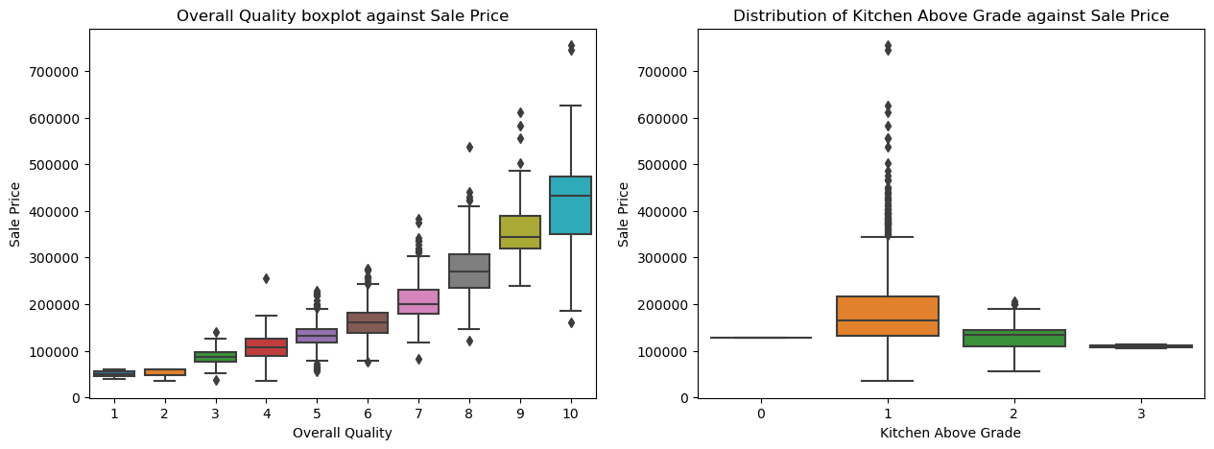
Research Question 4
To find out the features that have the strongest positive and negative correlation with sale price
Notes:
- **Plot 1: Overall Quality Vs. Price**:
In the first plot, there is a clear positive correlation between the overall quality of a house and its sale price.
Houses with higher quality ratings (8 - 10) tend to have significantly higher median sale prices,
often exceeding $300,000, while lower-quality houses (1– 4) are sold for less than $150,000.
- **Plot 2: Kitchen Above Grade Vs. Price**:
In the second plot, Houses with one kitchen above grade dominate the dataset, exhibiting a wide range of sale prices and the highest variability,
with some properties selling for over $700,000. Houses with two kitchens,and three kitchens however, have lower median sale prices compared to those with one kitchen,
suggesting that additional kitchens may not add significant value.

Slide 7
Conclusion and Recommendations
House prices are influenced by other factors including age of house at the time of sale. Therefore, future analytics can explore how other factors contribute to the overall sale price.

