Slide 1
GDW - Unskipable
Want a break from the ads?
Would be a shame if you couldn‘t skip them…

Slide 2
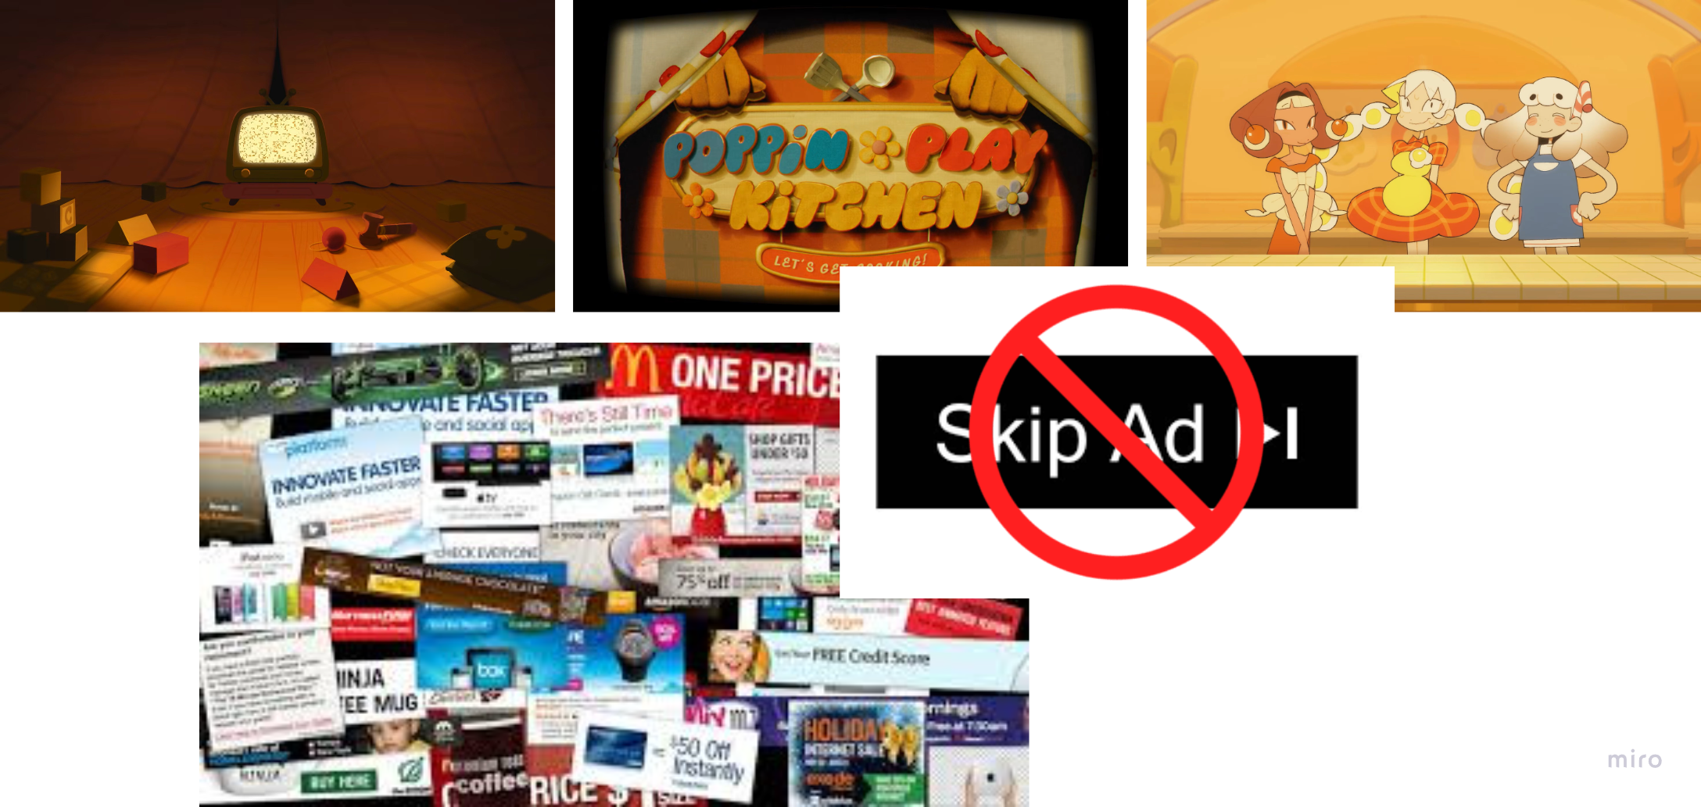
Moodboard
Ad(s) that don‘t want to be skipped
Try to find the skip button the ad(s) hide from you
The Team (that you could be part of)
We have 2D artists, Animators (x2) and a programmer (we all do a lil bit of game design)
We could use a sound designer

