Slide 1


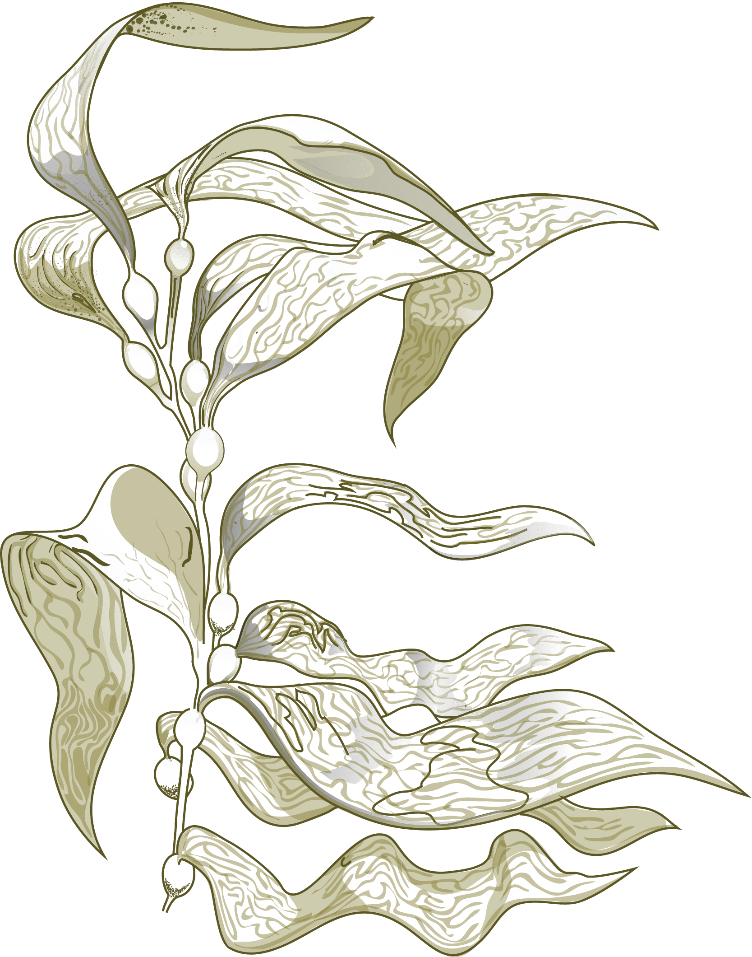



M2 Intership
Comparative analysis of genome-scale metabolic networks among brown algae
Pauline Hamon-Giraud
Supervisors : Anne Siegel, Jeanne Got & Gabriel Markov

Slide 2
Summary
Objectives
Generate metabolic networks
  AuCoMe tool
  Generated Networks
  Results
  Accessibility of results
  Perspectives
Study the evolution of gene loss in Laminarionema elsbetiae
  Finding the lost genes
  Results
  Interpretation
  Perspectives
Interactions between the endophyte L. elsbetiae and its host S. latissima

Slide 3
Objectives
Generate metabolic networks of brown algae from Phaeoxplorer data
Study the evolution of gene loss in Laminarionema elsbetiae (endophytic lifestyle)
Identify interactions of metabolic functions between the endophyte L elsbetiae and its host Saccharina latissima

Slide 4
Generate metabolic networks
Why ?
Identify the metabolic reactions / pathways of species
Compare metabolic networks between species allow to reconstruct trees based on metabolic capability
How ?
From annotated genome files : Phoexplorer + Public
Thanks to the AuCoMe metabolic networks reconstruction tool

Slide 5
AuCoMe tool
Objective : Automatically reconstruct metabolic networks and homogenize the annotations of the input files
—> overcome the heterogeneity of the annotations according to the organisms
Main steps :
Reconstruction of networks from file annotations (PathwayTools)
Gene propagation by orthology (Orthofinder)
Search for potential missed annotations during initial annotation of files
Adding spontaneous reactions to networks
Processing the results : clustering (Pvclust), tables

Slide 6


AuCoMe tool
GSMN = Genome-Scale Metabolic Networks
GSMN 1
Draft reconstruction
Genome 1
GSMN 2
Genome 2
Genome 3
MPWT
GSMN 3
Genome
Functional annotation
Metabolic reaction
Gene or Prot
Gene-Protein-Reaction relationship and metabolic reaction

Slide 7
AuCoMe tool
Orthogroups (OG)
GSMN 1
2. Orthology propagation
GSMN 2
Robust OG 
GPR propagation
✓ ✘
Non-robust OG 
no GPR propagation
GSMN 3
OrthoFinder
Genome
Functional annotation
Metabolic reaction
Gene or Prot
Gene-Protein-Reaction relationship and metabolic reaction

Slide 8
AuCoMe tool
GSMN 1
3. Structural verification
vs
&
vs
&
vs
GSMN 2
BlastP
Tblastn
Exonerate
Genome 2
Genome 3
GSMN 3
Genome
Functional annotation
Metabolic reaction
Gene or Prot
Gene-Protein-Reaction relationship and metabolic reaction

Slide 9
AuCoMe tool
Spontaneous reaction
GSMN 1
4. Spontaneous completion
Metabolic pathways
GSMN 2
GSMN 1
GSMN 2
GSMN 3
GSMN 3
Genome
Functional annotation
Metabolic reaction
Gene or Prot
Gene-Protein-Reaction relationship and metabolic reaction

Slide 10
b. Generated Networks
Phaeoexplorer
Public
● Long read
Diatoms
Brown algae
Networks generated for a dataset including long read assemblies + Laminarionema.E : Dataset 01
18 Brown algae :
Public :
Undaria pinnatifida (Kr2015)
Cladosiphon okamuranus
Ectocarpus species 7
Ectocarpus subulatus
Nemacystus decipiens
Saccharina japonica
Phaeoxplorer :
Ectocarpus crouaniorum (m) ●
Laminarionema elsbetiae
Desmarestia herbacea (m) ●
Porterinema fluviatile ●
Scytosiphon promiscuus (m) ●
Ectocarpus siliciosus (m) ●
Chordaria linearis ●
Pleurocladia lacustris ●
Ectocarpus fasciculatus (m) ●
Dictyota dichotoma (m) ●
Fucus serratus (m) ●
Saccharina latissima (f) ●
6 Outgroups :
Public :
Fistulifera solaris
Fragilariopsis cylindrus
Phaeodactylum tricornutum
Thalassiosira pseudonana
Nannochloropsis gaditana
Phaeoexplorer
Schizocladia ischiensis ●

Slide 11
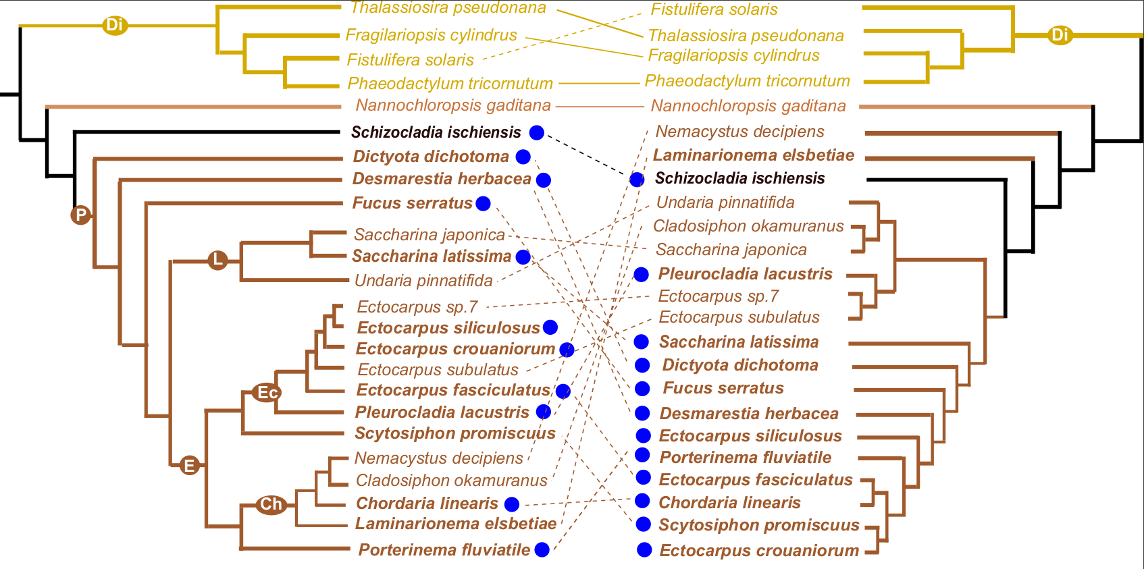
c. Results : Dataset 01
Original phylogeny Results Aucome dataset 01

Slide 12
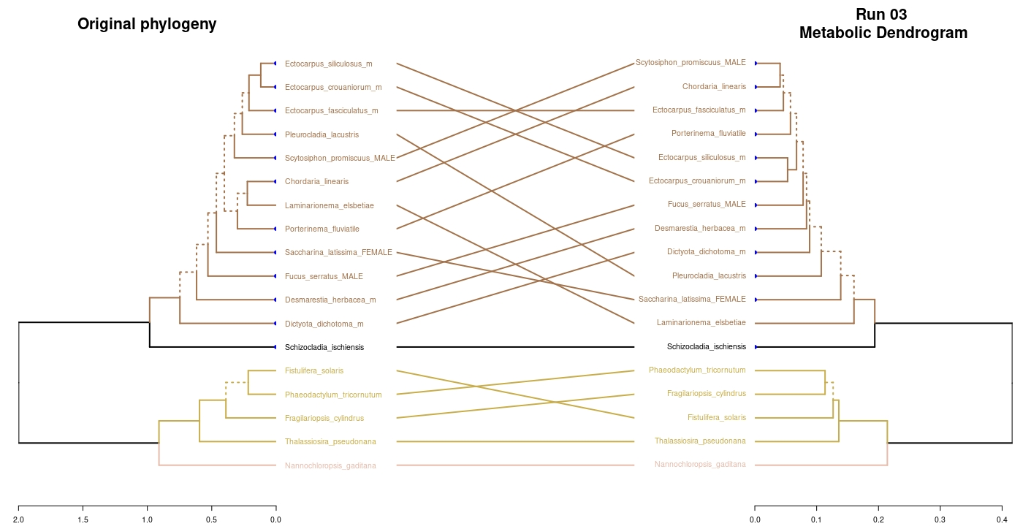
c. Results : Dataset 03

Slide 13
c. Results : Dataset 03 -> Interpretation
How to get closer to the phylogeny of species ?
Filter the reactions on brown algae -> remove the ones that seem questionable
Idea 1 : Remove reactions present in only 2-3 brown algae unless they belong to basal species of the phylogeny
Idea 2 : Remove the reactions present in only 1-2 brown algae if they belong to the wrong species (too much at the base)

Slide 14
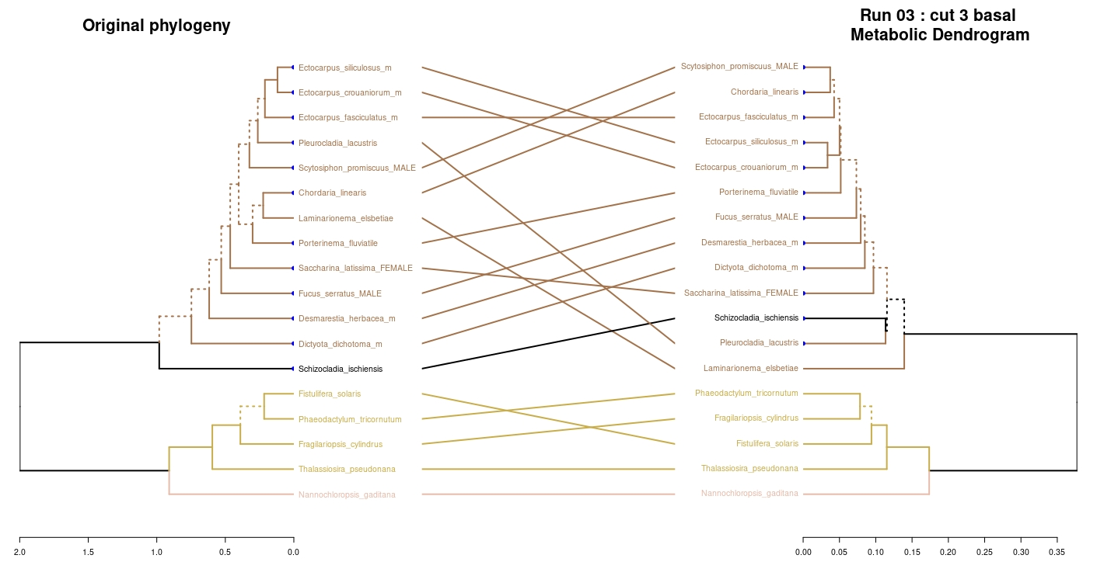
c. Results : Dataset 03 -> Idea 1

Slide 15
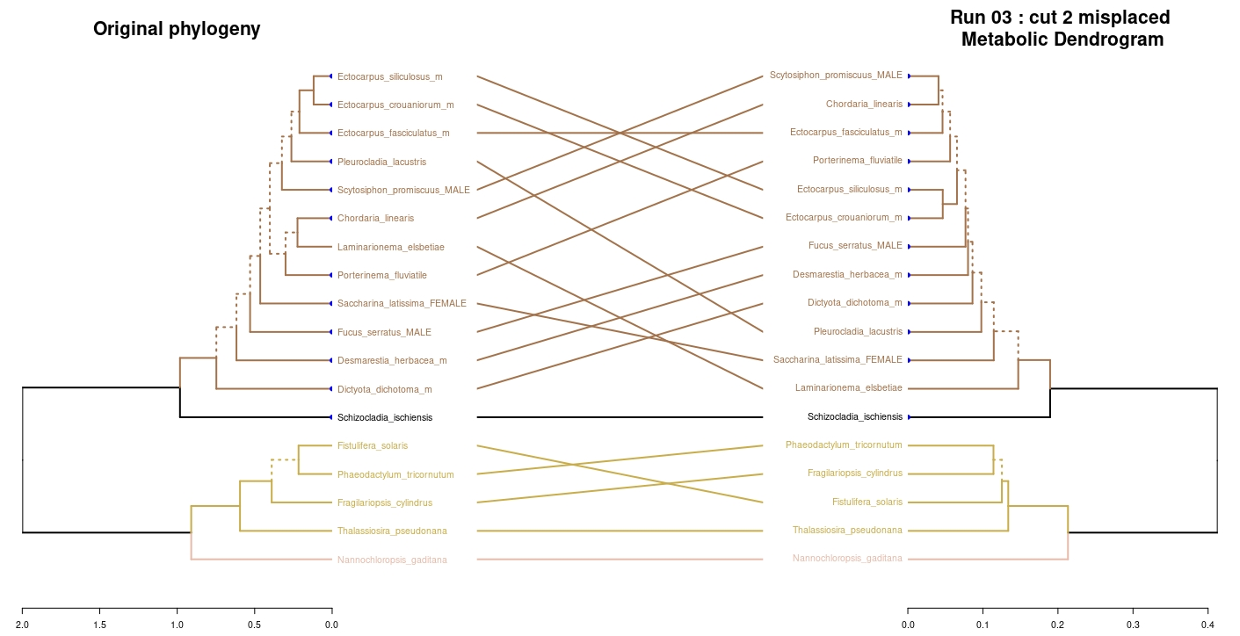
c. Results : Dataset 03 -> Idea 2

Slide 16
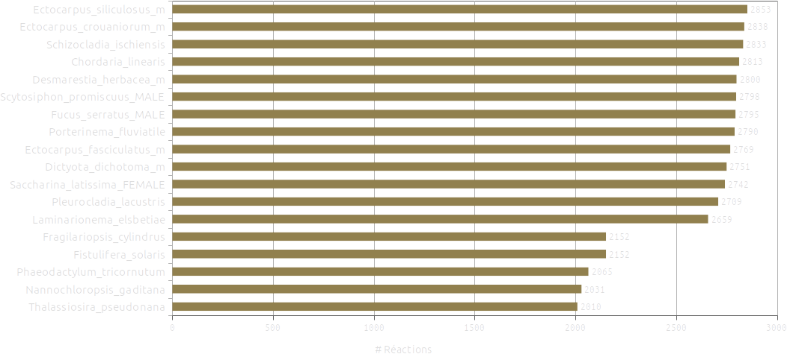
c. Results : Dataset 03 -> #Reations
Out

Slide 17
d. Accessibility of results
Data storage in wikis
Availability of file results in an easy human-readable online page
For each organism, list of genes, reactions, pathways and metabolites
Information on the origin of the integration of reactions : orthology or annotation

Slide 18
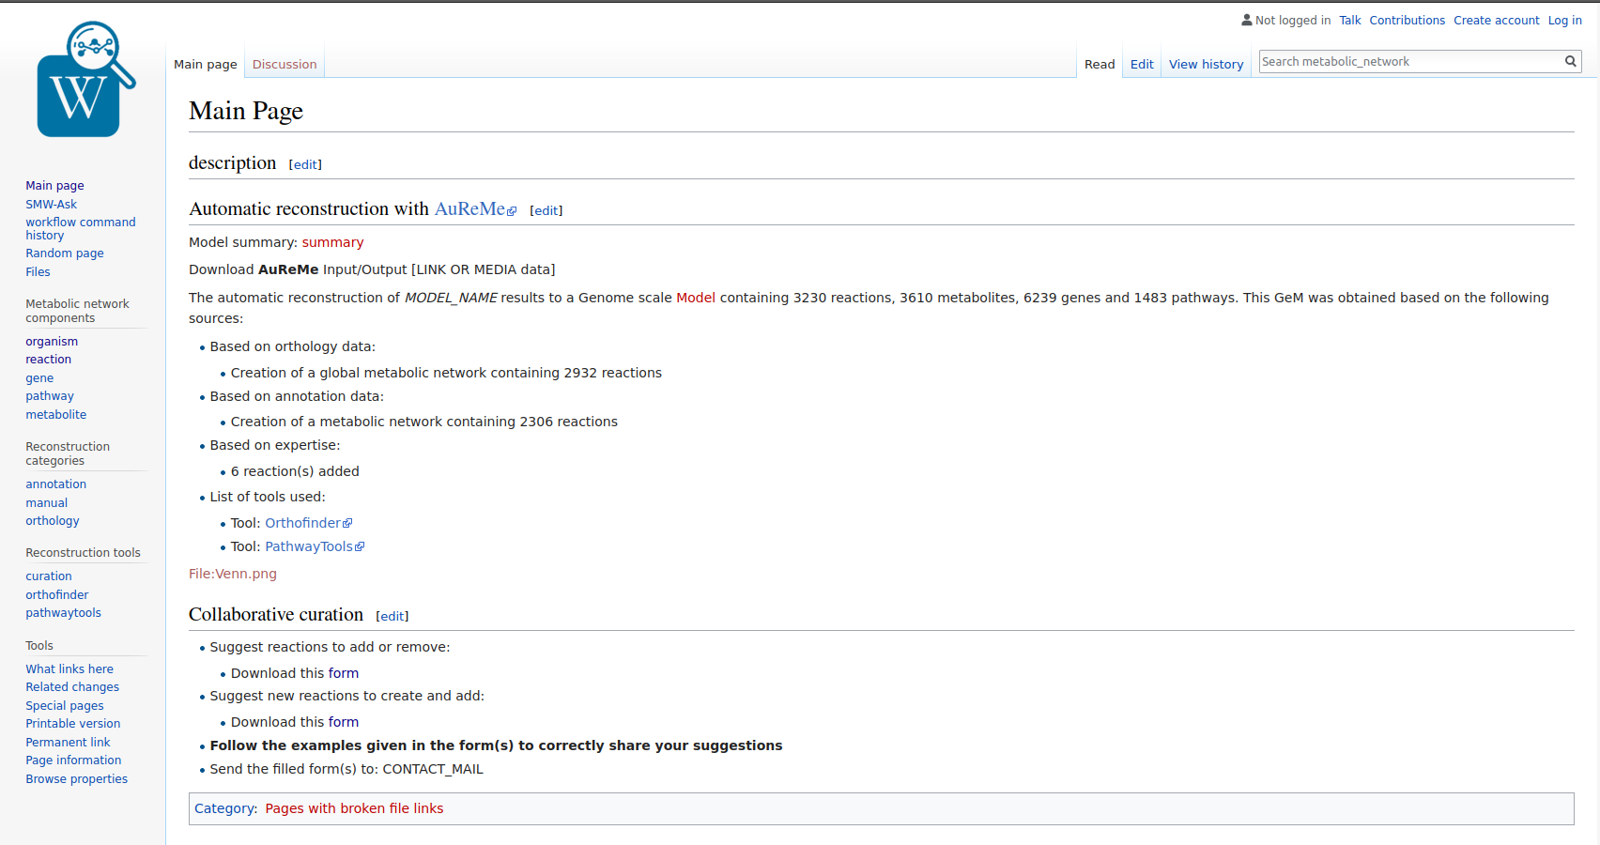
Expert input : possibility to suggest modifications of reactions

Slide 19
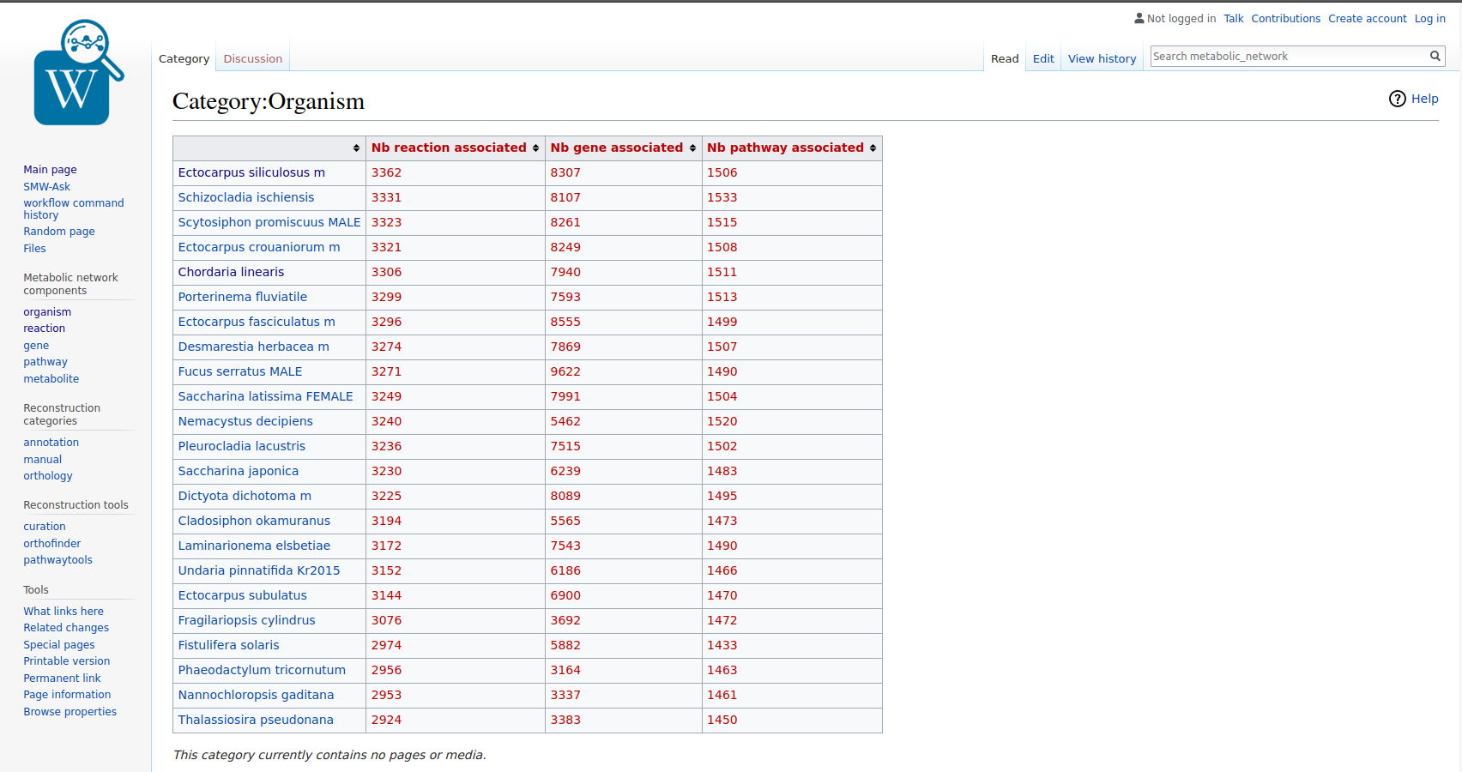
Overview for each organism : number of genes / reactions / pathways

Slide 20
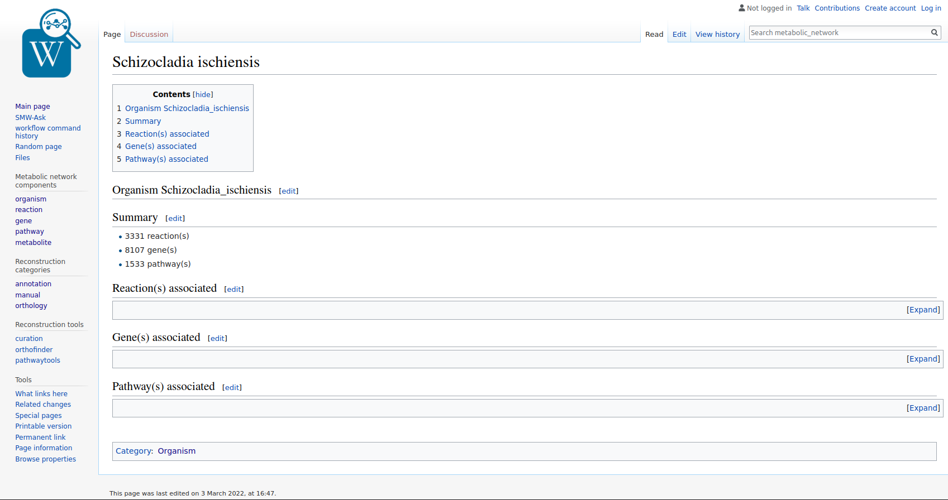
Details for a specific organism : list of genes / reactions / pathways

Slide 21
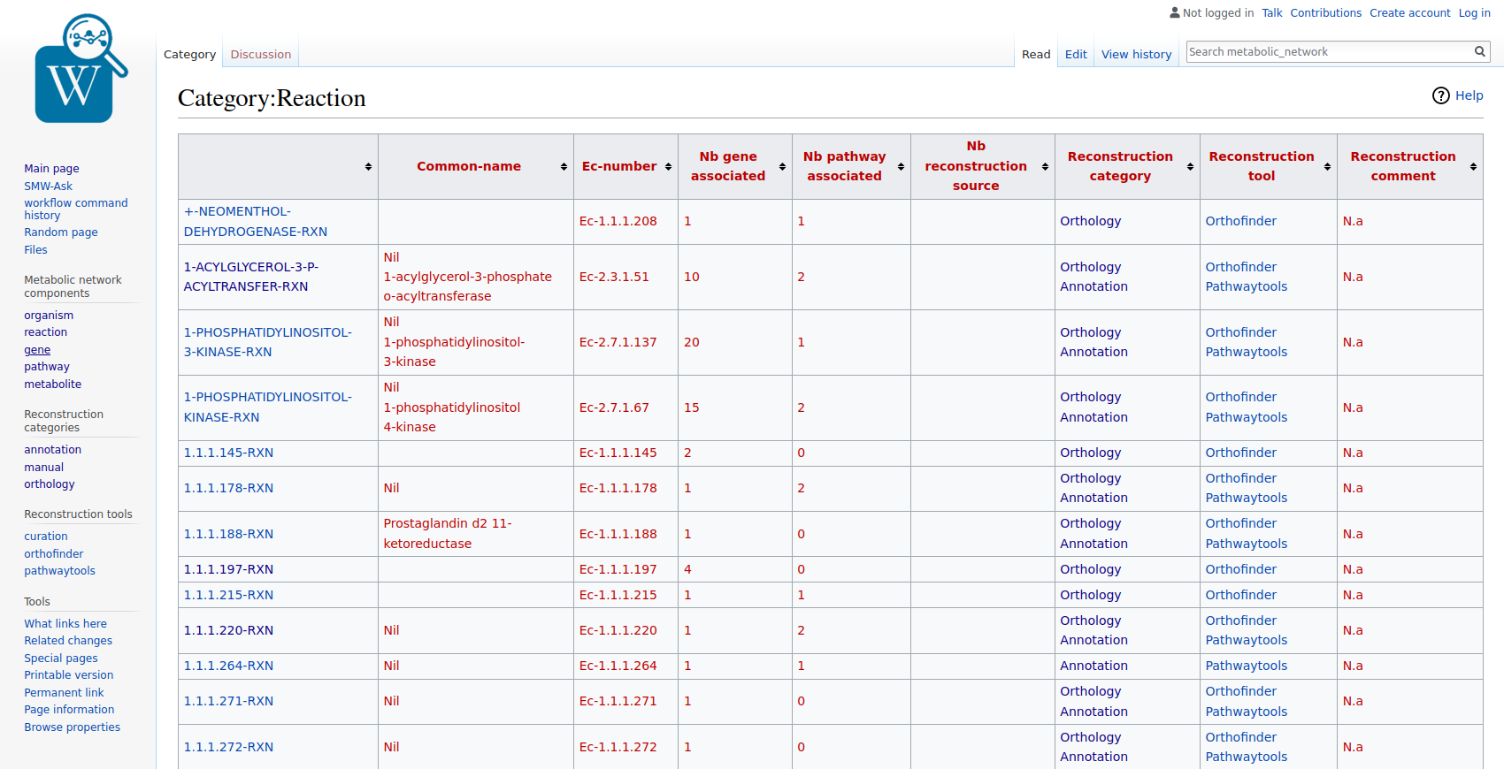
Ex : Reactions informations

Slide 22
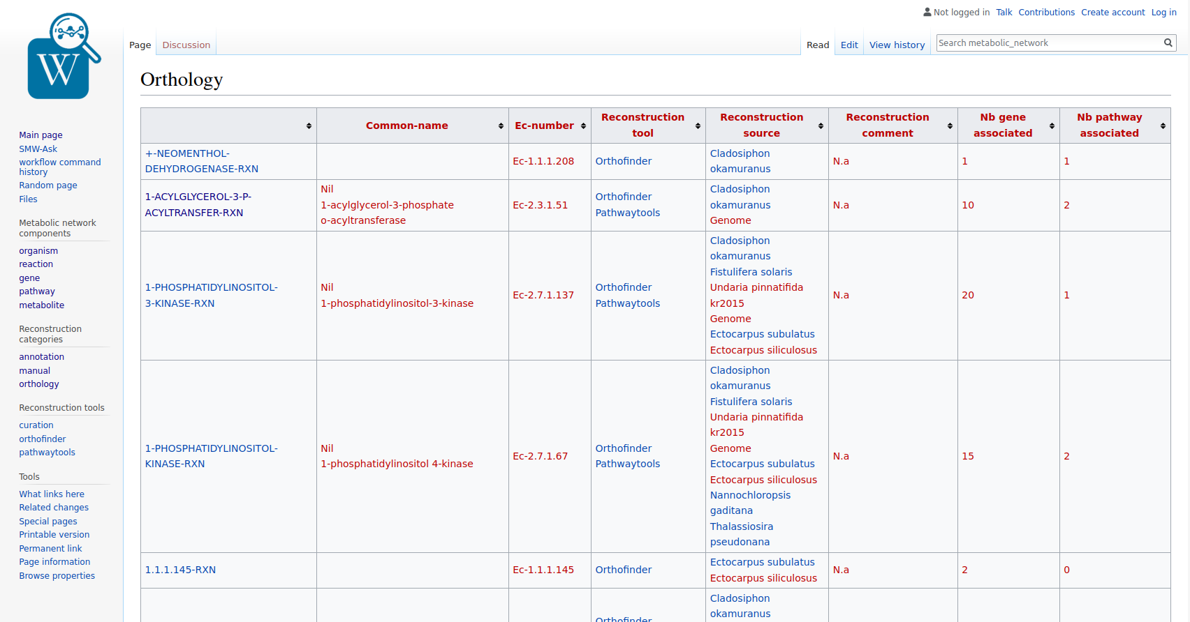
Ex : Reconstruction by orthology informations

Slide 23
e. Perspectives
Add more brown algae species :
species sequenced by Illumina in short read
soon available species sequenced in long read
Ascophyllum nodulosum
Pylaiella littoralis
Heterosigma akashiwo
Understand the potential technical biases that would induce phylogenetic mismatches

Slide 24
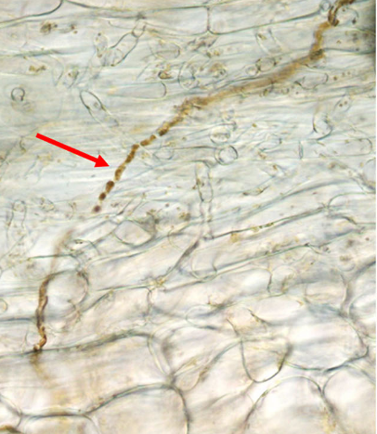
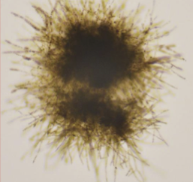
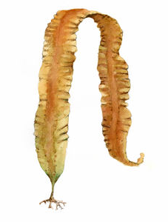
2. Study the evolution of gene loss in Laminarionema elsbetiae
Laminarionema elsbetiae :
Filamentous Brown Algae
Order of Ectocarpales
Endophyte of Saccharina latissima
Also found in S. japonica and rarly in L. digitata
Different impacts (physiological and transcriptomic) depending on the host inhabited
L. elsbetiae
S. latissima

Slide 25
Finding the lost genes
Simple method :
From a file indicating which reactions are present in which species :
Select the reactions present in all species except one
Select precisely those where it is the case for L. elsbetiae
Find the intersection of these reactions between the different runs
Define the genes / proteins associated with these reactions

Slide 26
b. Results
Dataset 02 (2022) : ● Long read only + Diatoms
Dataset 03 (2022) : ● Long read + L. elsbetiae + Diatoms
Dataset 40 (20 ??) : 40 algae + 7
12 Brown Algae
Dataset A0 (2020) : 12 brown algae + 4 outgroups
Dataset A1 (2022) : same as 0A with new datafiles
Dataset A2 (2022) : same as 1A : species with better quality assembly & + 1 species in outgroup
Quality expected : A2 > A1 > A0

Slide 27
b. Results
Intersection with A0 : 01 ∩ 40 ∩ A0
8 Reactions lost
Intersection with A1 : 01 ∩ 40 ∩ A1
16 Reactions lost
Intersection with A2 : 01 ∩ 40 ∩ A2
27 Reactions lost

Slide 28
c. Interpretation
These supposed lost genes could also be :
Genes misassembled
Genes not annotated
Some of these supposedly lost genes are found in the transcriptome

Slide 29
c. Perspectives
Inject transcriptome information into the data
The simple method could be improved :
Is 1 the optimal number to chose of species not having the reaction ?
Doesn’t take into account the position of species in the phylogenic tree
Doesn’t interpret lost or gain

Slide 30
3. Interactions between the endophyte L. elsbetiae and its host S. latissima
Study perspective :
Understand whether losses of metabolic function are compensated by the host
Understand whether certain metabolic functions of the host explain its acclimatization to the infection of the endophyte
Understand how the endophyte manage to inactivate host defenses

