Slide 1
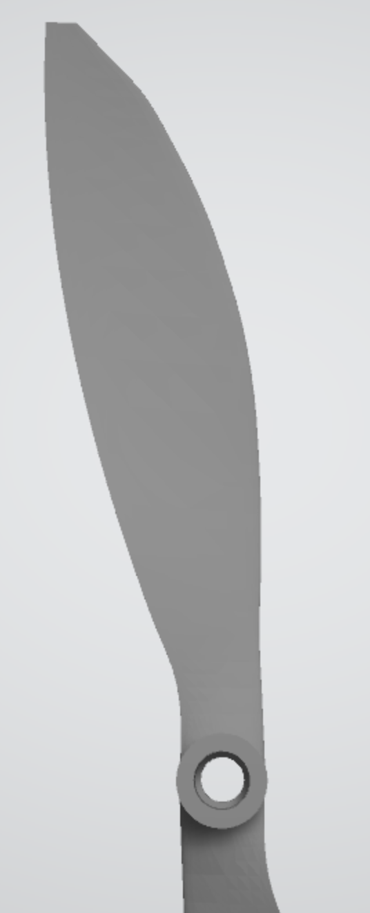
Tip radius
Hub radius
Chord length
Blade twist

Slide 2

Tip radius
Hub radius
Chord length
Blade twist

