Slide 1

Midterm semester project presentation
Automated propeller geometry measurement
from 3d scanning data
LIS
Supervisors :
D. Floreano
S. Steffen
A. Bhaskaran
Author:
P. Maury Laribière

Slide 2
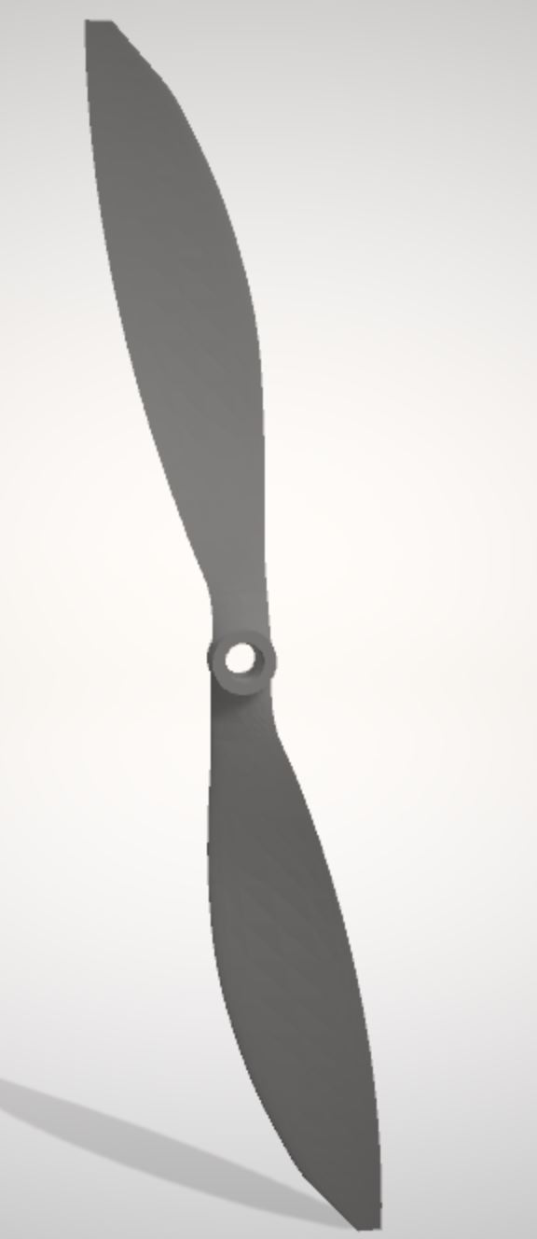
Introduction : Drones performance analysis
Summary :
Introduction
Goal of the project
State of art
Methodology
Done
Future work
Conclusion
Fig.1: Propeller STL file from 3D scanning

Slide 3
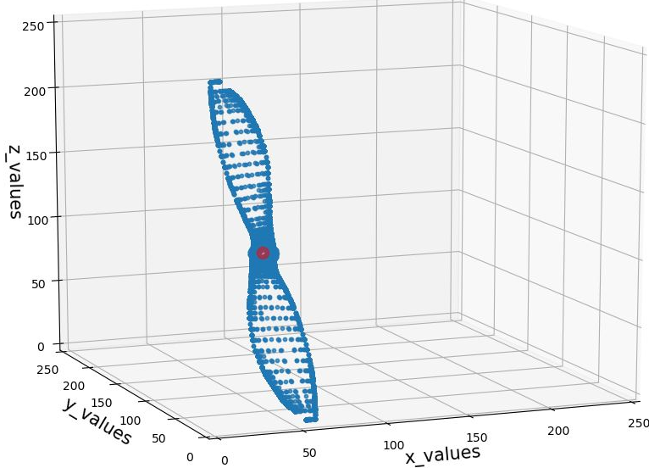
Introduction: Goal of the project
Drone performance analysis :
Need propeller shape:
Not available on market
3D scanning
No automated method
Wind Tunnels
Blade Elementum Theory
Fig.3: Point cloud of propeller
Notes:
To have info to use theory
Need performance drone that depend propeller to understand performance propeller. Need propeller shape to use theory
Problem: shape not available market Not characterize straight forward
However 3d scanning analyze. Project:3d scan file for simpler analysis. Evidence not easy available

Slide 4
Introduction: State of the art 3D Scanning
1. Contact
2. Non Contact Active
3. Non Contact Passive
CMM [1]
Structured Light [2]
Time of flight [2]
Laser triangulation [2]
Photogrammetry [3]
5 main techniques
Notes:
Add paper

Slide 5
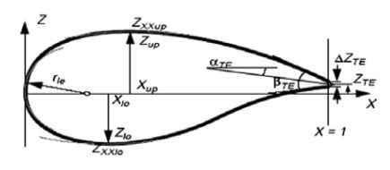
Introduction: State of the art Aerofoil parametrizations
Bézier [4]
Parsec [4]
Bésier – Parsec [4]
Sobieczky (with PARSEC) [5]
Improved Parameter Geometric [6]
Fig 2: PARSEC parametrization parameters
From Airfoil Parameterization Techniques: A Review,
Nilesh P. Salunke, Juned Ahamad R. A.2, S.A. Channiwala2
Notes:
Add paper

Slide 6
Methodology : Algorithm Done
Steps :
Pre-processing
STL to CSV
Main directions
File segmentation
Equation of planes Point segmentation
Projection
From upper or lower side
Projection
From interpolation of both sides

Slide 7
Methodology : Algorithm
Step 1: pre-processing
STL to CSV
Main direction

Slide 8
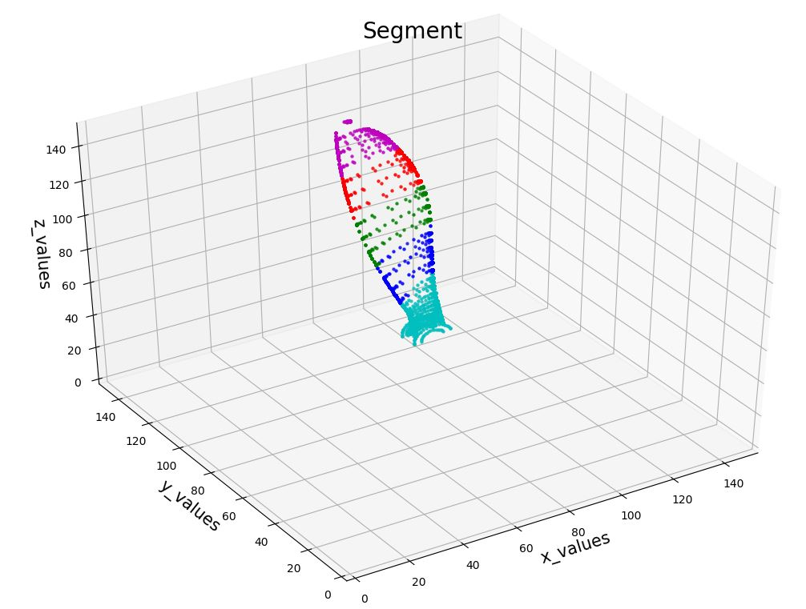
Methodology : Algorithm
Step 2: File segmentation
Equation of planes
Point segmentation
Fig.4: Segments of propeller

Slide 9
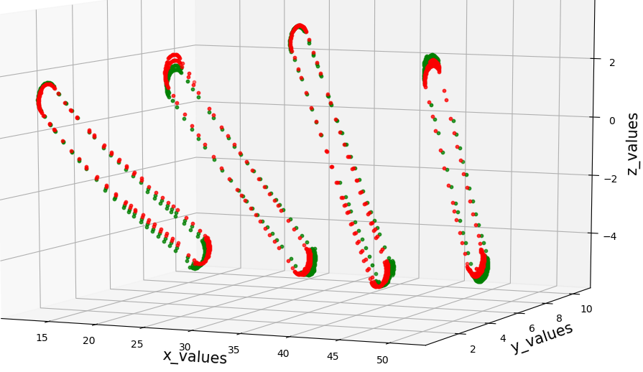
Methodology : Algorithm
Step 3: Projections
From upper or lower side
Step 4: Projections
From interpolation edges with
Fig.5: Projections on plane

Slide 10
Methodology : Algorithm Future work
Projections
Find interpolation
Parameters
Hub radius
Tip radius
X-foil software
Lift and drag
Blade twist
Chord length

Slide 11
Conclusion
Propeller shape for drone performance analysis
Pre-processing and segmentation
Finish projections
Xfoil and parameters
If time: automation of 3D scanning methods

Slide 12
Thank you for your attention

Slide 13
References
[1] A.W.L. Yao « Applications of 3D scanning and reverse engineering techniques for quality control of quick response products» Received: 2 October 2003 / Accepted: 27 January 2004 / Published online: 16 June 2004 © Springer-Verlag London Limited 2004
[2] Morteza Daneshmand, Ahmed Helmi, Egils Avots, Fatemeh Noroozi, Fatih Alisinanoglu, Hasan Sait Arslan, Jelena Gorbova, Rain Eric Haamer, Cagri Ozcinar, Gholamreza Anbarjafari. «3D Scanning: A Comprehensive Survey.» arXiv:1801.08863v1 [cs.CV] 24 Jan 2018
[3] Emmanuel P. Baltsavias. « A comparison between photogrammetry and laser scanning» Institute of Geodesy and Photogrammetry, Swiss Federal Institute of Technology, ETH-Hoenggerberg, CH-8093 Zurich, Switzerland Received 22 October 1998; accepted 17 March 1999
[4] Salunke, Nilesh P., Juned Ahamad R. A., and S.A. Channiwala. "Airfoil Parameterization Techniques: A Review." American Journal of Mechanical Engineering2.4 (2014): 99-102.
[5] Ava Shahroki Alireza Jahangirian Airfoil shape parameterization for optimum Navier–Stokes design with genetic algorithm. « Aerospace Science and Technology», Volume 11, septembre 2017
[6] Lu Xiaoqiang Huang Jun Song Lei Li Jing «An improved geometric parameter airfoil parameterization method.« Aerospace Science and Technology, Volume 78, July 2018

Slide 14
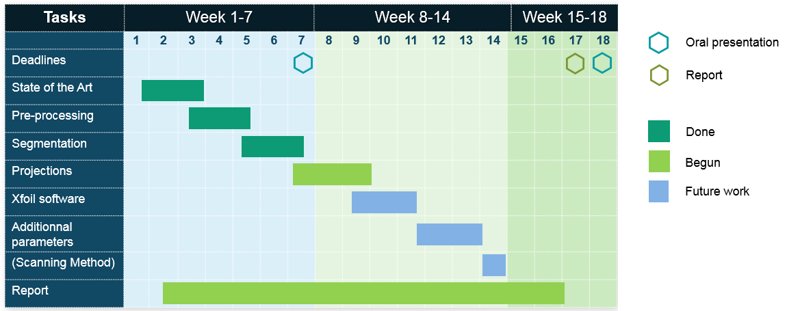
Gantt Chart

