Slide 1
ADVANCED R
Working with large data sets

Slide 2
INTRODUCTION
When using the data set diamonds, we need to load the data set from the package. We use the following code to accomplish that.
The output is a very large data set and may not be viewed as a whole on the console. Use the head() function to view the first few rows and the column names.

Slide 3
ADVANCED DATA MANIPULATION
Data manipulation in R is mostly associated with the plyr package. There are however specific packages derived from plyr that consider the object one is working with.
Dplyr is mostly used for data frames and since we are dealing with a data frame, we will focus on this particular package.
There are diverse functions for data manipulation in the dplyr package.
There will be examples and explanation provided for the respective examples plus the output.

Slide 4
filter()
This is normally used with Boolean operators.
This function is used to extract rows based on the specified criteria.
The output shows the data extracted using the criteria.

Slide 5
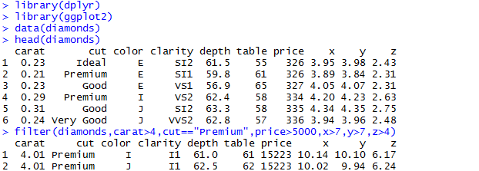
Code

Slide 6
slice()
The specific rows that are to be extracted are specified by their position.
All the values of all the columns of the rows selected are displayed.

Slide 7
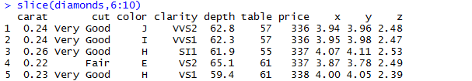
Code

Slide 8
arrange()
arrange() can be used in several ways.
One way is to specify one column that can be used to order the data set in a descending order according to the values of that column.

Slide 9
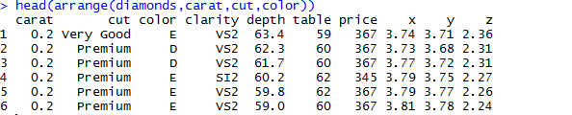
Code

Slide 10
Continuation of arrange()
The arrange() function is also used to order the data with regard to several rows.
The data set is ordered with reference to the first column to the last in the function.

Slide 11
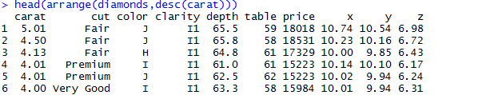
Code

Slide 12
select()
One way this function is used is to extract the columns specified.
The order of the data set is retained.

Slide 13
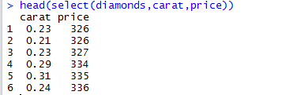
Code

Slide 14
Continuation of select()
The first function extracts only the x, y and z columns.
The second function extracts all the columns except the x, y and z columns.

Slide 15
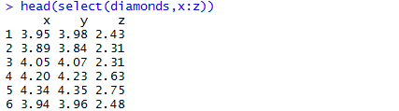
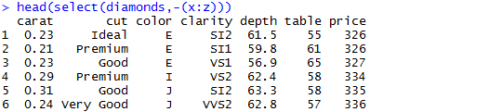
Code

Slide 16
Continuation of select()
There are several ways of extracting columns from the data set.
Below is another example based on the column names.

Slide 17
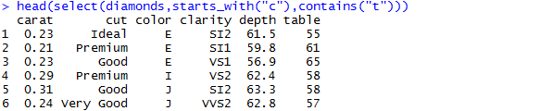
Code

Slide 18
rename()
This function is used to rename columns.
The output displays the changed column name but the column name does not change in the data set.

Slide 19
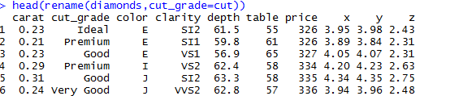
Code

Slide 20
distinct()
This function is used to extract unique values of the data set from the columns specified.
These values cannot be found in any other rows.

Slide 21
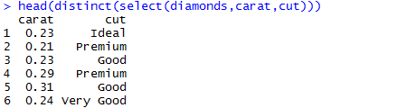
Code

Slide 22
mutate()
mutate() allows for the creation of a new column that is as a function of other columns.
This new column is however not saved to the data frame.

Slide 23
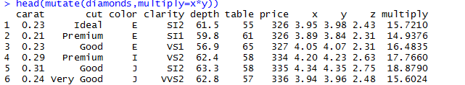
Code

Slide 24
transmute()
This function serves the same purpose as mutate(). The difference is in the output.
This function outputs only the created column.

Slide 25
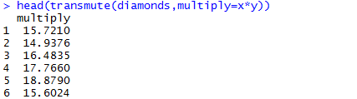
Code

Slide 26
summarise()
This function outputs data in one row displaying results of functions specified as arguments per column.
The first column is the standard deviation of the carat column, the second is the mean for the depth column while the third is the median for the price column.

Slide 27
Code

Slide 28
Sampling using sample_n()
This function uses simple random sampling to select a specific number of rows.
This selects 10 rows from the data set at random.

Slide 29
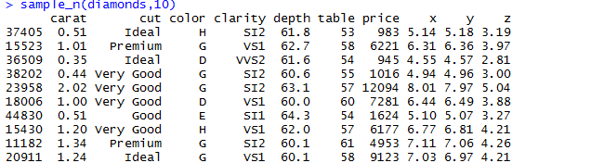
Code

Slide 30
Sampling with sample_frac()
This function also performs simple random sampling
The difference is, it bases the number of samples on a predetermined proportion of the rows in the data set.

Slide 31
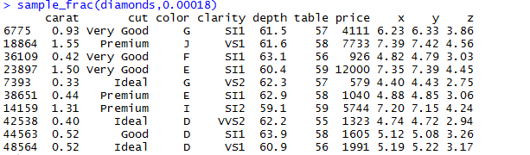
Code

Slide 32
Chaining
Chaining is the process of wrapping functions inside the other.
The functions become really powerful especially when using diverse combinations.
The functions are executed from the innermost operation outwards.
It is faster and efficient.

Slide 33
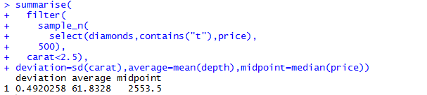
Code

Slide 34
ADVANCED INDEXING SYNTAX
This focuses on how to end up with subsets of objects.
These usually depends on how different objects are structured in R.
Examples of objects in R are data frames, lists, strings, arrays, vectors and matrices.

Slide 35
INTRODUCTION
Several constructs exist in R such that they enable access to individual elements through indexing.
Indexing is used to output these elements of to replace them.

Slide 36
INDEXING
There are several indexing operators e.g. [], [[]] and $.
For vectors, [] and [[]] are commonly used.
[] are more common than [[]].
They return a similar output.
Decimals used as indices are truncated to a whole number.
Negative indices return the entire vector.
Indices that exceed the length of the vector return NA.

Slide 37
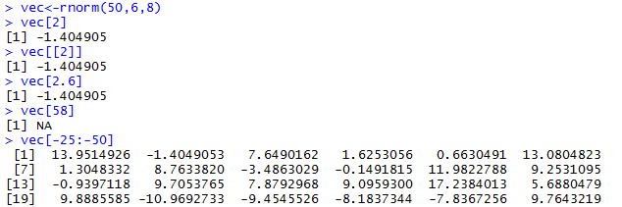
Code

Slide 38
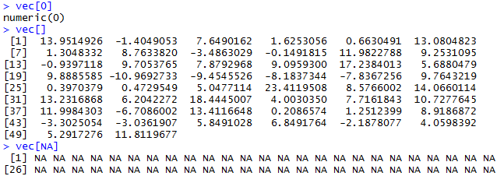
More Examples

Slide 39
INDEXING
A structure is indexed according to the number of dimensions it has.
For matrices and arrays, a single index may be used as well as multiple indices.
When using a single index, the names attribute is ignored.
It is possible to extract a subset of a matrix using a matrix as an index.

Slide 40
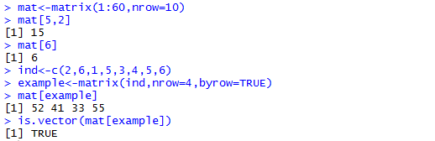
Code

Slide 41
INDEXING
From the results, the extracted values become a vector instead of remaining as a matrix.
NA and zero values can be used as indices.
Negative integers cannot be used.
Entire rows and columns can also be extracted.
Logical indices can also be used e.g. TRUE

Slide 42
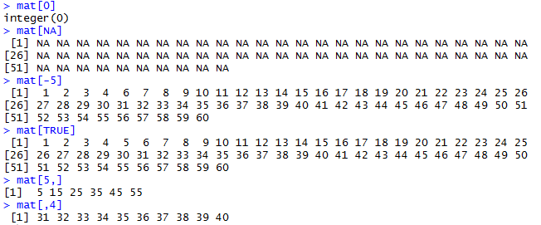
Code

Slide 43
INDEXING
A list is an object that has both characters and numerals as elements.
Examples can be obtained from simple functions such as lm() in linear regression.
$ is used to extract values as well as [] and [[]].
Double square brackets and $ recognize the attribute of names but the single square brackets do not and hence output the names as well.

Slide 44
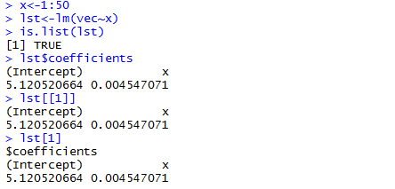
Code

Slide 45
REPLACING ELEMENTS
Indexing makes replacing elements in objects easier and faster.
Assigning different values to an object can be made as many times as possible.
The new object retains the most recent value assigned to each of its elements.

Slide 46
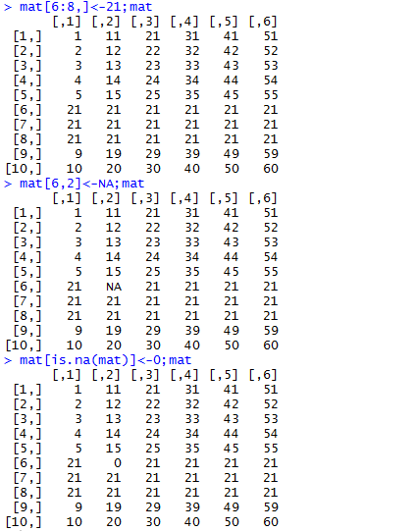

Slide 47
STRING PROCESSING(Using stringr)
The stringr package offers R users a way of working with and manipulating strings.
The function str_c() allows for the joining of several strings into a single string.
The function str_join() performs the same function as well and the output is similar.

Slide 48

str_c() and str_join()

Slide 49
str_count()
This function counts the number of specified characters in the string and returns a single value.
In the string new, the number of the character e is 3 .

Slide 50
str_detect()
The str_detect() function is used to detect the presence of a specified character in a string.
The value is a boolean vector such that TRUE shows the presence of the character while FALSE shows the absence of the character.

Slide 51
Continuation of str_detect()
str_detect() can also be used to check for the presence of certain characters at the beginning of a word.
The value is also a boolean vector where TRUE shows the presence of a word starting with the letter and FALSE shows the absence of a word beginning with the letter.

Slide 52

Code

Slide 53
str_locate()
str_locate() is used to identify the first position of a character in the string.
Only the first occurrence is output.
The spaces are also considered during counting.

Slide 54
str_locate_all()
It is used to identify the position of the specified chararcters
in the string.
The spaces are also considered when counting.
The start and end show the position of the characters.

Slide 55
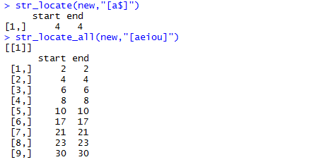
Code

Slide 56
str_extract()
It is used to extract the first occurrence of a specified character in the string.
In this case, the specified characters are from a to p hence the first letter in that category in the sentence is e.

Slide 57
str_extract_all()
This also extracts characters but it works for all occurrences of the specified characters in the string.
In this case, fourteen characters fit the description hence they are output inclusive of a and p.

Slide 58

Code

Slide 59
str_length()
This function is useful when tallying up the total number of characters in the string.
For our string, the spaces are also counted as characters.
The value is a single value vector.

Slide 60
str_replace()
It is used to replace the first occurrence of a character in the string with an alternative character.
Only the first occurrence is changed.

Slide 61
str_replace_all()
This functions almost the same as str_replace().
The difference is that this function replaces all the occurrences of the character.
In this case, all the letters between a and p inclusive in the string are replaced with $.

Slide 62

Code

Slide 63
str_match() and str_match_all()
str_match() is used to extract the first occurrence of a matched group from a string.
str_match_all() is used to extract all occurrences of matched groups from the string.

Slide 64
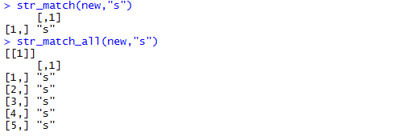
Code

Slide 65
str_sub()
It is used to extract a certain portion of a string according to the position of the characters.
Specific words can be extracted from the string giving regard to the spacing as well.

Slide 66
Continuation of str_sub()
It can also be used to alter the value of the string.
Characters can be changed in the string with regard to the spaces as well.
The changes are saved automatically in the string.

Slide 67
str_dup()
It is used to output a string a number of times.
The number of repetitions required should be specified in the function.

Slide 68

Code

Slide 69
str_pad()
This function is used to add characters to the strings at either end or both.
The string is padded to the specified width.
The end that is padded should be specified as either right, left or both.
The padding default is a space but if another padding is required, it should be stated.

Slide 70
str_trim()
It is used to trim the spacing found before and after strings.
It removes the white space from strings and should be specified as either both, right or left.

Slide 71
str_wrap()
This function wraps the string with regard to the width specified.
Each line is wrapped according to the number of characters in each line.
The exdent and indent arguments are used with the first line.

Slide 72
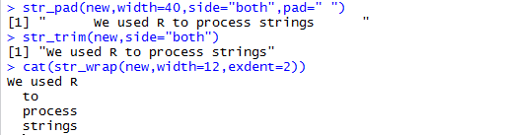
Code

Slide 73
str_split()
This function is used to split the string according to a pattern.
The maximum number of splits that can be made are specified in the arguments.
Inf suggests that any number of splits can be achieved.

Slide 74
str_split_fixed()
This function is similar to str_split().
The difference is the string is split into a specific number of pieces in the arguments.
In this example, the string is split into four pieces.

Slide 75
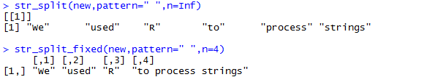
Code

Slide 76
DATE PROCESSING
We aim to use the package lubridate for date processing.
Dates are can be cumbersome to deal with at times.
This is because the syntax of the date differs from those of numerical vectors.
The package is loaded by running the following code: library(lubridate)

Slide 77
DATE PROCESSING
The ymd(), dmy() and mdy() functions all return the same output.
This is because, the input is written in the form of the function where y represents the year, d the day and m the month.
In the first function, the year comes first, then the month and finally the date. R interprets the value in quotes in that format.
The same goes for the other two functions.

Slide 78
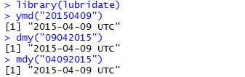
Code

Slide 79
DATE PROCESSING
The functions above can also be used with hms to specify a time too.
The h stands for hour, m for minute and s for second. The time is in 24 hour system.
The time zone is also given. Eg GMT, EAT etc

Slide 80
DATE PROCESSING
These values can also be saved.
If the value of a is to be changed, functions such as hour(), minute() and second() are used to alter the corresponding value.
Here, we change the time from 1500 hours to 1600 hours.

Slide 81

Code

Slide 82
DATE PROCESSING
Sometimes, we may save a date but later require to know what day of the week it was.
Therefore, wday() is used to output the day of the week. In our case, 09/04/2015 was on a Thursday.
yday() and mday() output the day of the year and the day of the month respectively.

Slide 83
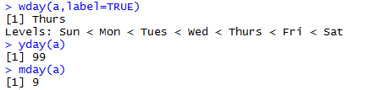
Code

Slide 84
DATE PROCESSING
We would also wish to know the time in another time zone. For example, we would like to know the time in Auckland.
with_tz() changes the time with respect to the specified time zone hence you can know time differences.
force_tz changes the time zone in the object. The time remains the same.

Slide 85

Code

Slide 86
DATE PROCESSING
Sometimes, we want to be able to create a time interval.
Therefore, we can create another object with a different time or date.
By using the function interval() we are able to create a time interval which is used in other computations.

Slide 87
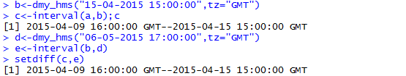
Code

Slide 88
DATE PROCESSING
Sometimes an interval is provided and you require to know the interval start and end.
This is done by using the functions int_start() and int_end() in order to output the required values.

Slide 89
DATE PROCESSING
The function int_flip() is used to reverse the direction of the interval.
The later date becomes the start of the interval.

Slide 90

Code

Slide 91
DATE PROCESSING
int_shift() can be used to alter the start or end of an interval.
The duration e.g. in number of days is given as an argument.
int_align() tests whether the start or the end of two intervals are aligned.
It returns a boolean vector i.e. TRUE or FALSE.

Slide 92
DATE PROCESSING
int_length() function gets the length of the interval in seconds.
This is easier than calculating the seconds for each day and summing them up.
Intervals can also be checked as to whether one is within another.

Slide 93
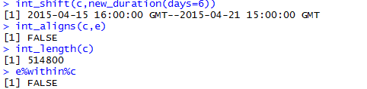
Code

Slide 94
DATE PROCESSING
hours() is useful when output of only a time is required.
dhours() is also used when converting hours into seconds.

Slide 95
DATE PROCESSING
Also, leap_year() can be used in order to check for leap years.
The output is a boolean vector where it is either true or false.

Slide 96
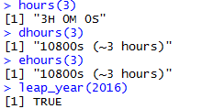
Code

Slide 97
DATE PROCESSING
The dmy() function can also be used with some arithmetic operators.
In this example, adding years(2) returns a value with the exact date just two years later.

Slide 98
DATE PROCESSING
Using the same function but now adding eyears(), “exact years”, we find that it returns a value with a slightly different day two years later.
This is because the function added exactly 730 (2*365) days to the date.
However, this would have returned the same date except that 2016 is going to be a leap year.

Slide 99
DATE PROCESSING
Adding days to dates is as simple as adding days().
Only the date is changes. The time remains the same.

Slide 100
DATE PROCESSING
Adding months too is just as simple. A range of months can also be added to the date.
In the example below, months() adds a consecutive range of months while keeping the rest of the information intact.

Slide 101
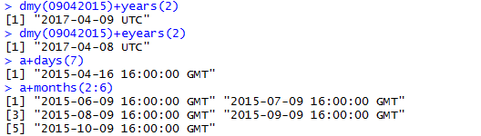
Code

Slide 102
DATE PROCESSING
Taking a date like 31st of a month, it is important to note that not all months have a 31st.
Therefore, using the same months() function with the 31st, the output contains NA since the values are not available.

Slide 103
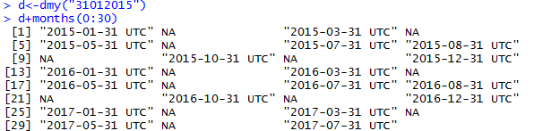
Code

Slide 104
DATE PROCESSING
If a constant pattern is required such that we need to output the date after 30 days, a combination of functions is used.
The below example shows how floor_date() is used with months() and days() to produce output that is exactly 30 days apart.

Slide 105
DATE PROCESSING
We may also require to find the corresponding last days of the months.
The output shows the last day of each month for the entire year.

Slide 106
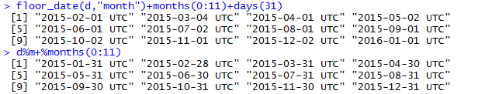
Code

Slide 107
DATE PROCESSING
Given a date object, we may need to know the last day of that month.
The function below outputs the last day in April which was the month in our date object.

Slide 108

Code

Slide 109
DATE PROCESSING
The duration of an interval can also be obtained by use of the function as.period().
The output is the exact duration down to the last second.
The two functions produce the same output.

Slide 110

Code

Slide 111
SQL IN R
The package sqldf is used.
It allows for SQL effects to be performed on data frames in R.
sqldf() function is used to accomplish tasks that can be completed by other functions.
It can be used to filter the data frame according to the value in the columns.

Slide 112
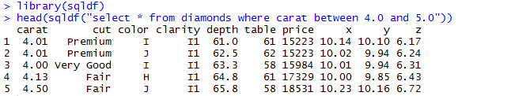
Code

Slide 113
SQL IN R
This function extracts rows from the data frame where the value of the column cut is 'Fair'.
Since a lot of rows will be extracted, we use head() to limit the output.

Slide 114
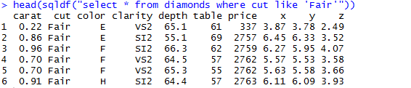
Code

Slide 115
SQL IN R
This example shows how the function extracts rows from the data frame ordered in a descending order by carat.
The number of rows is specified as six.

Slide 116
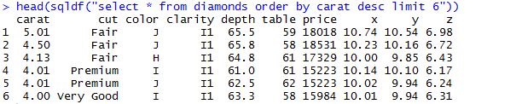
Code

Slide 117
SQL IN R
It can also extract rows from the data set and rearrange them according to the value of the column specified in either an ascending or descending order.
In our case, the column is carat and we arrange them in an ascending order.

Slide 118
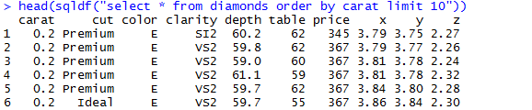
Code

Slide 119
SQL IN R
The function can also be used to extract certain rows in the data frame where some values in the columns can be specified.
We aim to select rows whose carat value is greater than 3.2 and whose cut is Premium.

Slide 120
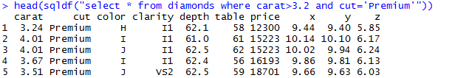
Code

Slide 121
SQL IN R
It can also be used to compute summary arithmetic such as mean.
Here, the mean price for a specific carat, say 0.2 is calculated from all carat values of 0.2.

Slide 122
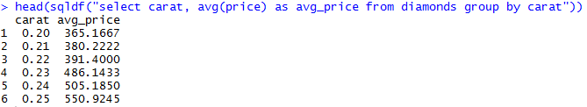
Code

Slide 123
DATA PROCESSING AND
TRANSFORMATION

Slide 126
EFFICIENT DATA PROCESSING AND TRANSFORMATION

Slide 129
SPEEDING UP IN R

Slide 133
EXTENDING R’S MEMORY

Slide 137
OBJECT-ORIENTED PROGRAMMING IN R
Everything in R is an object.
The original structure in R for classes, S3, is the most common.
R promotes encapsulation, which in turn promotes clarity.
R classes are polymorphic which enhances reusability.
R allows inheritance allowing for extension of a class to a specialized class.

Slide 138
S3 CLASSES

Slide 139
S4 CLASSES
These were developed later in order to add safety.

Slide 140
FUNCTIONAL PROGRAMMING

Slide 143
USING R ON A SERVER

Slide 144
USING R IN BATCH MODE

Slide 146
USING R ON THE CLOUD

Slide 148
R AND HADOOP

