Slide 1

基于超声波的空气污染物浓度测量系统研究
答辩人：周斯航
学号：1152513
指导老师：汪镭

Slide 2
背景介绍
目录
理论研究
模块设计
Contents
实验分析
总结展望

Slide 3
01
Part One
背景介绍

Slide 4

背景介绍
雾霾日益影响人们的生活
携带细菌与病毒进入人体呼吸道
能见度低触发交通事故
沉闷压抑影响心理健康

Slide 5
背景介绍
2015年5月上海天气质量为优的天数仅为2天
2015年5月
2天
19天
2014年12月
2013年12月上海天气质量为中度污染以上的天数为19天

Slide 6


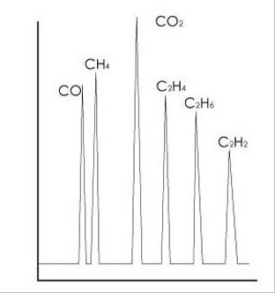

背景介绍
常用的测量气体浓度的方法
气相色谱法：
不同气体通过色谱柱时速度不同
超声波测声时法：
超声波在不同气体中传播速度不同
气敏电阻法：
元件阻值随环境空气浓度的变化而变化
载体催化燃烧法：
燃烧时铂丝电阻的增量与可燃气体浓度成正比

Slide 7
02
Part Two
理论研究
数学模型的建立
系统框架的设计

Slide 8
2-1 数学模型的建立

Slide 9





2-2 系统架构的设计

Slide 10
03
Part Three
模块设计

Slide 11




模块设计
硬件设计
嵌入式程序设计
安卓程序设计
Matlab程序设计
LPC1114微控制器、温湿度传感器、超声波传感器和蓝牙模块之间的PCB电路设计
实现对环境温湿度以及超声波在一段定长空气中传播的声时数据的测量控制并将这些数据装帧通过蓝牙发出
应用接口概念对通过蓝牙模块接收的数据帧进行解析，并将处理之后的数据以图象形式显示在屏幕上
将安卓上位机简单处理过的程序使用卡尔曼滤波算法进行最优估计，并作出声时对应温度的曲线图

Slide 12

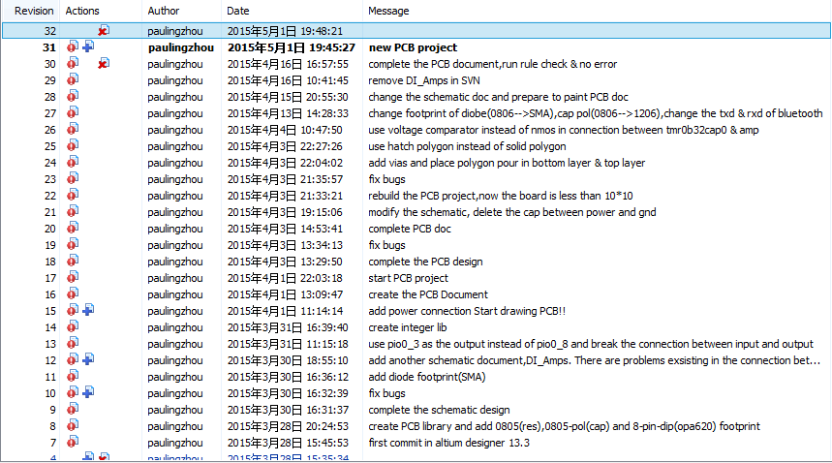
3-1 硬件设计
开发工具：Altium Designer
版本控制工具：Subversion(SVN)

Slide 13
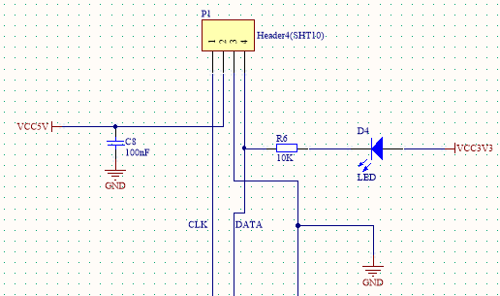
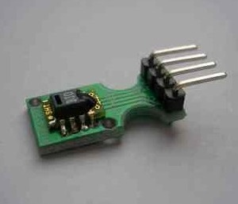
3-1 硬件设计
温湿度传感器外围电路设计
时钟(CLK)
供电(VCC)
接地(GND)
数据(DATA)
SHT10温湿度传感器

Slide 14
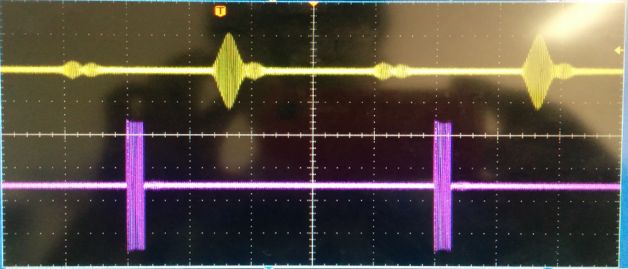



3-1 硬件设计
超声波传感器外围电路设计
超声波输入模块电路
超声波输出模块电路

Slide 15
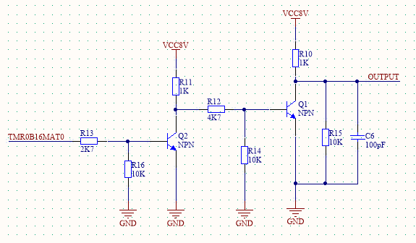
3-1 硬件设计
超声波传感器外围电路设计
超声波模块输入电路
功率放大
延时低
高频(180KHz)

Slide 16

2-3 Enter Your Title
Add your title.
Add your title.
You can click here to enter your text. You can click here to enter your text.
You can click here to enter your text. You can click here to enter your text.
Add your title.
You can click here to enter your text. You can click here to enter your text.
Add your title.
You can click here to enter your text. You can click here to enter your text.

Slide 17




3-1 Enter Your Title
Add your title
Add your title
Add your title
Add your title
You can click here to enter your text.
You can click here to enter your text.
You can click here to enter your text.
You can click here to enter your text.

Slide 18



3-2 Enter Your Title
Add your title
Add your title
Add your title
Add your title
You can click here to enter your text. You can click here to enter your text. You can click here to enter your text.
You can click here to enter your text. You can click here to enter your text. You can click here to enter your text.
You can click here to enter your text. You can click here to enter your text. You can click here to enter your text.
You can click here to enter your text. You can click here to enter your text. You can click here to enter your text.

Slide 19
3-3 Enter Your Title
70%
You can click here to enter your text. You can click here to enter your text. You can click here to enter your text.
55%
Add your title
You can click here to enter your text. You can click here to enter your text. You can click here to enter your text.
40%
You can click here to enter your text. You can click here to enter your text. You can click here to enter your text.

Slide 20
04
Part Four
Enter Your Title

Slide 21


4-1 Enter Your Title
You can click here to enter your text. You can click here to enter your text. You can click here to enter your text. You can click here to enter your text. You can click here to enter your text.
Add your title
Add your title
You can click here to enter your text. You can click here to enter your text. You can click here to enter your text.
You can click here to enter your text. You can click here to enter your text. You can click here to enter your text.

Slide 22

4-2 Enter Your Title
Title
Add your title
57%
You can click here to enter your text. You can click here to enter your text. You can click here to enter your text.
You can click here to enter your text. You can click here to enter your text. You can click here to enter your text.
Title
43%

Slide 23
4-3 Enter Your Title
Add your title
You can click here to enter your text. You can click here to enter your text. You can click here to enter your text. You can click here to enter your text. You can click here to enter your text. You can click here to enter your text. You can click here to enter your text. You can click here to enter your text. You can click here to enter your text.

Slide 24



4-4 Enter Your Title
You can click here to enter your text. You can click here to enter your text. You can click here to enter your text. You can click here to enter your text.
You can click here to enter your text. You can click here to enter your text. You can click here to enter your text. You can click here to enter your text.
You can click here to enter your text. You can click here to enter your text. You can click here to enter your text. You can click here to enter your text.
02
01
03
Add your title

Slide 25
logo
Thank You
Freedom design by Jenny

Slide 26
www.51pptmoban.com 搜集整理

