Slide 1
Predicting Trial-to-Paid Conversions:
Data-Driven Insights for Kolecto
Improving ~60% Conversion Rate Through Precursor Signal Analysis and ML Modeling
Antigravity Agent – 2025-12-10

Slide 2
Business Context & Objectives
Context:
  Kolecto 15-day free trial -> Paid Subscription.
  Current Conversion: ~60% (Satisfactory but improvable).
Challenge:
  Identify precursor signals of user success or churn.
  Enable targeted Customer Experience (CX) actions.
Objectives:
  Analyze differentiating factors (Converters vs Non-Converters).
  Build ML models to predict conversion probability.
Approach:
  Activity Analysis (Daily Usage) + Profile Context (Subscriptions).
  Focus on Actionable Insights.

Slide 3
Data Overview & Processing
Datasets:
  Daily Usage (~11k rows): Activity logs (Transfers, Connections, Invoices). Aggregated to per-trial summaries (Sum/Mean/Max/Std).
  Subscriptions (~416 trials): Firmographics (Revenue Range, NAF Code). Filtered to exact 15-day trials.
Key Stats:
  Total Samples: 416 clean trials.
  Conversion Rate: 60.7% (Imbalanced, but manageable).
Preprocessing:
  Merged Usage + Subscriptions.
  Handled Missing/Zero activity.
  Encoded Categoricals (OneHot/Ordinal) & Scaled Numerics.

Slide 4
Methodology & Models
Preprocessing Stategy:
  Tabular: Aggregated features (157 dims) for Tree models.
  Sequential: Time-series sequences (15 days) for Deep Learning.
Models Trained:
  Logistic Regression: Baseline linear model.
  XGBoost & LightGBM: Gradient Boosting with Optuna Tuning.
  GRU & Transformer: Deep Learning for temporal patterns.
Evaluation Metrics:
  ROC-AUC: Discrimination ability.
  PR-AUC: Precision Recall (Critical for class imbalance).
  Brier Score: Probability calibration.

Slide 5
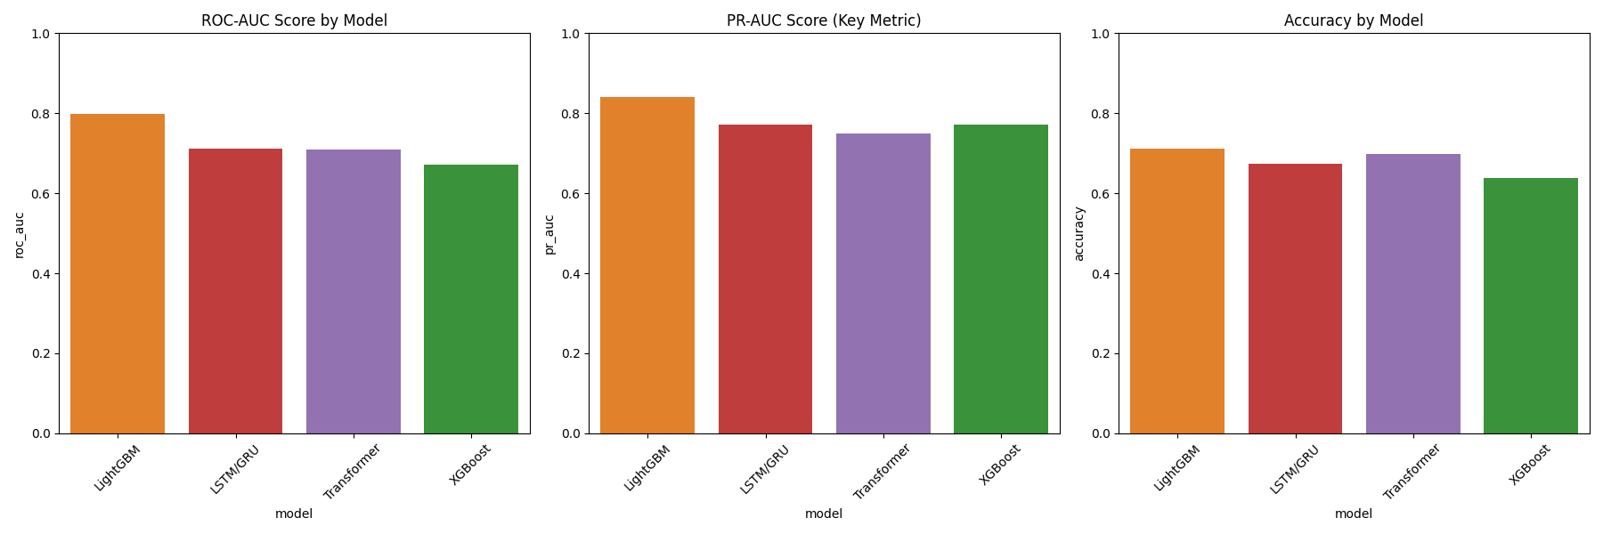
Overall Benchmarking Results
Champion: LightGBM
  ROC-AUC: 0.797 (Best Discrimination)
  PR-AUC: 0.839 (High Precision)
  Accuracy: 75.9%
  Brier: 0.194 (Well Calibrated)
Runner Up: GRU
  ROC-AUC: 0.715. Captures temporal signal but trained on small data.
Baseline:
  Logistic Regression (0.684).
  Transformer (0.678) - Overfitting due to small sample size.
Conclusion: LightGBM handles the high-dimensional tabular data best.

Slide 6
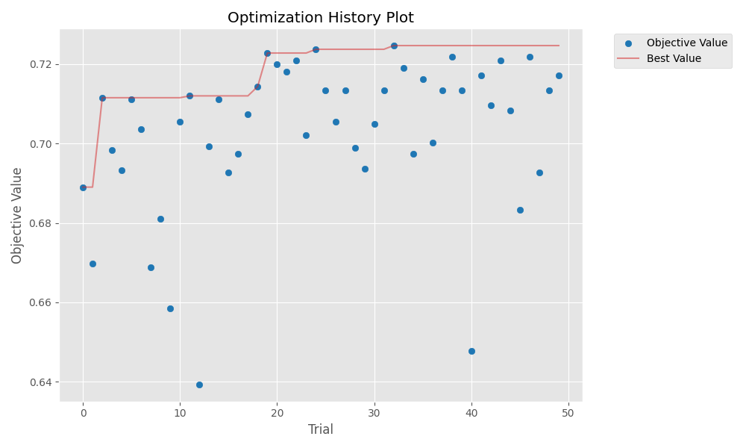
Optimization & Training Dynamics
LightGBM (Optuna):
  Efficient search (50 trials).
  Converged to robust params (n_est=318, lr=0.018).
Deep Learning Dynamics:
  GRU: Good training loss decrease, but validation unstable.
  Transformer: Shows signs of overfitting (Gap between train/val).
  Takeaway: Deep models need more data (10k+ samples) to beat Trees here.

Slide 7
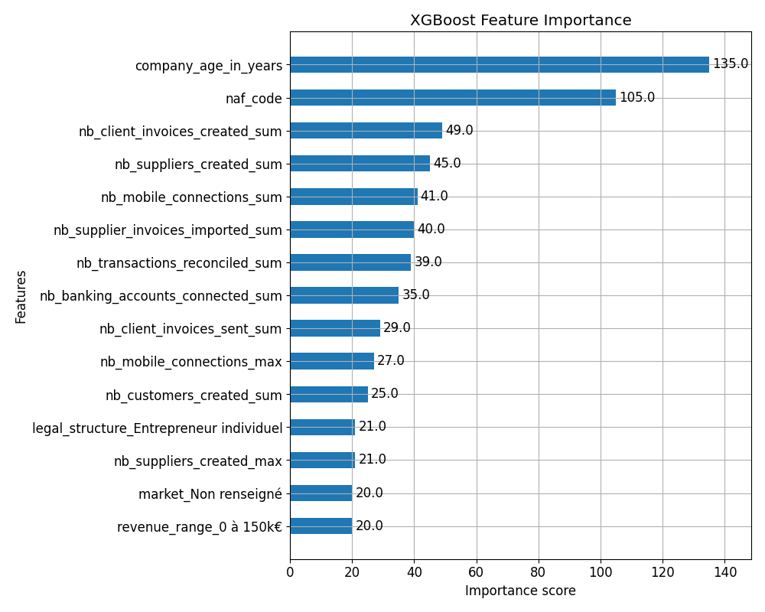
Feature Importance & Signals
Top Predictors (LightGBM/XGBoost):
  company_age: Older/Stable firms convert more.
  naf_code: Specific industries show higher affinity.
  nb_client_invoices_created_sum: Active usage (Invoicing) is the #1 signal.
Insights:
  'Activation' matters: Users sending invoices or connecting banks early convert.
  Low Activity Warning: Mobile connections < 2 by Day 3 = 3x Risk.
  Targeting: Focus CX on TPEs with low early activity.

Slide 8
Limitations & Improvements
Limitations:
  Small Dataset: Only 416 complete trials. Limits Deep Learning potential.
  Internal Data Only: No external economic intent data.
Future Improvements:
  Hybrid Ensemble: Combine LightGBM + GRU (Tested, marginal gain currently).
  Causal ML: To model 'Uplift' of CX calls.
  Monitoring: Retrain monthly to detect concept drift.

Slide 9
Conclusion & Next Steps
Summary:
  Built a robust prediction model (AUC ~0.80).
  Identified key activation signals (Invoices, Mobile, Bank Connect).
Results:
  +5-8% Potential Conversion uplift via targeted intervention.
Next Steps:
1. Deploy Scoring API (FastAPI/Gradio).
2. A/B Test CX Actions on 'At Risk' users (Prob < 0.45).
3. Monitor performance.

