Slide 1


Slide 2


Slide 3
The Domain Name System
Overview
Introduction
DNS overview
How DNS helps us?
Summary

Slide 4
Introduction

Slide 5
Welcome
  Brief Presentation
  We could spend all Day
  Unsure about level of technical expertise
  Stop me at any point if you have a query

Slide 6
DNS Overview

Slide 7
What is DNS?
  Distributed Directory Service
  Maps names to values – resource records
  Highly resilient to attack*
  Major backbone of the internet
  Makes networks human friendly
  Defined (primarily) in RFC1034 and 1035
  *if implemented properly

Slide 8
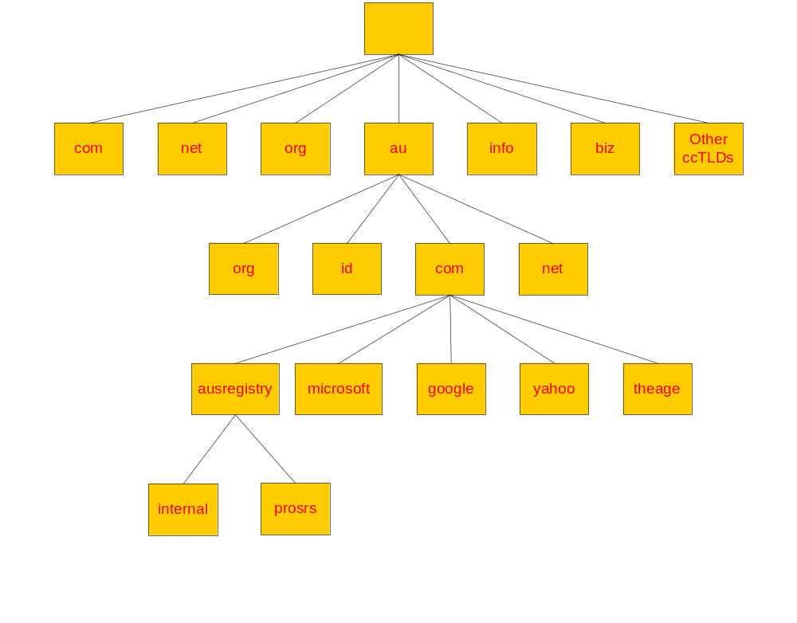
“root” zone
TLDs & ccTLDs
2lds
3lds
4lds

Slide 9
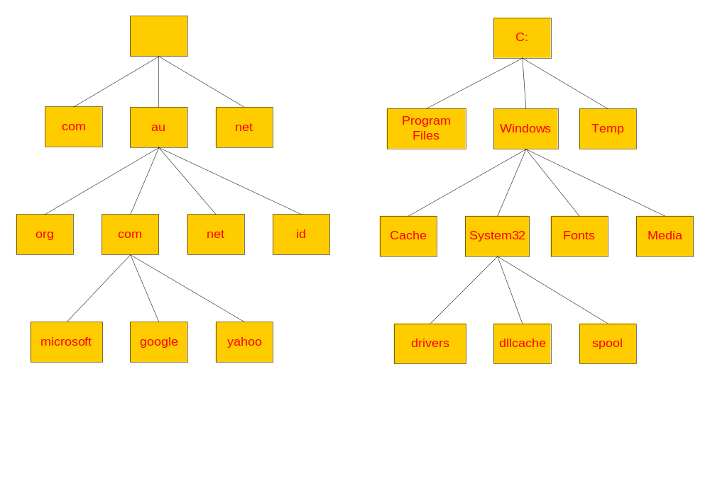
DNS vs File System

Slide 10
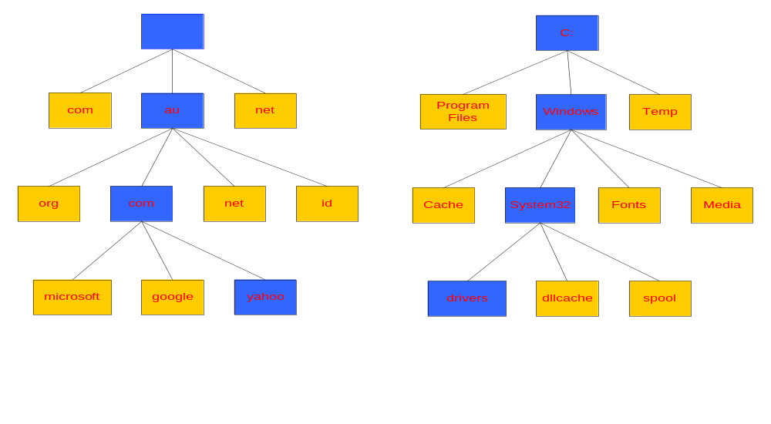
Naming a Domain Naming a Directory
Start Here
Start Here
C:\windows\system32\drivers\
yahoo.com.au.
A “.” is used as separator
A “\” is used as separator

Slide 11
“root” zone
TLDs & ccTLDs
2lds
“zone cuts” or delegation points
3lds
4lds

Slide 12
What is a domain?
A domain is a sub tree of a larger tree identified by a domain name
Contains resource records and sub-domains
Some resource records point to authoritative server for sub-domains / zones
eg. the root contains pointers to .au
google.com.au is a domain

Slide 13
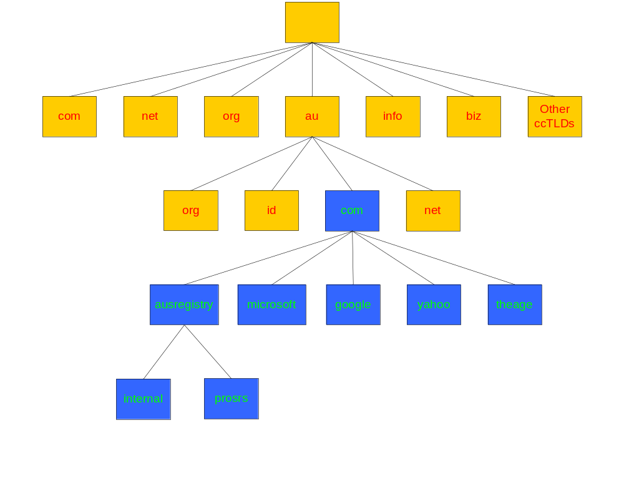
Domain com.au
The ausregistry.com.au sub-domain of com.au

Slide 14
What is a resource record?
A domain contains resource records
Resource records are analogous to files
Classified into types
Some of the important types are SOA, NS, A, CNAME and MX
Normally defines in “zone files”

Slide 15
The “A” Record
The “Address” record
One or more normally defines a host
Contains an IPv4 Address (the address computers use to uniquely identify each other on the internet)
Eg. The record:
www A 203.18.56.31
In the ausregistry.com.au domain, defines the host uniquely identifiable as “www.ausregistry.com.au” to be reachable at the IPv4 Address 203.18.56.31

Slide 16
The “CNAME” Record
A CNAME defines an alias
The alias will then be resolved, if another CNAME is encountered then the process continues until an A record is found
Eg. The record:
search CNAME www.google.com.
In the ausregistry.com.au domain, defines the name uniquely identifiable as “search.ausregistry.com.au” to be and alias to “www.google.com”

Slide 17
The “MX” Record
An MX record defines the mail servers for a particular domain
Mail eXchange records hold the name of hosts, and their priorities, able to deliver mail for the domain.
Eg. The record:
ausregistry.com.au MX 10 mail
In the ausregistry.com.au domain, defines the host mail to be the priority 10 mail server for the “ausregistry.com.au” domain

Slide 18
The “NS” Record
An NS record defines the authoritative Name servers for the domain.
The “Name Server” records also define the name servers of children domains
Eg. The record:
internal NS ns1.hosting.com.au.
In the ausregistry.com.au domain, defines the host “ns1.hosting.com.au” to be a name sever for the “internal.ausregistry.com.au” sub-domain

Slide 19
What is a Delegation?
Delegation refers to the act of putting NS records in a domain name “delegating” control of a sub-domain to another entity
This entity then has the ability to control the resource records in this sub-domain and delegate further children domains to other entities.
Eg. IANA delegating control of a country code domain to the country.

Slide 20
What is a zone?
Its records are held in a database (“zonefile”) and served from an authoritative name server
Zone refers to all the resource records in a domain but not its sub domains, the com.au zone contains delegations records for ausregistry.com.au, but not the resource records for ausregistry.com.au, however all of these records are part of the com.au domain

Slide 21
What is a Name Sever?
Server responsible for answering DNS queries
Exists at all levels of hierarchy
Authoritative name servers hold part of the DNS database
One name server can serve more then one zone
Many name servers “should” serve the same zone
Some name servers are authoritative for certain zones

Slide 22
Iterative vs Recursive Name Servers
  Serve two very different functions
  Shouldn’t mix the two
  Generally the DNS your computer points to is recursive
  Zones are hosted in iterative name servers
  Iterative servers can only answer information they know or have cached
  Recursive know how to ask others for information

Slide 23
Some Important Terminology
TLD, ccTLD, 2ld, 3ld …
resolver, name server, iterative, recursive
delegation, authoritative, domain, sub-domain
zone, zone cut, zonefile
start of authority (SOA), TTL, negative TTL, expiry, serial number
primary, secondary

Slide 24
Who runs what?
ICANN/IANA have been granted the power by the US department of commerce to run the root zone.
Root ‘zone’ is split into all the ISO ccTLD and some other TLD’s eg. .com, .net, .info
Domain name Registries are appointed to operate the “major” zones.
Each country elects a delegate whom controls their ccTLD eg in Australia the delegate is auDA.
Modify TLD and ccTLD resource records on behalf of registrants through a system of registrars eg. MelbourneIT.

Slide 25
So what does all this mean to you?
Domain names make large networks such as the internet human friendly
IPv4 address difficult to remember and offer no hint as to whom they belong to.
Problem gets worse when you consider IPv6
Allow intelligent systems (eg Mail (SMTP)) to preform tasks automatically

Slide 26
Accessing a web page
You type http://www.google.com into your web browser and hit enter.
What happens now?

Slide 27
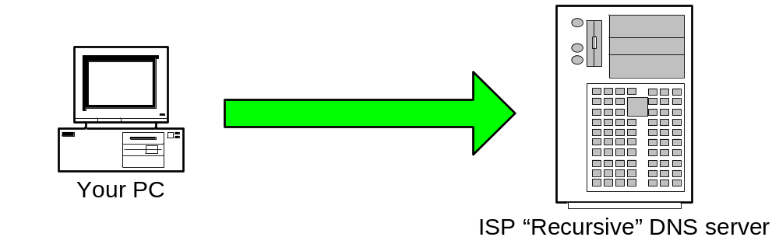
Step 1: Your PC sends a resolution request to its configured DNS Server, typically at your ISP.
Tell me the Address of “www.google.com”

Slide 28
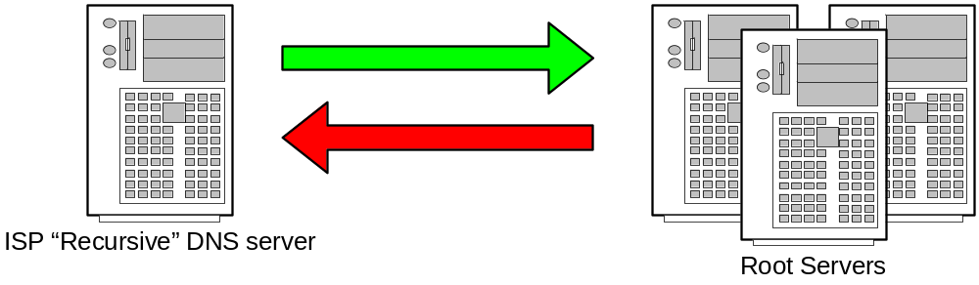
Step 2: Your ISPs recursive name server starts by asking one of the root servers predefined in its “hints” file.
Tell me the Address of “www.google.com”
I don’t know the address but I know who’s authoritative for the ”com” domain ask them

Slide 29
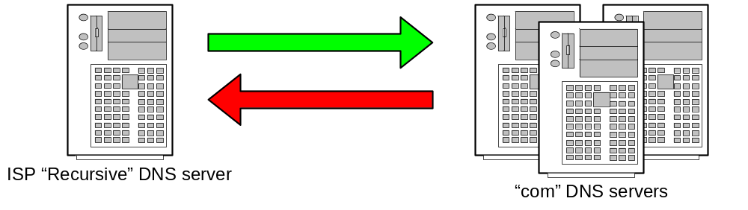
Step 3: Your ISPs recursive name server then asks one of the “com” name servers as directed.
Tell me the Address of “www.google.com”
I don’t know the address but I know who’s authoritative for the ”google.com” domain ask them

Slide 30
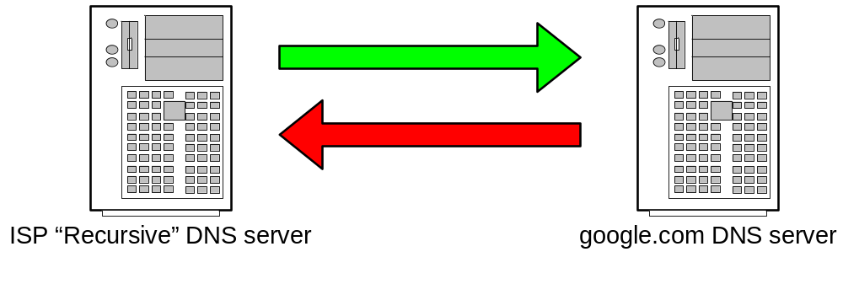
Step 4: Your ISPs recursive name server then asks one of the “google.com” name servers as directed.
Tell me the Address of “www.google.com”
The Address of www.google.com is 216.239.53.99

Slide 31
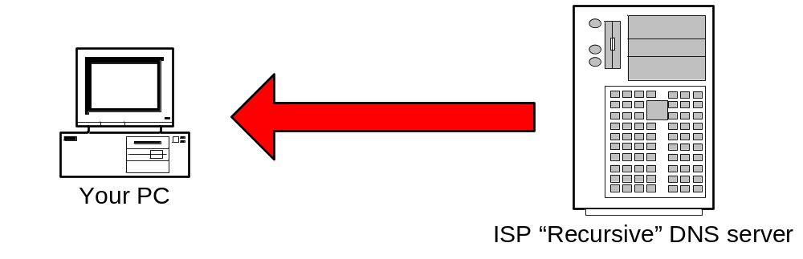
Step 5: ISP DNS server then send the answer back to your PC. The DNS server will “remember” the answer for a period of time.
The Address of www.google.com is 216.239.53.99

Slide 32
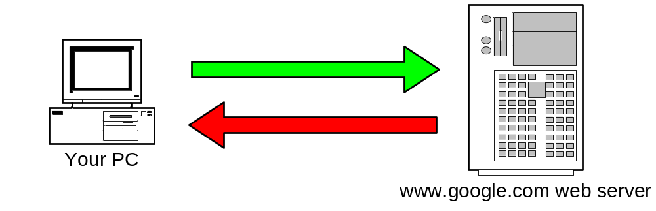
Step 6: Your PC can then make the actual HTTP request to the web server.
Send me the www.google.com.au web page
Here it is!

Slide 33
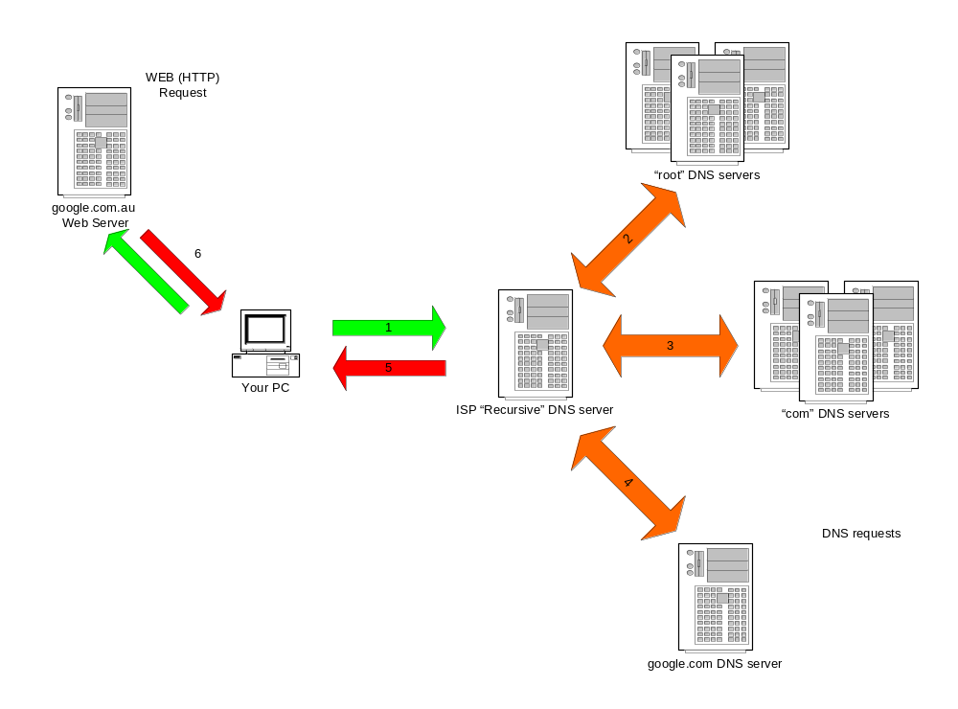
Summary
The actual web request
DNS

Slide 34
Sending an Email
DNS is not just used in HTTP protocol (web pages)
DNS is involved in almost every protocol in use on the internet
Next example is how DNS facilitates the transfer of electronic mail.

Slide 35

Step 1: Your PC sends the e-mail to its configured outbound mail server. A DNS request similar to the previous example is required to find the address of the mail server.
Please send this message to “someone@example.com”

Slide 36
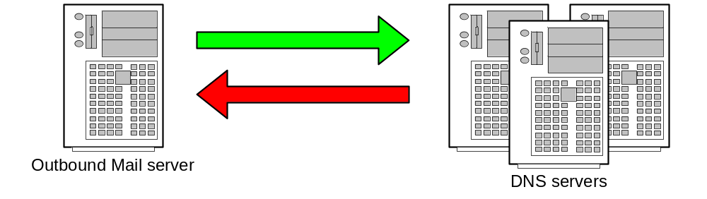
Step 2: Your mail server follows the same intensive process to find the authoritative servers for “example.com”.
Tell me the name servers for “example.com”
Here are the name servers for “example.com”

Slide 37
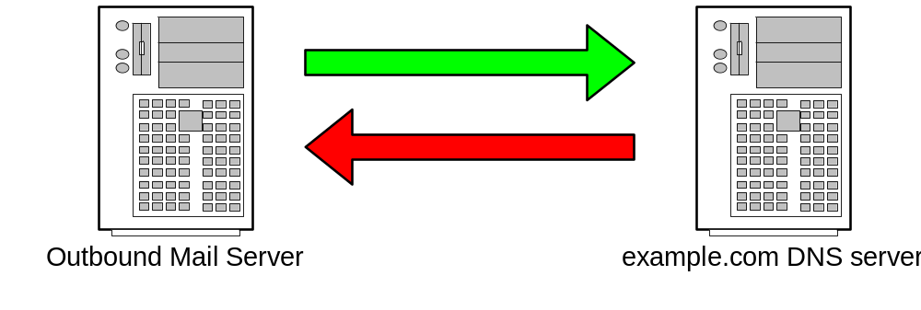
Step 3: Ask the “example.com” name server for the list of “Mail eXchangers (MX) for that domain.
Tell me the MX’s for “example.com”
The MXs are mx10.example.com and mx20.backmail.com

Slide 38

Step 4: Select a Mail server and deliver the mail.
Here is some mail for the “example.com” domain
Mail accepted for delivery

Slide 39
Summary
  DNS is integral part in most protocols used on the internet
  Makes the internet human friendly for us all
  Is the world largest distributed database system
  Fits the international model perfectly
  In simple terms is a mapping between names and IP addresses

Slide 40
Questions?

Slide 41
Thank you

