Slide 1
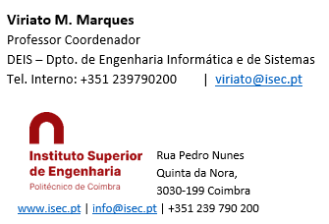
Sistemas de Informação II (LEI) Information Systems (ECS)
Lab Classes
5 – Analysis Services (OLAP)

Slide 2
The Analysis Services (SSAS Projects) projects allow the development of two kinds of projects:
OLAP – Online Analytical Processing – (cubes)
Data Mining, based on several algorithms
Here we’ll focus on the OLAP project only, following the steps
Create a new project
Define a Data Source
Create a Data Source View (including a virtual dimension)
Create a Time Dimension using the SSAS tool
Create a cube
Deploy the project
Test the project by browsing the data

Slide 3
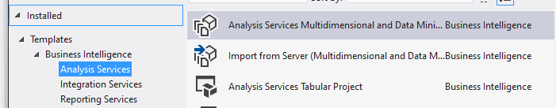
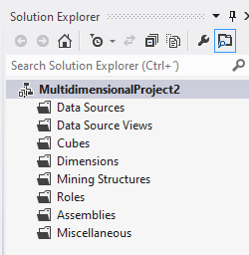
1 - Create an Analysis Services Project
Open Visual Studio executing as Administrator
File -> New Project -> Business Intelligence -> Analysis Services Project (there may be slightly differences in this sequence depending on the version)
Give a name to your project and choose a location (folder) where to store it
On VS the window “Solution Explorer” should be visible and show something like the figure here on the right
With Data Source we’ll define connections do DBs and DWs; the Data Source Views allow to define views of DBs, virtual tables … ; the Dimensions allow to manage dimensions, namely define the VS special behaviour of Time dimensions; the Cubes allow to implement the (final) OLAP server(s)

Slide 4
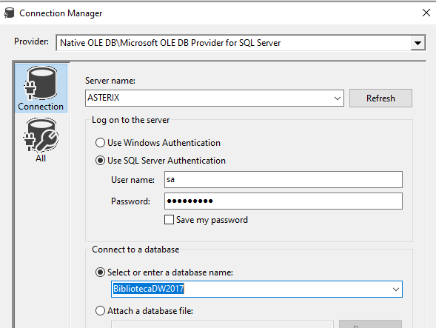
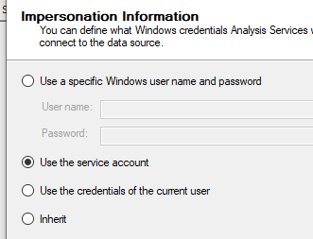
2 – Define a Data Source
A data source is a connection to a DW (the Library DW). To create it:
In the solution explorer right click data sources and then New Data Source. The wizard opens. Click Next and then New
.
Fill the form as shown, using your Server Name, your “sa” password and the name of your Library DW. Click Test connection: if you get na error, something is wrong (the password, the connection type, the DB service not running, the DW name or the server name)
Then click Next. In the Impersonation Information change to “Use the Service Account”. Click Next, give the Data Source a name and Finish
IMPORTANT NOTICE: The above configurations are the best and easiest choices in order to avoid future project deployment errors. At any time you can click the data source in the solution explorer, and verify / correct its parameters, if needed. In the pane that appears, use de Edit button to access the database login (sa , password)

Slide 5
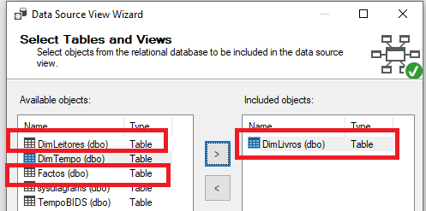
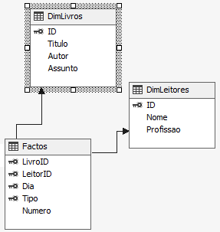
3 – Create a Data Source View
A data source view is a database view built from the tables that the data source(s) connect:
In the solution explorer right click Data Source Views and then New Data Source View. A wizard opens. Lick Next and then click the Data Source you’ve created before. And Next
On the next pane you must select the tables for the data source view. In this case you should select the dimension tables of Leitores and Livros, and the fact table (double click them or select by clicking and press the right arrow.
Next, give it a name, and Finish
On the Solution Explorer you can now click your data source view to open it. It should show the three tables below
In this schema there is the fact table and the two dimensions Livros and Leitores. However, according to our DW design we need 2 more dimensions: the Tipo (‘E’ or ‘D’) and time
We’ll create a virtual table for the dimension Tipo
For Time we’ll use some special features offered by BIDS

Slide 6
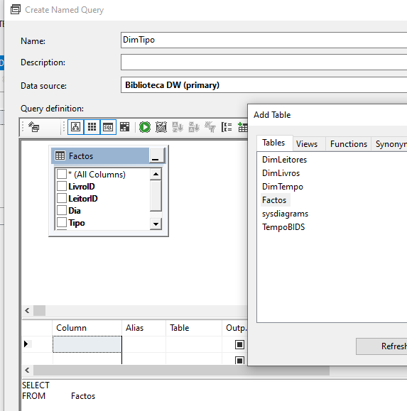
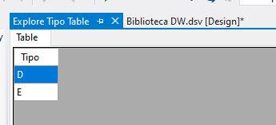
To create the virtual table for dimension Tipo
On the back of the data source view window, right click and select New Named Query. The query design form appears (if you get a exception error, probably you’re not executing VS as administrator: close VS and enter again running as Administrator)
In the form give the query a name such as DimTipo and click Add Table. As the type information resides on the fact table only, add the fact table. Then choose the attribute Tipo.
The system writes the query. However, the syntax
SELECT Tipo
From Factos
Is not correct: this table will have just 2 records, one of value “E” and another of value “D”, and is “all key”, what means that they can not be duplicated! To avoi this, edit the query manually, to obtain:
SELECT DISTINCT Tipo
From Factos
Close the query form. When the table appears, with drag and drop connect it to the fact table
Then right click it, choose Explore, and see what it contains. There shoud be 2 records only: “E” and “D”. If not, double click the table and edit the query as needed

Slide 7
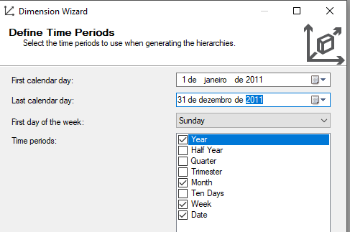
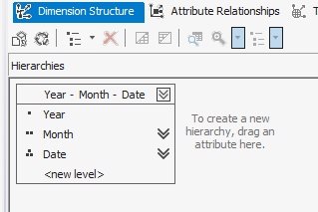

To create the table for the time dimension
On the Solution Explorer, Dimensions, click New Dimension. A wizard appears. Click Next
Choose “Generate a Time Table on the Data Source” ( this will create a physical table into the DW). Click Next
On the next pane, choose, for example, Date, Week, Month and Year. For the upper calendar, as our fact table is dated from 2011, choose 1st January 2011 to 31 December 2011 (could be a larger interval). And next
Then, keep the Regular Calendar. Next. Give it a name (DimTempo) and Finish
The Dimension editor appears. Look to its link on the right. Click it. This will populate the time dimension and create its physical table into the DW
Then open the Data Source View, right click it on a empty zone, Add Table and choose your new time dimension table to add it to the Data Source View
´Drag and drop to connect it from the date field of the fact table to its PK (date)

Slide 8
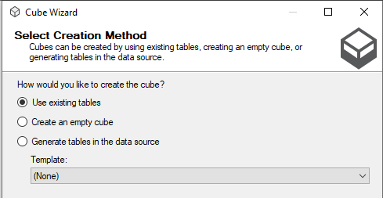
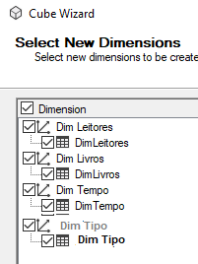
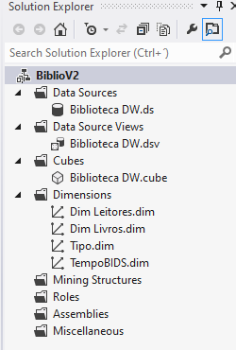
Create the Cube (OLAP)
We may now proceed to the creation of the Cube. This is the central piece of the Analysis Services (OLAP server) project. To create the cube:
On the Solution Explorer, right click cubes and then New Cube. The wizard appears Click Next
Confirm Use existing tables (this will create the cbe based on all the tables in the Data Source View). Next
On the Select Measure Group Tables pane, check the name of your fact table (where the measure is). Next
In the next pane, you may uncheck the FactosCount but if it stays, it doesn’t matter). And Next
Now, the correct dimensions should appear. Click Next
Then give the cube a name and Finish. The new cube shoud appear in the Solution Explorer

Slide 9
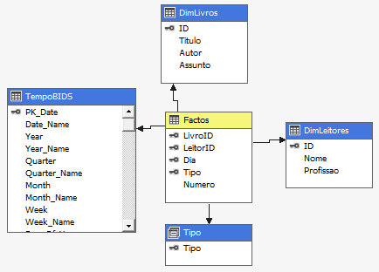
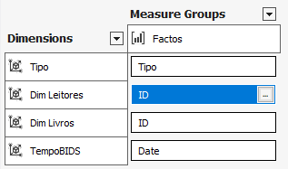
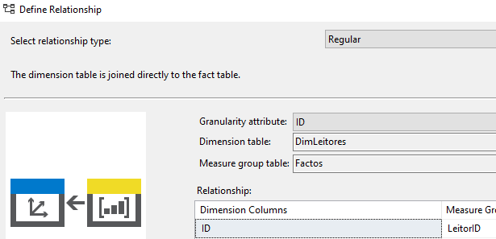
Open the cube by double clicking it on the Solution Explorer
You should see something similar to the right figure. The fact tables are always marked yellow and the dimensions marked blue
The Dimension Usage separator shows the realtionships between fact table(s) and dimension table(s)
At any moment, if needed, you may right click on its back and select Add Cube Dimension if you need to add to the cube any new dimension that you’ve created
For each dimension, click the 3 points on the right. This opens the dimension relationship window. A Regular relationship means that the fact table references, by a foreign key, the dimension table (the Fact relationship means that the dimension is degenerated, residing on the fact table). Look at the possible configurations and understand what they mean.
The Calculations separator specifies how the measures aggregations in the cube take place
Right clicking the CALCULATE visible in the Script Organizer pane, it’s possible to create New Calculated Members by using special functions and MDX scripts. This allows aggregations different from the usual sum, for example taking into account time (homologous months and periods, for example)

Slide 10

The KPIs separator allow to define Key Performance Indicators
A KPI is general shown as a gauge or semaphore with 3 colors that inform if a specified goal has been reached (green) or not (red)
They may include a Trend indicator, that shows the trend of the measure along time
The Actions separator allows to define some special behaviors of some measures such as, for example, showing an information detail about it, when you are visualizing its aggregated value on Excel
The Partitions separator is very important in real environments:
It allows to define how the cube will “operate”, i.e. do some kind of ´”tuning” between the pure ROLAP and the pure MOLAP
This affects the way values are propagated and updated, the performance of the system to ad-hoc queries, disk space …
The Aggregations separator, allow some modifications to the cube related with the items that compose measures and dimensions
Perpsctives allow to define a kind of “views”, i.e. only some values will be visible within a given perspective
Translations allow to translate the names of measures and dimensions
The Browser is used to test if the cube, calculations, KPIs and so on are working…

Slide 11
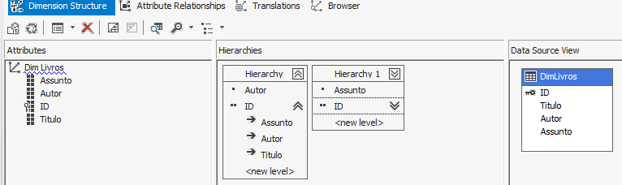

Define the Hierarchies
In the Solution Explorer double click the dimension Livros. The form designer appears. Here you can define the hierarchies for each dimension
From the dimension table on the right Data Source View, drag and drop to the left window (attributes) the fields that you may wish to use in a future analysis (in this case Titulo, Autor, Assunto)
Similarly design another hierarchy between the ID and the field Assunto
Clicking the Attribute Relationships separator, you’ll have “another view” of the relationships between attributes. You can use it for defining the hierarchies too. It should look like this:
From the left window drag and drop the PK to the middle window (Hierarchies) and then, over it, drag the Autor field: this establishes the hierarchy between book and author. The higher the level, thle less the number of points.
Open the dimension Autor and similarly define one hierarchy for it (ID → Autor)
The TIME dimension has its hierarchies automatically defined by VS. Open it and understand them. The Tipo dimension has no hierarchies.

Slide 12
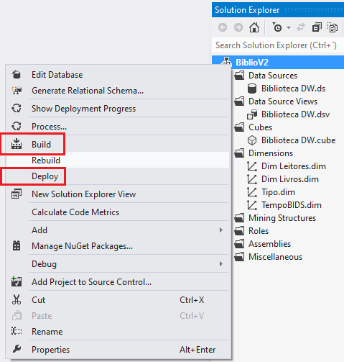
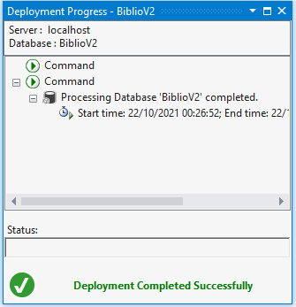
Deploy and Test the Cube
Before testing the cube, the project must be deployed
In the Solution Explorer, right click the project name (in the example, BiblioV2)
Then click Build. Generally there are no problems or errors in this step. Anyway, verify the error output window
Then click Deploy. This step frequently generates fatal errors. If the number of errors is high (about 30) and one of them refers “a connection could not be made …”
Open the data source and verify if it is configured for the login is “sa”, if the password is correct (test the connection), and the Impersonation Information is “Use the Service Account”
In the SS Configuration Manager, verify if the DB service and the Analysis Service are running
Exit Visual Studio and execute it again running as Administrator
Other error messages may refer duplicate keys. Verify the ETL project and the data in the DW tables by querying them. Correct the ETL and reload the tables. Try the deployment again

Slide 13
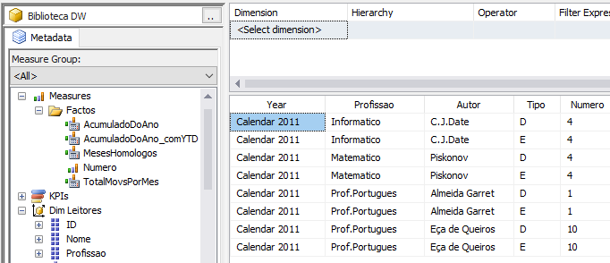
Test the cube using the Browser
Open the cube and click the right separator Browser. On the left you’ll see the fields of the fact table and those that you selected to appear in the dimensions
Drag the measure from the fact table to the viewing window. The number is the total of book lending and returns
Then drag some dimensions at your choice. On the top window you can add filters. Verify the results comparing the with the records of the original library DB.
Later we’ll use the BIDS Reports, Excel and PowerBI to show this kind of results in more interessant ways, such as pivot interactive tables, graphics and KPIs

Slide 14
Analysis Services (OLAP)
END

