Slide 1
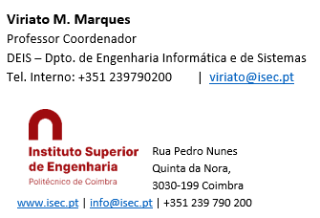
Sistemas de Informação II (LEI) Information Systems (ECS)
Lab Classes
6 – KPI’s

Slide 2
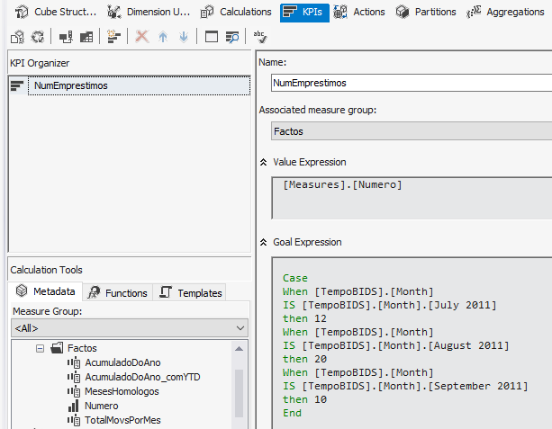
A KPI – Key Performance Indicator shows if a given measure is bellow or above a given goal, and the measure’s trend too. To create a KPI:
Open your Analysis Services project and then double click the Cube
On the top bar click the separator KPIs
Give the KPI any name you want
The Goal Expression is the value of the goal. I may be a single number (just write it in the box) or a more complex expression that defines a distinct gol for example for each month
In the Associated Measure Group write the name of the fact table that contains the measure you want to cotrol in the KPI
The Value Expression is the name of the measure that the KPI will control
Click the “+” sign near to the fact table
Drag and drop the measure from the table to the value expression pane (this will generate the correct sintax to identify the measure)

Slide 3
To create a goal that varies according to some condition, tipically a distinct vaue for each month, or quarter, use a CASE structure:
Manually compute a target that makes sense according to the measure expected values. It may be based on the average of the measure for each year, for exemple, with some variations for some monthes (for example beach business should be higher during August!)
Create a CASE structure:
Case
When [condition]
IS [dimension value or dimension key]
then [goal]
When …
End
Expand the time dimension by clicking the “+” signs on the its left
Drag and drop the “Month” into the right of the When condition
Then, expanding all the them dimension members (by clicking all the “+” signs until the “Members” and then “All” appear) drag and drop the month of July 2021 into the right of the IS keyword (you’ll see a complex syntax that is the dimension key for the July month. That will be ok)

Slide 4
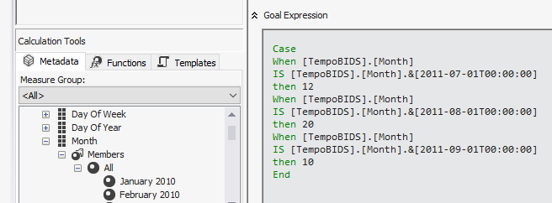
In front of the Then write the (numeric) goal for July 2011, for example, 12
Repeat these procedures for August and September. You shoud get a syntax as the
NOTICE: Instead of dragging and dropping the monthes and getting the key expression, you could carefully write the nameof the month, for example:
When [TempoBIDS].[Month]
IS [TempoBIDS].[Month].[July 2011]
The month name shoud be exactly written as it is in the time dimension table. You can see it on the left window or openning the cube digram and exploring the time dimension table

Slide 5

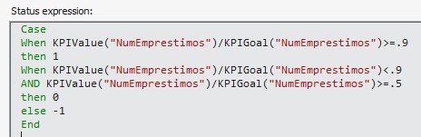
For the status indicator, choose a symbol, generally a gauge or a semaphore
The Status Expression is generally a CASE expression with 3 possible output values: -1, 0 and +1, that will place the status indicator into the red, yellow and green zone respectively:
Here, KPIValue and KPIGoal are reserved words that you must use; “NumEmprestimos” is the name you gave to your KPI
The values .9 and .5 just establish the limits for the colour change. You may define other limits or expressions as needed. This is just a tipycall example.

Slide 6

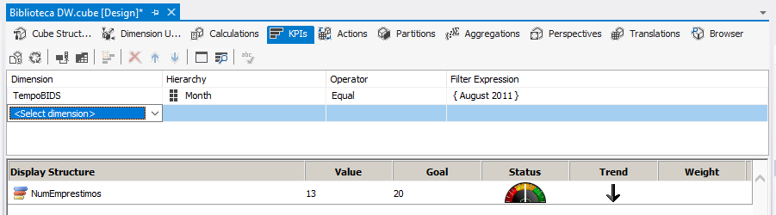
To test the KPI
On the Solution Explorer Build and Deploy the project.
Then click the KPI browser
You should see the above window. Configure the top row ( the filter) according to the conditions previously defined. For example, choose the time dimension as filter, month, “equal” condition and a month such as July, August or September. Then press the Tab on the keyboard or click on the Dsplay Strucure to refresh the KPI indicator
NOTICE: in this tutorial with didn’t define the Trend structure as it makes use of DMX Time Intelligence functions that are out of this scope. So the arrow shouldn’t be visible here.

Slide 7
Key Performance Indicators
END

