Slide 1

Sistemas de Informação II (LEI) Information Systems (ECS)
Lab Classes
7 – Reports, Excel, PowerBI

Slide 2
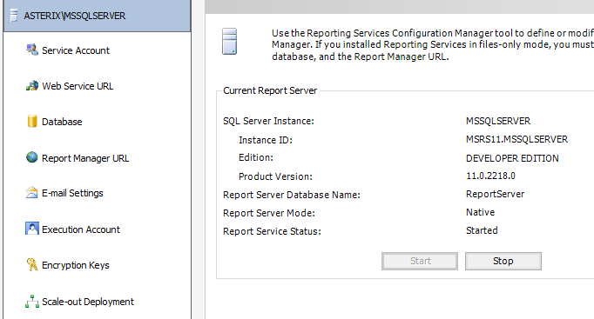
SQL Server Reporting Services
The results provided by the cube can be visualized using the SQL Server Reporting Services. For creating a Report project:
For SQL Server 2012 … 2016, on the SS Configuration Manager, start the DB services and/or the Analysis Services and the Reporting Services
For SQL Server 2017 and above, on the SSCM start de DB and/or the Analysis Services, and then look for the application Reporting Services Configuration:
Run the Reporting Services Configuration as Administrator
On the first page, click the Start button: the other options on the left pane, become active
NOTICE 1: These options configure the Report Server. For example, for testing a Report Project using the browser, you may need to access these configurations. However, frequently it is enough to confirm the default values
NOTICE 2: This Reporting Services Configuration exists for all the SS versions since 2012. On the 2012 you may also use it for starting and stopping the service (but you can do that using the SSCM only)

Slide 3
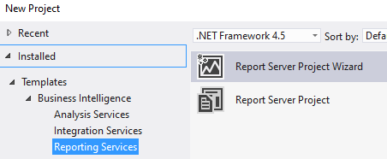
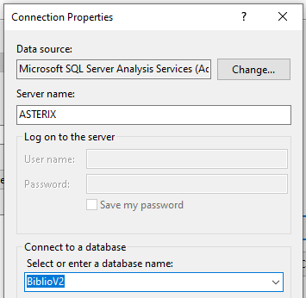
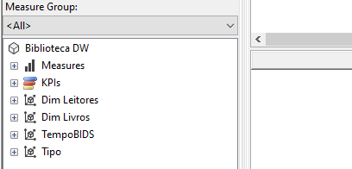
Creating a Basic Report
Enter Visual Studio running it as Administrator
Then File -> New Project -> Report Server Project Wizard (may vary a little bit due to SS versions)
Give the project a name and choose the folder
The Wizard appears. Click next. The Data Source configuration pane appears. You can connect to several types of sources:
Choose the Microsoft SQL Server Analysis Services (to connect to your Library OLAP project) and click the Edit button
In the Conncetion Properties you must manually write the server name (can see it in the Properties of the server in the SSMS), and the Analysis Services project you want to connect to. Choose name of your Library OLAP project
Click Test Connection and Ok.
Back to the Report Wizard, click Next and then the Query Builder button
Now you just have to drag and drop the attributes you want to include in your report

Slide 4
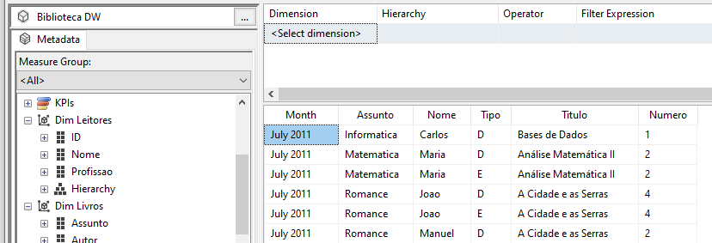
Expanding the “+” signs on the left, drag and drop your measure (Numero), Assunto (subject), Nome (reader’s name), Type (“D” or “E”), Titulo (book title) and Month
Then click Ok and Next: you’ll see a complex query built using a non SQL language. This is DMX, specially developed for querying OLAP servers
SELECT NON EMPTY { [Measures].[Numero] } ON COLUMNS, NON EMPTY { ([Temp …
Click Next. Then choose the Matrix layout (instead of Tabular) for your report. This provides a more interesting layout as it allows line and columns labels
Click Next. The Design Matrix appears:

Slide 5
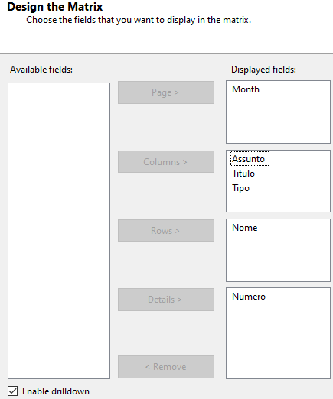
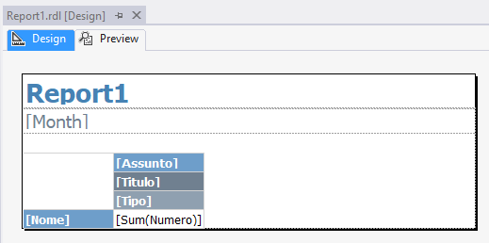
In the Design Matrix drag and drop the fields as shown. With this configuration
The report page will break when the Month changes
In the columns we’ll see the book subject (Assunto) and, as Enable Drill Down is checked, we’ll be able to click a “+” sign to see a detail – the name of the book (Titulo) and /or the “E” or “D” information (type)
The rows will show the name of the reader
Click Finish. For version 2012 the Matrix style appears. Just choose one that you like. Click Next
In the Deployment Location window, confirm de default values
Click Next, give the report a name and click Finish
The Design and Preview window appear. Here you can, in fact, create a report from scratch, or edit what the wizard designed. There are lots of possibilities, such as including graphics and indicators, changing colors and styles…

Slide 6
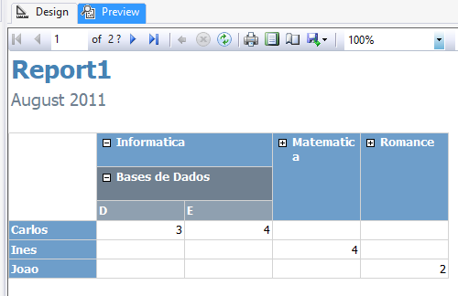
Click the Preview separator. The report should show up. Click some “+” signs to “drill down”. Observe de page brakes.
These reports are designed to be accessed by the Internet, using a browser (can even be included in an autonomous application developed with Visual Basic or C#). To see the reports on a browser:
Ensure that the Reporting Services are running
Open the old Internet Explorer or Chrome running as administrator
Use the URL http://localhost/ReportServer (for my server http://ASTERIX:80/ReportServer)

Slide 7
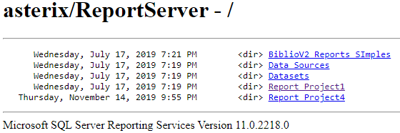
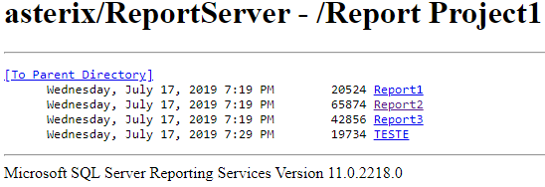
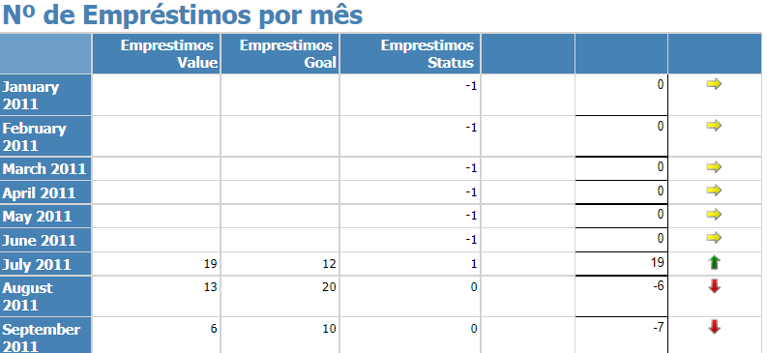
The report server page appears, showing the reports previously developed in Visual Studio
Click a project to open it and then choose one of the reports in this project
The report should appear. Here is na example of a more complex report:
NOTICE: If you experience any problems to browse the reports, open the SS Reporting Services Configuration and try to correct any possible error in the parameters.

Slide 8
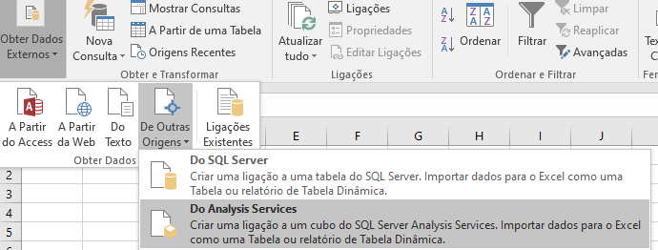
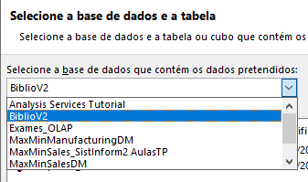
2. Using Excel for Dashboards and Ad-hoc Queries
Excel may be used as a front-end for data warehouses and OLAP servers. To create a dashboard based on Excel for your Library cube:
Enter Excel and create a new empty book
Click the Data separator -> Get Exernal Data -> From other Sources
Then, select the name of your OLAP project from the dropdown
Click Next. Give a name to your connection and click Finish
If the system will sugest the cell A1 to put the data, confirm
Choose Analysis Services (for the data warehouse it would be “From SQL Server”). The Connection wizard opens
Write the name of your server (can see it in the SSMS, server Properties). Click Next

Slide 9
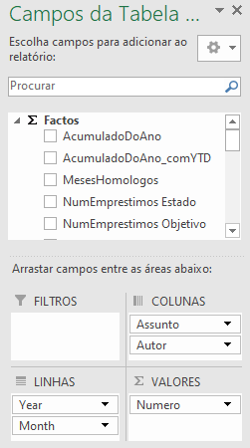
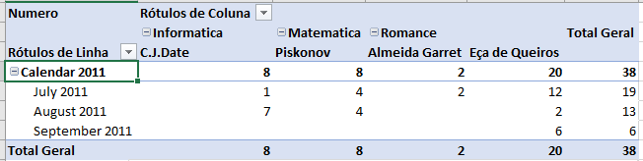
The Excel Sheet opens showing the fields of your OLAP project ready to be dragged and droped into Excel dynamic tables and graphs
To create a pivot table:
Drag and drop the measure(s) to the Values (Valores) pane
Drag and drop the dimensions you want as column names, to Columns (Colunas)
Drag and drop the dimensions you want as line banes, to Lines (Linhas)
(You may also test the use of filters (filtros) by dragging atribute(s) to the Filters (Filtros) pane)
As you drag and drop fields, the system builds a dynamic table (if it suggets the cell A1 to begin putting the data, confirm or change, as you wish)
You can expand (dril down) or compress (roll up) the dimensions, by clicking the “+” or the “-” signs. Try it, and try also to use other attributes in the dynamic table

Slide 10
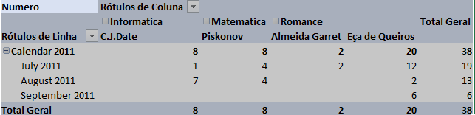
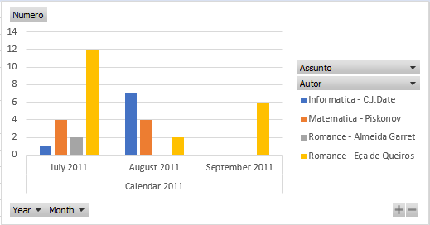
With Excel it is very easy to buils a graph based on a tabel, and that will automatically show all the changes of the table:
Select all the area of the pivot table
One interesting capability is the use of DAX. DAX stands for Data Analysis Expression and is the name of the language that PowerPivot for Excel uses to create calculations between the columns (fields) in an Excel Data Model (PowerBI may use DAX, too)
Notice that each time you change the visible dimensions, you are in fact sending ad-hoc MDX queries to the OLAP server
On the main menu click Insert and schoose a graphic, A good example may be the Grouped Columns Graph. It will look like this
Drill down or roll up some dimensions of the pivot table. The graph will change according to these operations
Change the dropdowns of the graph: the table will reflect these changes
You can save your Excel sheet as usually. Next time it will be ready to use
NOTICE: to update the data, click Data -> Update All
Excel offers a lot of possibilities such as many graph models, calculations and conditional formatting

Slide 11
3. Using PowerBI
PowerBI is a powerful Business Intelligence tool that can be used standalone or as a front-end for displaying data from a database, data warehouse, Internet tables, Excel data, OLAP server… Here we will just try it and in the next classes we’ll follow some detailed tutorials and projects.
Run the SQL Server Database and Analysis Services
Download and Installthe PowerBI application from https://powerbi.microsoft.com/en-us/downloads/
Install the PowerBI Desktop version, that has almost all professional functionalities but is free and has no license expiration date
Enter PowerBI
Create a new project
Connect to the OLAP Server of your Biblioteca (Library) Analysis Services project
Choose the fields to import
Explore the capacities os PowerBI by creating some dashboards that include diferente controls such as tables, scatters, filters …

Slide 12
Reports, Excel, PowerBI
END

