Slide 1
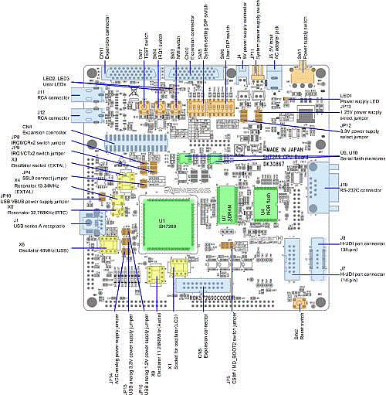
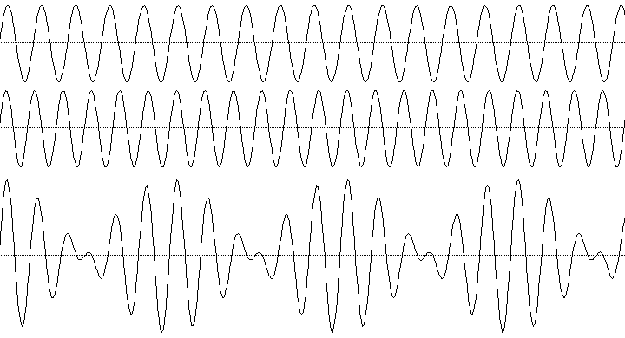
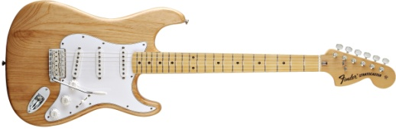
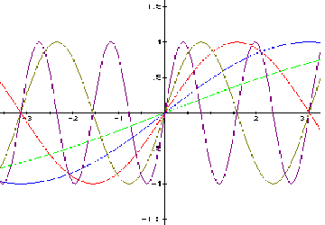
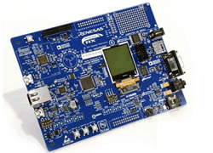
Real-Time Frequency Estimation and Tracking aka “Let’s Build a Guitar Tuner”
Paulito Mendoza
github.com/Paulito-M

Slide 2

Agenda
Overview
The Approach
Algorithms
MATLAB Plots
Real-Time Implementation
Demo (or video, in case of technical difficulty)
Conclusions
References

Slide 3

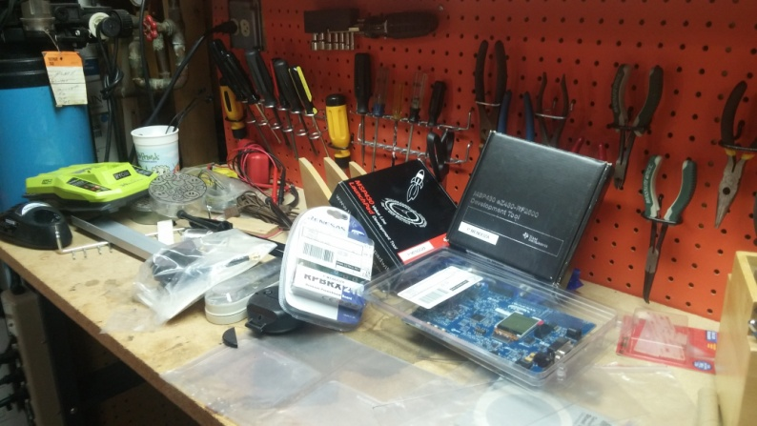
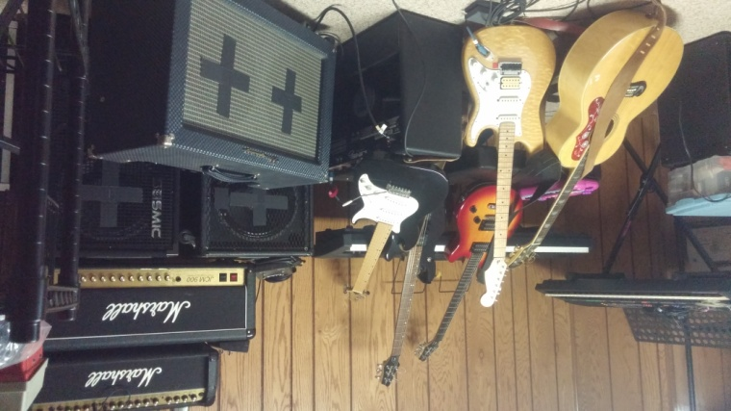
Overview
Build a guitar tuner
Demonstrate adaptive filtering to the family
You can never have enough guitar tuners
Evaluation boards collecting dust

Slide 4
The Approach
Find a couple of pitch tracking algorithms
Prototype in MATLAB
Port to C on eval board
Microphone input; sample real fast
Test!

Slide 5
Risk Summary
Algorithms; MATLAB
Real-time demonstration
Does the eval board still work?
Are the toolchains compatible with Windows 10?
How do I connect the microphone to the ADC?
Is this CPU fast enough to sample @10kHz?
How do I illustrate results?
Watch out for ESD…ON THE WAY TO CLASS!!!!

Slide 6
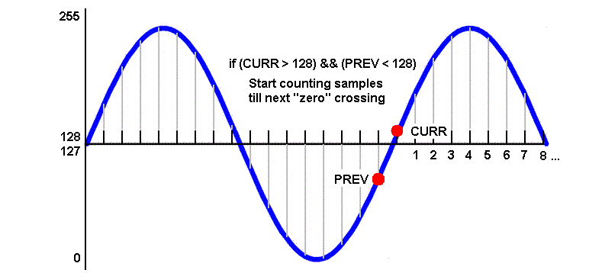
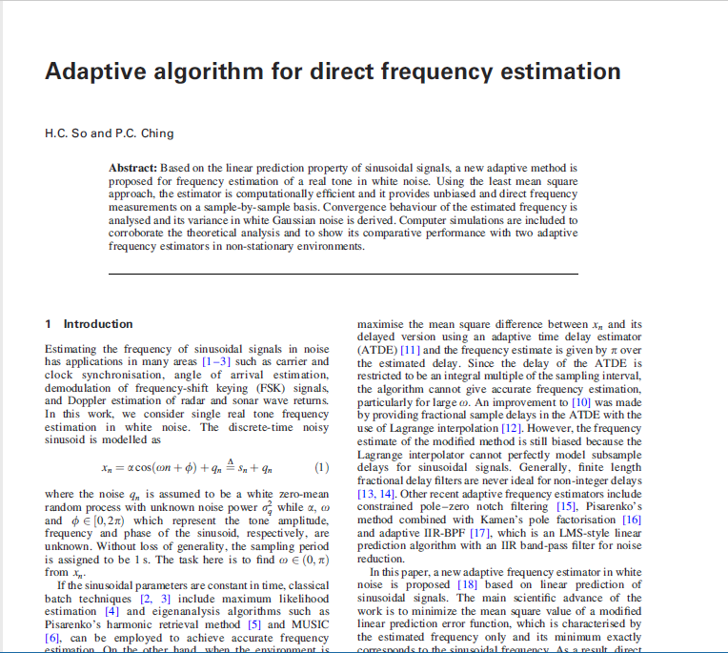
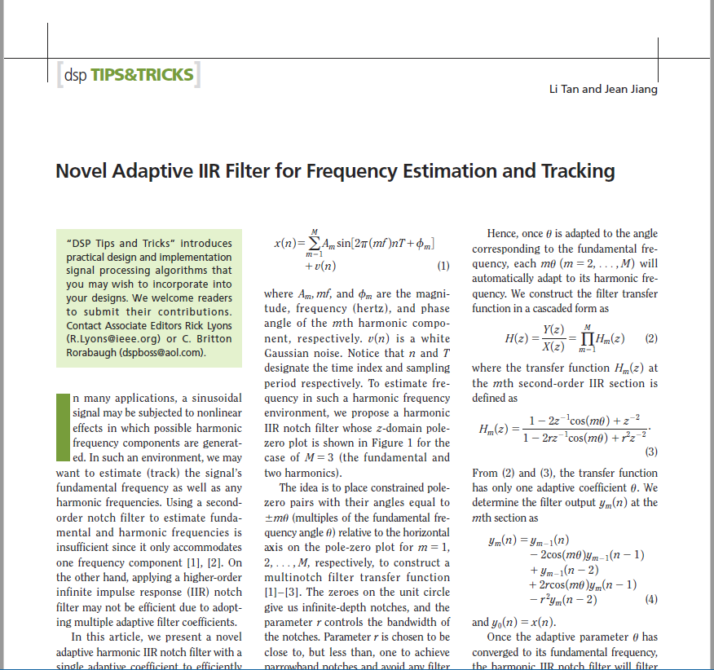
Algorithms
Zero-crossing
Count when sample goes from + to –
Linear Prediction
s=cos(ꙍ) s_{n}=2cos(ꙍ)s_{n–1} – s_{n–2}
Adaptive Notch Filter
Adjust notch to minimize signal power

Slide 7
Algorithms Linear Prediction aka Direct Frequency Estimation
Input: sinusoid + noise
“It can be shown that…”
Sinusoid approximated by two previous samples
Error signal
Mean Squared Error
Mean Squared Error, scaled
Squared Error, scaled
Stochastic gradient estimate: differentiate wrt frequency
Stochastic gradient estimate: simplified
LMS update equation

Slide 8
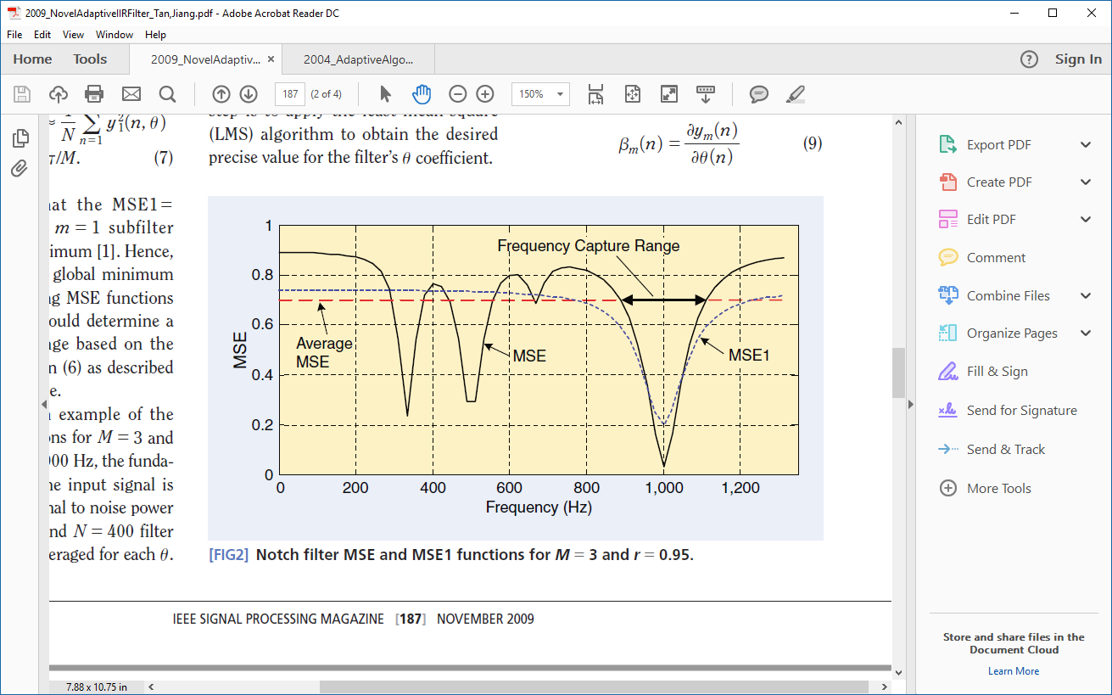
Algorithms Adaptive Notch Filter
‘r’ controls notch width
Transfer function
Difference equation is
Since this is a notch filter, intended to minimize output
y(n): the error e(n) = y(n)
Similar to previous: error squared; differentiate wrt frequency; obtain stochastic gradient expression
LMS update equation

Slide 9
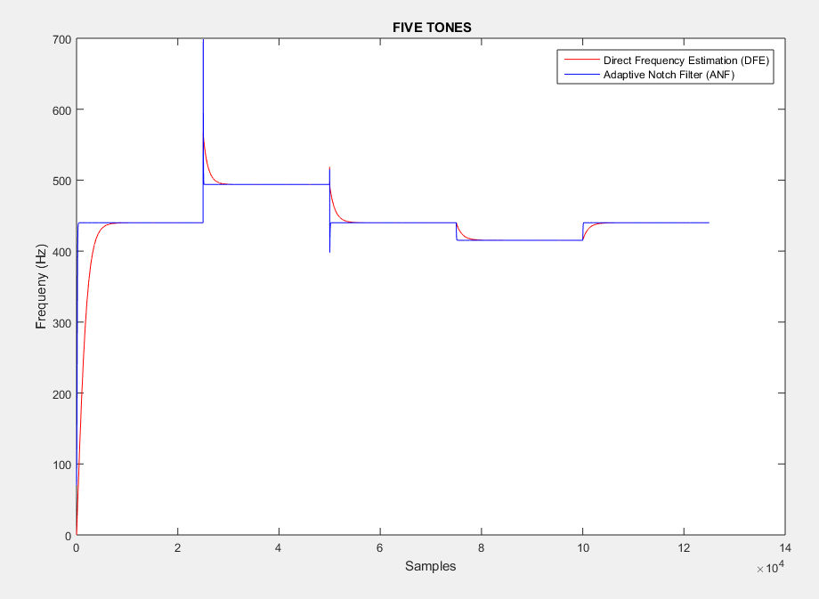
MATLAB Plots
AUDIO

Slide 10
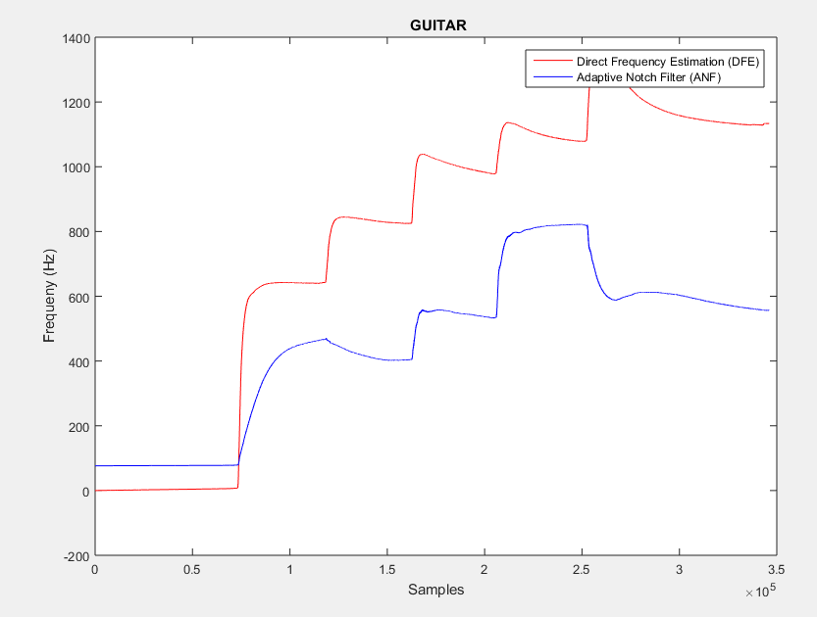
MATLAB Plots
AUDIO

Slide 11
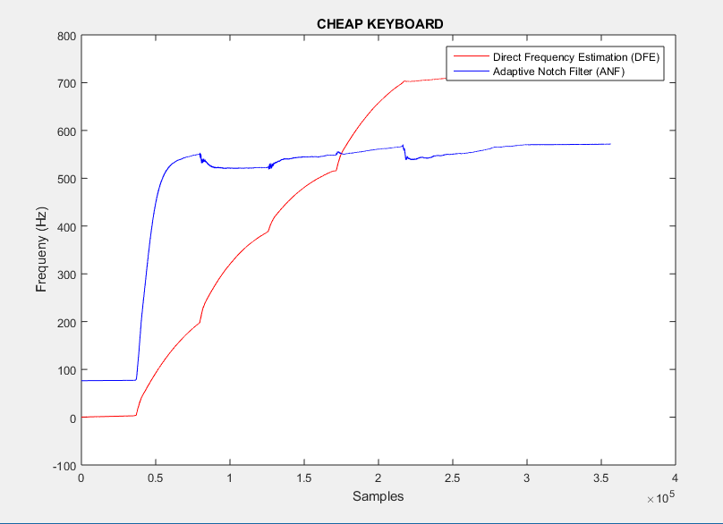
MATLAB Plots
AUDIO

Slide 12
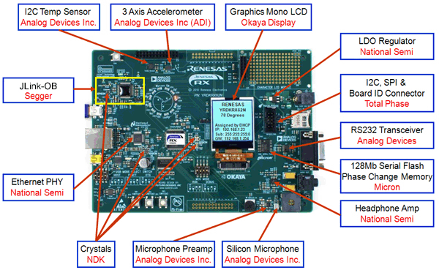
Real-Time Implementation

Slide 13
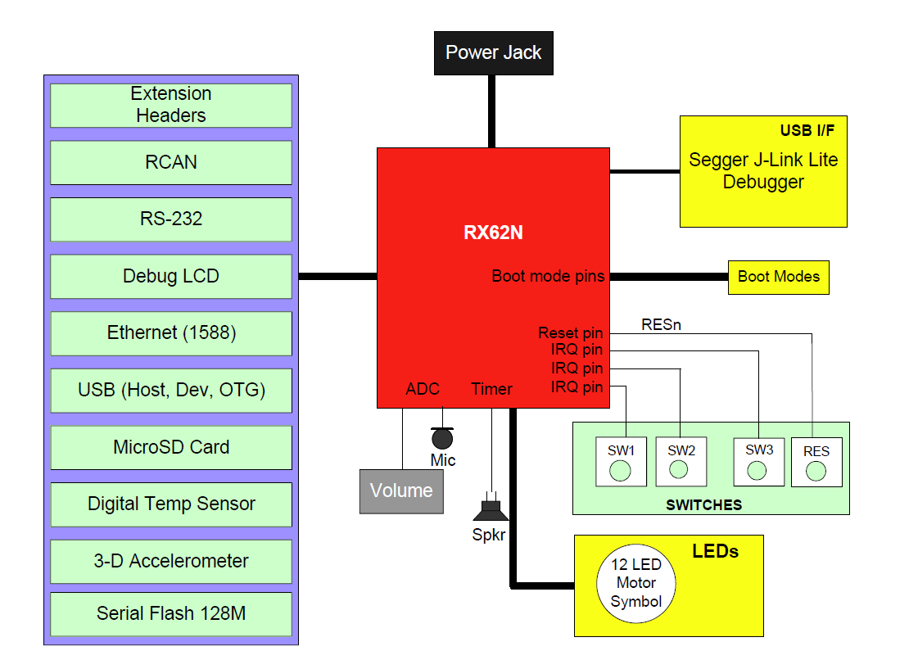

Real-Time Implementation
32-bit CPU
Floating point
ADC
Microphone
Works on Win10
Demo code works
Up to 20kHz

Slide 14
Demo Or Video in case of technical difficulty
Pure tones (Windows WAV)
Piano: A4-440, C5-523.25
Guitar: E4=329.63, A4=440, C5=523.25

Slide 15
Conclusions
Embedded implementation appeared to work better than MATLAB & recordings
Recordings were of poor quality
Emphasized noise, overtones
ANF superior to DFE
Test hardware earlier…in case it doesn’t work

Slide 16
References
So, H.C. and Ching, P.C.: “Adaptive algorithm for direct frequency estimation”
Tan, Li and Jiang, Jean: “Novel Adaptive IIR Filter for Frequency Estimation and Tracking”
renesas.com

Slide 17
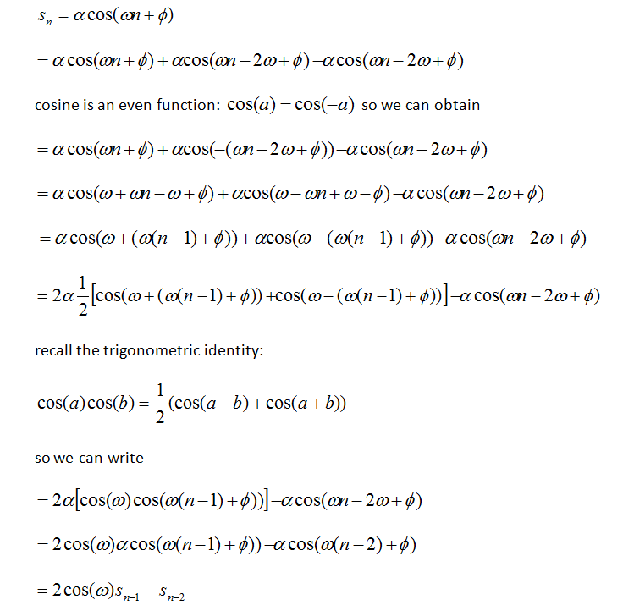
Appendix: proof of cos()

