Slide 1


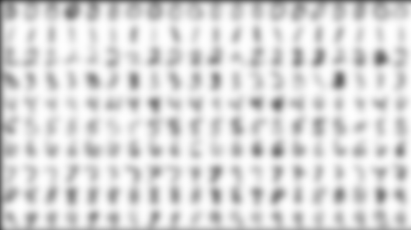
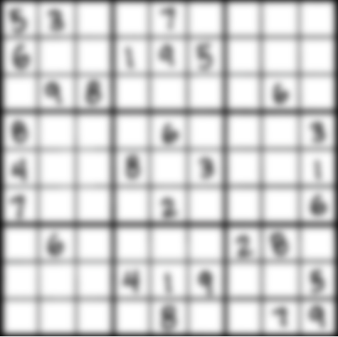
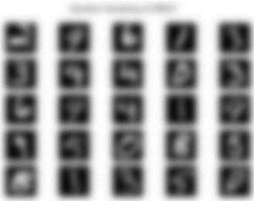
Solving Sudoku: An Application of Handwritten Digit Classification
Paulito Mendoza github.com/Paulito-M

Slide 2
Agenda
Overview
MNIST digit database
Algorithms
Sudoku Puzzle Solver: DEMO
Conclusions

Slide 3
Overview
Motivation: why are we doing this?
Building puzzle solvers is more interesting than solving puzzles manually
Wrote a Sudoku solver some years ago; it needs
A GUI
Some automated input so you don’t have to type in the puzzles
We need a classifier algorithm to read digits
Approach: what are we doing?
Prototype and test (at least one) algorithm to recognize handwritten digits
Write a Windows GUI to
Implement algorithm
Apply algorithm to scanned Sudoku image(s) to instantiate puzzle data
Attempt to solve using existing Soduku solver algorithm
VB.NET : not trendy, but reliable

Slide 4
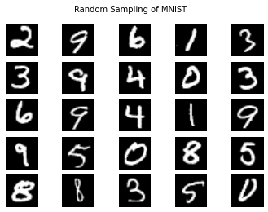
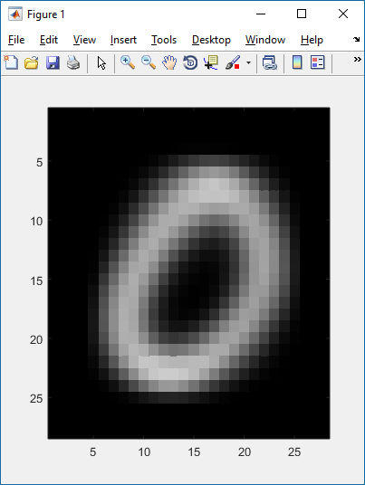
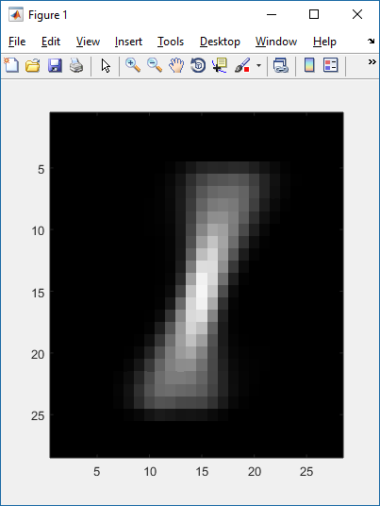
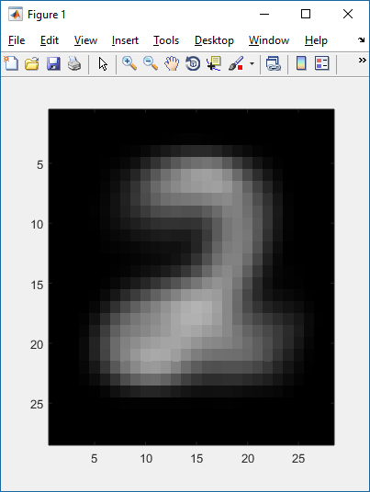
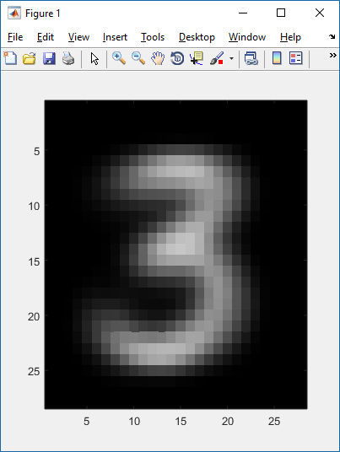
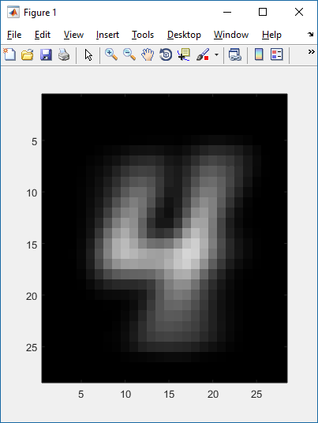
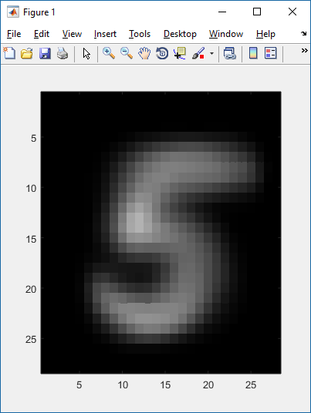
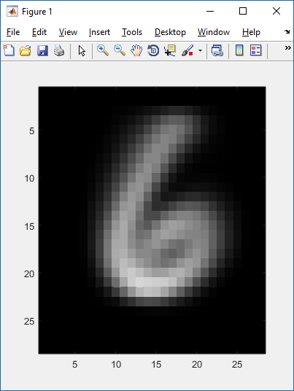
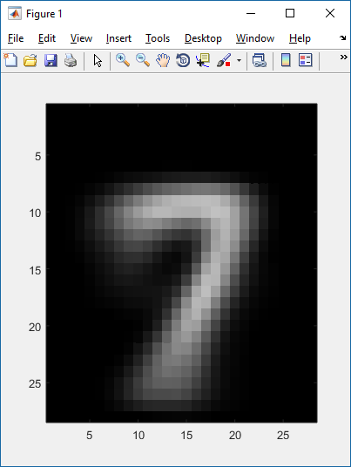
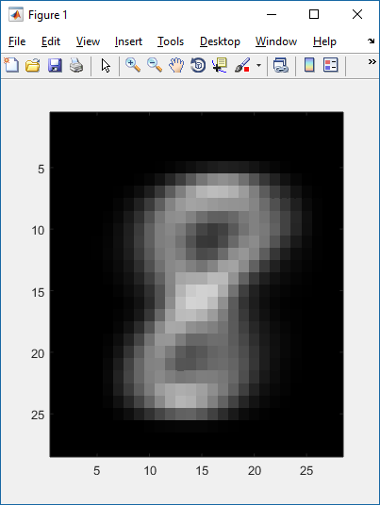
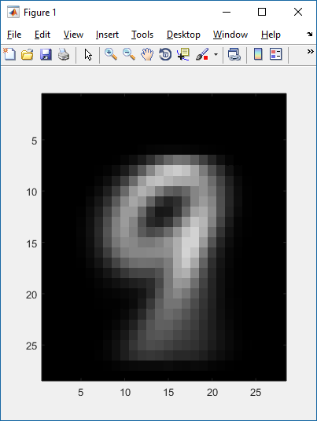
Modified NIST (MNIST) Digit Database
Original MNIST database:
Each image: 28x28 pixels
60K training samples, 10K test samples
http://yann.lecun.com/exdb/mnist/
Abbreviated MNIST database:
http://cis.jhu.edu/~sachin/digit/digit.html
10K training samples, 1K for each digit 0-9
Decomposed into easier file format

Slide 5
Algorithms Bayes Rule
Used in spam filtering:
Used in digit recognition:

Slide 6
Algorithms Bayes Rule for Digit Recognition: MAP Estimator
Assume all digits have equal probability
Find expression P( bitmap ) for each possible digit!

Slide 7
Algorithms Binary naïve Bayes
For digit i, probability of observing Bitmap_x
“naïve”: assume each pixel is independent
Where
P_{i}(x_{j}) = p_{i,j} probability that pixel j of digit i is ON
P_{i}(x_{j}) = ( 1 – p_{i,j} ) probability that pixel j of digit i is OFF
p_{i,j} is calculated by summing the pixel values of pixel j over all samples of digit i
Avoid underflow:
MATLAB: ~83% success

Slide 8
Algorithms Gaussian naïve Bayes
Similar, but: use pixel values (0-255), calculate Gaussian distribution for each pixel of each digit!
mean μ_{j,i}: average value of pixel j of digit i over all samples
Variance σ_{j,i}: average value of ( pixel_{j,i} – μ_{j,i} )² over all samples
MATLAB: ~79% success

Slide 9
Algorithms Other algorithms…
Multivariate Gaussian
Each image is a vector of 784 pixels
784-dimensional Gaussian
Mean is vector mean of 784 pixels
Calculate covariance matrix
Neural net approaches
MATLAB: ~63% success
2.5 hrs to run
(PBKAC)
Neural net approaches: < 1% error rate

Slide 10
Sudoku Solver
C++ implementation of Sudoku Puzzle Solver
Architecture: three classes of objects
cell
gridset
row, column, or square of cells
grid
NxN cells aggregated into rows, columns, squares
Each cell…
EITHER has a value (1..N)
OR has a list of possible values
Belongs to a row, a column, and a squares
Each grid…
Is a set of N x N cells
Has N rows
Has N columns
Has N squares

Slide 11
Sudoku Solver
1 | 4 | 3
3 |  | 1 | 4
2 | 3
 | 1 |  | 3
Recursive Backtracking Algorithm
DETERMINISTIC SOLUTION:
For each unpopulated cell in the grid
define that cell’s possible values, based on the values already present in the other cells contained in that cell’s row, column, and square
For each row, column, and square
If there is a cell with a unique possible value (ie it does not exist in the other cells for that gridset), populate that cell with that value, and restart the algorithm
RECURSIVE ITERATION:
At this point: there are no cell values that can be deterministically be defined
For each unpopulated cell in the grid
Loop through its possible values:
Populate the cell with the possible value
Duplicate the whole grid
Recursively call this algorithm with the new grid
If NOT SUCCESS: continue loop
If loop ends without SUCCESS: exit
If NOT SUCCESS: grid is unsolveable
1 | 4 | 3 | 2
3 | 2 | 1 | 4
2 | 3 | 4 | 1
4 | 1 | 2 | 3

Slide 12
Sudoku Solver
DEMO

Slide 13
Conclusions
83% success on MNIST != good results
With (3) scanned puzzles
Penstroke thickness; scan quality; …
80/20 Rule aka Pareto principle
80% of the effects come from 20% of the causes
80% of the development time comes from 20% of the features
VB.NET is very slow; C++ DLL better
Recursive algorithm + garbage collection
VB.NET is “managed code”
Questions? Comments?

Slide 14
