Slide 1
CS3347
Group 8

Slide 2
Highlights of Software Engineering Techniques
Universal Modeling Language Technique [UML] using Visual Paradigm tool
Object Oriented Methodology
Reverse Engineering Approach
Problem Solving Approach
System Modeling [Functional+Object+Dynamic]
Three-Tier Layered System Architecture

Slide 3
Highlights of Software Engineering Techniques
Universal Modeling Language Technique [UML] using Visual Paradigm tool
Software Development Best Practices
Visually model software

Slide 4
Highlights of Software Engineering Techniques
Object Oriented Methodology
Software Development Best Practices
Use Component-based Architecture

Slide 5
Highlights of Software Engineering Techniques
Reverse Engineering Approach
Software Development Best Practices
Gain sufficient design level understanding to aid maintenance,
strengthen enhancement and support replacement

Slide 6
Highlights of Software Engineering Techniques
Problem Solving Approach
Software Development Best Practices
Identify the problems and generate possible solutions

Slide 7
Highlights of Software Engineering Techniques
System Modeling [Functional+Object+Dynamic]
Software Development Best Practices
Develop Software Iteratively
Continuously Verify software quality

Slide 8
Highlights of Software Engineering Techniques
Three-Tier Layered System Architecture
Software Development Best Practices
Control changes to software

Slide 9
Scope of Project
Restart Game
View High Scores
HP Implementation
Boost Up
Spawn Waves

Slide 10
Software Engineering Techniques
Functional Modeling
Case Diagram
Object Modeling
Class Diagram
Dynamic Modeling
Sequence Diagrams
Software Process
Develop the game iteratively to maintain the quality
Test Case Reports

Slide 11
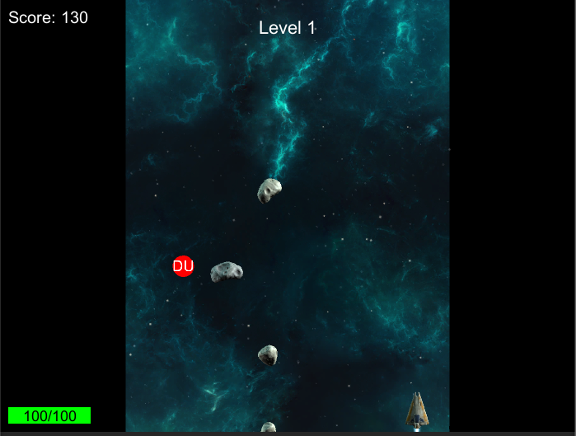
Bonus – Boost Up

Slide 12
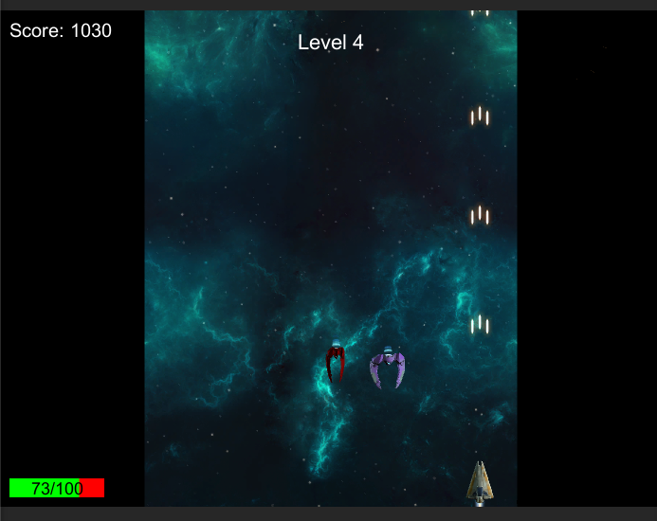
Bonus - Spawn Waves

