Slide 1


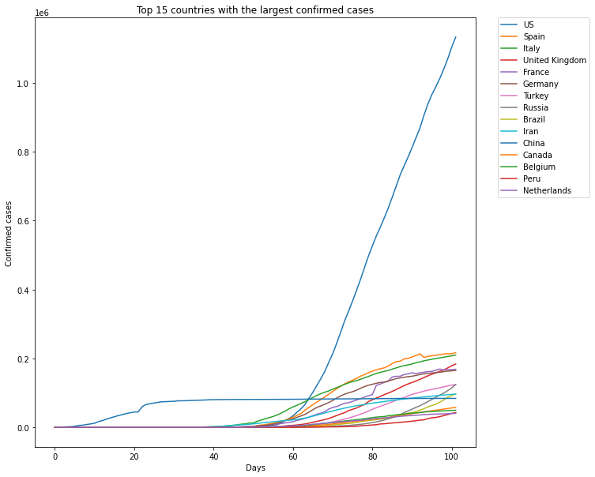
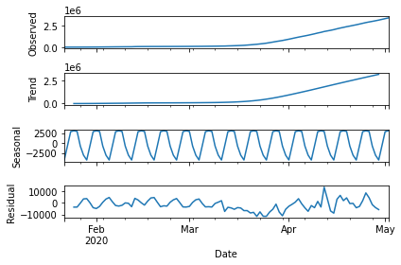
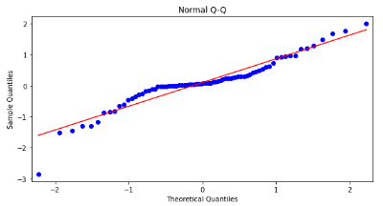
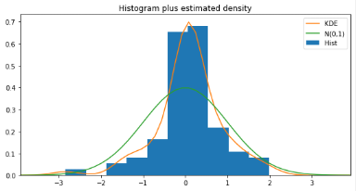
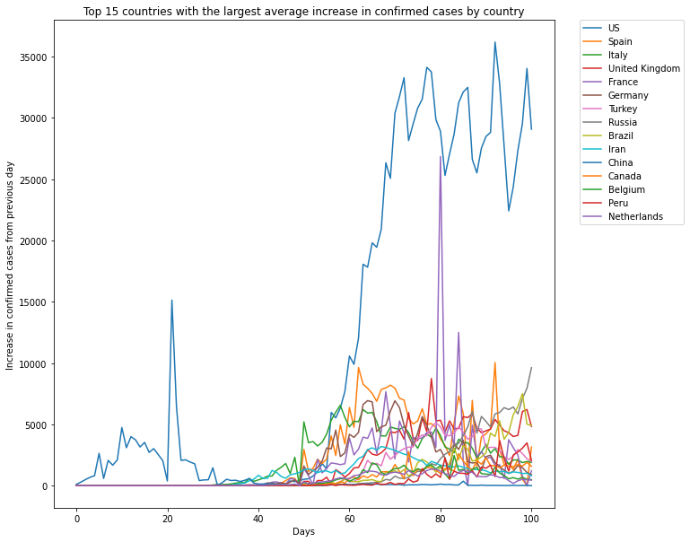
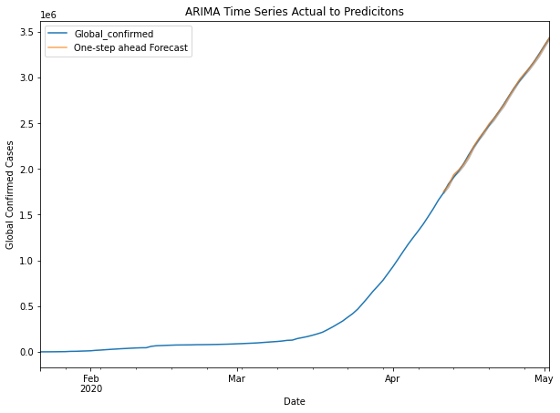
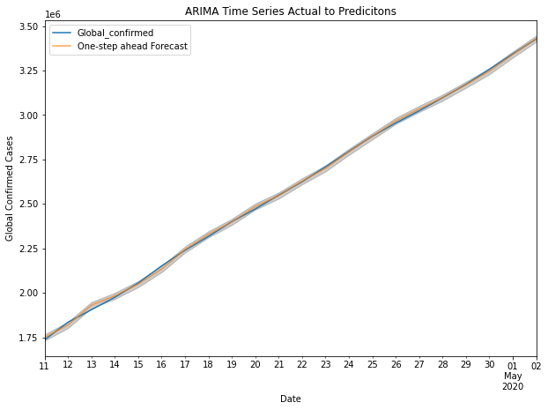
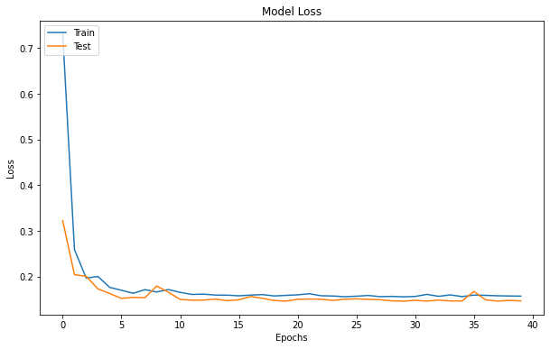
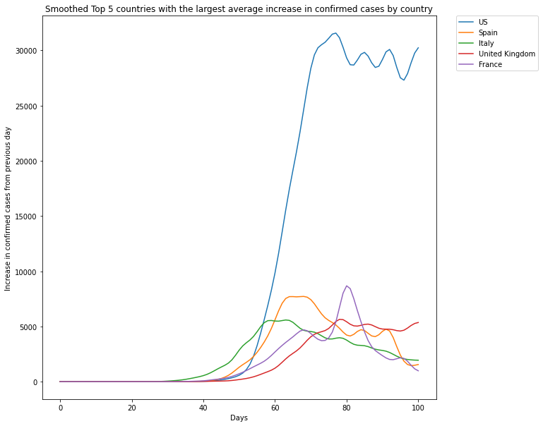
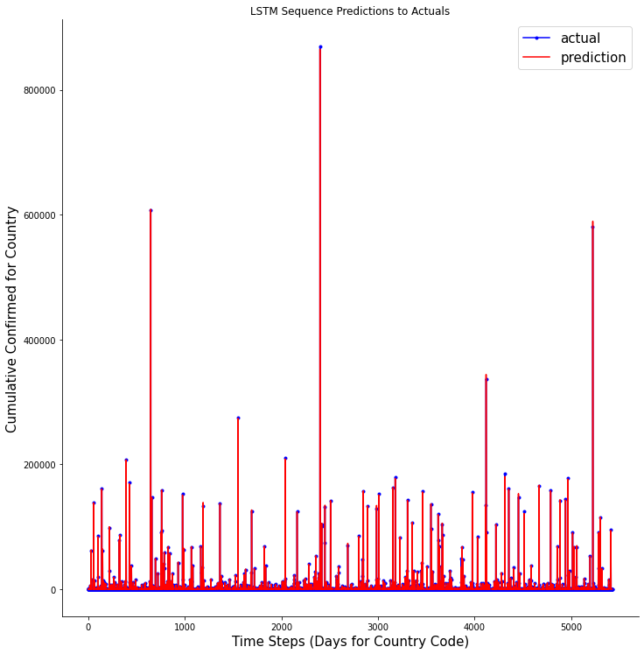
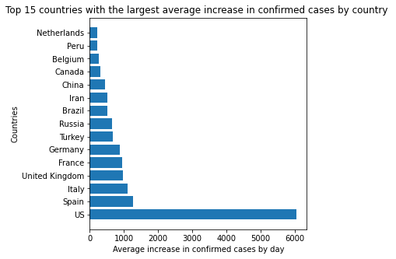
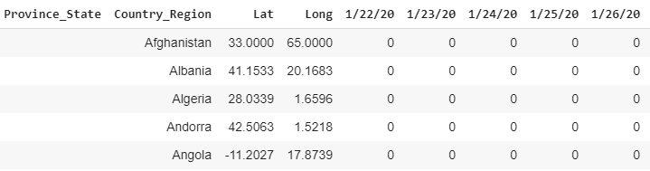
Covid-19 Confirmed Cases Time Series Modelling
Paul Lee – Leep5@rpi.edu
¹Rensselaer Polytechnic Institute, Tetherless World Constellation, Troy, NY, United States,
Abstract
Data Exploration
Modelling
Covid-19 or coronavirus has sent the entire world into states of emergency with its rapid rate of spread. Beginning in China, in a matter of a few months, the virus has been able to spread to almost all the countries in the world infecting a total of 3.49M people. There have been several calls for action by large tech companies and governments to help understand the dangers of Covid-19.
In this poster, a full stack data science solution to modelling the number of confirmed cases throughout the world will be demonstrated. Focusing on data selection, data preprocessing and modelling we observe an analytical approach to predicting on complex time series data. Modelling for both total global confirmed cases using an Arima time series model and a LSTM neural net model to predict for confirmed cases by pairwise date, country input values.
Arima Time Series Modelling
Fig5. Total Global Confirmed Cases Decomposition
Trend line exists and is positive where seasonality may be disregarded to the length of periods available
Fig1. Total number of confirmed cases over time
Mapping over days the total number of confirmed cases for the 15 countries with the largest number of confirmed cases
Fig6. Predication Distribution and Arima Validation
Predications are close to normal as demonstrated by linearity of QQnorm and histogram visual.
Motivation
Covid-19 or the Coronavirus has forced several countries to take extreme measures in preventing the spread of the virus. In this approach to modelling the number of confirmed Covid cases, we look to investigate the questions surrounding the rate at which Covid-19 is spreading.
There already exist several challenges and attempts at modelling the total number of confirmed Covid cases, but in this analysis, we look specifically at the applications of ARIMA and LSTM.
Fig7. Arima Prediction to Actual Comparison
Predictions graphed over time on Actuals with confidence interval shows accurate prediction power of model
Long Short-Term Memory Network Modelling
Input data for the LSTM model is reshaped and reformatted. Input is based on unique pairwise combinations of Date and Country Code. Predictions represent the total number of confirmed cases for an input value specifying a date for a country.
The Data
Train Loss
0.1572
Validation Loss
0.1467
All Data used in this analysis comes from
John Hopkins University - Coronavirus Research Center
Time Series Confirmed Cases
Time Series Death Cases
Time Series Recovered Cases
All datasets are in CSV format where each one is updated daily. For our analysis we specify our research to based around the total number of confirmed cases.
Dataset size: 266 rows x 107 columns
Columns
Province_State where many can be NA
Country_region for location representation
Lat and Long columns
Date columns where there is a column for every date from 1/22/20 – Current Day
Rows
A row value represents a country region and all confirmed cases over time
Fig2. Increase of confirmed cases over time
Mapping over days the increase in confirmed cases from previous day for the 15 countries with the largest number of confirmed cases
Fig8. Model loss over Epochs for training of LSTM NN
Error loss is captured over epochs in training of model where it approaches 0.15.
Fig3. Smoothed increase in confirmed cases
Mapping over days the increase in confirmed cases from previous day smoothed through Gaussian transform for the 5 countries with the most confirmed cases
Fig9. LSTM Predictions to Actuals over time periods
Accuracy is very high where actuals and predictions are almost identical. The predictions are number of confirmed cases for random sample of input values (Date, Country).
Conclusion
The Arima model shows high accuracy, but predicting total confirmed cases globally is not difficult due to the simple nature of the growth function. Future work will entail training the model specifically for each individual country. The LSTM model is very strong and has very accurate results but is complex to judge due to the nature of the input variables. Future work will focus on developing a baseline to compare with LSTM.
Sponsors:
Fig4. Greatest average increase in confirmed cases
Sorted 15 countries with the largest average day to day increase in confirmed cases
Glossary:
LSTM – Long Short-Term Memory model an adaptation of the RNN model
LSTM Model Input – Input for model must in 3D with the form (Batch_size, Time_steps, Seq_Len)
ARIMA– Auto Regressive Integrated Moving Average
Time Series – Data formatting style where date is most commonly index value
QQNorm – Quantile Quantile plot mapping variable distribution where linearity represents normality
Resources:
John Hopkins Covid-19 Dashboard: https://coronavirus.jhu.edu/us-map
Covid-19 Modelling and EDA (Andriy Samoshin) - https://www.kaggle.com/mrmorj -
Time Series Modelling (Susan Li) - https://towardsdatascience.com/time-series-analysis-visualization-forecasting-with-lstm-77a905180eba
Time Series Modelling (Susan Li) - https://towardsdatascience.com/an-end-to-end-project-on-time-series-analysis-and-forecasting-with-python-4835e6bf050b
LSTM Beginners - https://machinelearningmastery.com/gentle-introduction-long-short-term-memory-networks-experts/
Label Encoding - https://scikit-learn.org/stable/modules/generated/sklearn.preprocessing.LabelEncoder.html
Keras LSTM Documentation - https://www.tensorflow.org/api_docs/python/tf/keras/layers/LSTM
ARIMA Documentation - https://www.statsmodels.org/stable/generated/statsmodels.tsa.arima_model.ARIMA.html
ARIMA Forecasting - https://www.machinelearningplus.com/time-series/arima-model-time-series-forecasting-python/

