Slide 1
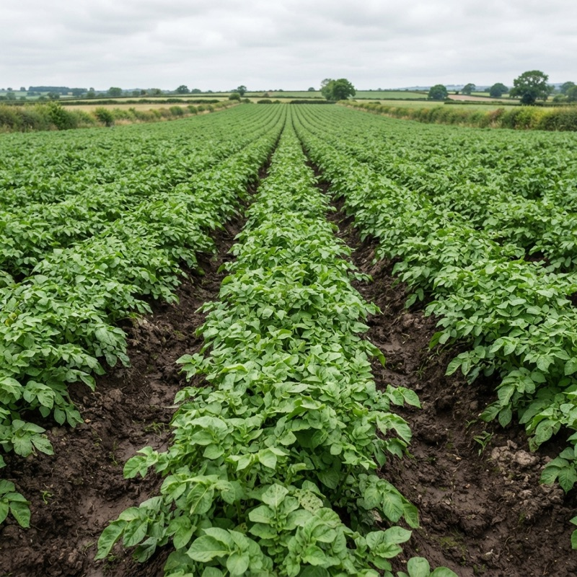

FlutterconKE · Flutter AI / Mobile · Advanced · 40 min
Beyond the API Call: On-Device AI in Flutter
with LiteRT and Offline-First Architecture
Paul Mburu
Titus Kariuki
Mobile Engineer, Pezesha · @paulnm
Mobile Developer, Volane International
Notes:
- Open with: "Most AI features in mobile apps are an HTTP call. Today we'll show what happens when you take the API call away."
- Key points:
- Introduce both speakers in one line each.
- The app is LeafCheck: it diagnoses potato leaves with no internet.
- Transition: "Let's start where the app is used: in the field."

Slide 2
A leaf and no signal
Late blight can destroy a potato field within days in cool, wet weather.
The person holding the leaf is in that field, where the signal is weakest.
Source: rag-service/knowledge/potato_late_blight.md
Paul Mburu
02
Notes:
- Open with: "In cool, wet weather, late blight can destroy a potato field within days."
- Key points:
- Late blight caused the Irish potato famine.
- The person who needs the answer is standing in the field, where the signal is weakest.
- Show: the photo; let it sit for a second.
- Transition: "So what does an API call actually cost out there?"
- Go deeper: PlantVillage paper (Hughes & Salathé), the open dataset behind most leaf-disease models.

Slide 3
The cost of the API call
One 3 MB leaf photo to a backend vs. the same model on the phone
1.9 ms
1.3 s
34 s
4 min
On-device (LiteRT)
Wi-Fi
3G
2G (EDGE)
laptop CPU, p50 · phone TBD
upload + RTT
upload + RTT
upload + RTT
1.9 ms measured on a laptop CPU; network times modelled from stated profiles · benchmarks/results.md D2, D3
Paul Mburu
03
Notes:
- Open with: "Same 3 MB photo. Same model. Two places to run it."
- Key points:
- On the phone: 1.9 ms.
- Through a backend: about 1.3 s on Wi-Fi, 34 s on 3G, 4 min on 2G.
- Say clearly that the network times are modelled from the stated profiles, not measured on a phone.
- Show: go left to right; stop on "4 min".
- Transition: "Running on the phone means the model has to get there. Where does it come from?"
- Likely question: "Is 1.9 ms on a real phone?" → "No, that's the laptop CPU (`benchmarks/results.md` D2). A mid-range phone will be slower, but still milliseconds, not seconds. Phone numbers are on our limitations slide."

Slide 4
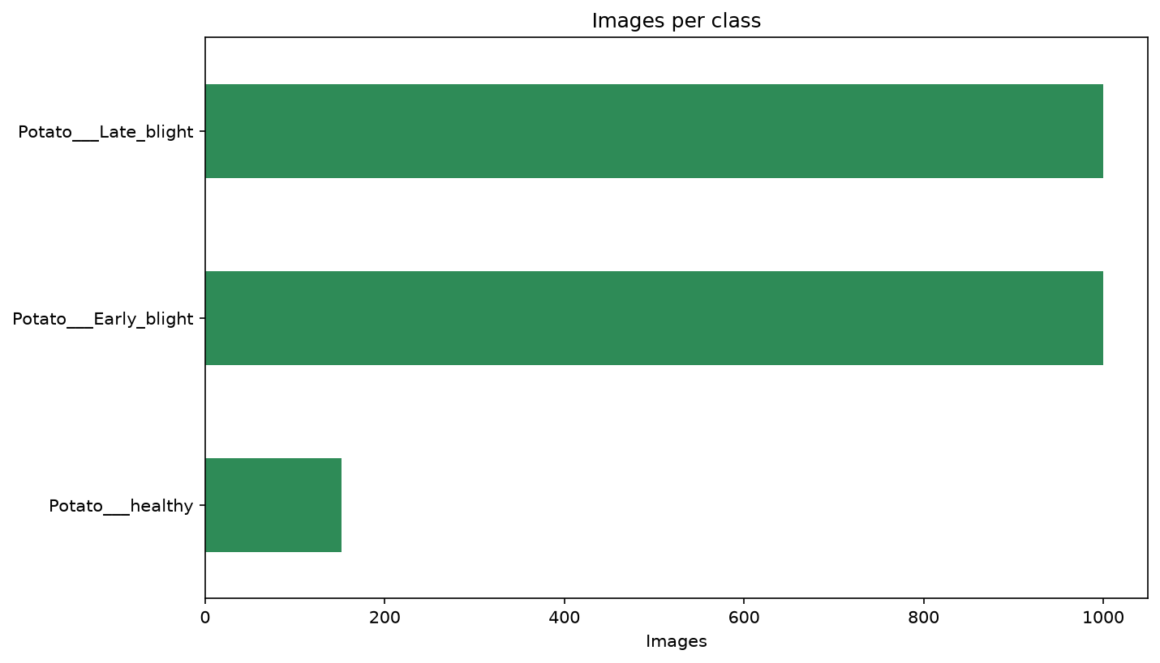
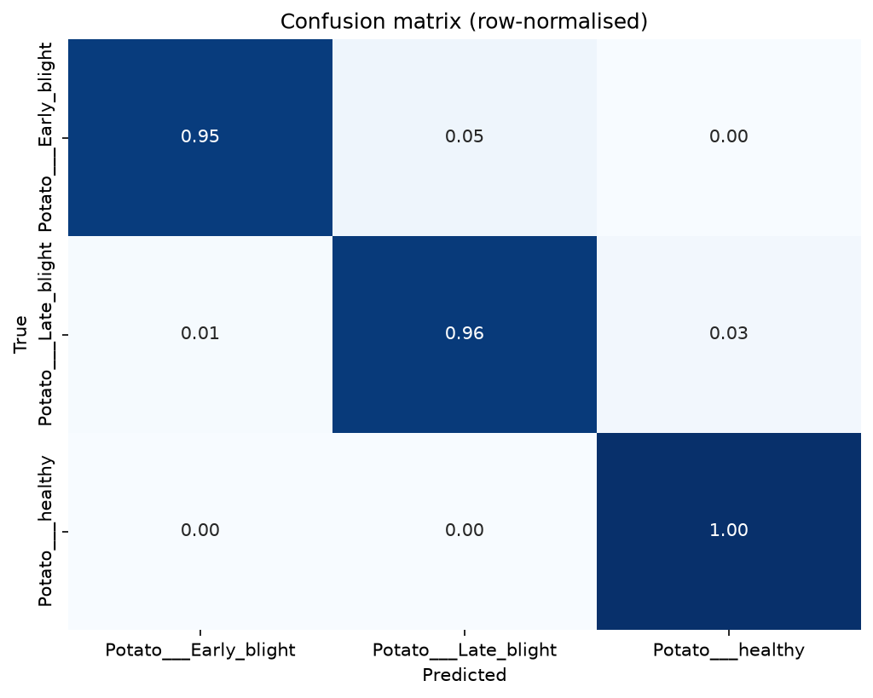
Data → model
2,152
images (healthy: 152)
95.8%
test accuracy
0.945
macro F1
MobileNetV2, frozen base, ~40 s to train · ml-training/outputs/eval_summary.json
Paul Mburu
04
Notes:
- Open with: "2,152 potato leaf photos, and only 152 of them healthy."
- Key points:
- The dataset is imbalanced: 6.6× fewer healthy leaves.
- MobileNetV2 with a frozen base trains in about 40 s.
- 95.8% accuracy, macro F1 0.945 on 216 test images.
- Show: the confusion matrix diagonal.
- Transition: "That's a PyTorch model. Our app is Dart."
- Go deeper: MobileNetV2 paper (why it is small enough for phones).

Slide 5
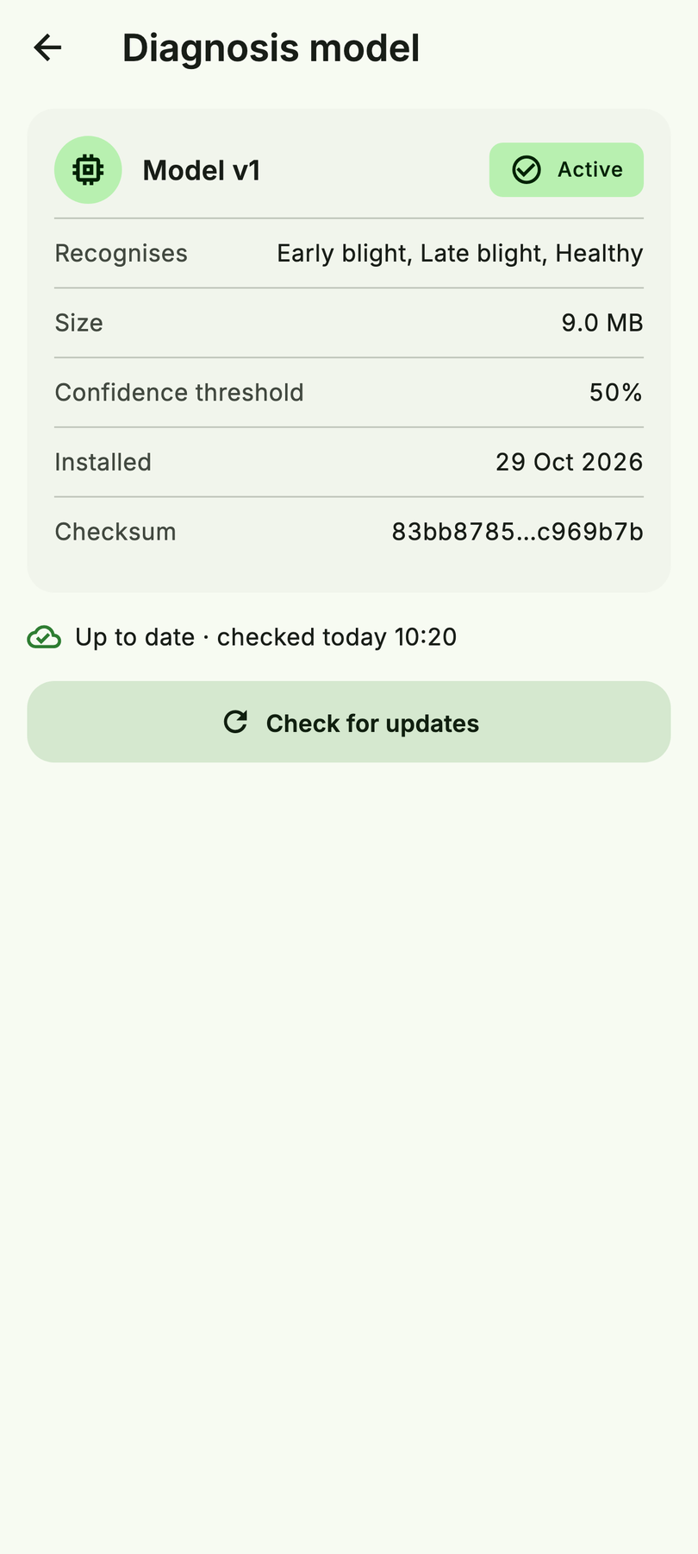
One model, two runtimes
python-ml-service
/api/v1/predict
PyTorch .pt
MobileNetV2 v1
crop_disease_v1.tflite
9.0 MB · [1,224,224,3] → [1,3]
export_tflite.py
matches PyTorch to 8e-7
crop_disease_v1.json
labels · threshold · shape
{ "input_shape": [1, 224, 224, 3],
"input_layout": "NHWC",
"class_names": ["…Early_blight", "…Late_blight", "…healthy"],
"confidence_threshold": 0.5 }
Paul Mburu
05
Notes:
- Open with: "One model, exported twice: PyTorch for the server, LiteRT for the phone."
- Key points:
- The `.tflite` file is 9.0 MB and matches PyTorch to 8e-7.
- The `.json` beside it is the contract: labels, threshold and input shape. Nothing about the model is hardcoded in Dart.
- Show: the JSON snippet, then the Model screen.
- Handover: "That's how the model is made. Titus will show how the Flutter app runs it."
- Go deeper:
- LiteRT: convert PyTorch models
- LiteRT overview

Slide 6
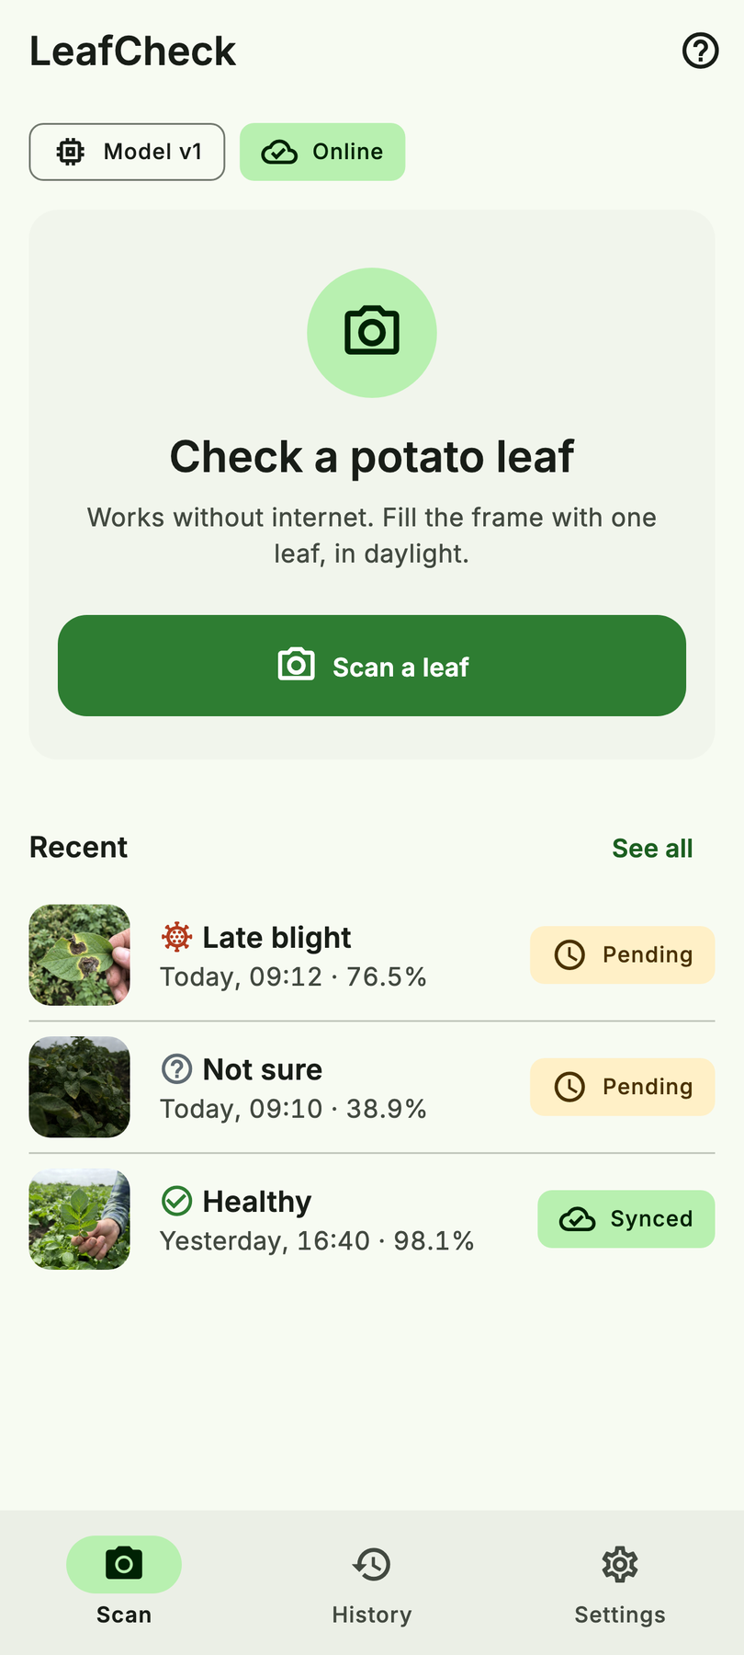
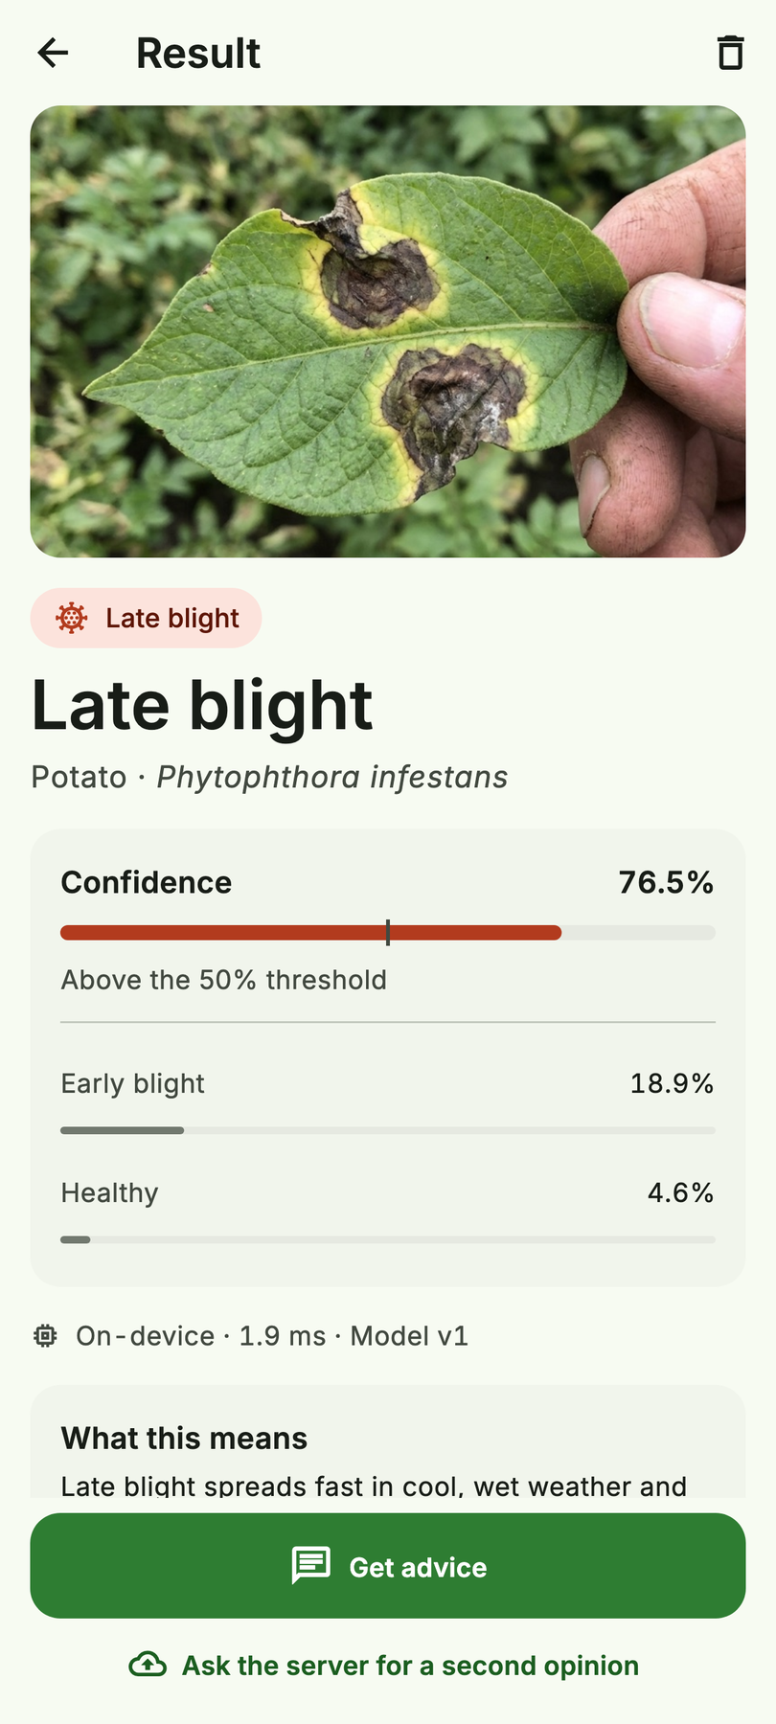
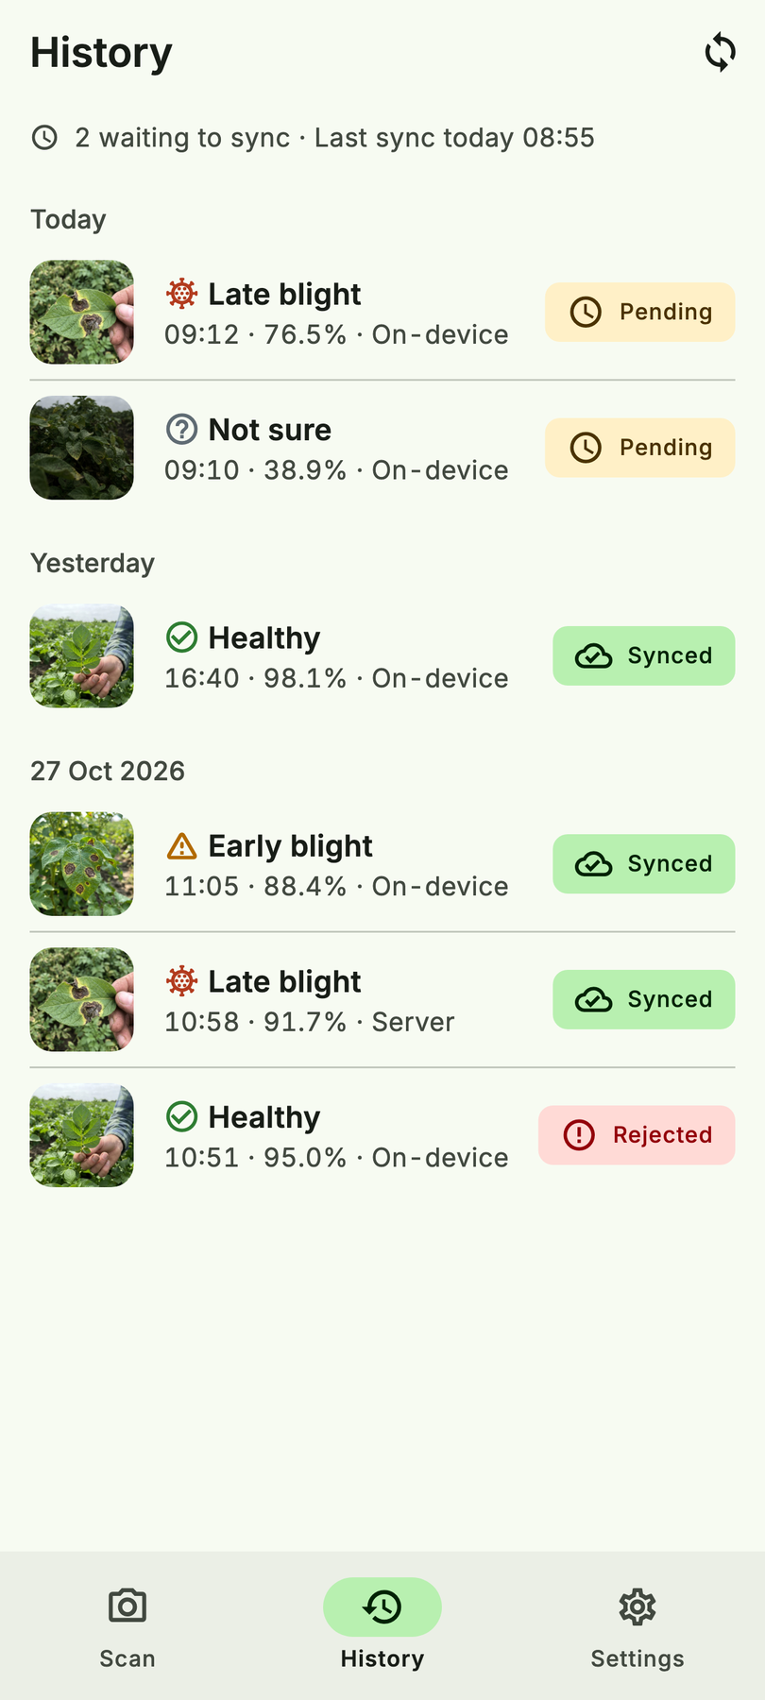
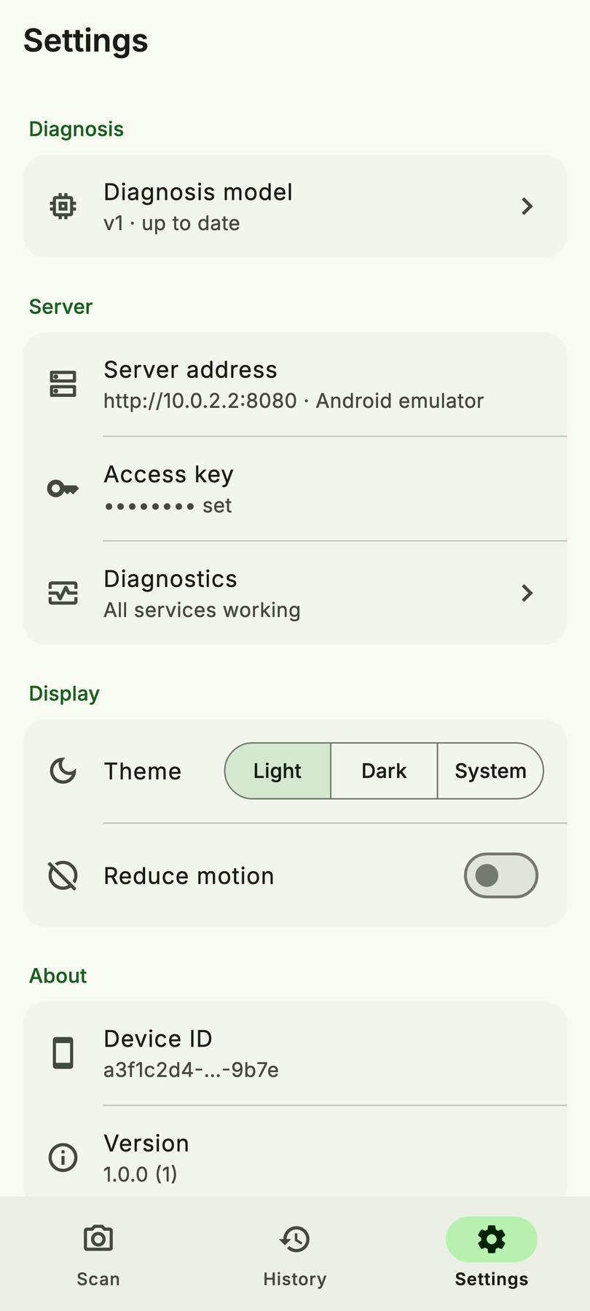
The app at a glance
UI on mock adapters behind real ports · model, Go and RAG are real
Scan
Result
History
Settings
Titus Kariuki
06
Notes:
- Open with: "Four tabs' worth of app, and none of it needs the internet."
- Show: Scan → Result → History → Settings.
- Transition: "How is it built so the model can be swapped and tested?"

Slide 7
Clean layers in Flutter
presentation
pages · notifiers
// app/di/providers.dart
final classifierProvider =
Provider<Classifier>(…);
final diagnoseLeafProvider =
Provider((ref) =>
DiagnoseLeaf(
classifier: ref.watch(
classifierProvider),
…));
application
use cases · ports
domain
pure Dart
infrastructure
flutter_litert · Hive · Dio
test/architecture_test.dart enforces the arrows · mocks today, real adapters in F1 behind the same ports
Titus Kariuki
07
Notes:
- Open with: "`flutter_litert` is an implementation detail. The app depends on a `Classifier` port."
- Key points:
- Domain is pure Dart, and use cases return `Result`.
- Infrastructure holds LiteRT, Hive and Dio; mocks stand in today.
- `providers.dart` is the only place where things are wired together.
- An architecture test fails the build if a layer imports the wrong thing.
- Show: the arrows, then the snippet.
- Likely question: "Why not call the interpreter from the widget?" → "Then you can't test the UI without a model, or swap the model's runtime."
- Go deeper:
- Flutter app architecture guide
- Riverpod
- `flutter_litert` on pub.dev

Slide 8
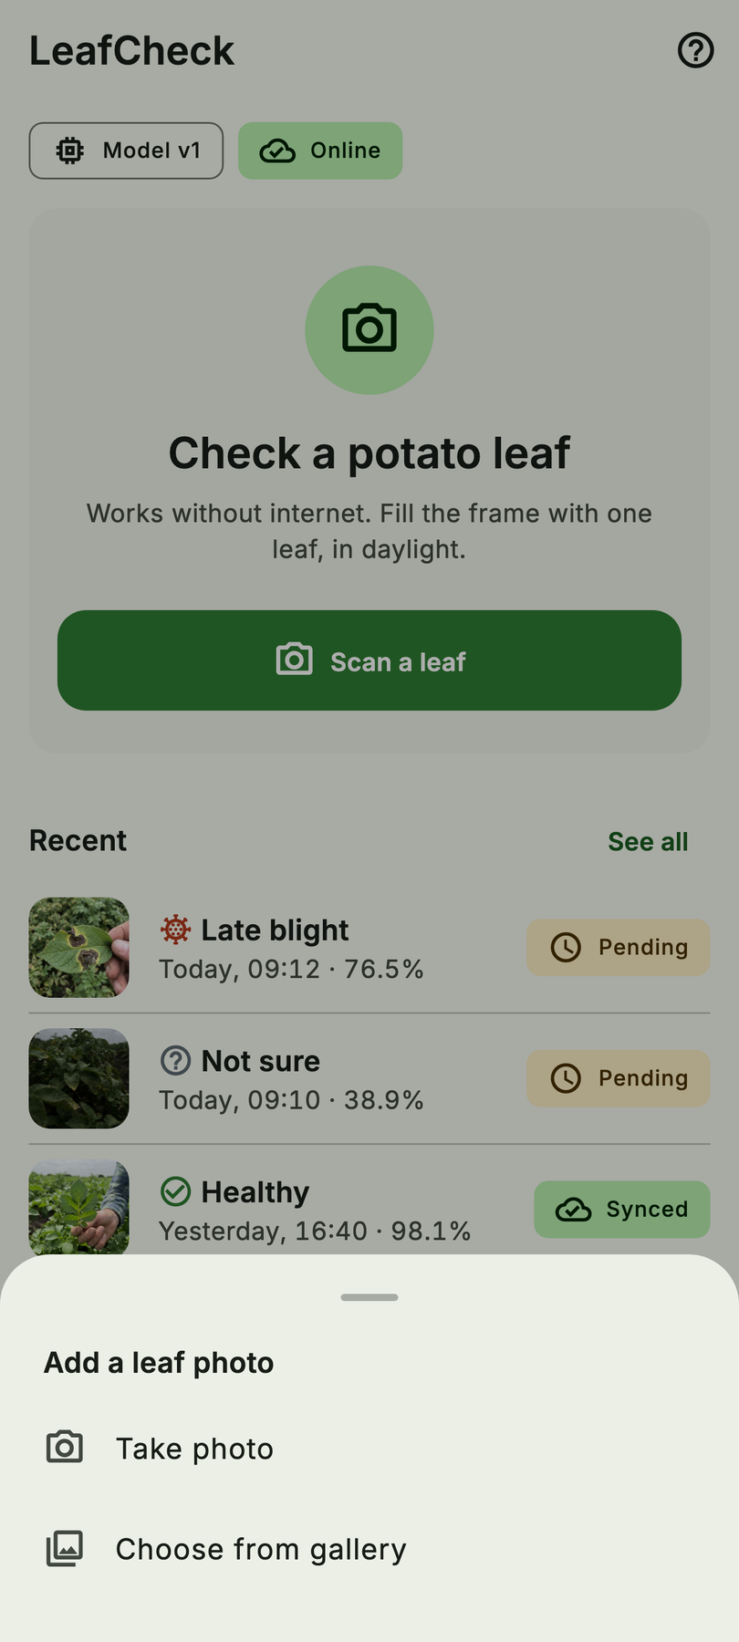
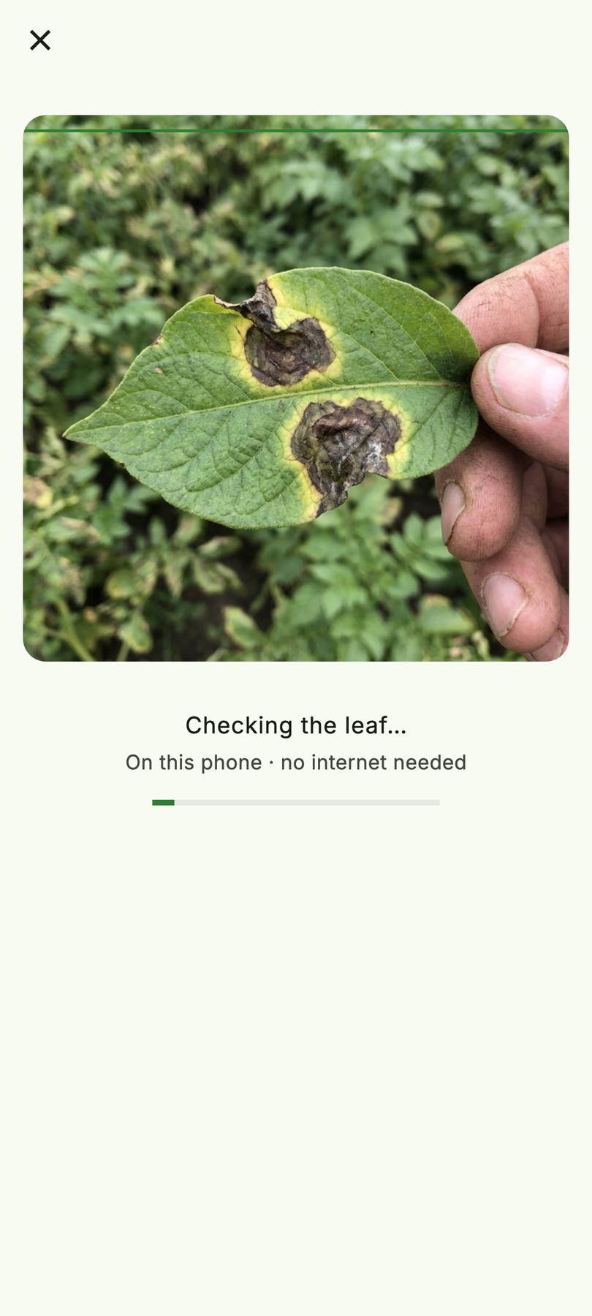

Capture → analyze
Photo source
Off the UI thread
Saved, then shown (≥ 600 ms)
Titus Kariuki
08
Notes:
- Open with: "Pick a photo; inference runs off the UI thread."
- Key points:
- The result is saved before it's shown.
- The scan line is held at least 600 ms. Users don't trust an instant answer they can't see happen.
- Show: the three steps left to right.
- Transition: "Here's the bug that cost us the most time."

Slide 9
The silent bug
Same model, same photos. One preprocessing slip in Dart, and no error is raised.
95.8%
Correct preprocessing
// must match Python training exactly
resize(shortSide: 256) → centerCrop(224)
rgb → float32 / 255.0 // NHWC [1,224,224,3]
Forgot ÷255
9.3%
210 / 216 leaves → “healthy”
Guard: golden test, Dart tensor vs Python fixture (max diff ≤ 1e-4)
55.6%
Red/blue swapped
ml-training/outputs/mismatch.json
Titus Kariuki
09
Notes:
- Open with: "Same model, same photos. One line of preprocessing wrong, and no error."
- Key points:
- Forget ÷255: 9.3%, with 210 of 216 leaves called "healthy".
- Red and blue swapped: 55.6%.
- The fix is a golden test comparing the Dart tensor with Python's (max diff ≤ 1e-4).
- Show: pause on 9.3%. Ask the room: "Who would have caught this in code review?"
- Transition: "Even with correct preprocessing, the model will sometimes be unsure."
- Go deeper: On-device image classification in Flutter (DEV Community, 2026), which walks through the full preprocessing pipeline.

Slide 10
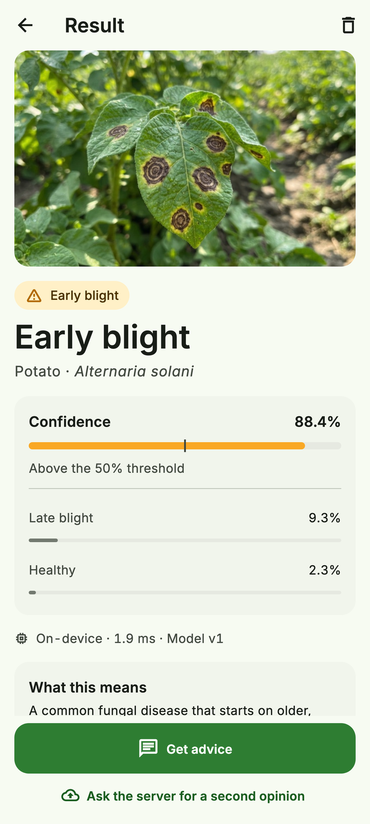
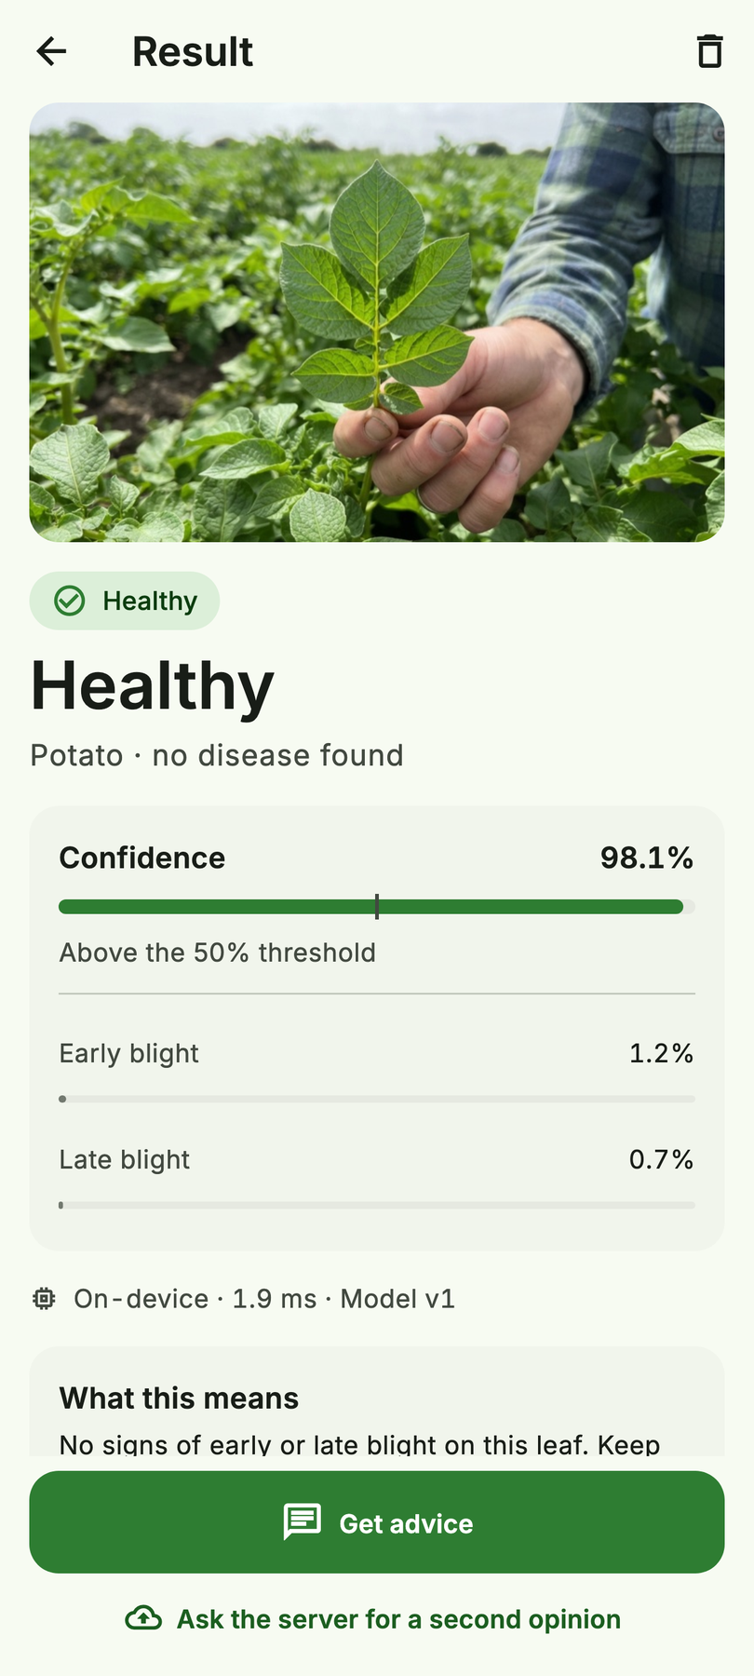
Show the answer honestly
Late blight · 76.5%
Early blight
Healthy
Titus Kariuki
10
Notes:
- Open with: "A percentage alone isn't an answer."
- Key points:
- The confidence bar has a threshold tick, with the top 3 underneath.
- It shows on-device latency and the model version.
- Status is always icon + label + colour, never colour alone.
- Show: the threshold tick on the late-blight screen.
- Go deeper: Flutter accessibility

Slide 11
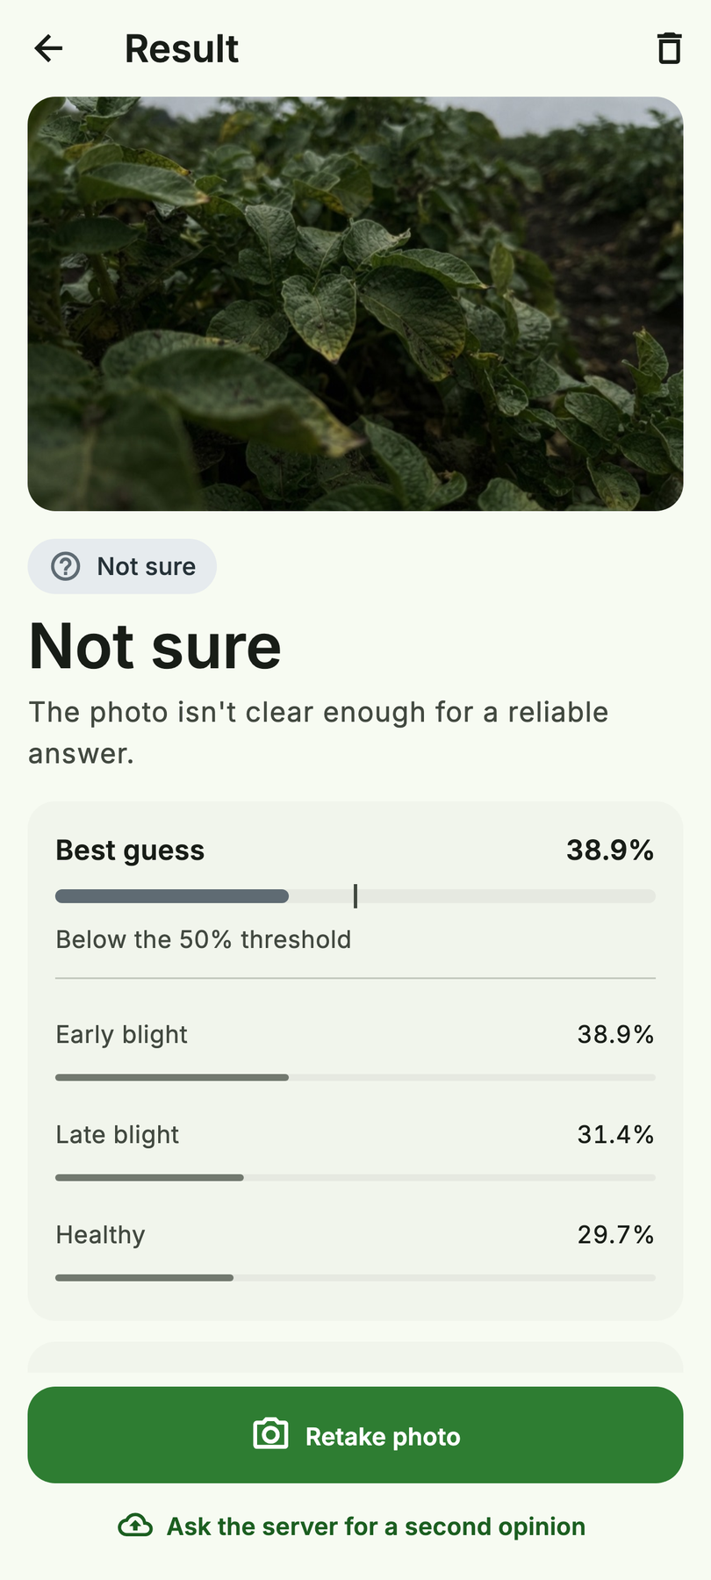
Don’t guess: abstain
96.3%
97.1%
photos answered
correct when answered
Threshold 0.50, read from the model’s .json.
Below it: “Not sure”, best guess, retake.
ml-training/outputs/eval_summary.json
Confident · 76.5%
Not sure · 38.9%
Titus Kariuki
11
Notes:
- Open with: "The most useful thing the model can say is 'I'm not sure'."
- Key points:
- With a 0.50 threshold, it answers 96.3% of photos and is right 97.1% of the time when it answers.
- Below the threshold, it says "Not sure, retake" and shows its best guess.
- Show: left vs right phone.
- Transition: "A diagnosis has to survive the network. That's the offline-first part."

Slide 12
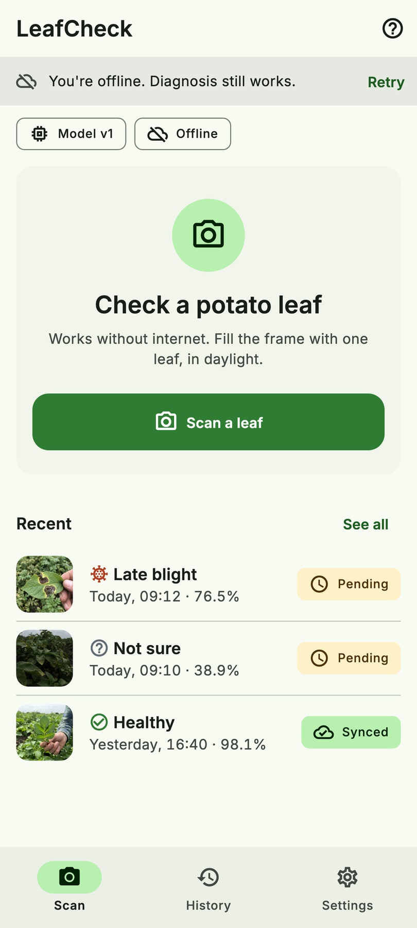
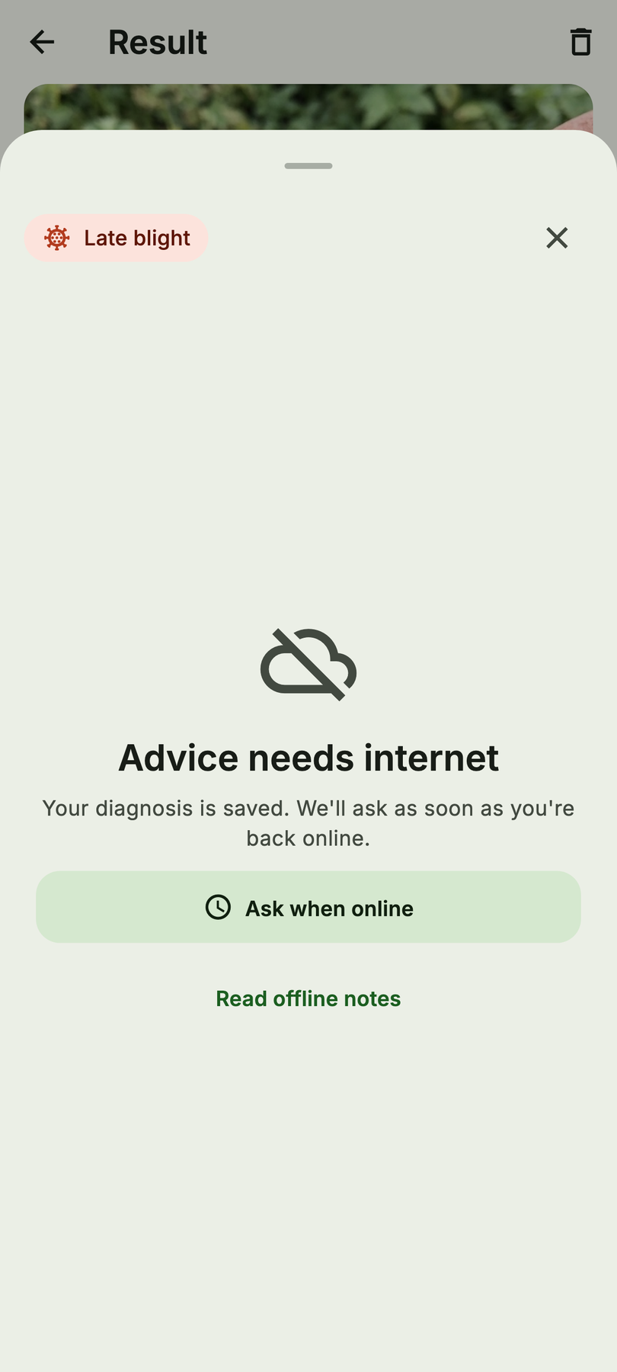
Offline is the default
Scanning is never disabled
Online = GET /ready answered in 2 s
connectivity_plus alone isn’t enough: Wi-Fi without internet is common
Advice explains why it’s unavailable
backend_status_provider.dart
Scan, offline
Advice, offline
Titus Kariuki
12
Notes:
- Open with: "Offline isn't an error state in this app. It's the normal state."
- Key points:
- Scanning is never disabled.
- "Online" means `GET /ready` answered within 2 s. `connectivity_plus` only tells you there's a network, not that the server is reachable.
- Show: the offline banner, then the advice-offline screen.
- Go deeper:
- Flutter offline-first design pattern
- `connectivity_plus` (read its note on what it can't detect)

Slide 13
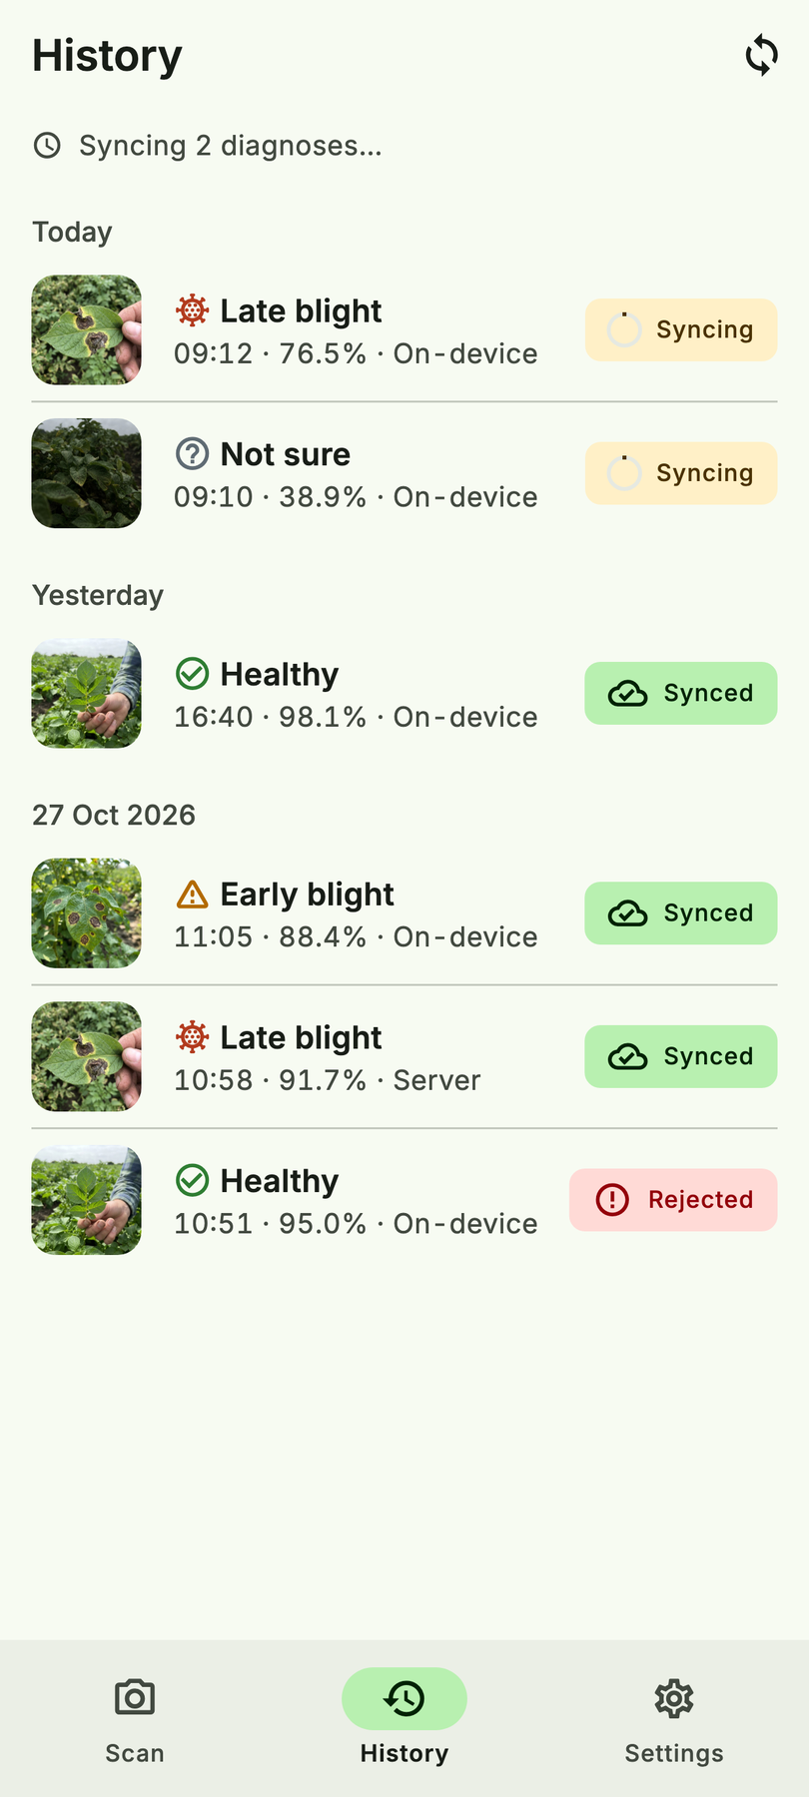
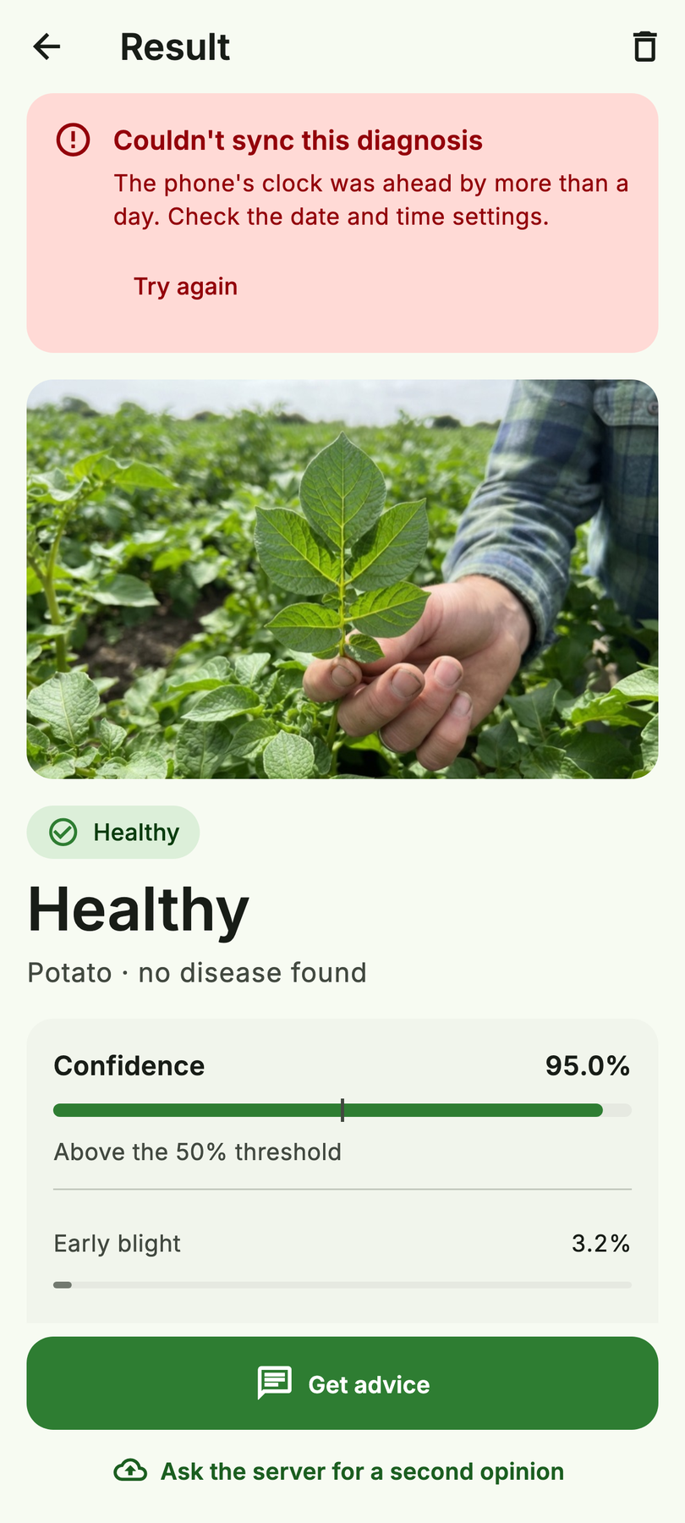
Write first, sync later
① Save locally (Hive), then show the result
② Outbox with UUIDs made on the phone
③ Re-sent batch → duplicate, never a 2nd row
④ Rejected items explain why
go-backend sync test: 100 created → resend → 100 duplicate
Pending
Syncing
Rejected, with reason
Titus Kariuki
13
Notes:
- Open with: "Every result is written to the phone first. Sync is a background detail."
- Key points:
- The outbox lives in Hive, and the UUIDs are made on the phone.
- Re-sending a batch returns `duplicate`, never a second row. The Go test sends 100 diagnoses, then the same 100 again: 100 created, then 100 duplicate.
- Rejected items say why.
- Show: Pending → Syncing → Rejected.
- Likely question: "Why not Firebase or PowerSync?" → "They work too. We wanted the sync contract to be visible and testable against our own Go API."
- Go deeper:
- Create offline-first apps (Android Developers, YouTube)
- How to make an offline-first app in Flutter (Arthur Giani, YouTube)
- Designing robust APIs with idempotency (Stripe)
- Hive CE

Slide 14
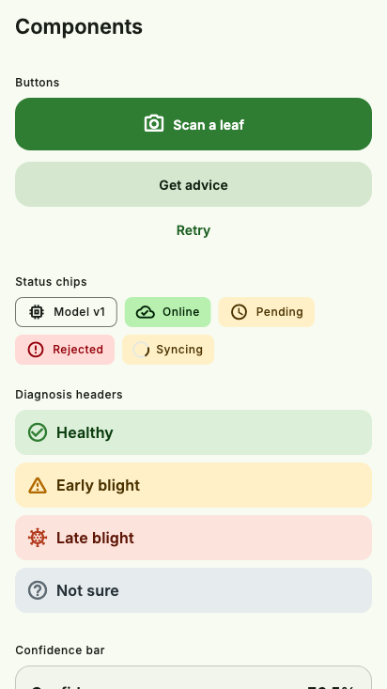
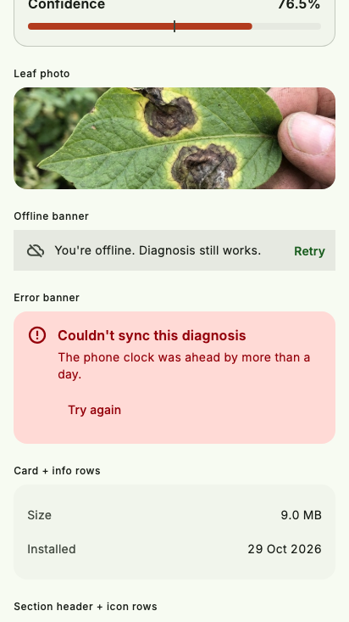
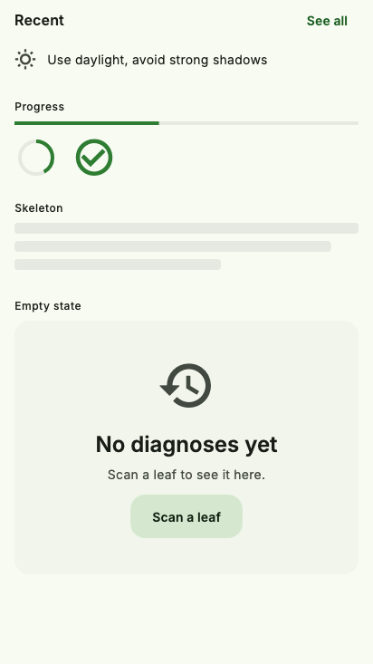
Design system → code
Stitch DESIGN.md → lib/ui/theme tokens
Drift test fails if they diverge
19 shared widgets
Stitch mistakes corrected, not copied
design_tokens_test.dart · docs/UI_IMPLEMENTATION.md §1
Titus Kariuki
14
Notes:
- Open with: "We designed in Google Stitch, but we didn't copy it blindly."
- Key points:
- DESIGN.md became the theme tokens, and a drift test fails if they diverge.
- There are 19 shared widgets.
- Stitch's mistakes were fixed, not copied.
- Go deeper: Google Stitch

Slide 15
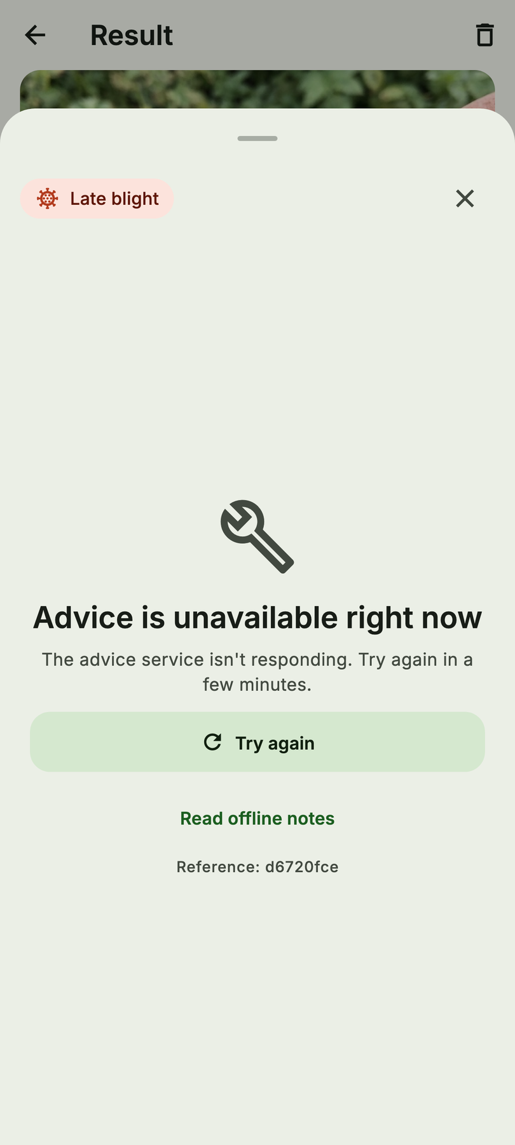
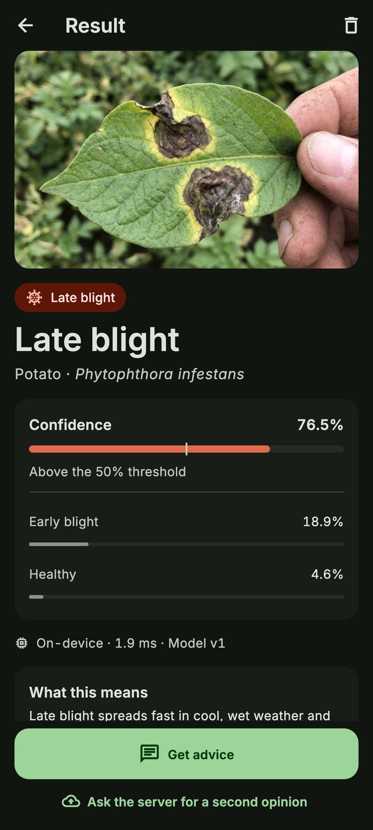
Testing the UI
91
tests
4
real a11y bugs found
Text contrast 4.18:1
Crash under reduce motion
40 dp tap target
Unlabelled switch
Light golden
Light golden
Dark golden
Titus Kariuki
15
Notes:
- Open with: "91 tests, and a golden image for every screen state in light and dark."
- Key points: accessibility checks found 4 real bugs:
- text contrast of 4.18:1
- a crash under reduce motion
- a 40 dp tap target
- an unlabelled switch
- Go deeper:
- `matchesGoldenFile`
- WCAG contrast minimum

Slide 16
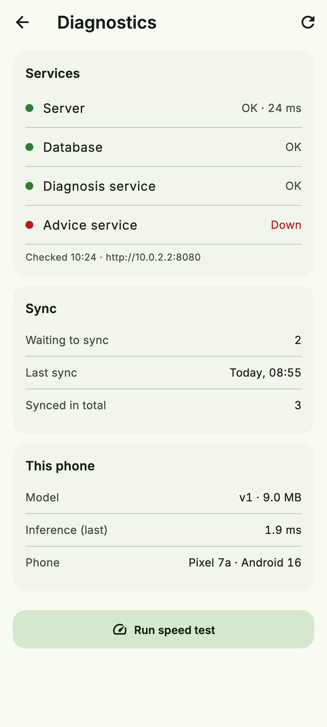
One door: go-backend
go-backend
chi · pgx · Postgres
python-ml-service
/predictions proxy
LeafCheck
Flutter
rag-service
/advice proxy
diagnoses:sync · device history · model releases
The app never calls the Python services directly
Same DDD layers as the app
Titus Kariuki
16
Notes:
- Open with: "When the network comes back, the app talks to exactly one service."
- Key points:
- Go owns sync, history and model releases, and proxies predictions and advice.
- The app never calls the Python services directly.
- Show: the Diagnostics screen (service health), then the diagram.

Slide 17
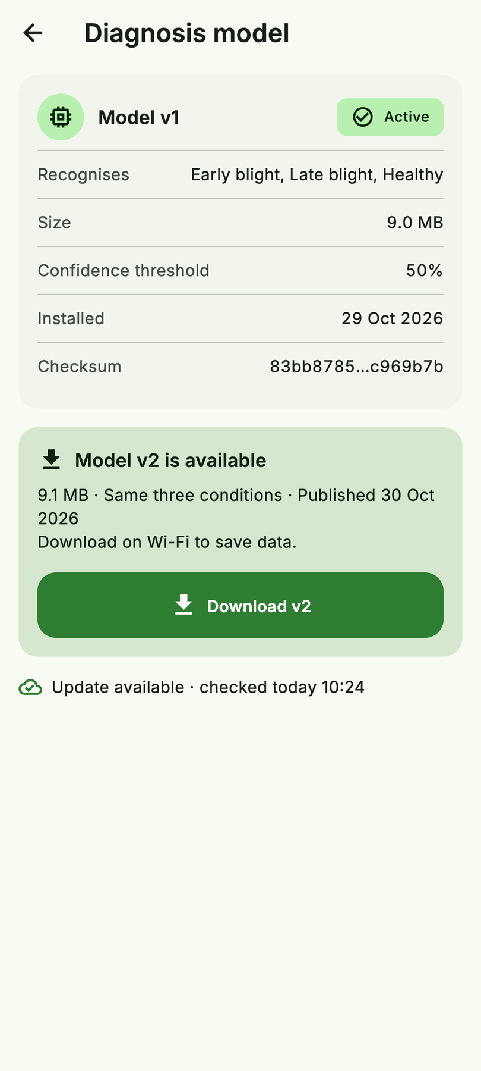
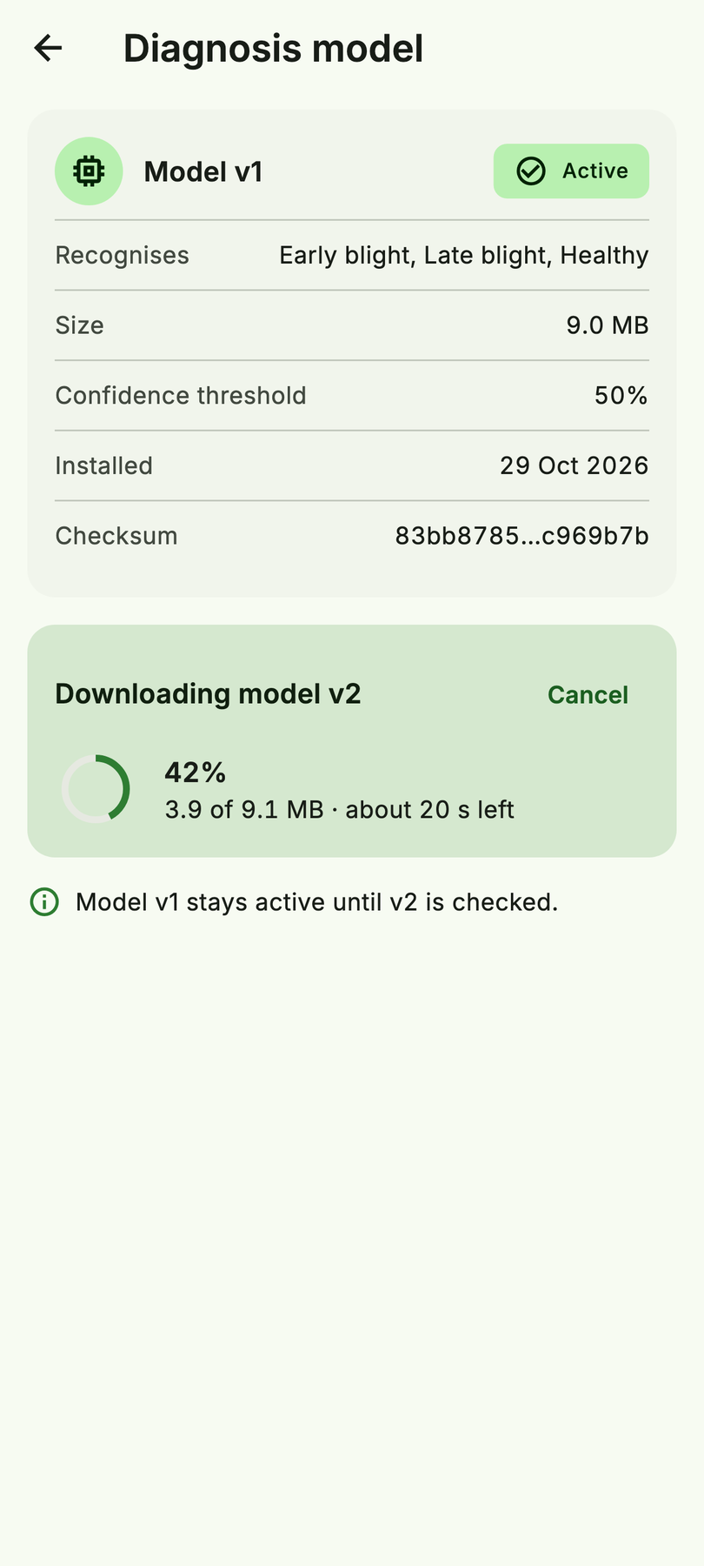
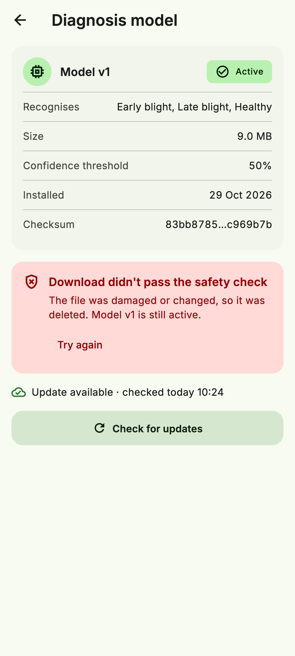
Safe model updates
ETag/304 → Range download → sha256 check before switching → keep the previous model
Update offered
Resumable download
Bad file refused
Titus Kariuki
17
Notes:
- Open with: "Shipping a new model is a download. Downloads fail."
- Key points:
- ETag/304 keeps checks cheap.
- Range requests let a download resume.
- The sha256 is checked before switching, and the previous model is kept.
- Show: "Bad file refused".
- Go deeper: Android 16 KB page sizes (why native ML libraries need checking).

Slide 18
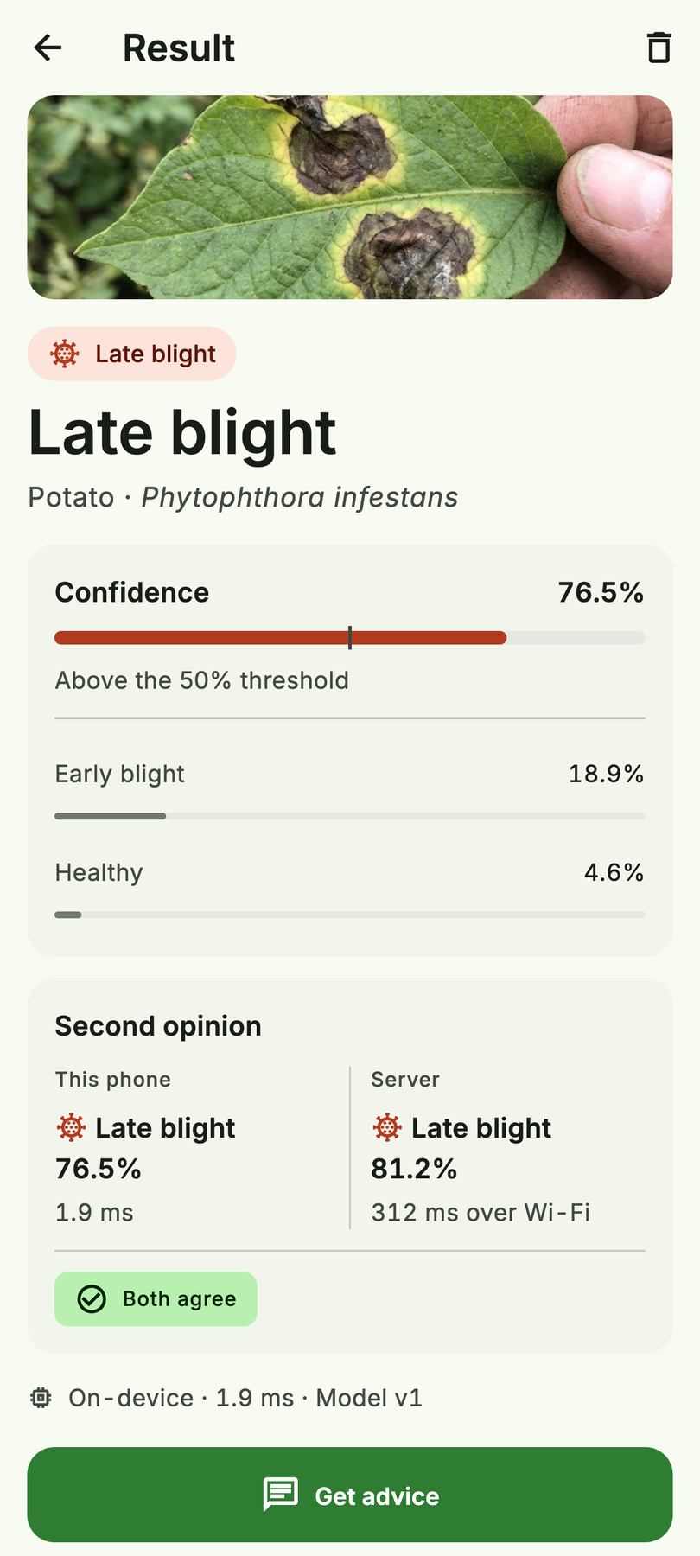
Second opinion
Phone 76.5% vs server 81.2%
App → go-backend → python-ml-service
The photo leaves the phone only when the user asks
Mock values today · live via /api/v1/predictions
Titus Kariuki
18
Notes:
- Open with: "The server model is optional, and only on request."
- Key points:
- The phone says 76.5%; the server says 81.2%. Say "mock values today".
- The photo leaves the phone only when the user taps.

Slide 19
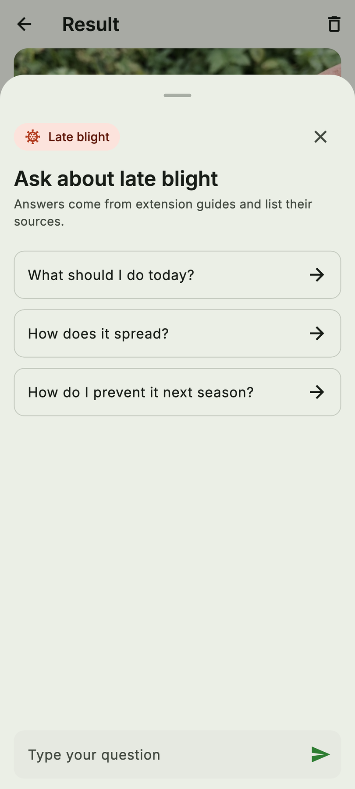
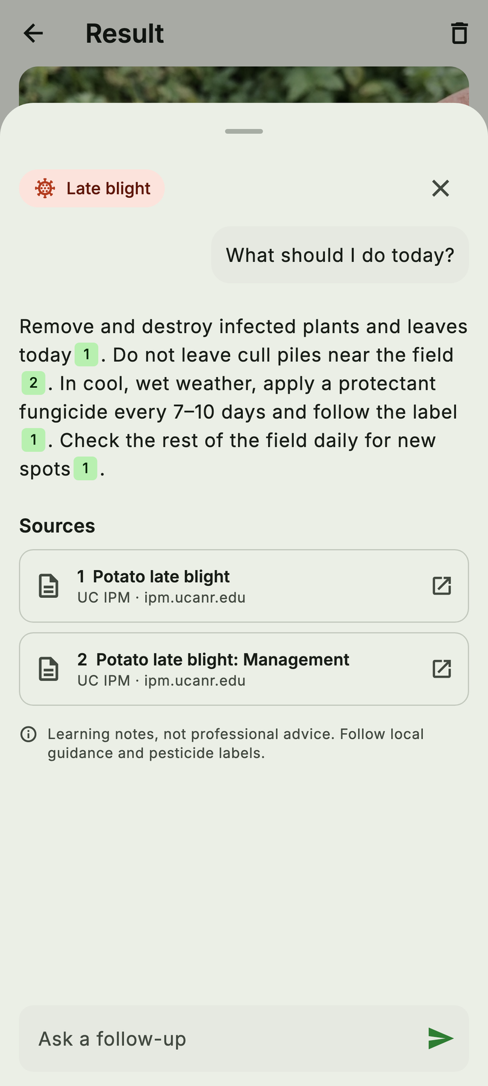
“What do I do about this?”
App → go-backend → rag-service → local LLM, with [n] sources
0.51 → 0.88
≈3.5 s
faithfulness
warm answer
two fixes
an add-on, never blocking
Fixes: no “padding” rule in the prompt · self-contained “Cause” sentences in the notes
Paul Mburu
19
Notes:
- Handover (Titus, end of 18): "The app can diagnose. Paul will show how it explains what to do."
- Open with: "A diagnosis without advice is half an answer."
- Key points:
- The RAG service retrieves from curated notes and answers with a local LLM, citing `[n]` sources.
- Faithfulness went from 0.51 → 0.88 after two fixes:
- removed the "padding" rule from the prompt
- rewrote the notes so each "Cause" sentence stands on its own
- A warm answer takes about 3.5 s, so advice is an add-on and never blocks.
- Likely question: "Why a local LLM?" → "There's no per-call cost and the data stays private, and on a laptop it runs on Ollama."
- Go deeper:
- What is RAG? (IBM Technology, YouTube)
- Original RAG paper
- Ragas docs
- Ollama

Slide 20
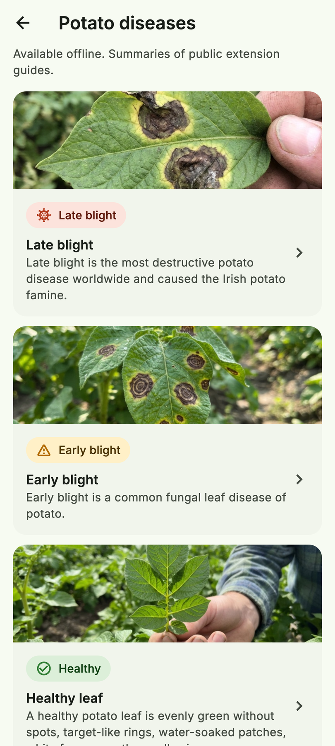
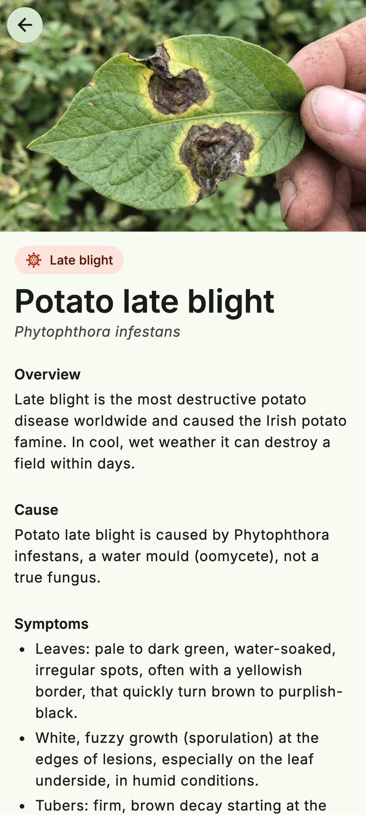
Same knowledge, offline
The RAG notes ship inside the app
Disease library works in airplane mode
One source of truth: rag-service/knowledge/
mobile-app/assets/knowledge/
Paul Mburu
20
Notes:
- Open with: "And the same notes are bundled in the app, so the library works in airplane mode."
- Transition: "Enough slides. Let's show it."

Slide 21
Live demo
① Offline phone: scan → “Pending”
② Blurry photo → “Not sure”
③ Online phone: Sync now → “Synced”
④ Get advice, with sources
⑤ The real call behind it:
curl -X POST localhost:8080/api/v1/advice \
-d '{"question": "What should I do today?"}'
UI runs on mock adapters today · backup: screen recording
Phone 1 · offline
Phone 2 · online
Paul & Titus
21
Notes:
See the demo runbook below. Titus drives the phone and Paul narrates. Use path A unless F2 is done.

Slide 22
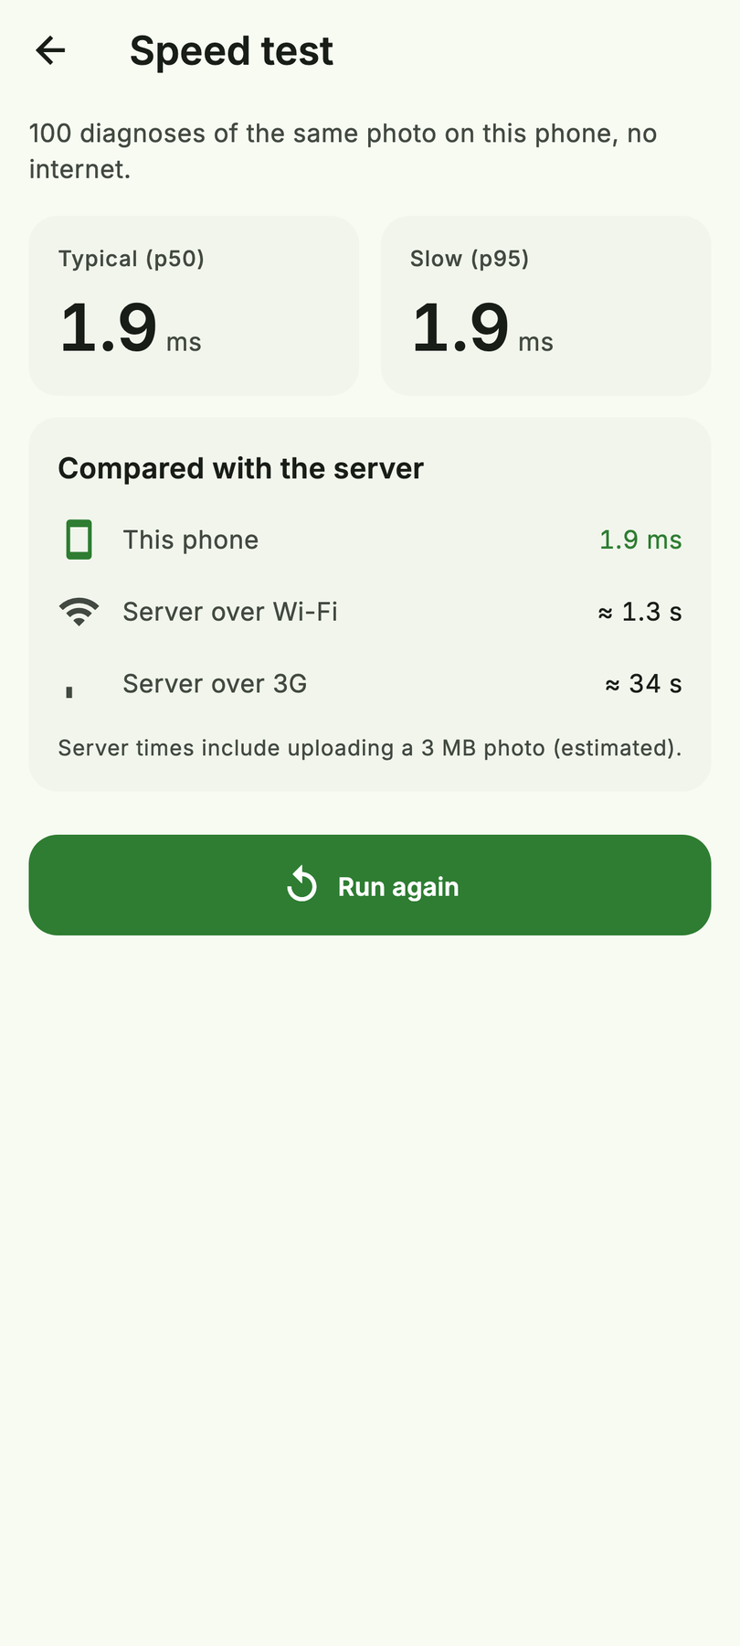
Limitations, honestly
95.8%
54.8%
Lab photos (PlantVillage)
221 field photos (PlantDoc)
Knows “diseased”: 0.9% of diseased leaves called healthy
Confuses the two blights; threshold still answers 86%, at 55%
Next: field data with consent · calibration · phone benchmarks
Phone benchmarks: still to measure
Paul Mburu
22
Notes:
- Open with (Paul): "95.8% is on lab photos. Here's the number that matters."
- Key points:
- 54.8% on 221 field photos (PlantDoc).
- The model knows "diseased": only 0.9% of diseased leaves were called healthy. But it confuses the two blights, and the threshold doesn't catch it: it still answers 86% of field photos, at 55%.
- Next: field data collected with consent, calibration, and phone benchmarks.
- Go deeper: PlantDoc paper (why field photos are harder).

Slide 23
Five takeaways
1
2
3
4
5
Measure the network cost
Preprocessing is part of the model
Let the model abstain
Write first, sync idempotently
Verify every update
Paul & Titus
23
Notes:
Paul reads takeaways 1–3 and Titus reads 4–5, one line each, then stops.

Slide 24
Any questions?
Paul Mburu · Titus Kariuki
Paul & Titus
24
Notes:
Use the Q&A bank. Backup slide 25 ("What is real today") is after this one.
---

Slide 25
Backup · What is real today
Real, measured
Mock, behind the real ports
Trained model, eval and field numbers
.tflite export, 1.9 ms laptop benchmark
go-backend: sync, model releases, proxies
rag-service with cited answers, RAGAS
Flutter UI, 91 tests, goldens
In-app inference (LiteRT in F1)
Local storage and sync (F1/F2)
Online/offline = SCENARIO flag
Second-opinion numbers
Paul & Titus
25

