Slide 1
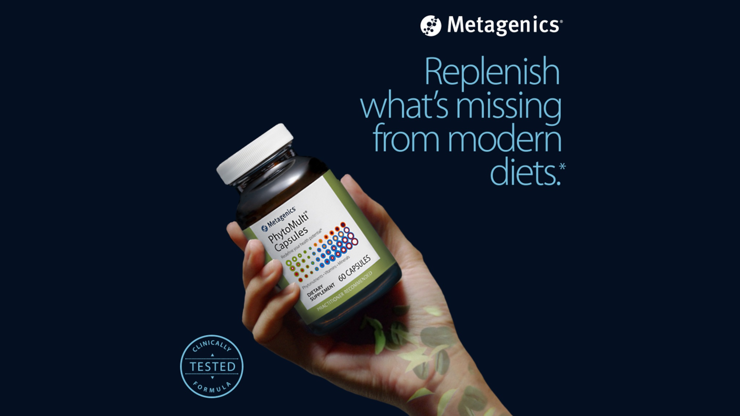

LEADERSHIP PRESENTATION
CRM Transformation Strategy
From sales tracking to an AI-assisted customer growth platform
Built from inside + outside sales discovery, prior CRM transformation plan, and the 5–10 year vision for Dynamics 365.
Prepare → Engage → Recommend → Close + Learn
Prepared by Paul
May 2026
Notes:
Set the tone: this is a business transformation story, not a CRM feature demo. The objective is to help sales leadership see a practical path from current CRM usage to intelligent customer growth.

Slide 2
Executive storyline
The message for sales leadership
Metagenics already has strong sales ingredients: practitioner relationships, retail engagement, product education, repeat ordering, eCommerce signals, and sales history. The opportunity is to connect those ingredients into one guided selling experience.
1
2
3
Where we are
What we heard
Where we go
CRM supports sales activity, but sellers still prepare, engage, and follow up using disconnected tools and habits.
Sales needs better pre-call planning, engagement capture, product recommendations, order support, and follow-up discipline.
Dynamics 365 becomes a daily sales assistant and long-term intelligent customer growth platform.
North Star: CRM should help every seller know who to engage, what to discuss, what to recommend, and what to do next.
Metagenics CRM Transformation Strategy | 2
Notes:
This slide is the clean executive narrative. It should be used early to keep the audience focused on business outcomes, not technical implementation.

Slide 3

Why this matters now
CRM must support the way Metagenics sells
R
Relationship-led selling
Field and inside sales depend on trust, account context, product knowledge, and ongoing follow-up.
E
Education-led growth
Product training, account maintenance, samples, and customer education are part of the value proposition.
O
Repeat-order economics
Growth comes from replenishment, retention, product adoption, and better recommendations.
M
Multi-channel engagement
In-person meetings, Teams/Zoom, phone, FaceTime, texts, eCommerce, and order support all matter.
Strategic implication: CRM cannot be just a database. It must become the sales operating layer that connects account knowledge, product insight, and next actions.
Metagenics CRM Transformation Strategy | 3
Notes:
Use this to connect Metagenics sales reality to the CRM strategy. This is why the transformation matters now.

Slide 4
Current state: sales tracking, but not yet sales intelligence
What the prior plan and discovery show
Seller friction
• Reps manually prepare for visits using multiple sources.
• Sales data exists but is not always actionable in the selling moment.
• Engagements are logged, but structure and quality can vary.
• Follow-ups can depend on rep memory, local habits, or scattered notes.
• Limited visibility into product adoption and at-risk accounts.
Business impact
• Missed cross-sell and upsell opportunities.
• Inconsistent seller execution and rep productivity.
• Reactive account management instead of proactive growth.
• Leadership has incomplete visibility into account health.
• CRM may feel like a reporting requirement instead of a selling tool.
The transformation is not about replacing CRM. It is about making CRM more actionable, guided, and measurable.
Metagenics CRM Transformation Strategy | 4
Notes:
This is the current-state framing. Avoid making it sound negative. CRM is a foundation, but it needs to mature from tracking to intelligence.

Slide 5
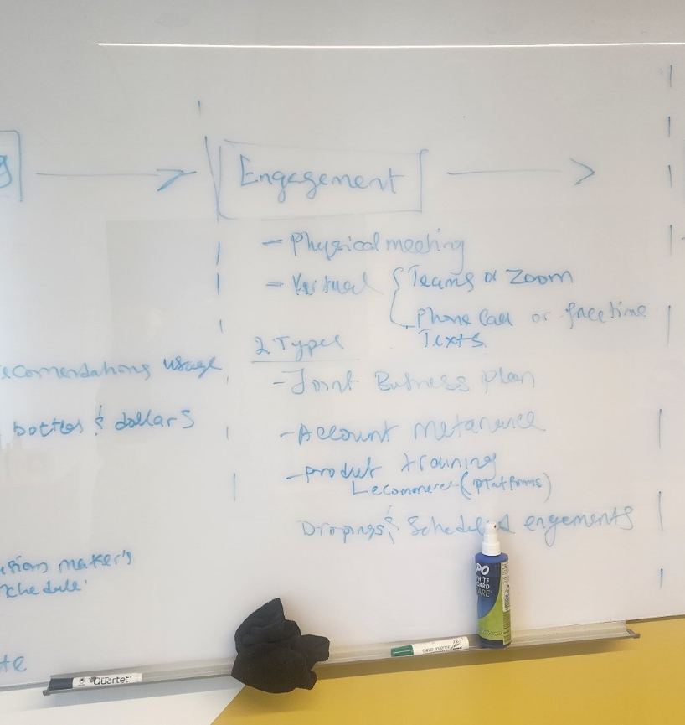
What we heard from inside & outside sales
Discovery themes grounded in the whiteboard session
1
Pre-call planning is manual
Sellers check Power BI, D365, Excel, Google/Maps, decision-maker schedules, sales history, product utilization, and notes.
2
Engagement is multi-channel
Physical meetings, Teams/Zoom, phone calls, FaceTime, texts, trainings, account maintenance, and product education all need structure.
3
Recommendations need context
Product recommendations should be based on account history, product adoption gaps, engagement answers, and customer needs.
4
Follow-up is where value is won
Trade incentives, order placement, replacing orders, returns/issues, replenishment, patient recommendations, and drop shipping need reliable next steps.
Metagenics CRM Transformation Strategy | 5
Notes:
This is the slide you asked to add. It grounds the presentation in actual inside and outside sales discovery, which makes the strategy more credible.

Slide 6
The sales journey CRM should support
A simple operating model
The discovery notes naturally organize into four selling moments. Each moment is an opportunity for CRM to reduce seller effort and improve consistency.
01
02
03
04
Pre-call planning
Engagement
Product recommendation
Closing + follow-up
Account summary
Sales history
Product gaps
Route / commute
Decision maker
Physical + virtual
Training / education
Specialty
Patients / wallet
Account maintenance
Products to focus on
Trade incentive
Wholesale / patient path
Samples
Drop shipping
Place / replace orders
Returns / issues
Replenishment
Tasks / reminders
Learn for next call
Design principle: CRM should guide the journey, not simply record the journey.
Metagenics CRM Transformation Strategy | 6
Notes:
This creates the structure for the rest of the deck. It turns the discovery notes into a system design direction.

Slide 7
The strategic gap
Insight exists, but sellers must assemble it manually
Today, valuable signals are spread across systems, reports, notes, and seller memory. The future CRM experience should bring those signals into the sales workflow.
P
Power BI
D
D365 CRM
e
eCommerce
E
Excel / Notes
G
Google / Maps
Sales history
Product utilization
Trends by bottles & dollars
Accounts
Contacts
Call notes
Activities
Digital ordering
Platform adoption
Customer behavior
Decision-maker schedules
Manual planning
Local knowledge
Commute planning
Local context
Route decisions
Target state: Sales Assistant Workspace inside Dynamics 365
One guided place to prepare, capture engagement, recommend products, trigger follow-up, and create leadership visibility.
Metagenics CRM Transformation Strategy | 7
Notes:
The key phrase is orchestration. We are not saying every system must be replaced; we are saying the seller experience should be orchestrated through CRM.

Slide 8

FUTURE STATE & VISION
Dynamics 365 becomes the intelligent growth platform for Metagenics sales.
The system should guide sellers before the call, during engagement, and after the meeting — while creating a more reliable data foundation for leadership.
Customer 360
AI-assisted selling
Sales, eCommerce, engagement, product adoption, orders, and account health.
Account summaries, product gaps, next best action, risk signals, and call prep.
Sales execution system
Leadership intelligence
Standardized engagement, guided questions, follow-ups, and workflow automation.
Territory, productivity, product adoption, account health, and revenue visibility.
Metagenics CRM Transformation Strategy | 8
Notes:
This is the north-star slide. Emphasize that this is a phased direction, not a request to build everything at once.

Slide 9
Future seller experience
What should change for a rep
The best future state is simple: sellers should spend less time hunting for information and more time having better customer conversations.
1
Before the visit
Open account workspace → see summary, product gaps, past orders, health, next best action, and recommended focus.
2
During engagement
Use structured engagement types, guided prompts, product education needs, specialty, patient/wallet context, and notes.
3
After the meeting
CRM creates follow-ups, tasks, issue workflows, order prompts, product recommendations, and replenishment reminders.
Success measure: every engagement ends with a clear next step and better data for the next conversation.
Metagenics CRM Transformation Strategy | 9
Notes:
This slide translates the vision into a day-in-the-life experience for sellers.

Slide 10
Pre-call planning transformation
Make every seller better prepared
AI account summary
Product adoption gaps
Risk + opportunity signals
Summarize account history, recent notes, orders, product usage, and relationship context.
Highlight top products, missing categories, low utilization, and declining trends.
Identify inactive, at-risk, or growth-ready accounts before the visit.
Talking points
Route planning
Recommend discussion themes, trade incentive focus, product education, and decision-maker questions.
Support field planning with nearby accounts, commute context, and territory efficiency.
Business outcome: less manual research, better call quality, more consistent account coverage, and higher-value customer conversations.
Metagenics CRM Transformation Strategy | 10
Notes:
This is a strong first pilot candidate because it directly addresses pain from the discovery notes.

Slide 11

ENGAGEMENT TRANSFORMATION
Make every interaction easier to capture and easier to act on.
1
Standardized engagement types
Physical meeting, virtual meeting, product training, account maintenance, scheduled engagement, call, text.
2
Guided selling prompts
Specialty, number of patients / wallet, delivery model, education interest, virtual consult needs.
3
Recommendation capture
Products discussed, customer response, samples dropped, training needs, wholesale / patient path.
4
Automatic next steps
Follow-up task, order assistance, issue workflow, replenishment reminder, next engagement date.
Metagenics CRM Transformation Strategy | 11
Notes:
This slide is about standardizing sales execution without making the system feel heavy.

Slide 12
Closing and follow-up transformation
Turn every engagement into action
The close should not depend on memory. CRM should convert each engagement into recommendations, order support, issue resolution, and next steps.
1
2
3
4
Product recommendation
Order support
Follow-up automation
Risk detection
Suggest products using account history, product adoption gaps, engagement answers, and customer needs.
Support placing orders, replacing orders, returns/issues, patient recommendation, wholesale path, and drop shipping.
Create tasks, reminders, replenishment prompts, and scheduled engagement follow-ups automatically.
Alert sellers and leaders when orders decline, follow-ups are missed, or account issues remain open.
Future-state goal: every seller leaves the meeting with the right recommendation and a tracked next step.
Metagenics CRM Transformation Strategy | 12
Notes:
This slide ties directly to revenue impact: follow-up consistency, product adoption, replenishment, and order support.

Slide 13

5–10 YEAR CRM VISION
From visibility to predictive customer growth.
0–6 months
2–5 years
Foundation
Intelligent selling
Account/location model, data quality, engagement standards, dashboards, governance.
AI summaries, account health score, next best action, territory optimization, predictive alerts.
6–18 months
5–10 years
Guided selling
Growth platform
Pre-call workspace, engagement capture, follow-up automation, recommendation rules.
Connected sales, eCommerce, marketing, finance, data warehouse, and AI-driven growth orchestration.
Metagenics CRM Transformation Strategy | 13
Notes:
This slide answers the 5-10 year vision directly. It shows maturity over time instead of one large implementation.

Slide 14
Practical roadmap
Build momentum in phases
Phase 1
Weeks 1–5
Confirm account/location model, engagement standards, source systems, data quality rules, and governance cadence.
Foundation
Phase 2
Weeks 6–9
Create account health views, product adoption dashboards, rep activity visibility, and leadership reporting.
Visibility
Phase 3
Weeks 10–14
Automate follow-ups, reminders, issue workflows, replenishment prompts, and order support actions.
Automation
Phase 4
Weeks 15–20
Pilot AI account summaries, product gaps, risk signals, pre-call insights, and next-best-action recommendations.
AI-assisted pilot
Recommended approach: pilot one high-value seller workflow first, then scale with governance and data discipline.
Metagenics CRM Transformation Strategy | 14
Notes:
This keeps the prior four-phase roadmap but makes it easier to present to leadership.

Slide 15
CRM Product Roadmap
Year 1 + Year 2 detailed, later years directional
The roadmap should behave like a product plan: build trusted data and repeatable seller workflows first, then layer automation and AI where it improves sales execution.
PRODUCT TRACK
YEAR 1 — Foundation & Adoption
YEAR 2 — Guided Selling & Automation
YEARS 3–5
YEARS 5–10
Q1
Q2
Q3
Q4
Q1
Q2
Q3
Q4
Yrs 3–5
Yrs 5–10
Data & Architecture
Data cleanup
& dedupe
Account / location
model
Order + eCom
signals
Customer 360
data layer
Advanced data
products
Predictive
data fabric
trusted model
Seller Experience
Pre-call
MVP
Engagement
capture
Follow-up
workspace
Guided account
playbooks
Sales assistant
workspace
Seller
cockpit
Autonomous
next action
prepare → engage → close
Product Intelligence
Product gap
indicators
Rules-based
recommendations
AI-assisted
recommendations
Personalized
product plays
Predictive
adoption
AI growth
optimization
recommendation engine
Automation & Workflow
Tasks + reminders
from engagement
Order / returns
support
Replenishment
triggers
Automated
journeys
Proactive
alerts
Closed-loop
growth
orders + follow-up
Reporting & Governance
Baseline KPIs
& adoption
Governance board
+ releases
Executive
scorecards
Outcome-based
funding
Predictive
leadership
Strategic CRM
platform
visibility + control
Year 1 outcome
Trusted CRM foundation + standardized seller habits
Year 2 outcome
Guided selling + automation inside daily workflow
Long range
Intelligence, prediction, personalization, and growth orchestration
Metagenics CRM Transformation Strategy | 15
Notes:
This product roadmap is deliberately detailed for the first two years because those are the execution years. Later years are directional horizons for intelligence, prediction, personalization, and growth orchestration.

Slide 16
Technical operating model
The platform foundation behind the sales vision
The sales transformation will only scale if the CRM platform is clean, governed, supportable, and easy for users to work in every day.
1
Data foundation
2
Environment discipline
3
User administration
Clean account/location model, deduplication, territory alignment, and trusted data warehouse inputs.
Clear Dev / UAT / Prod path, Microsoft ALM, managed deployments, and release control.
Role/team-based access, onboarding/offboarding, license review, and standard request intake.
4
Supportability
5
User experience
Monitoring, issue triage, flow/plugin tracking, integration alerts, and production runbooks.
Simplified forms, fewer duplicate fields, cleaner navigation, and faster seller workflows.
Technical goal: make CRM reliable enough for leadership and simple enough for sales adoption.
Metagenics CRM Transformation Strategy | 16
Notes:
Use this as the transition from the sales vision into the technical foundation. The message is that strategy and technical discipline must move together.

Slide 17
Data foundation and architecture
Clean data is the first requirement for intelligent selling
AI summaries, product recommendations, territory planning, and leadership dashboards depend on trusted CRM data and a clear account/location model.
1
Account + location structure
Confirm parent account, store/location, practitioner, retail, contact, and territory relationships so sales activities are tracked at the right level.
2
Data cleansing + deduplication
Remove duplicate accounts, duplicate contacts, inactive records, and duplicated fields that confuse users and reporting.
3
Territory management
Define rules for territory assignment and automate territory updates where possible, especially when locations move or reps change.
4
Data warehouse integration
Shift from point-to-point dependency toward trusted data warehouse inputs for sales history, eCommerce, product utilization, and recommendations.
5
Data ownership
Assign business/data stewards for account hierarchy, required fields, source of truth, and quality rules.
Decision needed: confirm the future account/location/territory model before building AI recommendations or executive dashboards.
Metagenics CRM Transformation Strategy | 17
Notes:
This slide comes from the handwritten technical notes: data model/architecture, data cleaning/deduplication, account and location structure, territory management, and moving from Boomi dependency toward data warehouse sourcing.

Slide 18
Environment and ALM strategy
Control change before scaling change
The CRM roadmap requires a disciplined delivery path so enhancements are built once, tested properly, and moved to production with lower risk.
DEV
UAT
PROD
Unmanaged build environment
Managed test environment
Controlled production
Develop solutions, flows, plugins, web resources, custom pages, and configuration.
Validate business scenarios, roles, data rules, performance, and deployment readiness.
Deploy approved managed solutions only, monitor adoption, and protect stability.
Operating practices
• Follow Microsoft ALM principles with solution versioning and deployment notes.
• Use environment variables and connection references instead of hard-coded values.
• Ensure all regions/business areas follow the same Dev → UAT → Prod discipline.
• Recreate or bring missing production flows into Dev so the source environment is complete.
• Run solution checks, dependency reviews, and release validation before production.
Metagenics CRM Transformation Strategy | 18
Notes:
This slide aligns to the notes: follow Microsoft ALM, ensure regions have Dev/UAT/Prod, use unmanaged in Dev and managed in UAT/Prod, and recreate all production flows that are missing from Dev.

Slide 19
User administration, support, and monitoring
Make CRM easier to run after go-live
A scalable CRM needs a defined operating model for users, access, support, and production monitoring — not just new features.
1
User onboarding
2
User offboarding
Standard request form, manager approval, role/team assignment, license validation, and new-user checklist.
Disable access, remove team membership, reassign records, review ownership, and document completion.
3
Access governance
4
Support process
Use roles and teams consistently; review security role assignments and licenses on a regular cadence.
Define intake channel, prioritization, response expectations, escalation path, and ownership between CRM/IT and business.
5
Monitoring
Track flow failures, plugin errors, integration issues, deployment history, audit needs, and recurring defects.
Supportability principle: every production workflow should have an owner, a monitoring method, and a recovery path.
Metagenics CRM Transformation Strategy | 19
Notes:
This slide expands user administration and monitoring/supportability from the handwritten notes: onboarding, offboarding, support process, and regular monitoring.

Slide 20
Performance and user experience
Simplify CRM so sellers use it consistently
For adoption, CRM must feel fast, clean, and useful. The technical work should reduce seller friction, not add another administrative burden.
Current friction
• Long or cluttered forms
• Duplicate or confusing fields
• Too many tabs and clicks
• Manual follow-up tracking
• Inconsistent engagement capture
Target experience
• Clean role-based forms
• Remove duplicated fields
• Relevant views and commands
• Automated tasks and prompts
• Standardized engagement experience
Form cleanup
View cleanup
Load-time review
Seller workspace
Remove unused fields, duplicate fields, and low-value sections.
Build focused views by role, team, account type, territory, and engagement need.
Reduce heavy subgrids, unnecessary scripts, and expensive synchronous logic.
Create a guided page for pre-call planning, engagement capture, recommendations, and follow-up.
Metagenics CRM Transformation Strategy | 20
Notes:
This slide captures the performance and user experience notes: clean and simplify forms, remove duplicated fields, and improve usability.

Slide 21
Technical roadmap alignment
Build the platform foundation in parallel with sales capabilities
The recommended approach is to align technical cleanup with the sales roadmap so the foundation improves while sellers see visible business value.
Foundation
Data model, deduplication, account/location hierarchy, environment discipline, Dev source of truth.
Visibility
Clean views, Power BI alignment, account health data, product utilization, territory dashboards.
Automation
Follow-ups, onboarding/offboarding, territory assignment rules, integration alerts, support intake.
AI-assisted selling
AI summaries, product recommendations, call prep, next best action, risk alerts.
Technical message for leadership: the 5–10 year CRM vision depends on doing the basics well now — clean data, controlled environments, standard support, and a usable seller experience.
Metagenics CRM Transformation Strategy | 21
Notes:
This slide connects technical talk points back to the business roadmap and makes the technical work feel strategic instead of back-office cleanup.

Slide 22
Governance and success measures
How to sustain the transformation
CRM transformation requires both platform delivery and business ownership. The governance model should connect roadmap decisions to adoption, data quality, and measurable outcomes.
Operating governance
• CRM Governance Board to prioritize roadmap and approve major changes.
• Sales process owners to define engagement standards and adoption expectations.
• Data stewards to own account hierarchy, product adoption definitions, and reporting trust.
• CRM/IT team to own ALM, security, integrations, releases, and supportability.
Business KPIs
• Seller adoption and active usage.
• Pre-call planning completion.
• Follow-up completion rate.
• Product adoption / cross-sell movement.
• Average order value and repeat order trends.
• Account health and at-risk account visibility.
Governance turns CRM from a project into a durable business capability.
Metagenics CRM Transformation Strategy | 22
Notes:
The key point: ownership cannot sit only with IT. Sales, data, and leadership must own the operating model.

Slide 23

RECOMMENDED LEADERSHIP DECISIONS
Decide the first proof point, then build toward the 5–10 year vision.
1
Confirm the vision
CRM as a daily sales assistant and customer growth platform.
2
Validate the model
Account/location structure, engagement types, product adoption data, and source systems.
3
Choose the pilot
Pre-call planning workspace, guided engagement capture, or follow-up automation.
4
Stand up cadence
Governance board, roadmap review, data quality review, and adoption measurement.
Discussion: Which seller workflow should become the first CRM transformation pilot?
Metagenics CRM Transformation Strategy | 23
Notes:
Close with a decision question. This turns the presentation into a leadership alignment discussion.

Slide 24
Metagenics Web Color Palette
Branding reference for CRM transformation slides
1. Primary Navy
2. White
3. Charcoal
4. Slate Blue
5. Purple
#002A54
#FFFFFF
#393D40
#4D6A87
#77447D
6. Light Gray
7. Off White
8. Pale Blue
9. Royal Blue
10. Very Light Blue
#D0D3D6
#FAFBFC
#DAE6F2
#3555C7
#F0F6FC
11. Focus Blue
12. Soft Orange
13. Burnt Orange
14. Pale Teal
15. Deep Teal
#B8CFE5
#FCE7DA
#A64F11
#E1EDED
#1D5959
Design rule: use Primary Navy, White, Charcoal, Pale Blue, Very Light Blue, Deep Teal, and Burnt Orange as the main presentation system; reserve Purple/Royal Blue for emphasis only.
Notes:
This slide documents the brand palette used in the deck so the presentation has a controlled, repeatable design system.

