Slide 1
Fundamentals of Accelerated Data Science
NVIDIA

Slide 2
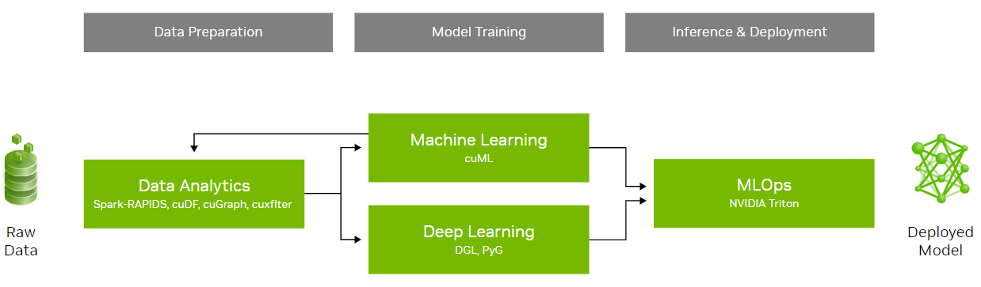
Workshop Overview
An introduction to data science with a focus on speed and efficiency
Learning objectives:
Understand the fundamental concepts of data science and parallel computing
Explore practical examples of accelerated data science pipelines
Examine the methods used to achieve acceleration in data science and discuss their broader implications
This workshop will not cover statistical analysis, neural networks, and distributed computing
 | Workshop Outline
Task 1 | Data science overview Data manipulation
Task 2 | Graph analytics
Task 3 | Machine Learning
Coding Assessment | Biodefense

Slide 3
Section 2 Agenda
• | Graph 101
• | Graph Analytics
• | Hands-On Lab

Slide 4
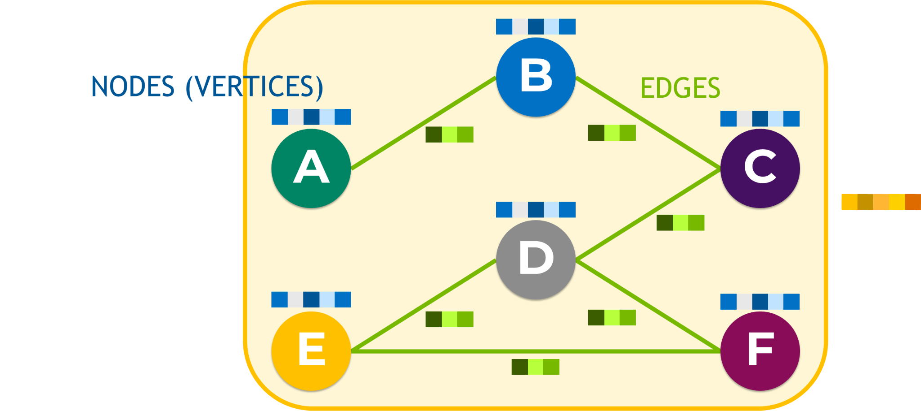
Anatomy of a Graph

Slide 5
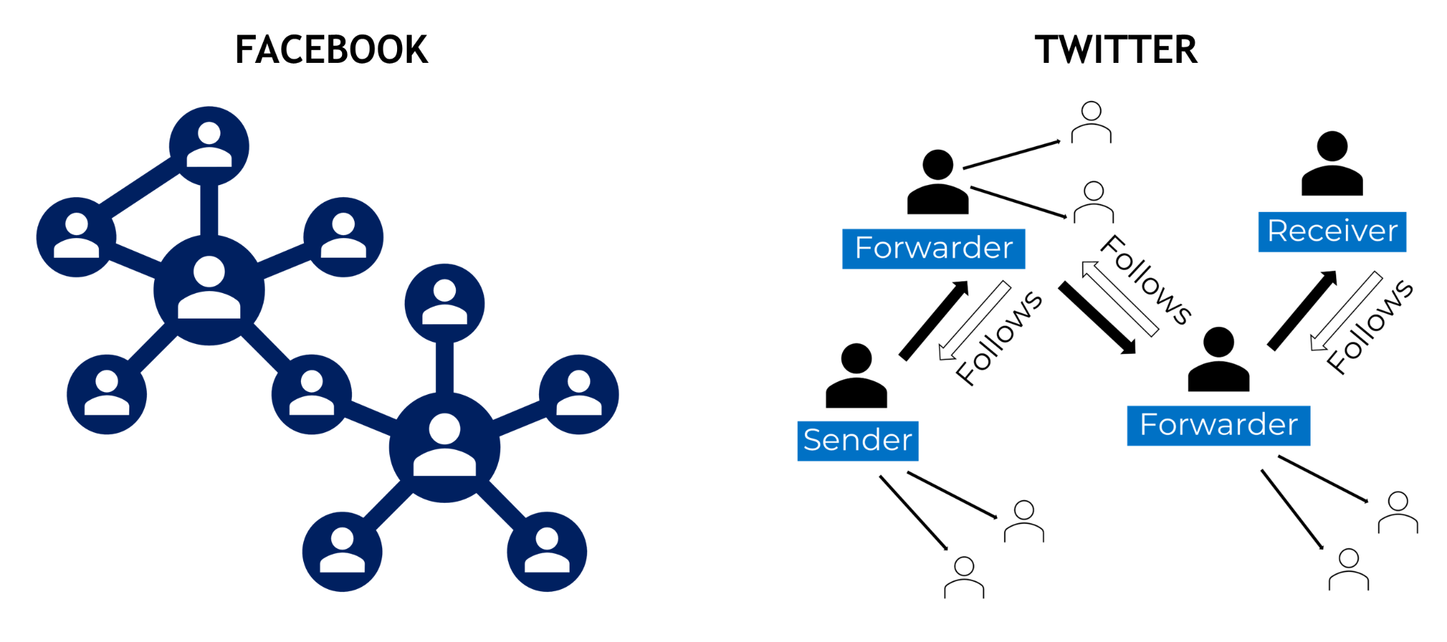
Edges
Directed, undirected, weighted, and unweighted

Slide 6
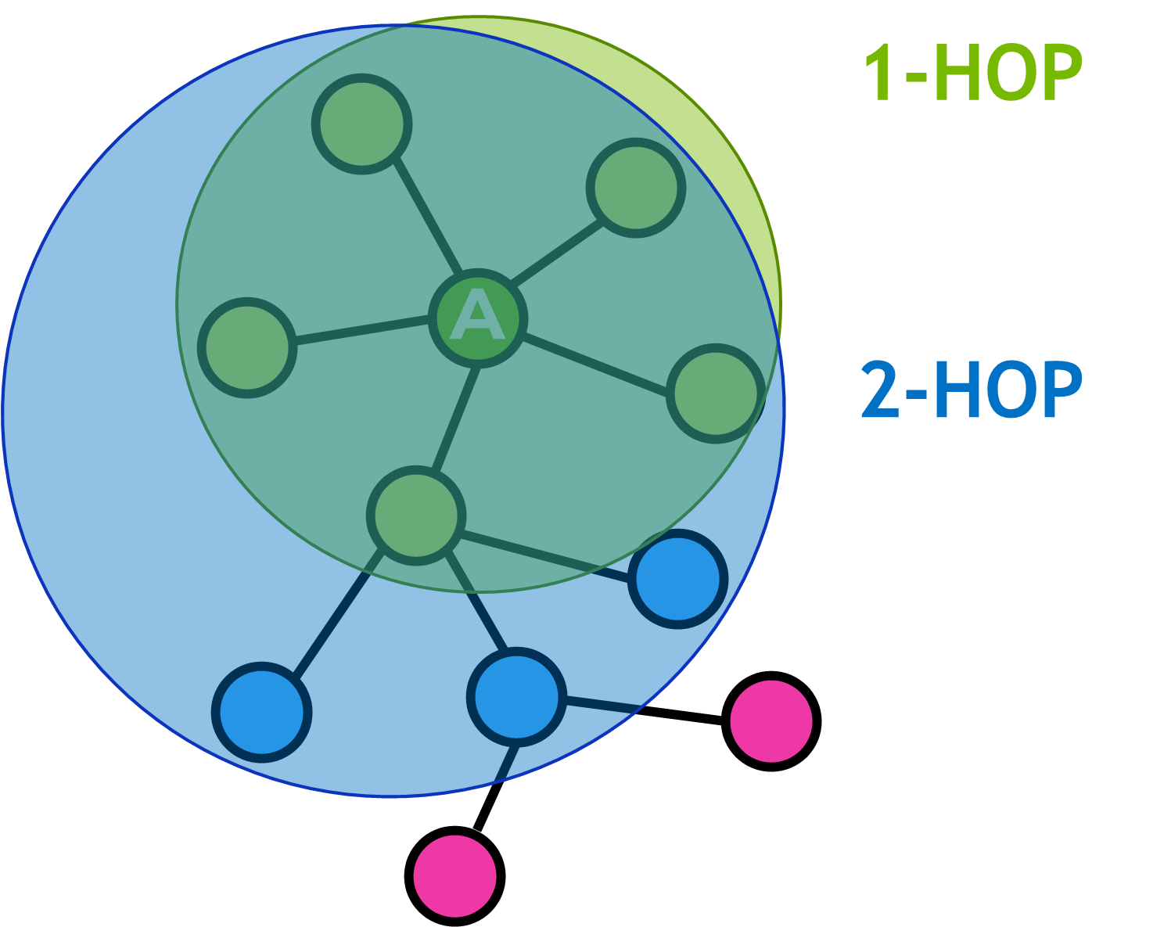
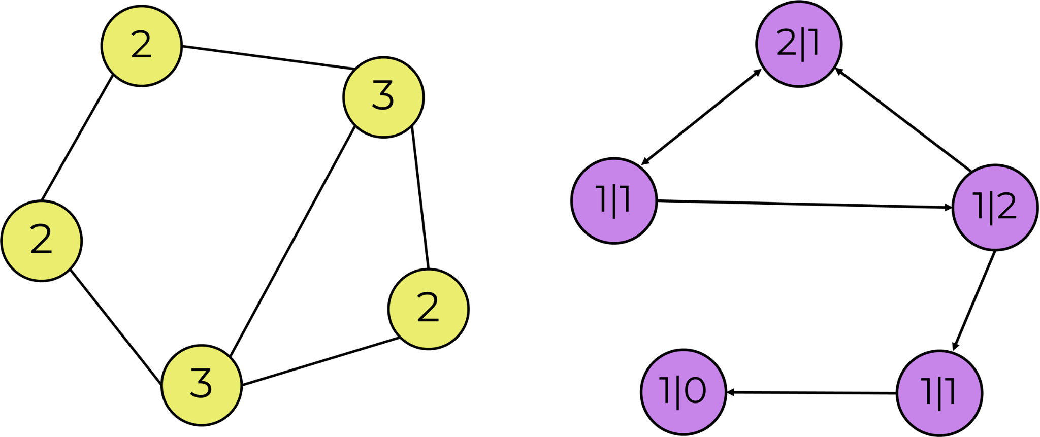
Degree and Neighborhood
In-degree, out-degree, 1-hop, and 2-hop

Slide 7
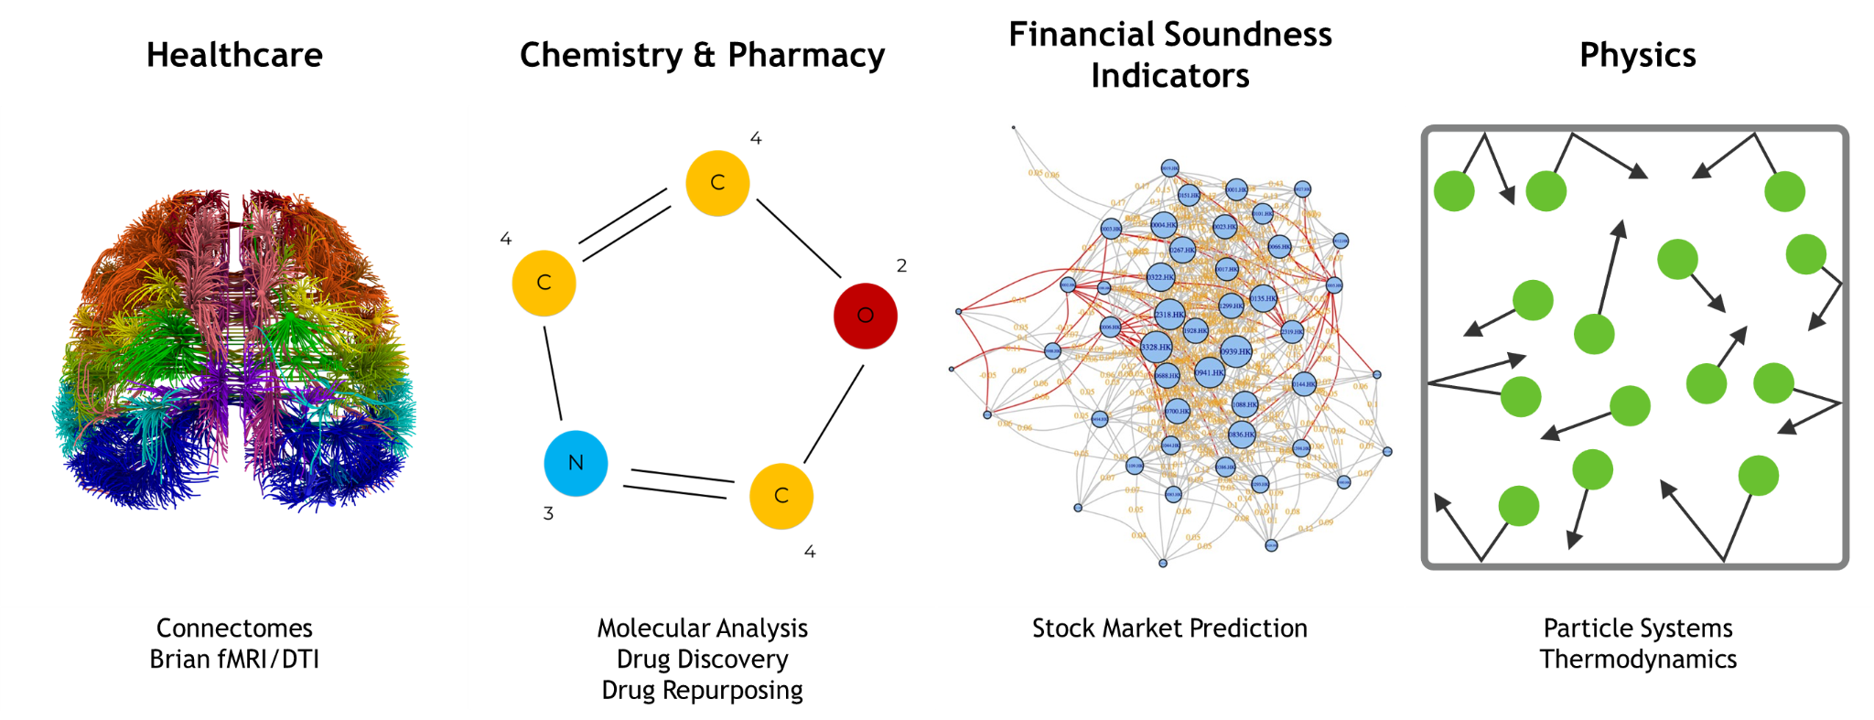
Common Graph Data Use Cases
Usage extends across industries

Slide 8
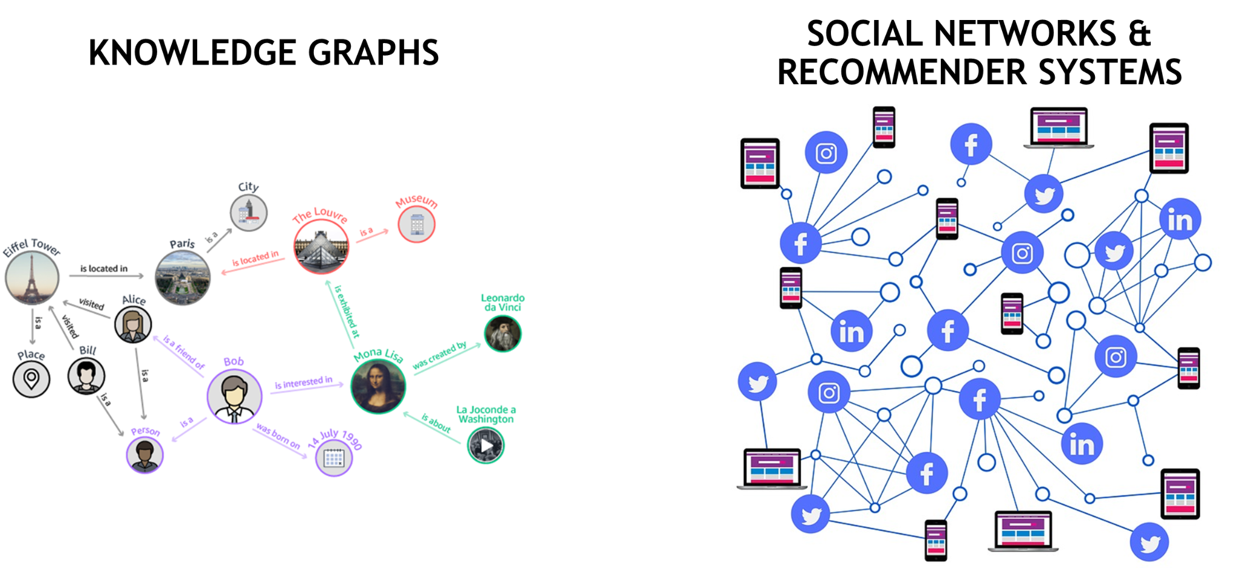
Advance Graph Data Use Cases
Used to gather information about relationships between objects

Slide 9
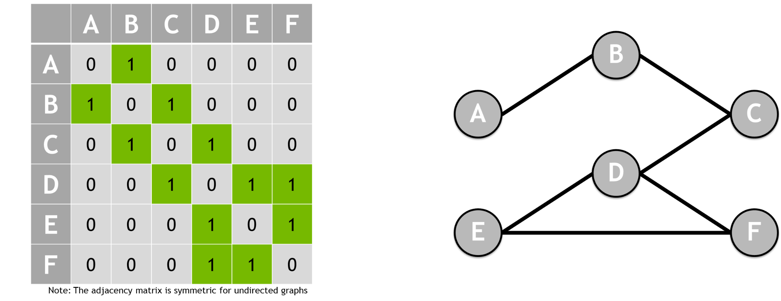
Representing Graphs
Adjacency matrix shows the neighborhood of each node

Slide 10

Representing Graphs
Adjacency matrix can also be used for a weighted graph

Slide 11
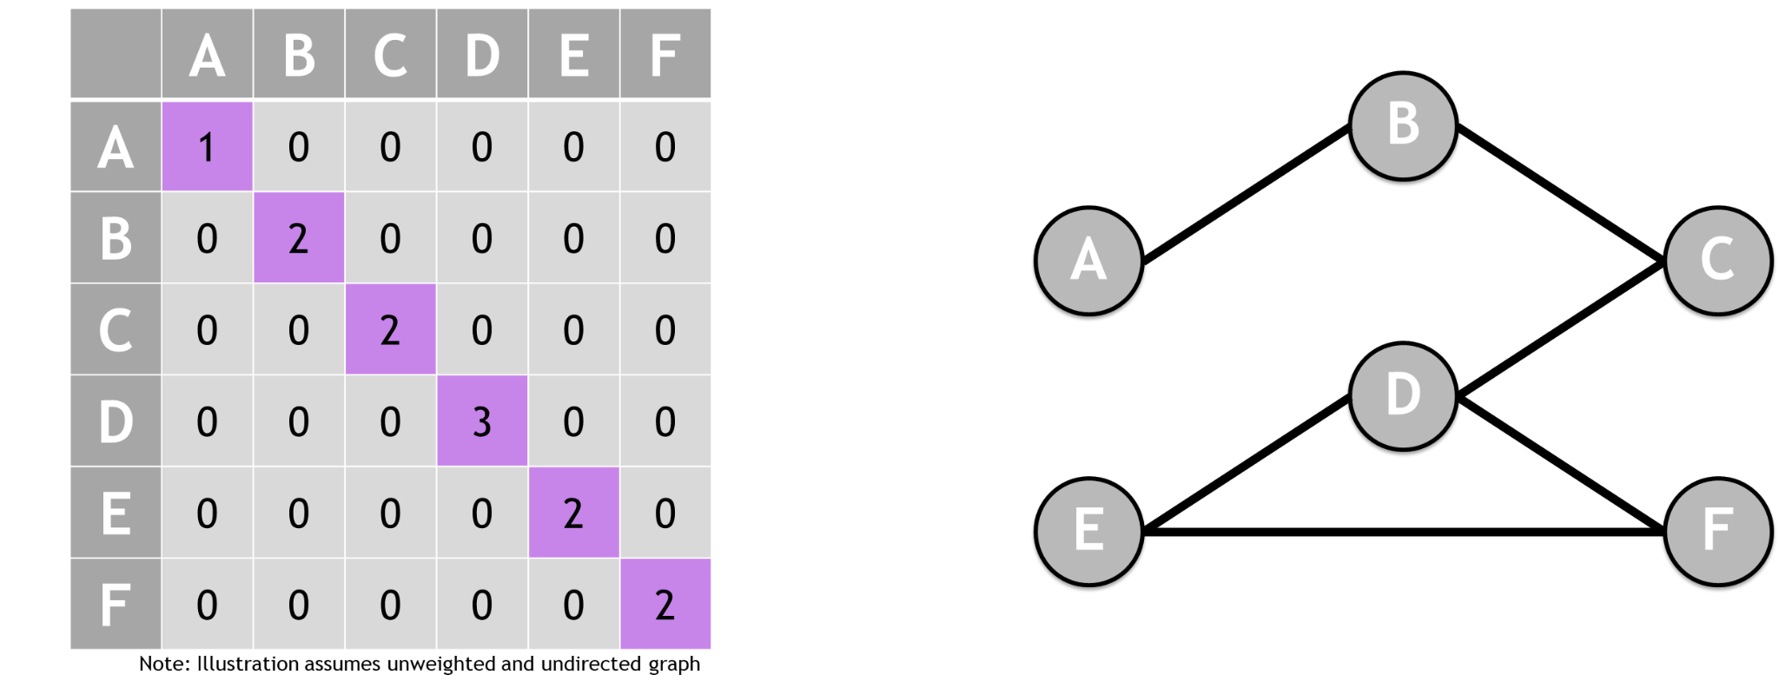
Representing Graphs
Degree matrix counts number of connections to each node

Slide 12
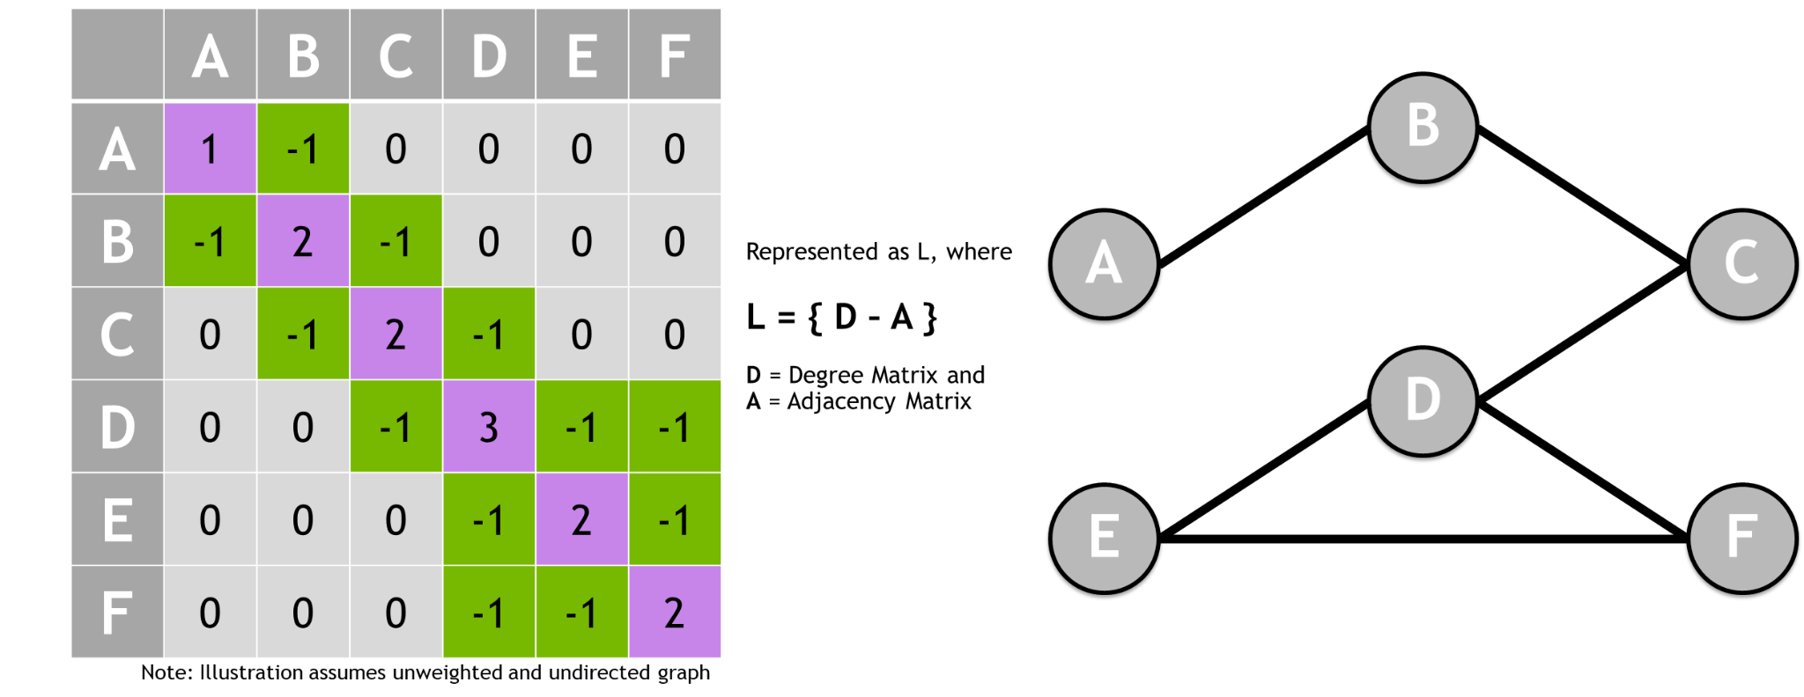
Representing Graphs
Laplacian matrix shows the smoothness of the graph

Slide 13
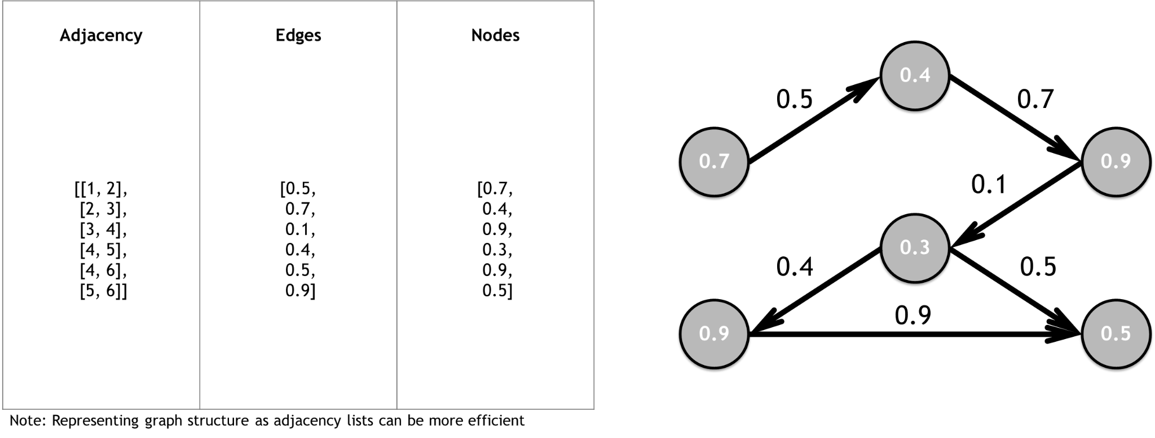
Representing Graphs
Graphs can also be represented by an adjacency list

Slide 14
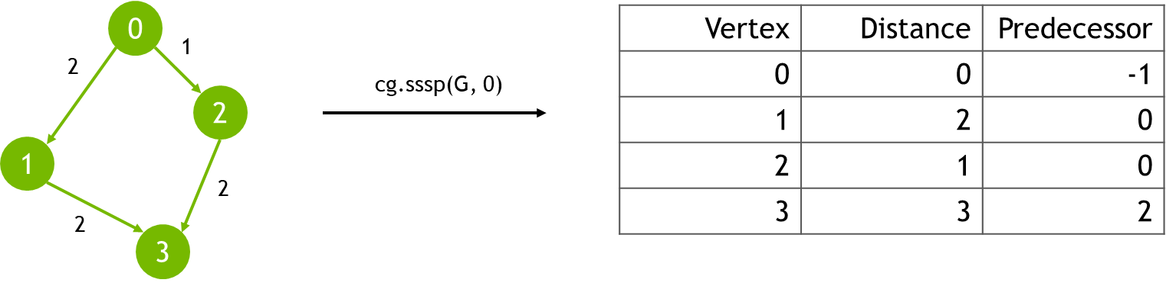
Single-Source Shortest Path
Computes the shortest path from a designated source node to all other reachable nodes in a weighted graph
Input: Graph (w/o negative-weight cycles), Node ID
Output: Vertex, Distance, Predecessor columns
Use cases: road networks, logistics, communications, and network analysis.

Slide 15
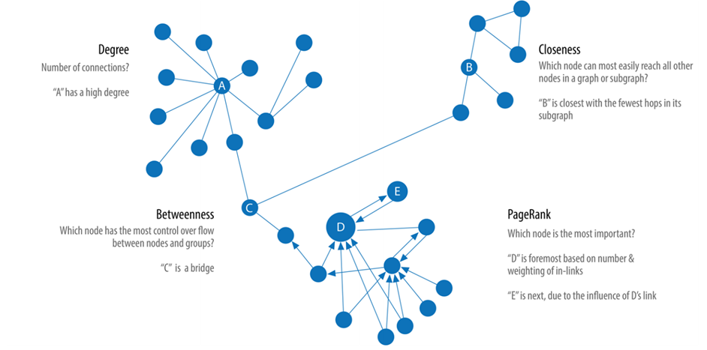
Centrality
Measuring different aspects of importance of nodes within a network

Slide 16
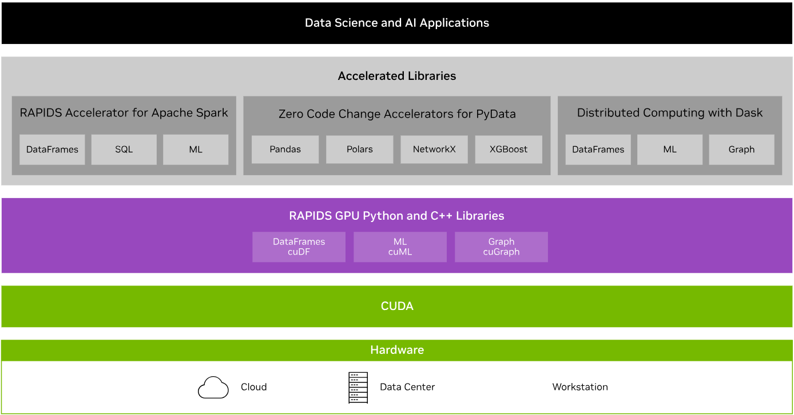

RAPIDS Transforms Data Science
An optimized hardware-to-software stack for the entire data science pipeline

Slide 17
nx-cugraph
NetworkX backend that provides GPU acceleration to many popular graph analytics algorithms
Aims to bridge the gap between the ease of use of NetworkX and the high-performance capabilities of GPU-accelerated graph analytics
Works by leverages GPUs to perform graph computations in parallel
Leads to faster processing, especially for large graphs and complex algorithms
Uses more efficient data structures than NetworkX’s dictionary-based approach
Minimizes data movement between CPU and GPU
Integrates with other RAPIDS libraries like cuDF for efficient data loading and preprocessing on GPUs
There are 3 ways to utilize nx-cugraph
Environment variable at runtime
Backend keyword argument
Type-based dispatching

Slide 18
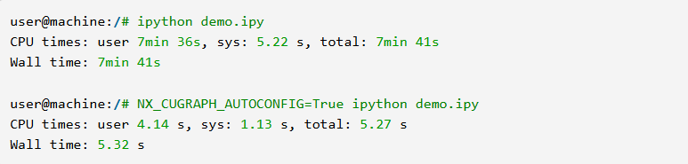
nx-cugraph
Enable no-code acceleration using an environment variable
The NX_CUGRAPH_AUTOCONFIG environment variable can be used to have NetworkX automatically dispatch to specified backends. This also works in Jupyter Notebooks by using the %env magic to set the variable.

Slide 19
nx-cugraph
Explicitly specify the cugraph backend
Backend keyword argument: NetworkX also supports explicitly specifying a particular backend for supported APIs with the backend keyword argument

Slide 20
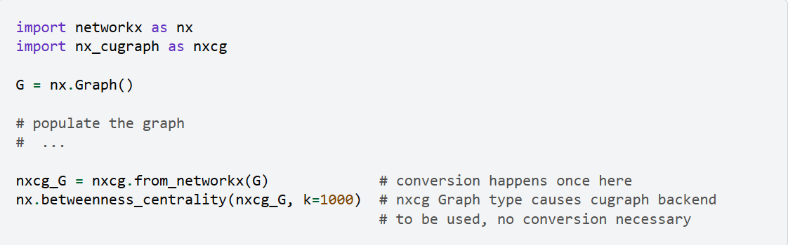
nx-cugraph
Type-based dispatching
Type-based dispatching: for users wanting to ensure a particular behavior, without the potential for runtime conversions, NetworkX offers type-based dispatching. To utilize this method, users must import the desired backend and create a Graph instance for it.

Slide 21
Hands-On Lab

